Slide 1



The Role of Micro, Small, and Medium Scale Enterprise to the Indonesia Economy
Zulkarnain Lubis
Notes:
NOTE: To replace a picture, just select and delete it. Then use the Insert Picture icon to replace it with one of your own!

Slide 2

Some Definitions of Micro, Small and Medium Enterprises
UU. No 9/95 tentang Usaha Kecil
Small Enterprises : Asset ≤ Rp 200 millions not included land and buildings; turnover ≤ Rp 1 billions/year
Central Bureau of Statistics
Micro Scale : workers < 5 people included family workforce
Small Scale : workers 5 – 9 people
Medium Scale : workers 20 – 99 people
Ministry of Cooperatives and SMEs
Small Scale : Asset ≤ Rp 200 millions not included land and buildings; turnover ≤ Rp 1 billions/year
Medium Scale : Asset > 200 millions; turnover Rp 1 – 10 billions/year

Slide 3
Indonesian Central Bank
Micro Scale : managed by the poor or almost poor as a family business, using local resources, applying simple technology, easily enter and quit to/from the industries
Small Scale : Asset <= Rp 200 millions, turnover <=Rp 1 billion /year
Medium Scale : For industries, Asset < Rp 5 billions,
For others (included service sector), asset < 600 millions excluded land and buildings; turnover < Rp 3 billions per year
World Bank
Micro Scale : workers < 10 people, Asset < $ 100.000, turnover < $ 100.000 per year
Small Scale : workers < 50 people, Asset < $ 3 millions, turnover < $ 3 millions per year
Medium Scale : workers < 300 orang, Asset < $ 15 millions, turnover < $ 15 millions per year

Slide 4


The Role of MSMEs to the Indonesian Economy (Ministry of Cooperatives and SMEs, 2005):
As main players in the economic activities for various sectors
The biggest job provider
Important players in the development of local economic activities and community empowerment
New market creators and source of innovation
Having significant contribution in maintaining the balance of payments through export activities.
Notes:
Picture with background removed
(Intermediate)
To reproduce the picture effects on this slide, do the following:
On the Home tab, in the Slides group, click Layout, and then click Blank.
On the Insert tab, in the Images group, click Picture.
In the Insert Picture dialog box, select a picture and then click Insert.
Select the picture. Under Picture Tools, on the Format tab, in the Size group, click the Size and Position dialog box launcher. In the Format Picture dialog box, resize or crop the image so that the height is set to 7.5” and the width is set to 10”. To crop the picture, click Crop in the left pane, and in the right pane, under Crop position, enter values into the Height, Width, Left, and Top boxes. To resize the picture, click Size in the left pane, and in the right pane, under Size and rotate, enter values into the Height and Width boxes.
Also under Picture Tools, on the Format tab, in the Adjust group, click Color, and then under Recolor click Grayscale.
Also in the Adjust group, click Corrections, and then under Brightness and Contrast, click Brightness: -40% Contrast: +20%.
On the Home tab, in the Clipboard group, click the arrow to the right of Copy, and then click Duplicate.
Select the second picture. On the Home tab, in the Drawing group, click Arrange, point to Align, and then do the following:
Click Align to Slide.
Click Align Middle.
Click Align Center.
Under Picture Tools, on the Format tab, in the Adjust group, click Reset Picture.
Also under Picture Tools, on the Format tab, in the Size group, click the Size and Position dialog box launcher.. In the Format Picture dialog box, resize or crop the image to focus on the main subject in the picture. (Example picture is set to 3.54” height and 3.24” width). To crop the picture, click Crop in the left pane, and in the right pane, under Crop position, enter values into the Height, Width, Left, and Top boxes. To resize the picture, click Size in the left pane, and in the right pane, under Size and rotate, enter values into the Height and Width boxes.
Also under Picture Tools, on the Format tab, in the Adjust group, click Remove Background, and then do the following:
To remove additional background areas from the picture, on the Background Removal tab, in the Refine group, click Mark Areas to Remove. Select all of the additional areas to be removed.
To keep additional areas of the picture that have been removed, on the Background Removal tab, in the Refine group, click Mark Areas to Keep. Select all of the additional areas to be kept.
Click Keep Changes in the Close group when finished.
To reproduce the shape effects on this slide, do the following:
On the Home tab, in the Drawing group, select Rectangle.
On the slide, drag to draw a rectangle.
Select the rectangle. Also on the Home tab, in the Drawing group, click the Format Shape dialog box launcher.
In the Format Shape dialog box, in the Size tab, enter 7.5” into the Height box and enter 4” into the Width box.
Also in the Format Shape dialog box, in the Fill tab, select Gradient fill, and then do the following:
In the Type list, select Linear.
In the Angle box, enter 90°.
Under Gradient stops, click Add gradient stops or Remove gradient stops until three stops appear in the slider.
Also under Gradient stops, customize the gradient stops as follows:
Select the first stop from the left in the slider, and then do the following:
In the Position box, enter 0%.
Click the button next to Color, and then under Theme Colors click Black, Text 1 (first row, second option from the left).
In the Transparency box, enter 100%.
Select the second stop from the left in the slider, and then do the following:
In the Position box, enter 40%.
Click the button next to Color, click More Colors, and then in the Colors dialog box, on the Custom tab, enter values for Red: 47, Green: 91, and Blue: 77.
In the Transparency box, enter 0%.
Select the third stop from the left in the slider, and then do the following:
In the Position box, enter 100%.
Click the button next to Color, and then under Theme Colors click Black, Text 1 (first row, second option from the left).
In the Transparency box, enter 90%.
Also in the Format Shape dialog box, in the Line Color tab, select No Line.
Select the second picture. On the Home tab, in the Drawing group, click Arrange, and then click Bring to Front.
To reproduce the text effects on this slide, do the following:
On the Insert tab, in the Text group, click Text Box, and then on the slide drag to draw your text box.
Enter text in the text box, and then select the text. On the Home tab, in the Font group, do the following:
In the Font list, click Calisto MT.
In the Font Size list, click 36 pt.
Click Font Color, and then under Theme Colors click White, Background 1 (first row, first option from the left).
Position text over the least transparent part of the gradient.

Slide 5
Some strategic roles of MSMEs based on Bank Indonesia
The amount is large and is found in every economic sector
Absorbing a lot of labor force and in every investment creates more employment opportunities
Having the ability to utilize local raw materials and to produce goods and services needed by wider communities at affordable pric
Notes:
Picture with background removed
(Intermediate)
To reproduce the picture effects on this slide, do the following:
On the Home tab, in the Slides group, click Layout, and then click Blank.
On the Insert tab, in the Images group, click Picture.
In the Insert Picture dialog box, select a picture and then click Insert.
Select the picture. Under Picture Tools, on the Format tab, in the Size group, click the Size and Position dialog box launcher. In the Format Picture dialog box, resize or crop the image so that the height is set to 7.5” and the width is set to 10”. To crop the picture, click Crop in the left pane, and in the right pane, under Crop position, enter values into the Height, Width, Left, and Top boxes. To resize the picture, click Size in the left pane, and in the right pane, under Size and rotate, enter values into the Height and Width boxes.
Also under Picture Tools, on the Format tab, in the Adjust group, click Color, and then under Recolor click Grayscale.
Also in the Adjust group, click Corrections, and then under Brightness and Contrast, click Brightness: -40% Contrast: +20%.
On the Home tab, in the Clipboard group, click the arrow to the right of Copy, and then click Duplicate.
Select the second picture. On the Home tab, in the Drawing group, click Arrange, point to Align, and then do the following:
Click Align to Slide.
Click Align Middle.
Click Align Center.
Under Picture Tools, on the Format tab, in the Adjust group, click Reset Picture.
Also under Picture Tools, on the Format tab, in the Size group, click the Size and Position dialog box launcher.. In the Format Picture dialog box, resize or crop the image to focus on the main subject in the picture. (Example picture is set to 3.54” height and 3.24” width). To crop the picture, click Crop in the left pane, and in the right pane, under Crop position, enter values into the Height, Width, Left, and Top boxes. To resize the picture, click Size in the left pane, and in the right pane, under Size and rotate, enter values into the Height and Width boxes.
Also under Picture Tools, on the Format tab, in the Adjust group, click Remove Background, and then do the following:
To remove additional background areas from the picture, on the Background Removal tab, in the Refine group, click Mark Areas to Remove. Select all of the additional areas to be removed.
To keep additional areas of the picture that have been removed, on the Background Removal tab, in the Refine group, click Mark Areas to Keep. Select all of the additional areas to be kept.
Click Keep Changes in the Close group when finished.
To reproduce the shape effects on this slide, do the following:
On the Home tab, in the Drawing group, select Rectangle.
On the slide, drag to draw a rectangle.
Select the rectangle. Also on the Home tab, in the Drawing group, click the Format Shape dialog box launcher.
In the Format Shape dialog box, in the Size tab, enter 7.5” into the Height box and enter 4” into the Width box.
Also in the Format Shape dialog box, in the Fill tab, select Gradient fill, and then do the following:
In the Type list, select Linear.
In the Angle box, enter 90°.
Under Gradient stops, click Add gradient stops or Remove gradient stops until three stops appear in the slider.
Also under Gradient stops, customize the gradient stops as follows:
Select the first stop from the left in the slider, and then do the following:
In the Position box, enter 0%.
Click the button next to Color, and then under Theme Colors click Black, Text 1 (first row, second option from the left).
In the Transparency box, enter 100%.
Select the second stop from the left in the slider, and then do the following:
In the Position box, enter 40%.
Click the button next to Color, click More Colors, and then in the Colors dialog box, on the Custom tab, enter values for Red: 47, Green: 91, and Blue: 77.
In the Transparency box, enter 0%.
Select the third stop from the left in the slider, and then do the following:
In the Position box, enter 100%.
Click the button next to Color, and then under Theme Colors click Black, Text 1 (first row, second option from the left).
In the Transparency box, enter 90%.
Also in the Format Shape dialog box, in the Line Color tab, select No Line.
Select the second picture. On the Home tab, in the Drawing group, click Arrange, and then click Bring to Front.
To reproduce the text effects on this slide, do the following:
On the Insert tab, in the Text group, click Text Box, and then on the slide drag to draw your text box.
Enter text in the text box, and then select the text. On the Home tab, in the Font group, do the following:
In the Font list, click Calisto MT.
In the Font Size list, click 36 pt.
Click Font Color, and then under Theme Colors click White, Background 1 (first row, first option from the left).
Position text over the least transparent part of the gradient.

Slide 6

The important roles of MSMEs
Playing a role in providing broad economic services to the community, including in the process of equity, increasing community income, encouraging economic growth, and realizing national stability.
Helping out in generating new jobs by creating new work units employing new workers supporting household income, because MSMEs have a relatively higher labor intensity and smaller investments
Having high flexibility comparing to larger capacity businesses, especially in facing and adapting to market changes

Slide 7
The important roles of MSMEs
The development of micro-enterprises would contribute to economic diversification and structural changes as a precondition for stable and sustainable long-term economic growth.
The development of MSMEs is expected to provide a significant positive contribution to the efforts of overcoming economic and social problems in the country such as high levels of poverty, inequality in income distribution, unequal development processes and urbanization problems
MSMEs are not too affected by external pressure, and not too tightly depended on imported components because they usually utilizes cheaper and easier raw materials and local resources so that it saves foreign exchange

Slide 8

“Kecil-kecil cabe rawit”, that is the right words to describe the role of the Micro, Small and Medium Enterprises (MSME) sector toward the national economy.

Slide 9

MSME and National Economy

Slide 10

The Contribution to the National Income
The contribution of the micro, small and medium enterprises (MSMEs) sector to gross domestic product increased from 57.84 percent to 60.34 percent in the last five years
These MSMEs are spread throughout the country, the number of which in 2016 was 57.9 million and increased to 59 million in 2017 or has controlled around 99.9 percent of business activities, with more than 98 percent owned by micro scale enterprise
Meanwhile, there are only around 8 thousands of large corporations, only 0.01 percent of the total business units

Slide 11

The Contribution to the National Income
The number of MSME players continue to increase indicated by an increasing entrepreneurial ratio; in 2014, amounting to 1.55%, increasing to 1.65% in 2016 and again becoming 3.1% at the end of 2017. For 2018, the ratio was predicted to reach 7% of the total population

Slide 12

the Contributions to Exports
The contribution of the MSME sector to Indonesia's exports in 2015 was only 15.8 percent, far smaller comparing to other countries in Southeast Asia.
The contribution of the Thai MSME sector to exports was 29.5 percent and the Philippines was 20 percent
At the global level, the contribution of the German MSME sector to exports reached 55.9 percent and Japan was around 53.8 percent.
MSME products are still not able to penetrate the world market, partly due to access of the MSME sector to supply chain global production which is only 0.8%. This means that most MSMEs do not have information and access to global markets

Slide 13
the Contributions to Labor Absorption
For previous years, employment absorption for MSMEs sector was quite high, which was around 96.99 percent of the total workforce, this figure increased to 97.22 percent in 2018 (meaning only 2.78 percent of the workforce is absorbed by large companies)

Slide 14

The Productivity of MSMEs
The productivity of MSMEs is not linear to the number of businesses and workers, with a business unit of 99.9 percent and a workforce of 97.3 percent, the contribution is only 60.34 percent of GDP. On the contrary, the corporation has only a portion of 0.01 percent and labor absorption is only 2.7 percent, the contribution is almost 40 percent

Slide 15
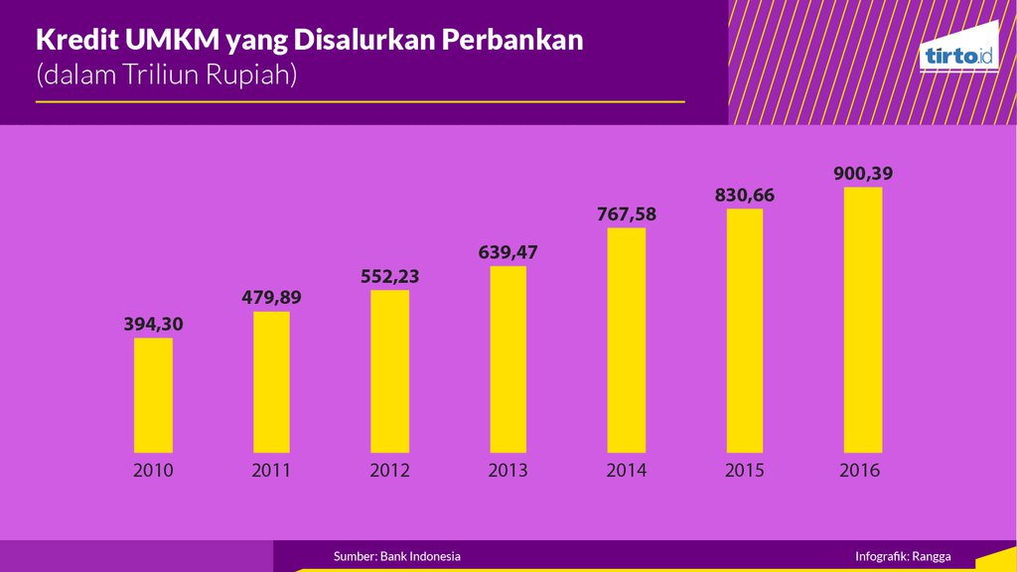
Credit distributing to the MSMEs players
Credits distributed to MSMEs are still very limited, indeed, the trend in numbers is continuing to increase, however the percentage is constantly declining
2010; Rp394,3 trillion
2011; Rp479,89 trillion (21,77 percent)
2016; Rp900,4 trillion (19,98 percent)
For 99.9 percent out of the total business units and 97.3 percent out of all labor absorption, MSMEs only get 19.98 percent of all credits distributed
For only 0.01 percent of business units and 2.7 percent of workers, large companies get credit around 80.02 percent of total bank loans

Slide 16

DIVIDER SLIDE
Credit distributing to the MSMEs players
Most of MSMEs do not have access to bank for financing and developing their businesses, they are not "bankable" because they are considered “powerless” to meet banking requirements
These MSMEs players try to use their own money or seek loan from informal source such as neighbors and relatives as well as borrow from moneylenders imposing high interest
the credit gotten from informal sources is not able to develop their business, so the business is stagnant and it can only use to finance daily life.

Slide 17
Credit distributing to the MSMEs players
Out of the small proportion of credits distributed to MSMEs that is only 19.98 percent, 66.8 percent was given to the Java Bali region, meaning that the spread was also uneven.
the credits being spread as much as 19.98 percent is only given to around 15.6 million units or only 27.6 percent of MSMEs getting credit, in other words around 40 million units of MSMEs do not get capital support from banks and most of them are micro-businesses.
In 2015, the number of MSMEs that did not receive bank financing through the People's Business Credit (KUR) was around 44.2 million units of MSMEs (71.5 percent), meaning MSMEs getting credits from banks were only 61.6 million units of MSMEs (28.5 percent )

Slide 18

Credit distributing to the MSMEs players
The credits distributed to MSMEs in Indonesia is only 7.1 percent of the country's GDP, this number is relatively low comparing to the average MSME financing by banks in Asia that is 11.6 percent of GDP and 18.7 percent of total financing
The condition indicates that
Financial institutions consider that MSMEs are still riskier rather than big scale businesses
Banks do not believe that MSMEs have good prospects.

Slide 19
Briefly …..
MSMEs play an important role in the national economy, especially for national income, employment
MSMEs still have small role in exports, they have not been able to penetrate the world market as well as do not have information and access to global markets
MSMEs are still low in productivity and do not have linear relationship with the number of business units and workers used
MSMEs that do not have access to bank financing to develop their businesses so that they are not optimal in developing their business

Slide 20

The low productivity of MSMEs is believed to be related to the issues of efficiency, effectiveness, business ability, as well as weakness in capital and do not get capital support in the form of bank loans
human resources
capital
technology
place of business

Slide 21
HR;
Less product innovation
Lack of supervisor or consultant
Capital;
The problem of financing and access to credit
Place of business;
Licensing and legality
Technology
Market research
(Online) Marketing
Product distribution
Bookkeeping is usually still manual

Slide 22
Additional for HR; there are a number of fears that are often faced by MSME players;
fear to be in an uncomfortable zone,
fear to look different,
fear of unwanted reactions,
fear to step in to change,
fear to confront others.
fear of being judged,
fear of facing changing circumstances,
fear of facing problems,
fear of facing failure

Slide 23

Two important keywords for the MSME’s problems are :
Creativity and Innovation
Creative Economics and Innovation Economics

Slide 24



Innovation = Creativity + Commercialization
“Creativity is thinking up new things, Innovation is doing new things”

Slide 25

Innovation economics
Innovation economics is defined as a body of economic theory that contends a priori that economic development is the result of appropriated knowledge, innovation and entrepreneurship operating within an institutional environment of systems of innovation
Innovation economics is a growing economic theory that emphasizes entrepreneurship and innovation

Slide 26
Innovation economics
Innovation economics is an economic doctrine that reformulates the traditional model of economic growth so that knowledge, technology, entrepreneurship, and innovation are positioned at the center of the model rather than seen as independent forces that are largely unaffected by policy
Two fundamental tenets,
the central goal of economic policy should be to spur higher productivity and greater innovation
markets relying on price signals alone will not always be as effective as smart public-private partnerships in spurring higher productivity and greater innovation

Slide 27
Information Technology in Advancing the Creative Economy to Develop MSMEs
One of the main components in advancing the Creative Economy, especially among MSMEs, is conducted through the development of information technology (IT)
IT as stated in Law No. 11 of 2008 (UU No. 11/2008) concerning Electronic Information and Transactions (ITE) is defined as techniques for collecting, preparing, storing, processing, announcing, analyzing, and/or disseminating information
In the context of developing creative economics, IT is defined as a process of generating ideas to produce a work having added value, namely technology as a technique in collecting, processing, analyzing, and / or disseminating information in order to facilitate users interacting through computer networks

Slide 28
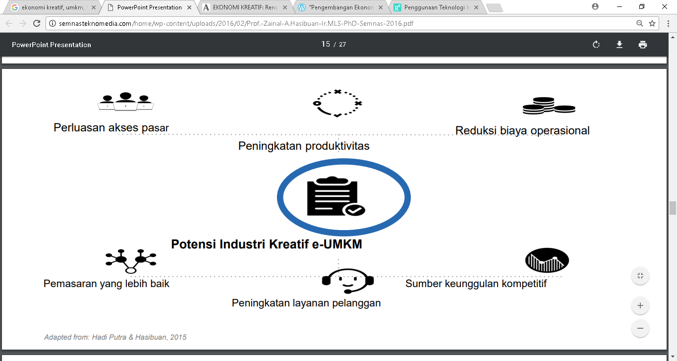
productivity increment
market access expansion
operational cost reduction
the potential of the creative industry; e-MSME
Enhancement customer services
Better marketing
Source of Competitive advantages

Slide 29
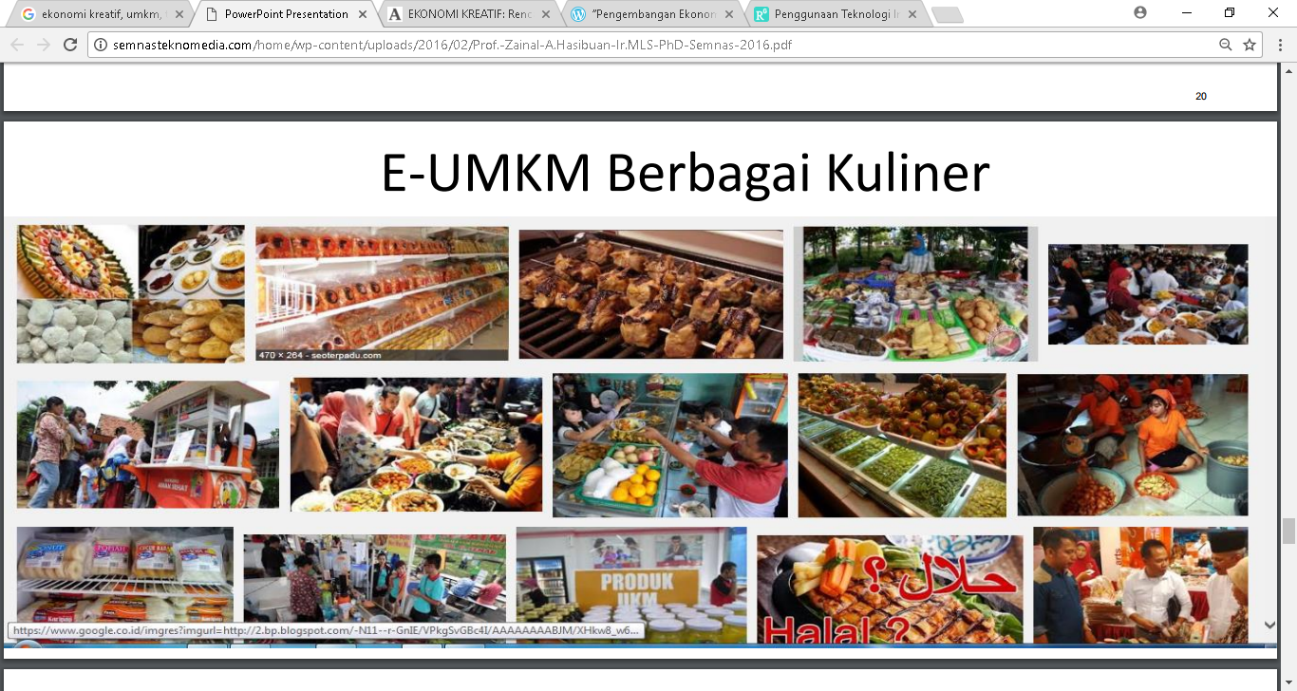
E-MSME culinary

Slide 30
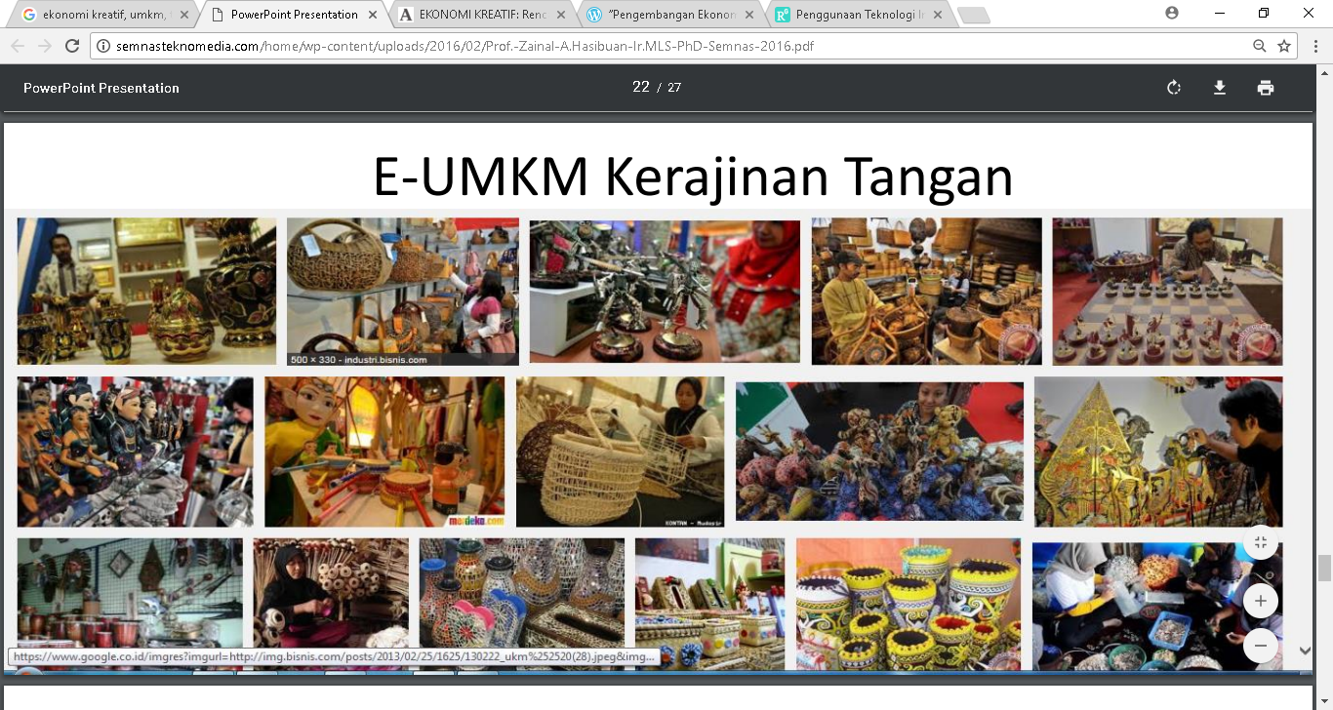
E-MSME handicrafts

Slide 31

E-MSME agriculture

Slide 32
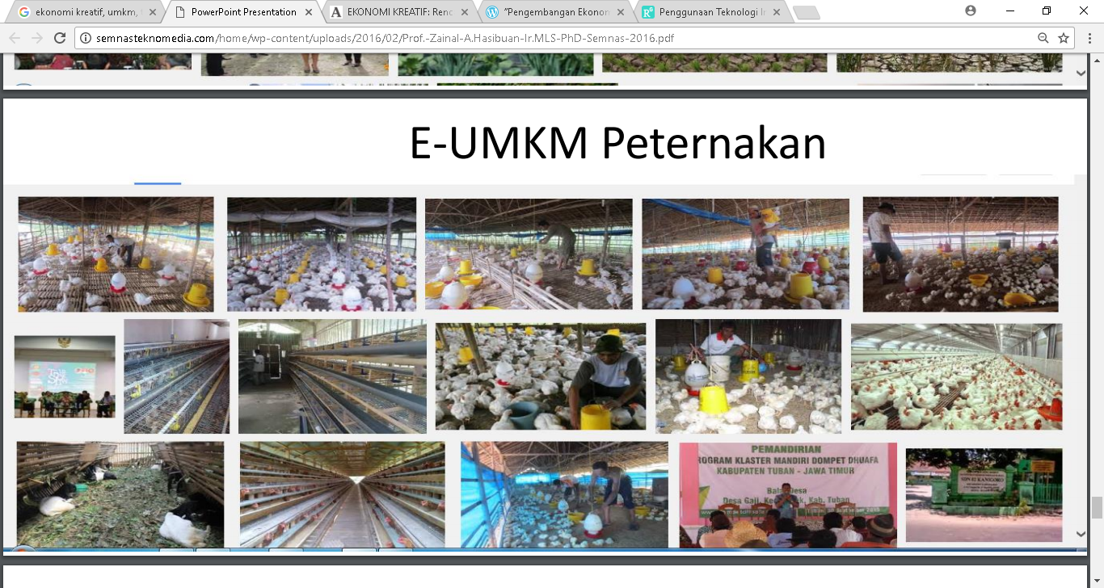
E-MSME livestock

Slide 33
The Performance of MSMEs:
small role in exports
low in productivity
do not have linear relationship between numbers and the productivity
do not have access to bank financing
human resources
capital
technology
place of business
Important Role of MSMEs to the national economy
information technology (IT)
Creative Economics and Innovation Economics
Creativity and Innovation
E-MSME
Culinary, handicrafts, agriculture, livestock ,etc.

Slide 34

Thank you and Terima kasih

