Slide 1

STATISTIKA UNTUK ANALISIS DATA PENELITIAN
Zulkarnain Lubis

Slide 2

Analisis Data
Dalam kaitan proses pelaksanaan penelitian, untuk analisis data penelitian
Dalam kaitan pengambilan keputusan, data base decision making

Slide 3

Analisis Data
Analisis Kualitatif
Analisis Kuantitatif (Analisis Statistika, Analisis Kuantitatif Selain Statistika)

Slide 4

Qualitative Data Analysis
Qualitative data result from the collection of non-standardised data that require classification and are analysed through use of conceptualisation
Qualitative analysis can involve summarising, categorising and structuring data
The process of data analysis and collection are necessarily interactive

Slide 5

Statistika merupakan alat bantu yang sangat efektif dalam membuat keputusan, membantu menyediakan data dan dalam menganalisis data penelitian

Slide 6

Statistika
Sebagai Alat Bantu dalam Pengambilan Keputusan Berdasarkan Data
Alat Bantu dalam Penelitian dan Pengembangan IPTEK sesuai bidang yang ditekuni
Membantu dalam Penyajian dan Penyederhanaan Data
Membantu dalam berpikir dan bekerja secara sistematis
Membantu melakukan evaluasi secara kuantitatif

Slide 7

Perbedaan penerapan antara ilmu natural vs ilmu sosial
Tingkat kemudahan dalam mengkuantifikasi peubah (skala pengukuran)
Perbedaan objek yang dihadapi (manusia vs lainnya)
tingkat kemampuan prediksi
Kesulitan melakukan percobaan (kemampuan menset kontrol dan perlakuan)
Tingkat kesulitan memilih/menentukan alat ukur

Slide 8

Diagram/
Grafik
Visual
Tabel
STATISTIKA DESKRIPTIF
Pemusatan
Ukuran
Penyebaran
Ukuran Lain
ANALISIS STATISTIKA
Stat. Parametrik
STATISTIKA INDUKTIF
Stat. Nonparametrik

Slide 9
Descriptive Statistics
Visually
By measurement
Table: Cross Tabulation, Frequency Tables, etc.
Figure/Picture/ Chart/Graph: Histogram, Bar Chart, Plot Diagram, Box-Plot Diagram, Pie Chart, Run Chart, Control Chart, Time Series graph, Stem and Leaf Diagram
Measures of central tendency or measure of location: mean, median, modus, midrange, midhinge
Measures of dispersion: range, variance, standard deviation, standard deviation, absolute deviation, inter-quartile range
Other measures: proportion, percentages, ratio

Slide 10

Slide 5
Analisis Statistik Deskriptif; Mendeskripsi Secara Visual
Mengidentifikasi Pola Penyebaran Data
histogram
diagram dahan dan daun (stem and leaf diagram)
diagram kotak garis (box-plot diagram)
Mengidentifikasi Hubungan Antar Variabel dengan Gambar dan Tabel
tabulasi silang (cross tabulation); untuk data kategorikal
diagram plot (plot diagram): untuk data kontiniu (continuous data).

Slide 11

Slide 6
Analisis Statistik Deskriptif; Mendeskripsi Secara Visual
Peramalan, Identifikasi Masalah, dan Pengamatan Proses
run chart,
control chart,
grafik deret waktu (time series graph)
Mendeskripsi Penyebaran Data Untuk Skala Nominal
bagan melingkar (pie chart)
diagram batang (bar chart)

Slide 12

Analisis Statistik Deskriptif; Mendeskripsikan Menggunakan Ukuran
ukuran pemusatan atau ukuran kecenderungan memusat (measures of central tendency) atau disebut juga sebagai ukuran lokasi (measure of location):
rata-rata (mean), median, modus, midrange, midhinge
ukuran penyebaran (measures of dispersion):
ragam atau variansi (variance), standar deviasi (standard of deviation), jangkauan atau kisaran (range), jarak antar kuartil (inter quartile distance)
ukuran-ukuran lain:
proporsi (proportion), nisbah (ratio), persentase (percentage), peragam (covariance).

Slide 13


Frequencies; Histogram Frequency, Descriptive Statistics; Deskripsi Data, Explore, Crosstab
Histogram
rata-rata (mean),
median,
modus,
midrange,
Midhinge
Quartile
Stem And Leaf Diagram
Plot Diagram
Box-plot Diagram
Skewness
Curtosis
Variance
standard of deviation
Range
inter quartile distance

Slide 14

Inductive Statistics
Parametric Statistics
Non-Parametric Statistics
Parametric Statistics: based on strict assumptions relating to the characteristics of the population from which data were obtained
Such assumptions: normal distribution, independent, homogenous variance
Usually used interval and ratio scale of measurement
Suitable for natural science
Non-Parametric Statistics: The assumptions are not so strict , the assumption is usually required only symmetry
Can be used for an ordinal, interval, and ratio scale of measurement
Suitable social sciences which are sometimes the data are difficult to be quantified

Slide 15

Berbagai Jenis Analisis Statistik dan Uji hipotesis
analisis statistik univariat (univariate statistical analysis) yang merupakan uji hipotesis terhadap hanya satu variabel
analisis statistik bivariate (bivariate statistical analysis) yang merupakan uji hipotesis untuk dua variabel
analisis statistik multivariat (multivariate statistical analysis) yang merupakan uji hipotesis untuk banyak variabel

Slide 16

Uji Hipotesis
hipotesis relasional (relational hypothesis) berupa uji hipotesis pengaruh perubahan satu variabel kepada perubahan variabel lainnya
hipotesis untuk mengidentifikasi perbedaan antar group untuk melakukan pengujian apakah nilai satu variabel berbeda antara satu group dengan group lainnya
hipotesis untuk melakukan pengujian apakah nilai variable tertentu sama besar atau berbeda dengan satu ukuran yang telah ditentukan

Slide 17

Test for population mean
One sample t test for population mean
T test for comparing two population means
ANOVA for testing population means of k independent

Slide 18

Uji Hipotesis Relasional
sekadar keeratan hubungan, digunakan koefisien korelasi
mengetahui pengaruh satu atau lebih variabel terhadap variabel lain, digunakan analisis regresi
analisis regresi, dua jenis variabel:
variabel yang mempengaruhi (variabel bebas)
variabel yang dipengaruhi (variabel tak bebas)
uji hipotesis untuk analisis regresi, apakah perubahan variabel bebas signifikan memberi perubahan pada variabel tak bebas
untuk analisis korelasi, hanya sekedar ingin mengidentifikasi keeratan hubungan dua variabel tanpa memerlukan yang mana yang mempengaruhi dan yang mana yang dipengaruhi.

Slide 19

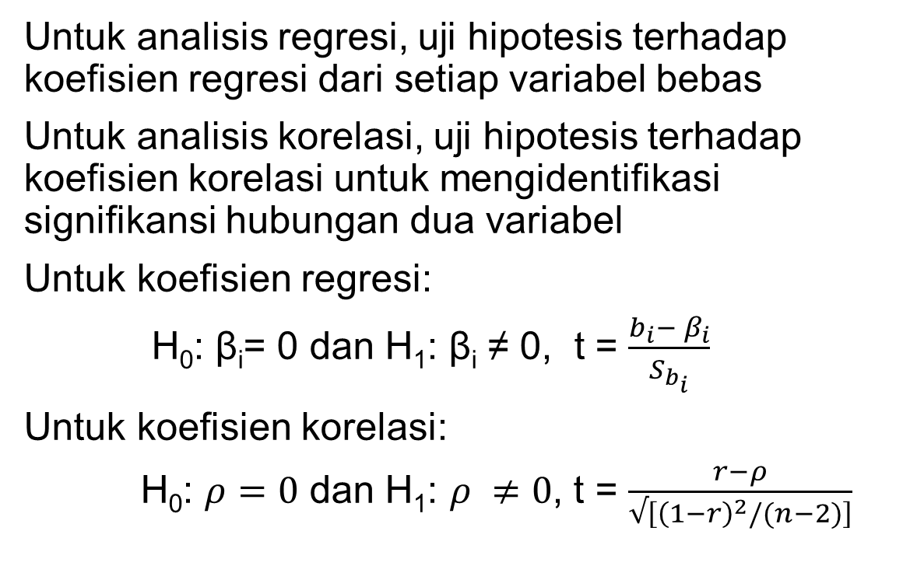
Uji Hipotesis Relasional
Untuk analisis regresi, uji hipotesis terhadap koefisien regresi dari setiap variabel bebas
Untuk analisis korelasi, uji hipotesis terhadap koefisien korelasi untuk mengidentifikasi signifikansi hubungan dua variabel
Untuk koefisien regresi:
H₀: β_{i}= 0 dan H₁: β_{i} ≠ 0, t = $\frac{b_{i}− β_{i}}{S_{b_{i}}}$
Untuk koefisien korelasi:
H₀: $ρ=0$ dan H₁: $ρ ≠0$, t = $\frac{r−ρ}{√\left[{\left(1−r\right)}^{2}/(n−2)\right]}$

Slide 20
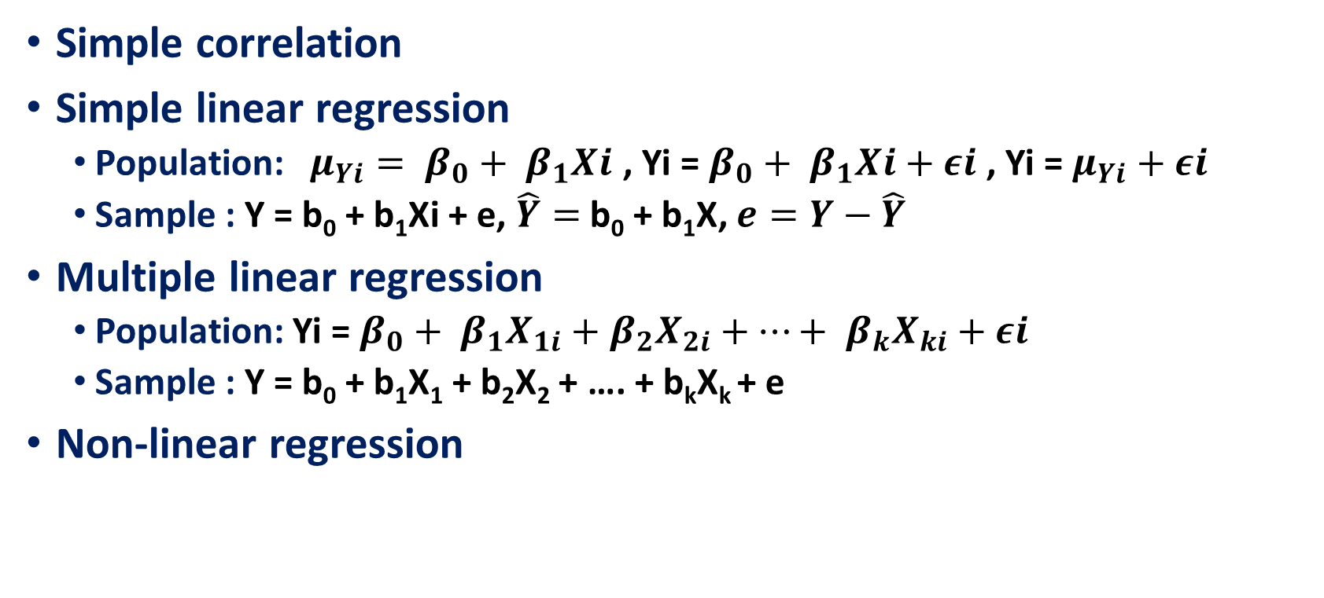
ESTIMATING RELATIONSHIP AMONG VARIABLES
Simple correlation
Simple linear regression
Population: $μ_{Yi}= β_{0}+ β_{1}Xi$ , Yi = $β_{0}+ β_{1}Xi+εi$ , Yi = $μ_{Yi}+$ $εi$
Sample : Y = b₀ + b₁Xi + e, $\hat{Y}=$b₀ + b₁X, $e=Y−\hat{Y}$
Multiple linear regression
Population: Yi = $β_{0}+ β_{1}X_{1i}+β_{2}X_{2i}+…+ β_{k}X_{ki}+εi$
Sample : Y = b₀ + b₁X₁ + b₂X₂ + …. + b_{k}X_{k} + e
Non-linear regression

Slide 21
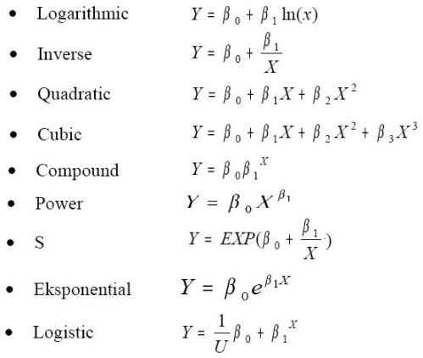

Slide 22
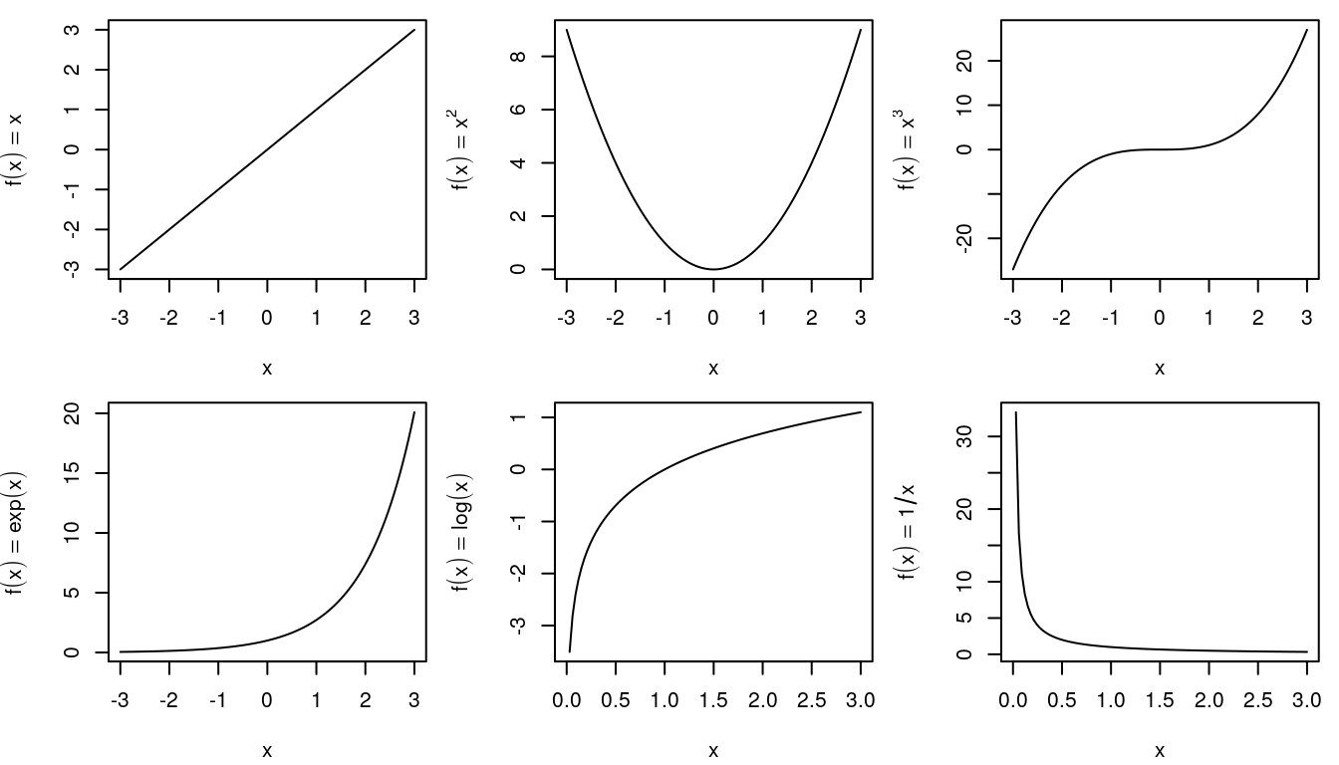

Slide 23

Classical Assumption For Regression Analysis
Normality :In general, the normality test is to compare the empirical data (the data we have) to the theoretical data (distributed normally)
Homoscedasticity: Homoscedasticity: the variances are equal at any level of every independent variable
No Multicollinearity: No or low correlation among the independent variables
No Autocorrelation: The absence of highly correlated between one observation value and other observation value

Slide 24
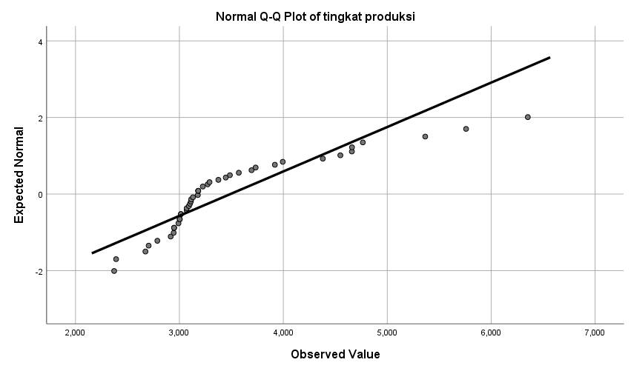
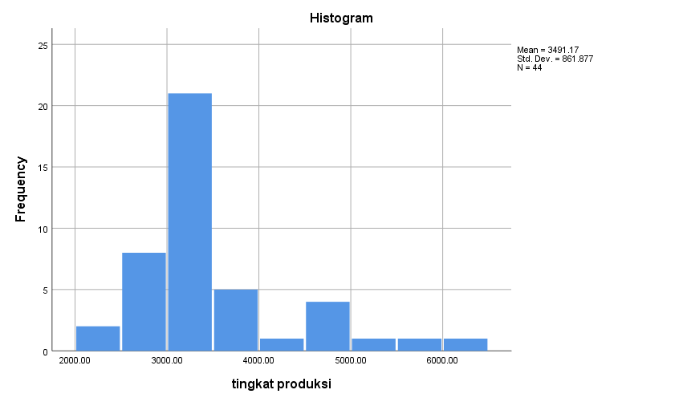
Normality test can be done by using:
histogram
stem-leaf diagram
scatter diagram
box plot diagram
Lilliefors
Kolmogorov-Smirnov
goodness of fit test
normal P-P Plot (normal Probability Plot)
Most of the tests can be performed using statistical software such as SPSS, MINITAB, and others

Slide 25
There are many methods to test the heteroscedasticity:
Plot diagram
Goldfeld-Quandt Test
Breusch-Pagan Test
Park Test
Glejser Testt
Spearman’s Rank Correlation Test
Breusch-Pagan-Godfrey Test
White’s General Heteroscedasticity Test,
Koenker-Basset Test
Heteroscedasticity
Heteroscedasticity
No Heteroscedasticity

Slide 26

Various ways are used to detect multicollinearity. It can be identified by :
Calculating the correlation coefficient among independent variables,
Comparing the coefficient of determination of each independent variable (r²) to the coefficient of determination for all independent variables (R²),
Condition Index (CI)
Tolerance Value (TOL)
Eigenvalue
Variance Inflation Factor (VIF)
VIF, TOL, eigenvalue, and CI can be calculated by using statistical software like SPSS

Slide 27

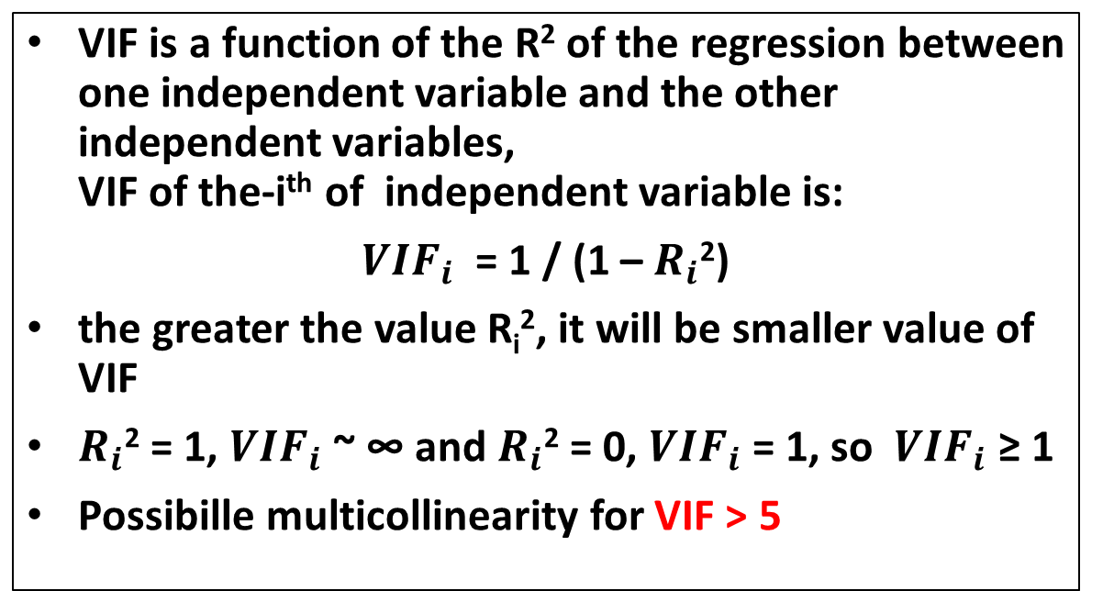
Variance Inflation Factor (VIF)
VIF is a function of the R² of the regression between one independent variable and the other independent variables, VIF of the-i^{th} of independent variable is:
${VIF}_{i}$ = 1 / (1 – $R_{i}$²)
the greater the value R_{i}², it will be smaller value of VIF
$R_{i}$² = 1, ${VIF}_{i}$~ ∞ and $R_{i}$² = 0, ${VIF}_{i}$= 1, so ${VIF}_{i}$ ≥ 1
Possibille multicollinearity for VIF > 5

Slide 28

Tolerance Value (TOL)
The formula of TOL (Tolerance Value):
the greater the VIF, it will be smaller the TOL
Possibille multicollinearity for TOL < 0.1

Slide 29

Characteristic Value (Eigenvalue)
Another way to detect multicollinearity problem is by calculating the characteristic value (eigenvalue) of the X'X matrix, where the matrix X is a data matrix of independent variables
Eigenvalue symbolized as λ_{i} where λ_{i} > 0 and i is equal to 1,2, ..., p + 1, p is the number of independent variables
Multicollinearity level is determined based on the comparison between the λ maximum and the λ minimum expressed as k.
In general,
k <100, no multicollinearity problem,
100 ≤ k ≤ 1000, moderate multicollinearity problem
k> 1000, serious multicollinearity problem

Slide 30
Condition Index (CI)
Condition Index (CI) is equal to the square root of k,
CI < 10, no multicollinearity problem
10<CI< 30, moderate multicollinearity problem
CI> 30, serious multicollinearity problem

Slide 31

Autocorrelation, the presence of highly correlated between one observation value and other observation value.
Of course for time series data, it can be said that highly correlated between one observation value for a certain time period and the observation value for previous observation
Usually, autocorrelation problem is rarely found for cross section data, but it often occurs for the time series data
One way to test the autocorrelation is the Durbin-Waston Test.
This test is based on the consideration that the residuals for a certain period in the regression model is influenced by the residual in the previous period.

Slide 32


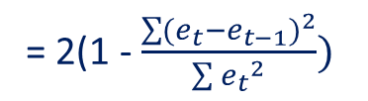

The Durbin-Waston Coefficient can be expressed as
ε_{t} = ρε_{t-1} + a_{t}
ρ which magnitude is -1 <ρ <1, is an indicator of the level of autocorrelation
d which is an indicator of the level of autocorrelation can be written as
d =
$\frac{\sum{{(e_{t}−e_{t−1})}^{2}}}{\sum{{e_{t}}^{2}}}$
= 2(1 - $\frac{\sum{{(e_{t}−e_{t−1})}^{2}}}{\sum{{e_{t}}^{2}}})$
= 2(1 - $ρ)$
If ρ = 1, then d = 0, perfectly positive autocorrelation
If ρ = -1, then d = 4, perfectly negative autocorrelation
If ρ = 0, then d = 2, perfectly no autocorrelation
the closer d to 2, the less possibility to have autocorrelation problem
the closer d to 0, the more possibility to have positive autocorrelation problem
the closer d to 4, the more possibility to have negative autocorrelation problem

Slide 33

The limit indicating d close to or far from 0, 2, or 4, is determined by using Durbin-Watson Table, which shows the value of d_{L} and d_{U} depending of the numbers of variables and observations
Positive autocorrelation if d <d_{L}
Can not be concluded if d_{L} <d <d_{U}
No autocorrelation if d_{U} <d <4 - d_{U}
Can not be concluded if 4 - d_{U} <d <4 - d_{L}
Negative autocorrelation if d> 4 – d_{L}
By using SPSS, it is just needed to click 'Durbin-Watson' on 'statistics' menu after entering the independent variables and the dependent variable

Slide 34

More On Estimating Relationship Among Variables
Logistic Regression
Path Analysis
Structural Equation Modeling
Partial Least Square

Slide 35
Logistic Regression
For logistic regression, the data scale dependent variable (Y) is categorical (non-metric), either binary (binary logistic regression) or multinomial (ordinal logistic regression)
In logistic regression, we know namely the concept of odds ratio related to the concept of probability
Logistic regression is part of the regression analysis that is used when the dependent variable (response) is a dichotomous variable (for binary).
Dichotomous variables usually only consists of two values, which represent the appearance or absence of an event that is usually given the number 0 or 1

Slide 36
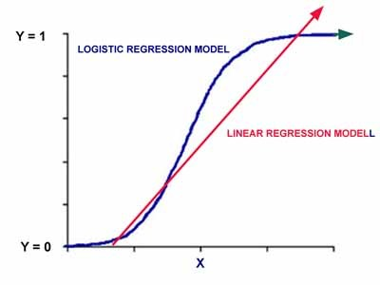
Unlike ordinary linear regression, logistic regression does not assume the relationship between independent and dependent variables is linear. Logistic regression is a non-linear regression models specified which would follow the pattern of the curve as shown below

Slide 37

The model used in the logistic regression is: Log (p / 1 - p) = β0 + β1X1 + β2X2 + .... + βkXk Where p is the possibility for Y = 1, and X1, X2, X3 are the independent variables, and βs are regression coefficients.

Slide 38

Uji Hipotesis
uji hipotesis relasional untuk menguji ukuran dan siginifikansi (significance)
koefisien korelasi
koefisien regresi
pengaruh langsung (direct effect)
pengaruh tak langsung (indirect effect)

Slide 39

Direct And Indirect Effect
Direct effect and indirect effect can be identified by :
path analysis
structural equation modeling
partial least squares

Slide 40

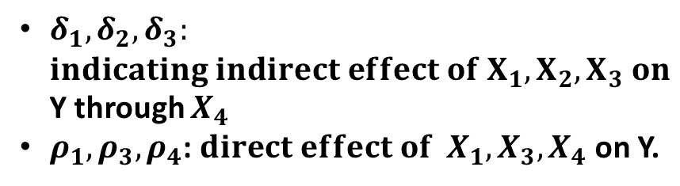
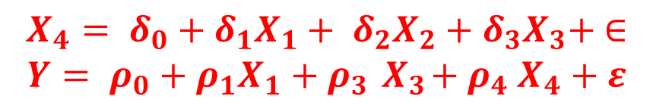
Path analysis is a technique for analyzing the causal relationship that occurs in multiple regression if the independent variables affect the dependent variable not only directly but also indirectly ". (Robert D. Retherford 1993)
Path analysis is an extension of multiple regression analysis
$$X_{1}$$
$$X_{2}$$
$$X_{4}$$
Y
$$X_{3}$$
$$X_{4}= δ_{0}+δ_{1}X_{1}+ δ_{2}X_{2}+δ_{3}X_{3}+ ∈$$
$$Y= ρ_{0}+ρ_{1}X_{1}+ρ_{3}{ X}_{3}+ρ_{4} X_{4}+ε$$
$δ_{1}, δ_{2}, δ_{3}:$
$indicating indirect effect of X_{1}, X_{2}, X_{3} on$Y through $X_{4}$
$ρ_{1}, ρ_{3}, ρ_{4}$: $direct effect of { X}_{1}, X_{3}, X_{4}$on Y.

Slide 41

Structural Equation Modeling
Structural Equation Modeling
Structural equation modeling (SEM)
A very general, chiefly linear, chiefly cross-sectional statistical modeling technique
factor analysis
path analysis and
regression
SEM is a largely confirmatory rather than exploratory technique
A researcher are more likely to use SEM to determine whether a certain model is valid rather than using SEM to "find" a suitable model
Although SEM analyses often involve a certain exploratory element

Slide 42

A structural equation model implies a structure of the covariance matrix of the measures
hence an alternative name for this field, "analysis of covariance structures"

Slide 43

Partial Least Square (PLS)
PLS is an alternative method of settlement of a complex multilevel models that do not require a big size samples
PLS regression is particularly useful when we need to predict a set of dependent variables from a (very) large set of independent variables (predictors)
In addition there are also some advantages, namely PLS which will have implications for the optimal prediction accuracy
PLS method is a powerful method of analysis because it does not assume a scale of measurement data and can also be used to confirm the theory

Slide 44

PLS regression is a recent technique that generalizes and combines features from principal component analysis and multiple regression.
Its goal is to predict or analyze a set of dependent variables from a set of independent variables or predictors.
This prediction is achieved by extracting from the predictors a set of orthogonal factors called latent variables which have the best predictive power.
Some programs are designed to complete the PLS is SmartPLS, PLSGraph, VPLS or PLS-GUI.

Slide 45

Salah Kaprah Tentang Statistika
Cenderung hanya selesai dengan persamaan-persamaan matematika
Cenderung cukup pada kesimpulan nyata dan tidak nyata dalam pengujian hipotesis
Banyak yang menggunakan alat analisis statistika tanpa mempertimbangkan apakah tepat atau tidak.
Menganggap jika sudah menggunakan statistika, sudah pasti valid kesimpulan yang diambil.
Salah dalam menginterpretasi hasil analisis

Slide 46

Good Luck
email: prof.zulkarnain@gmail.com
phone: 082277096951

