Slide 1
COST THEORY
Zulkarnain Lubis

Slide 2
Cost concept
Short run and long run cost
Economy and diseconomy of scale
Cost Forecasting
Economic efficiency

Slide 3
Cost function
Fungsi Biaya merupakan persamaan matematika yang menjelaskan hubungan antara tingkat output yang diproduksi dengan besarnya biaya operasional atau biaya produksi yang dikeluarkan.
Persamaan matematika tersebut dapat ditulis sbg : C = f(Q), nantinya C ini untuk jangka pendek akan diklasifikasikan sbg biaya total, biaya tetap, dan biaya variabel

Slide 4
Short Run Production Costs
Total fixed cost (TFC)
Total amount paid for fixed inputs
Does not vary with output
Total variable cost (TVC)
Total amount paid for variable inputs
Increases as output increases
Total cost (TC)
TC = TFC + TVC
TC = b + g(Q), b is total fixed cost (TFC) and constant and g(Q) is total variable cost (TVC) and a function of Q

Slide 5
Short-Run Total Cost Schedules
Output (Q) | Total fixed cost (TFC) | Total variable cost (TVC) | Total Cost (TC=TFC+TVC)
0 | $6,000
100 | 6,000
200 | 6,000
300 | 6,000
400 | 6,000
500 | 6,000
600 | 6,000
$ 0
$ 6,000
4,000
10,000
6,000
12,000
9,000
15,000
14,000
20,000
22,000
28,000
34,000
40,000

Slide 6
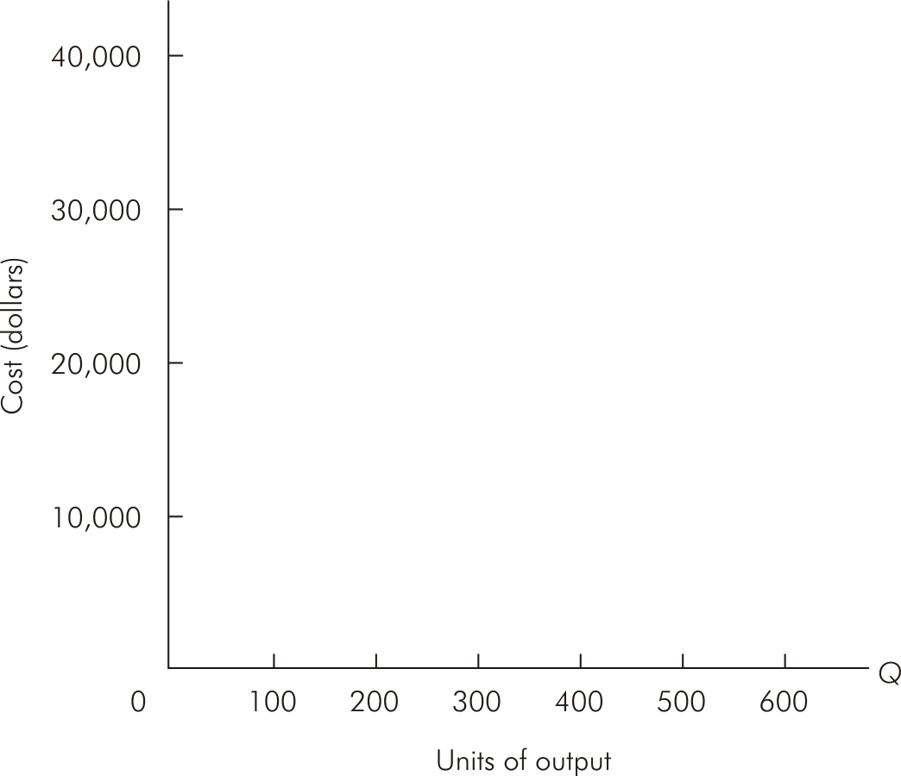
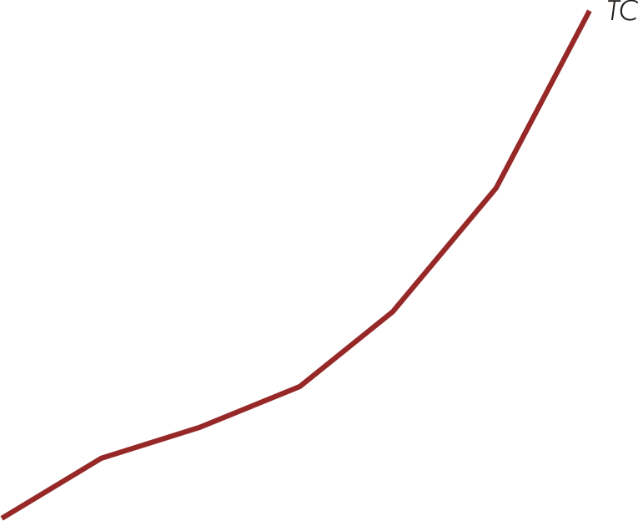


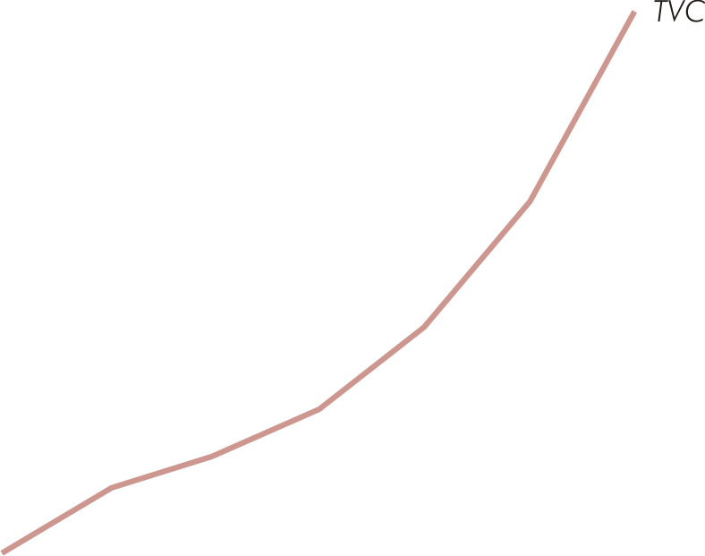
Total Cost Curves

Slide 7
Cost
TC
TVC
TFC
Output

Slide 8


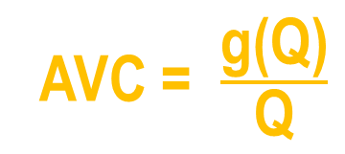
Average Costs
Average fixed cost (AFC)
AFC = $\frac{\text{b}}{\text{Q}}$
Average variable cost (AVC)
AVC = $\frac{\text{g}\text{(}\text{Q}\text{)}}{\text{Q}}$
Average total cost (ATC)
ATC = $\frac{\text{b}}{\text{Q}}$ + $\frac{\text{g}\text{(}\text{Q}\text{)}}{\text{Q}}$

Slide 9

Short Run Marginal Cost
Short run marginal cost (SMC) measures rate of change in total cost (TC) as output varies
SMC = $\frac{d\text{g}\text{(}\text{Q}\text{)}}{dQ}$

Slide 10
Average & Marginal Cost Schedules
Output (Q) | Average fixed cost (AFC=TFC/Q) | Average variable cost (AVC=TVC/Q) | Average total cost (ATC=TC/Q= AFC+AVC) | Short-run marginal cost (SMC=ΔTC/ΔQ)
0
100
200
300
400
500
600
--
--
--
--
$60
$40
$100
$40
30
30
60
20
20
30
50
30
15
35
50
50
12
44
56
80
10
56.7
66.7
120

Slide 11
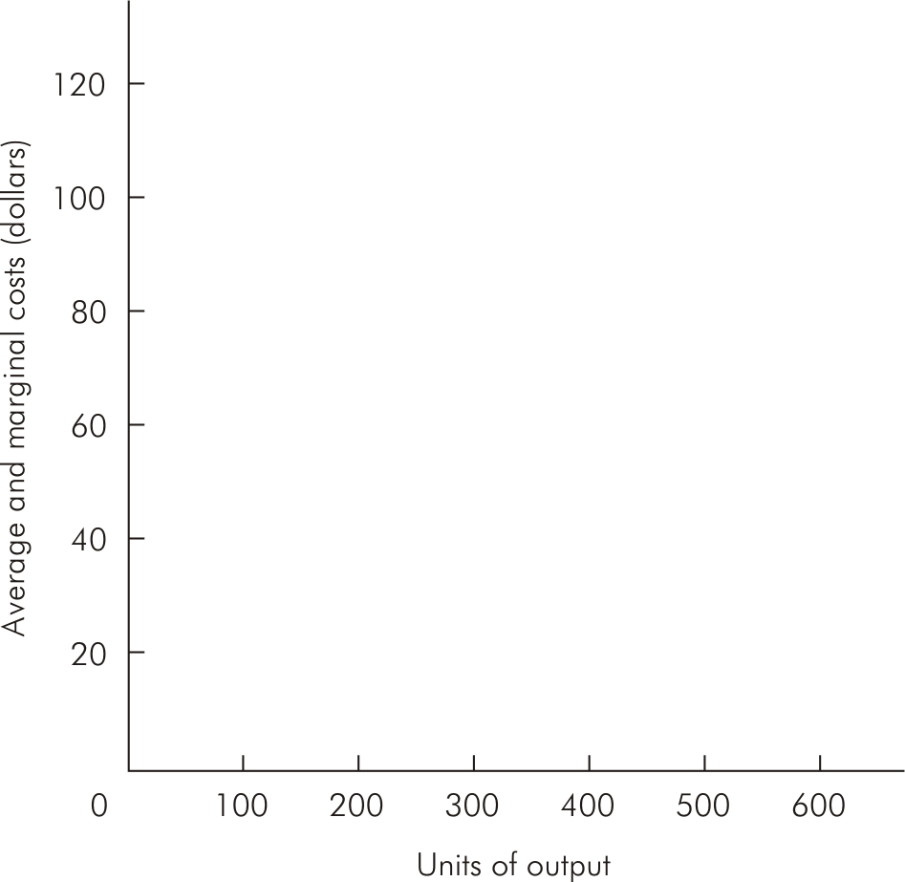
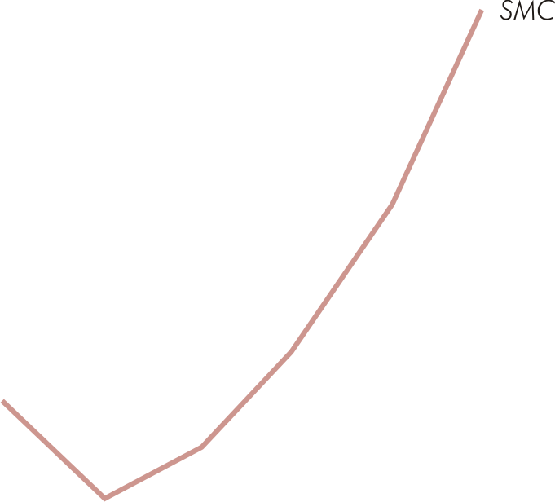


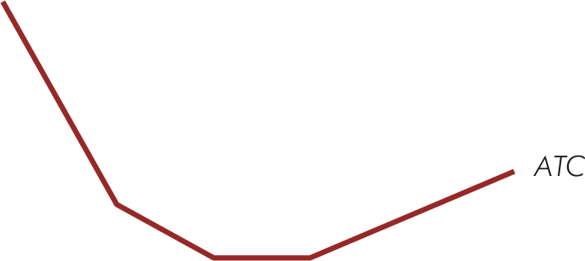
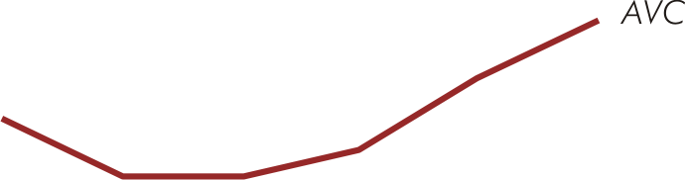

Average & Marginal Cost Curves

Slide 12
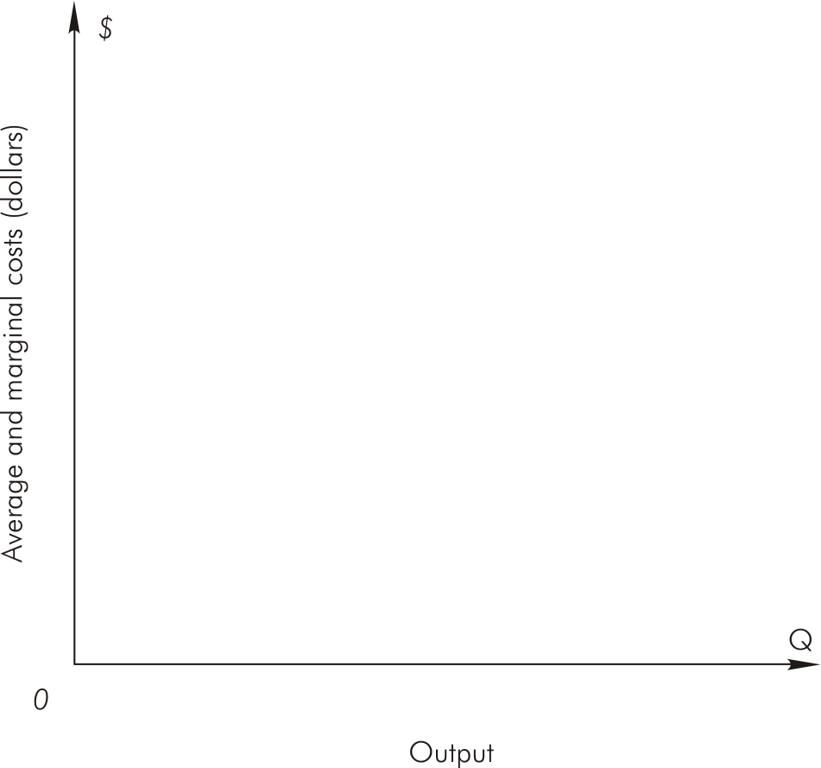
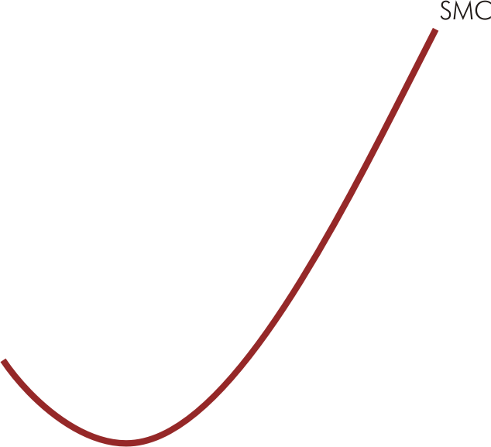



Short Run Average & Marginal Cost Curves

Slide 13
Short Run Cost Curve Relations
AFC decreases continuously as output increases
Equal to vertical distance between ATC & AVC
AVC is U-shaped
Equals SMC at AVC’s minimum
ATC is U-shaped
Equals SMC at ATC’s minimum

Slide 14
Short Run Cost Curve Relations
SMC is U-shaped
Intersects AVC & ATC at their minimum points
Lies below AVC & ATC when AVC & ATC are falling
Lies above AVC & ATC when AVC & ATC are rising

Slide 15
Relations Between Short-Run Costs & Production
output
Cost Function
Production Funtion
Cost
input

Slide 16
Relations Between Short-Run Costs & Production
In the case of a single variable input, short-run costs are related to the production function by two relations
Where w is the price of the variable input,
TC = wL + rK

Slide 17
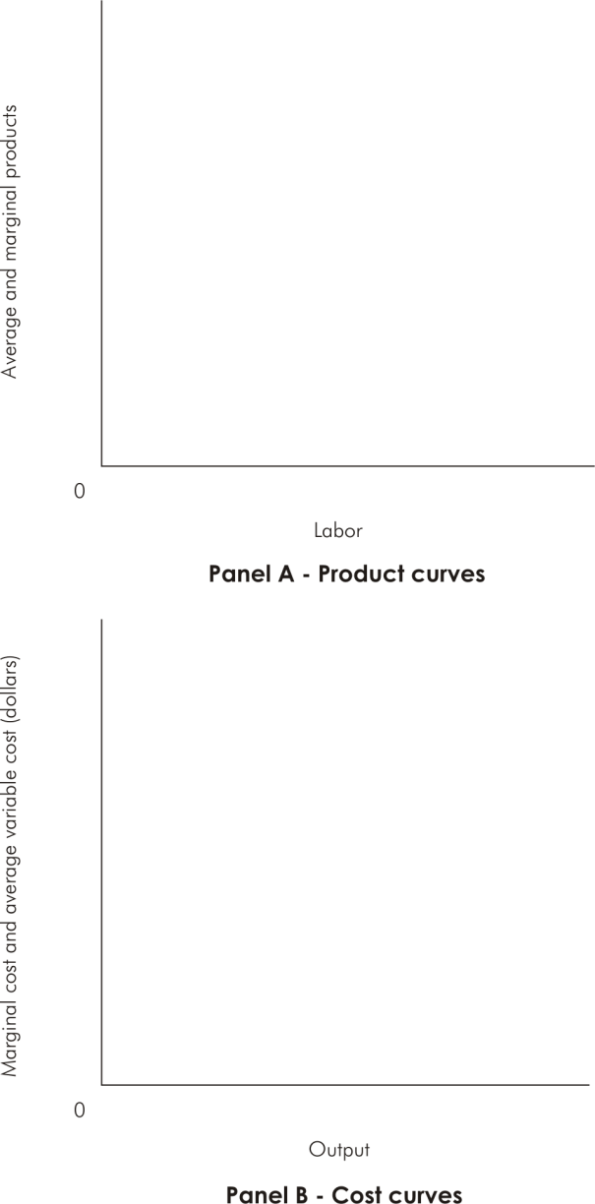
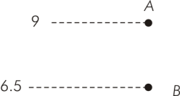
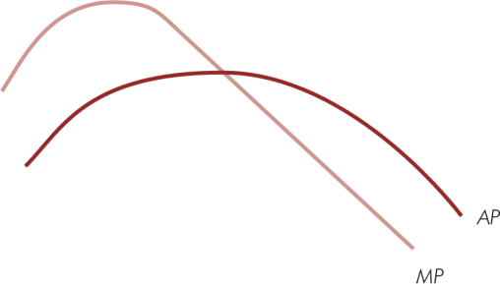


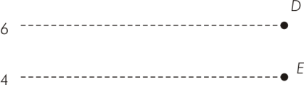

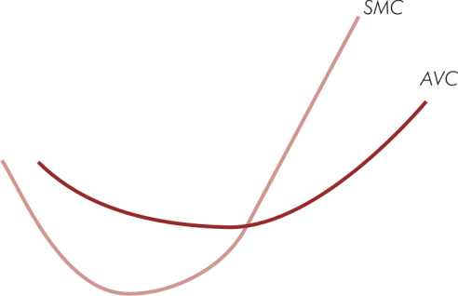
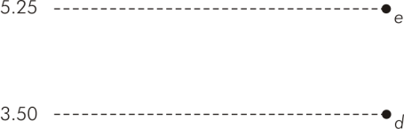

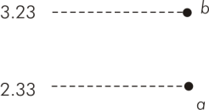


Short-Run Production & Cost Relations

Slide 18
Relations Between Short-Run Costs & Production
When marginal product (average product) is increasing, marginal cost (average cost) is decreasing
When marginal product (average product) is decreasing, marginal cost (average variable cost) is increasing
When marginal product = average product at maximum AP, marginal cost = average variable cost at minimum AVC

Slide 19
ESTIMATING Short-Run Cost FUNCTION
Short-run cost function is assumed as cubic function; TC = a + bQ + cQ² + dQ³, a,b,d>0,c<0,c²<3bd, so :
TFC = a
TVC = bQ+cQ²+dQ³
ATC = a/Q + b + cQ + dQ²
AFC = a/Q
AVC = TVC/Q = b + cQ + dQ²
MC = ∆TC/∆Q = b + 2cQ + 3dQ²
Total cost elasticity = MC/ATC
AVC reachs minimum at AVC=MC, Q = -c/2d

Slide 20
Iput Usage, Cost, and Output
K | L | TFC | TVC | TC | Q
3 | 0 | 3000 | 0 | 3000 | 0
3 | 1 | 3000 | 500 | 3500 | 70
3 | 2 | 3000 | 1000 | 4000 | 220
3 | 3 | 3000 | 1500 | 4500 | 430
3 | 4 | 3000 | 2000 | 5000 | 690
3 | 5 | 3000 | 2500 | 5500 | 1020
3 | 6 | 3000 | 3000 | 6000 | 1350
3 | 7 | 3000 | 3500 | 6500 | 1610
3 | 8 | 3000 | 4000 | 7000 | 1820
3 | 9 | 3000 | 4500 | 7500 | 1970
3 | 10 | 3000 | 5000 | 8000 | 2040

Slide 21
Iput Usage, Output, Total CostM Average Cost, Marginal Cost
L | Q | TC | ATC | AVC | AFC | MC
0 | 0 | 3000 | - | - | - | -
1 | 70 | 3500 | 50 | 7.143 | 42.86 | 7.143
2 | 220 | 4000 | 18.18 | 4.545 | 13.64 | 3.333
3 | 430 | 4500 | 10.47 | 3.488 | 6.977 | 2.381
4 | 690 | 5000 | 7.246 | 2.899 | 4.348 | 1.923
5 | 1020 | 5500 | 5.392 | 2.451 | 2.941 | 1.515
6 | 1350 | 6000 | 4.444 | 2.222 | 2.222 | 1.515
7 | 1610 | 6500 | 4.037 | 2.174 | 1.863 | 0.192
8 | 1820 | 7000 | 3.846 | 2.198 | 1.648 | 2.381
9 | 1970 | 7500 | 3.807 | 2.284 | 1.523 | 3.333
10 | 2040 | 8000 | 3.922 | 2.451 | 1.471 | 7.143

Slide 22
Cost Function
Production Function

Slide 23
The Graphs of ATC, AVC, AFC, and MC
ATC
AFC
MC
AVC

Slide 24
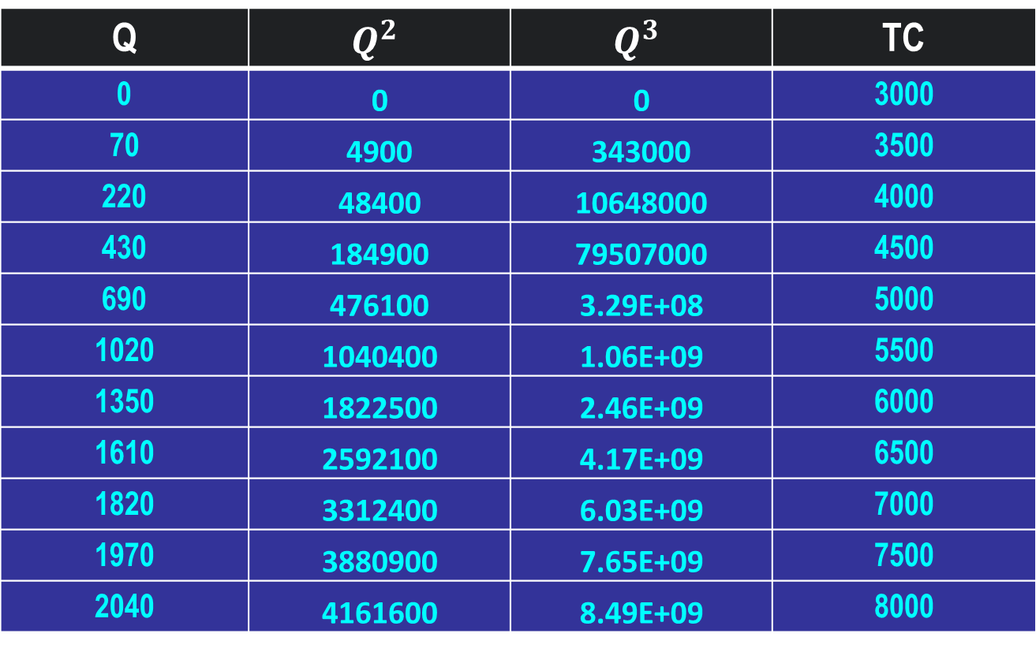
The level of Q, Q^{2 ,} Q³ as an independent variable and total cost as a dependent variable which will be used to estimate cost function
Q | $$Q^{2}$$ | $$Q^{3}$$ | TC
0 | 0 | 0 | 3000
70 | 4900 | 343000 | 3500
220 | 48400 | 10648000 | 4000
430 | 184900 | 79507000 | 4500
690 | 476100 | 3.29E+08 | 5000
1020 | 1040400 | 1.06E+09 | 5500
1350 | 1822500 | 2.46E+09 | 6000
1610 | 2592100 | 4.17E+09 | 6500
1820 | 3312400 | 6.03E+09 | 7000
1970 | 3880900 | 7.65E+09 | 7500
2040 | 4161600 | 8.49E+09 | 8000

Slide 25
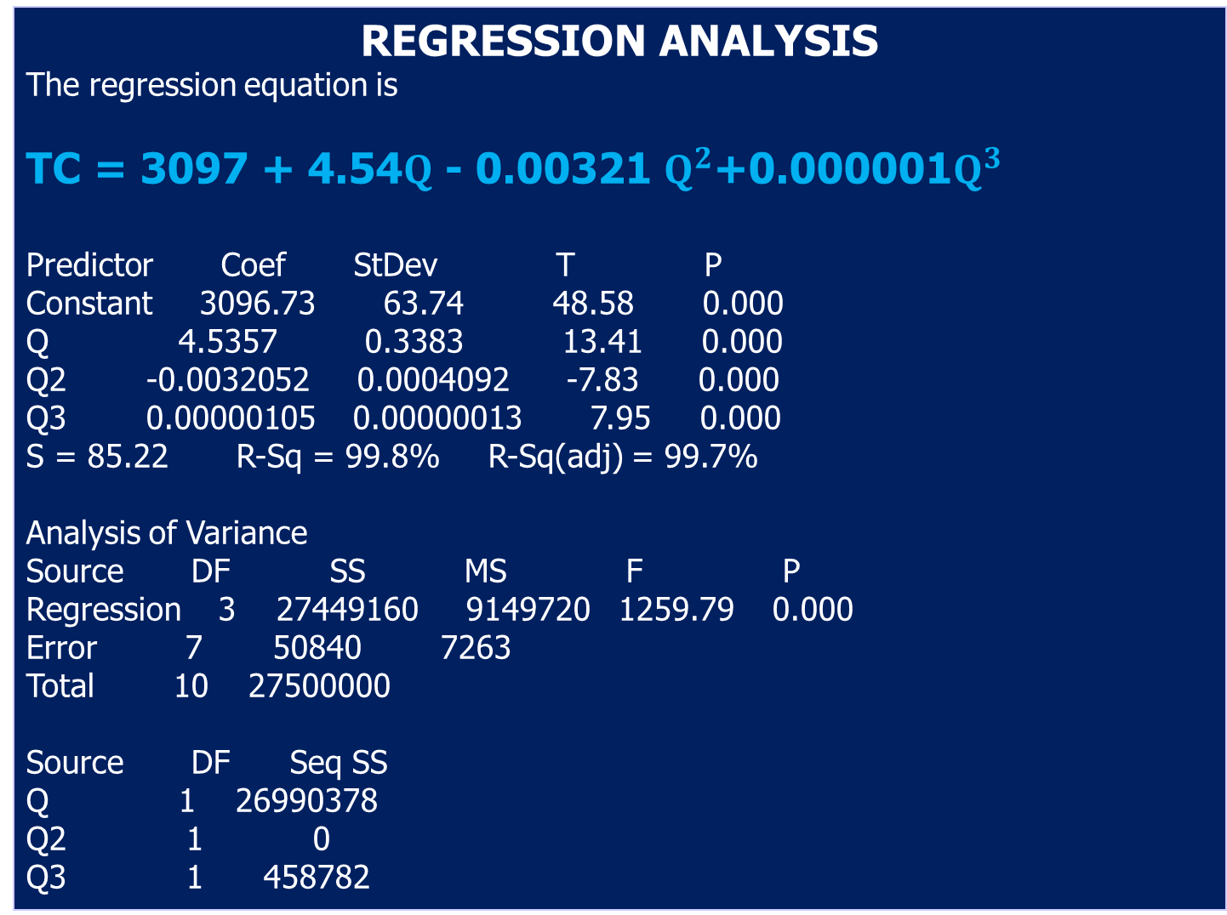
Regression Analysis
The regression equation is
TC = 3097 + 4.54$Q$ - 0.00321 $Q^{2}$+0.000001$Q^{3}$
Predictor Coef StDev T P
Constant 3096.73 63.74 48.58 0.000
Q 4.5357 0.3383 13.41 0.000
Q2 -0.0032052 0.0004092 -7.83 0.000
Q3 0.00000105 0.00000013 7.95 0.000
S = 85.22 R-Sq = 99.8% R-Sq(adj) = 99.7%
Analysis of Variance
Source DF SS MS F P
Regression 3 27449160 9149720 1259.79 0.000
Error 7 50840 7263
Total 10 27500000
Source DF Seq SS
Q 1 26990378
Q2 1 0
Q3 1 458782

Slide 26
Long-Run Costs
There is no fixed input, all input become variable inputs, consequently, there is no fixed cost, all costs become variable costs
The concept of long-run is needed by managers to determine the scale of operation in order to identify minimum cost in producing at any given level of output
Lonr-run cost is derived from long-run expansion path

Slide 27
Long-Run Costs
Long-run total cost (LTC) for a given level of output is given by:
LTC = wL* + rK*
Where w & r are prices of labor & capital, respectively, & (L*, K*) is the input combination on the expansion path that minimizes the total cost of producing that output

Slide 28
Long-Run Costs
Long-run average cost (LAC) measures the cost per unit of output when production can be adjusted so that the optimal amount of each input is employed
LAC is U-shaped
Falling LAC indicates economies of scale
Rising LAC indicates diseconomies of scale

Slide 29
Long-Run Costs
Long-run marginal cost (LMC) measures the rate of change in long-run total cost as output changes along expansion path
LMC is U-shaped
LMC lies below LAC when LAC is falling
LMC lies above LAC when LAC is rising
LMC = LAC at the minimum value of LAC

Slide 30
A firm uses 10 units of L and 7 units of K to produce 100 units of output by the least cost method. The price of L (w) is $5 and the price K (r) is $10 (isocost: C = 10K + 5L), so it spent $50 + $70 = $120 for 100 units of Q.
Due to the market demand, the firm raise the level of output to be 200 units, the price held constant, the combination of input to produce 200 units of output is K = 8 and L = 12, so that the cost = $140.
LAC (Long run Average Cost) and LMC (Long run Marginal Cost) for any level of output,
Q = 100
LAC = LTC/Q = 120/100 = $1.2 per unit
LMC = ∆LTC/∆Q = (120-0)/(100-0) = $1.2 per unit
Q = 200
LAC = LTC/Q = 140/200 = $0.70 per unit
LMC = ∆LTC/∆Q = (140-120)/(200-100) = $0..20 per unit

Slide 31
Q = 300
LAC = LTC/Q = 200/300 = $0.67 per unit
LMC = ∆LTC/∆Q = (200-140)/(300-200) = $0.60 per unit
Q = 400
LAC = LTC/Q = 300/400 = $0.75 per unit
LMC = ∆LTC/∆Q = (300-200)/(400-300) = $1.00 per unit
Q = 500
LAC = LTC/Q = 420/500 = $0.84 per unit
LMC = ∆LTC/∆Q = (420-300)/(500-400) = $1.20 per unit
Q = 600
LAC = LTC/Q = 560/600 = $0.97 per unit
LMC = ∆LTC/∆Q = (560-420)/(600-500) = $1.40 per unit
Q = 700
LAC = LTC/Q = 720/700 = $1.03 per unit
LMC = ∆LTC/∆Q = (720-560)/(700-600) = $1.60 per unit

Slide 32
Derivation of a Long-Run Cost Schedule
 | Least-cost combination of
Output | Labor (units) | Capital (units) | Total cost (w = $5, r = $10) | LAC | LMC
100
10
7
$120
$1.20
$1.20
200
12
8
140
0.70
0.20
300
20
10
200
0.67
0.60
400
30
15
300
0.75
1.00
500
40
22
420
0.84
1.20
600
52
30
560
0.93
1.40
700
60
42
720
1.03
1.60

Slide 33
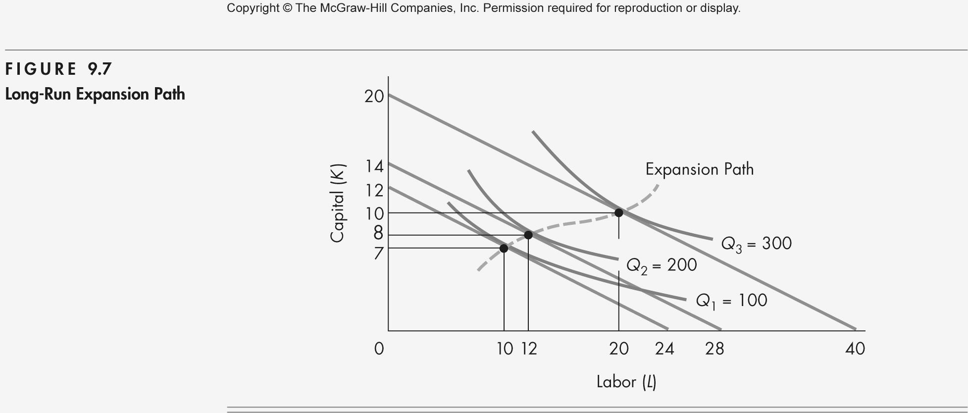
Long-Run Expansion Path

Slide 34
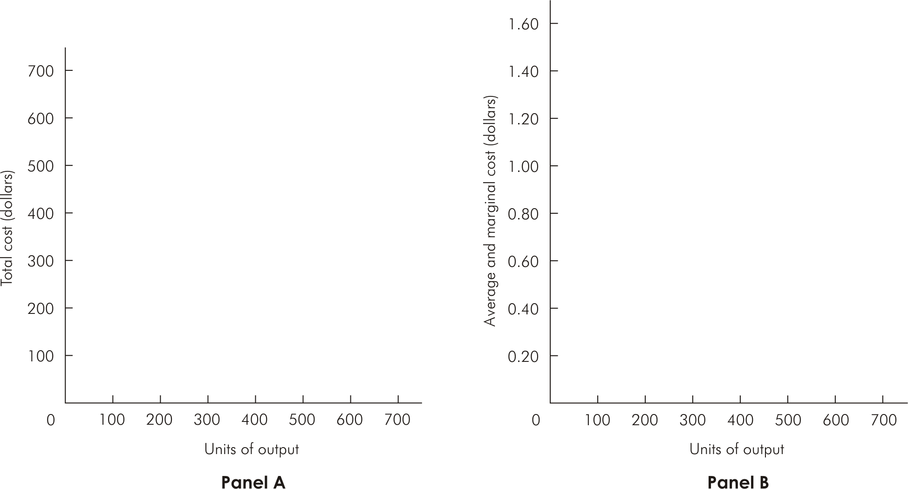
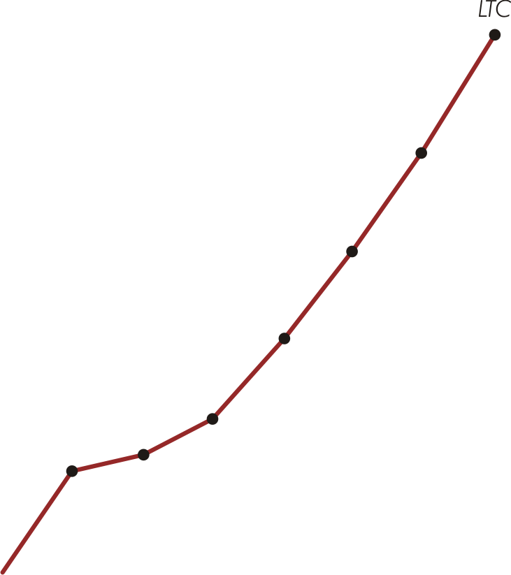
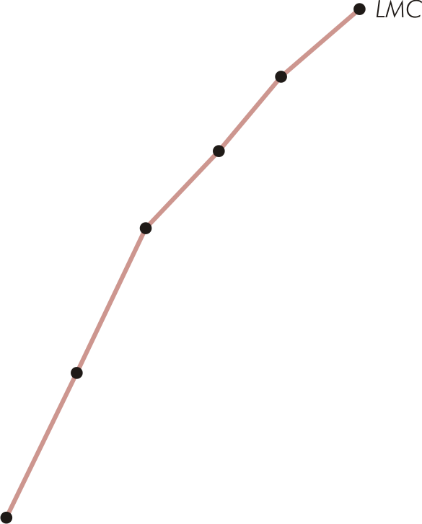
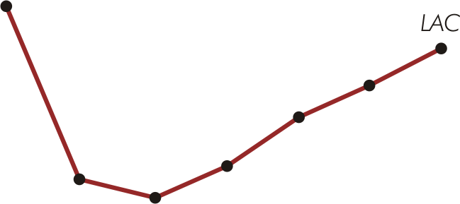

Long-Run Total, Average, & Marginal Cost

Slide 35
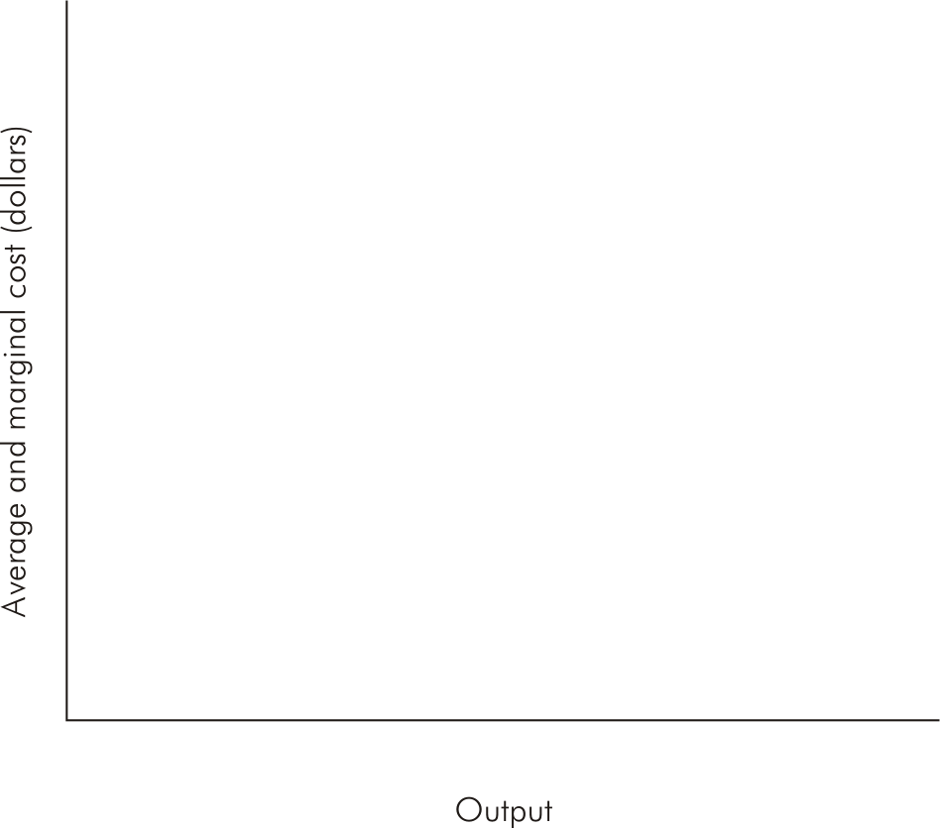
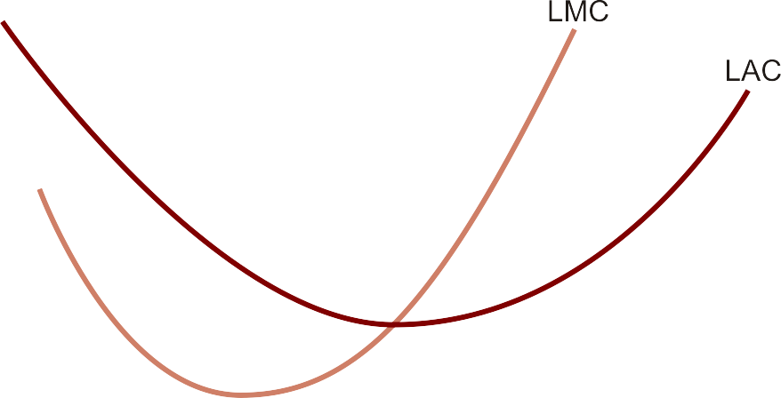
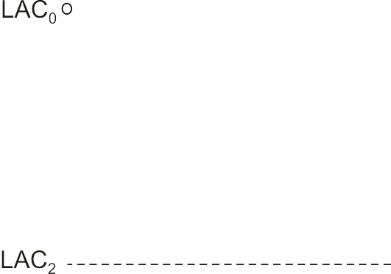
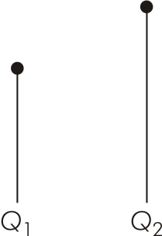
Long-Run Average & Marginal Cost Curves
AC,MC (dollars)

Slide 36
Based on the graph, it can be seen that both LAC and LMC are declining and ascending back after reaching the minimum point, however, when the LMC reaches the minimum point, LAC continues to decline and will reach the minimum when intersected with LMC

Slide 37
Economies of Scale
Larger-scale firms are able to take greater advantage of opportunities for specialization & division of labor
Scale economies also arise when quasi-fixed costs are spread over more units of output causing LAC to fall
Variety of technological factors can also contribute to falling LAC

Slide 38
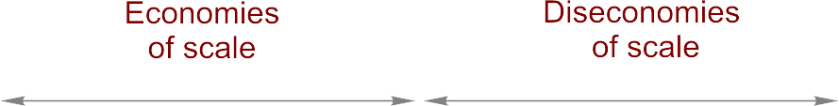

Economies & Diseconomies of Scale
AC,MC (dollars)

Slide 39
Constant Long-Run Costs
Absence of economies and diseconomies of scale
Firm experiences constant costs in the long run
LAC curve is flat & equal to LMC at all output levels

Slide 40
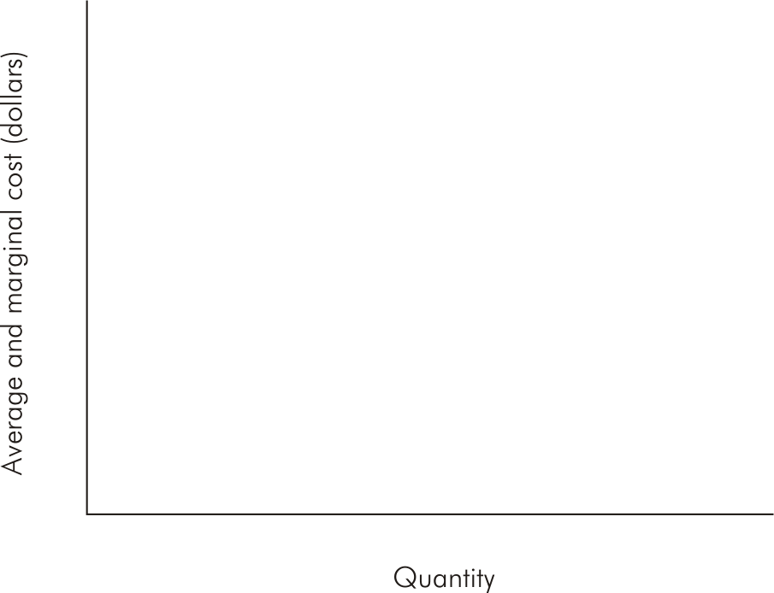
Constant Long-Run Costs (Figure 9.11)

Slide 41
Minimum Efficient Scale (MES)
The minimum efficient scale of operation (MES) is the lowest level of output needed to reach the minimum value of long-run average cost

Slide 42
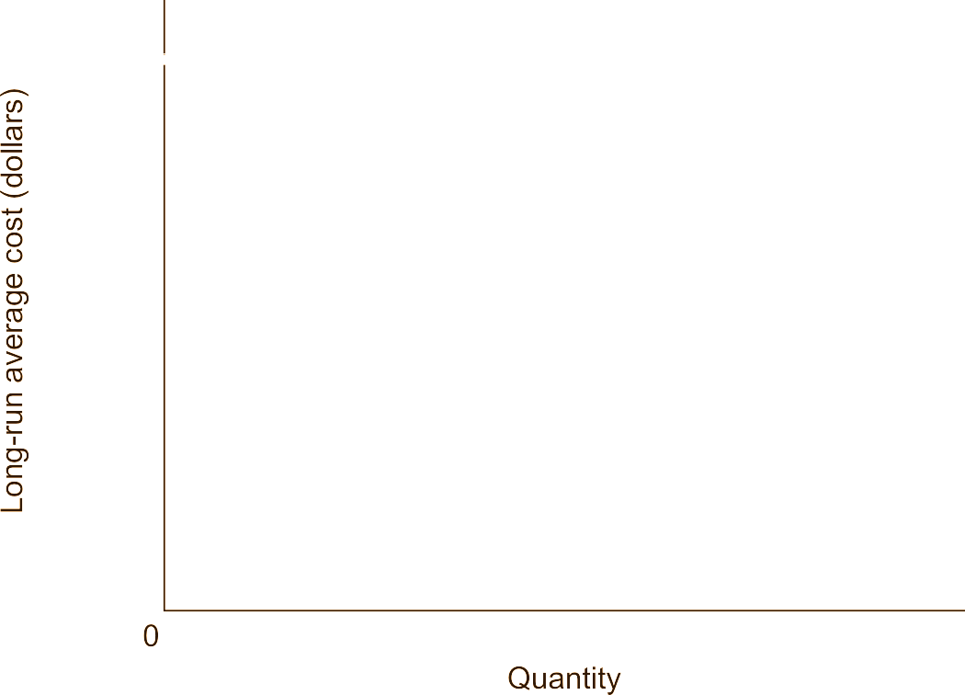
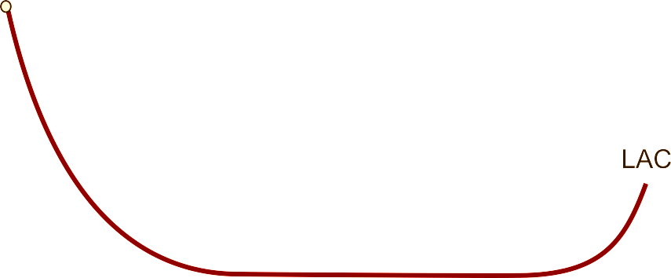
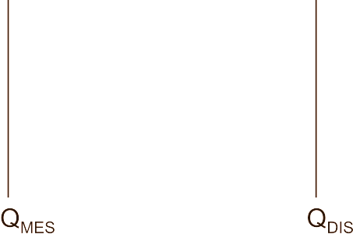

Minimum Efficient Scale (MES)

Slide 43
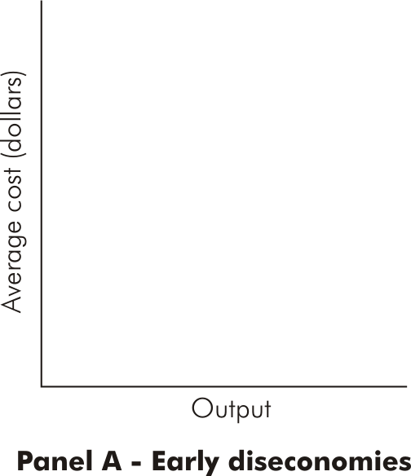
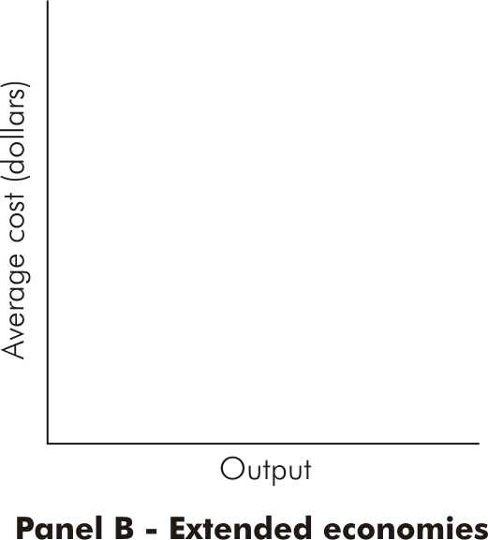
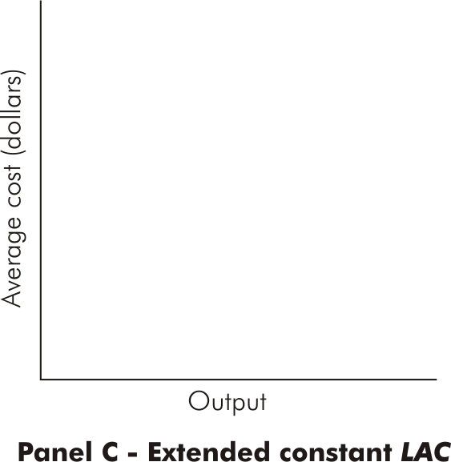
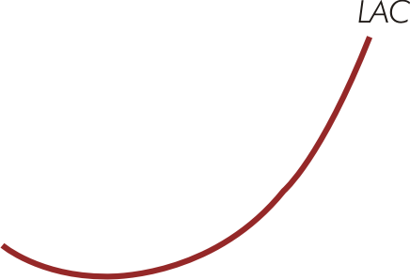
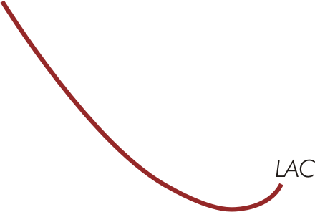
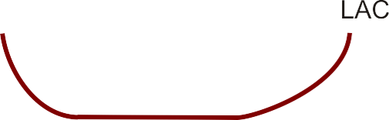

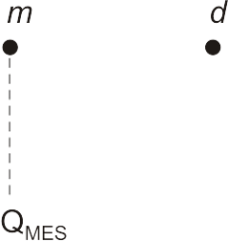

MES with Various Shapes of LAC

Slide 44
Economies of Scope
Exist for a multi-product firm when the joint cost of producing two or more goods is less than the sum of the separate costs for specialized, single-product firms to produce the two goods:
LTC(X, Y) < LTC(X,0) + LTC(0,Y)
Firms already producing good X can add production of good Y at a lower cost than a single-product firm can produce Y:
LTC(X, Y) – LTC(X,0) < LTC(0,Y)
Arise when firms produce joint products or employ common inputs in production

Slide 45
Purchasing Economies of Scale
Purchasing economies of scale arise when large-scale purchasing of raw materials enables large buyers to obtain lower input prices through quantity discounts

Slide 46
Reasons for economies of scope
Joint products : when production of good X causes one or more other goods to be produced as byproducts at little or no additional cost
Joint products always lead to economies scope, however, occurrences od scope economies area much more common than cases of joint product
Common or shared inputs: inputs that contribute of two or more goods or services
Economies of scope arise because the marginal cost of adding another good (Y) by a firm already producing a given good (X)- and thus able to use common inputs at very low cost-will be less costly than producing good Y by a single product

Slide 47
Purchasing Economies of Scale
Purchasing economies of scales arise when large scale purchasing of raw material-or any other input, for that matter- enables large buyers to obtain lower input prices through quantity discounts, causing LAC to shift downward at the point of discount

Slide 48
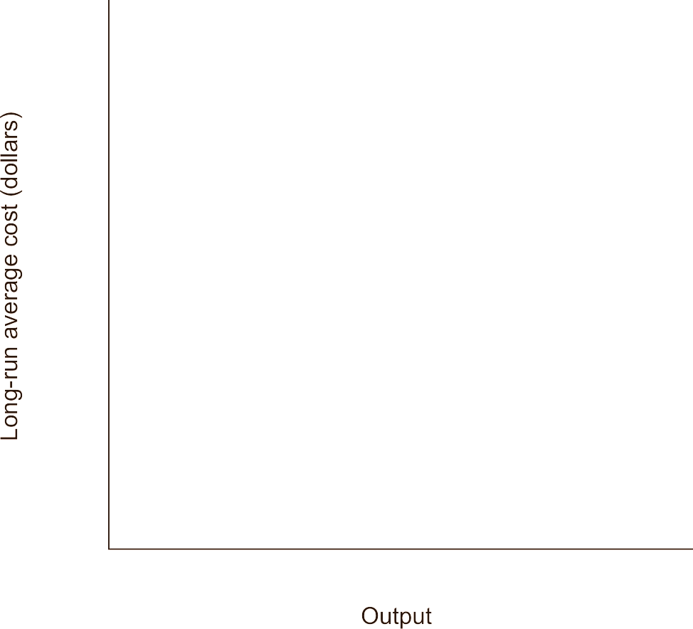
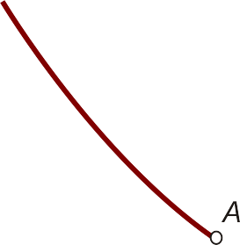
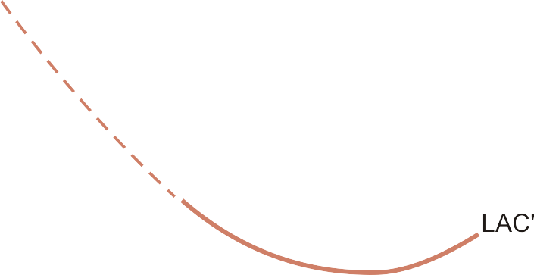
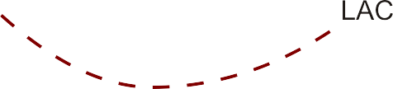


Purchasing Economies of Scale

Slide 49
Learning or Experience Economies
“Learning by doing” or “Learning through experience”
As total cumulative output increases, learning or experience economies cause long-run average cost to fall at every output level (LAC shifts downward)

Slide 50
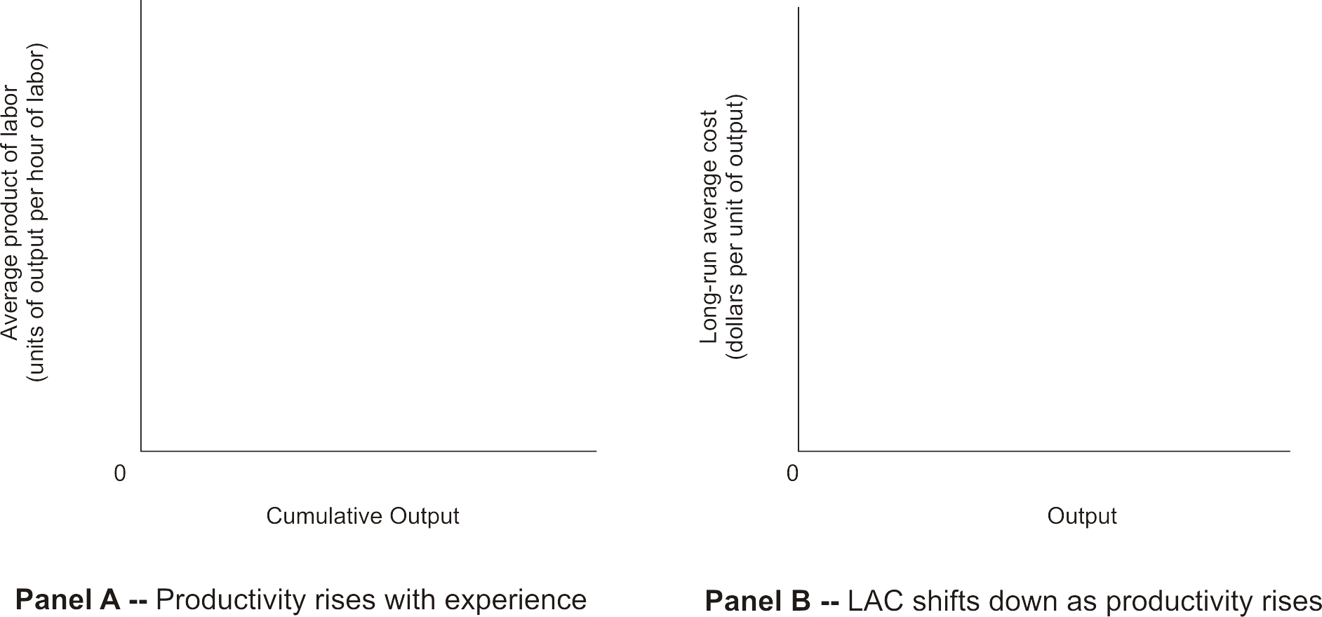
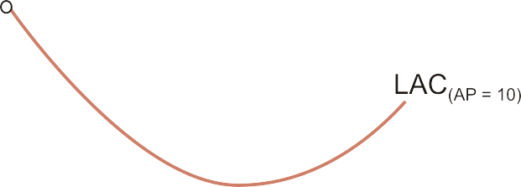
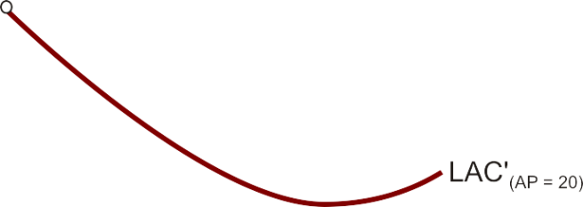
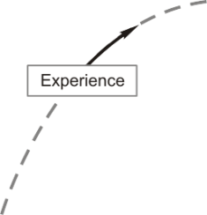

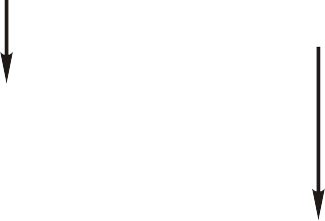



Learning or Experience Economies

Slide 51
Relations Between Short-Run & Long-Run Costs
LMC intersects LAC when the latter is at its minimum point
At each output where a particular ATC is tangent to LAC, the relevant SMC = LMC
For all ATC curves, point of tangency with LAC is at an output less (greater) than the output of minimum ATC if the tangency is at an output less (greater) than that associated with minimum LAC

Slide 52








Long-Run Average Cost as the Planning Horizon

Slide 53
Long-Run Average Cost as the Planning Horizon
MC3
SAC3
SAC1
MC1
LAC
MC2
SAC2
LMC
Qs
Q1
Qm
Q2
Ql

Slide 54
Restructuring Short-Run Costs
Because managers have greatest flexibility to choose inputs in the long run, costs are lower in the long run than in the short run for all output levels except that for which the fixed input is at its optimal level
Short-run costs can be reduced by adjusting fixed inputs to their optimal long-run levels when the opportunity arises

Slide 55







Restructuring Short-Run Costs

Slide 56
Summary
Short-run total cost, TC, is the sum of total variable cost, TVC, and total fixed cost, TFC: TC = TVC + TFC
Average fixed cost, AFC, is TFC divided by output: AFC = TFC/Q; average variable cost, AVC, is TVC divided by output: AVC = TVC/Q; average total cost (ATC) is TC divided by output: ATC = TC/Q
Short-run marginal cost, SMC, is the change in either TVC or TC per unit change in output Q
The link between product curves and cost curves in the short run when one input is variable is reflected in the relations, AVC = w/AP and SMC = w/MP, where w is the price of the variable input

Slide 57
Summary
Minimize total cost of producing a given quantity of output by choosing the input combination on the isoquant that is just tangent to an isocost curve
The two slopes are equal in equilibrium
Maximizing output for a given level of expenditure requires choosing an input combination satisfying the exact same conditions as for minimizing costs
The expansion path shows the optimal (or efficient) input combination for every level of output; long-run cost curves are derived from the expansion path
LMC lies below (above) LAC when LAC is falling (rising); LMC equals LAC at LAC’s minimum value

Slide 58
Summary
When LAC is decreasing, economies of scale are present, and when LAC is increasing, diseconomies of scale are present; Economies of scope arise when firms produce joint products or when firms employ common inputs in production
Because managers possess the greatest flexibility in choosing inputs in the long run, long-run costs are lower than short-run costs for all output levels except the output level for which the short-run fixed input is at its optimal level

