Slide 1
Theory Of Consumer Behavior
Zulkarnain Lubis

Slide 2
Consumer preferences and utility.
Indifference curves,
Marginal rate of substitution,
Indifference map,
The consumer’s budget constraint.
Utility maximization
Individual consumer and market demand
Substitution and income effects:
why demand slopes downward.

Slide 3
Consumer Behavior Concept
Consumer behavior concept is abstract or simplicity of the process and the way of a consumer as an individual in making decision
The main goal of consumers to consume a product is maximizing satisfaction
Because the income is limited, choices must be made about how to spend their limited income in order to get the maximum satisfaction

Slide 4
Principally, the level of consumer satisfaction can be mentioned as complying the need, the want, and the desire of consumers related to consuming a certain good or service
Consumer satisfaction, actually, related to the quality of the product which can be identified by 8 indicators: performance, feature, reliability, conformance, durability, serviceability, aesthetic, and perceived quality
Usually, the characteristics of the product that the consumers want in order to meet their satisfaction are faster, cheaper, and better which are related to the time dimension, price dimension, and quality dimension

Slide 5
The relation between the want of consumers and the availability of the product and or consumer satisfaction
Consumers Want
A Attention | B Bravo
D Don’t worry Be happy | C Cut or communi cate
Consumers Do not Find
Consumers Find
Consumers Do not Want

Slide 6
Utility and Utility Function
In terms of consumer behavior, satisfaction is called as utility.
Utility can also be defined as the benefits consumers obtain from the goods and services they consume
The level of utility can’t be counted or measured and there is not found a “utility meter” either.
The level of utility is arbitrary and determined as an ordinary scale based on the combination of goods and services consumed
Utility function

Slide 7
The utility function: an equation that shows an individual’s perception of the level utility that would be obtained from consuming each conceivable bundles of goods and services
Suppose there are only two goods consumed, X and Y, the utility function of a person who consume these two goods can be written as
U = f(X, Y)
where X and Y are, respectively , the amount of goods X and Y consumed, U is the level of utility the person receives from each combination of X and Y, while f means “a function of” or “depend on”

Slide 8
Indifference Curve
Related to the utility function, there is a fundamental tool for analyzing consumer behavior, an indifference curve
An indifference curve: a set of points representing different bundles of goods and services , each of which yields the same level of total utility The main assumption in analyzing consumer behavior based on indifference curve is that consumers will do the rational choice

Slide 9
The consumer’s optimization problems
All individuals make consumption decisions with the goal of maximizing their total satisfaction from consuming various goods and services, subject to the constraint that their spending on goods and services exactly equals to their incomes
Consumers do not spend either less or more than their incomes (no borrowing, no saving)
Consumers make their purchasing decisions when they are completely informed about all things that matter, they know the full range of products and services available, as well as the capacity of each product to provide utility
Consumers know the price of each good and their incomes during the time period in a question

Slide 10
Properties of consumer preferences
Customers could be able to rank (or to order) various combinations of goods and services according to the level of satisfactions associated with each combination
The combinations of specific quantities of goods or services are called consumption bundle
There are several Important assumptions must be made about how people rank bundles of goods (consumer preferences):
Complete preference ordering (completeness)
Transitive preference ordering (transitivity)
More is preferred to less (non satiation)
Convexity

Slide 11
Completeness
If there were only two goods consumed, e.g. Rice (B) and Textiles (T)
A consumer can decide whether B is preferably of T, T is preferred than B, or he or she is indifferent between B and T
The consumer’s preferences are complete if the consumer can do this for every possible pair of consumption bundles
Transitivity
If the product X> Y, Y> Z, then X> Z. If X = Y, Y = Z, X = Z
The fact is not necessarily so

Slide 12
Non Satiation
Consumers always prefer to have more of a good rather than less of the good
The fact is also not necessarily so
Convexity
Consuming a combination of two products is better than 1 product
X and Y are two products consumed, it is better to choose a part of the X and a part of Y rather than all X or all Y.

Slide 13
Product 2
Indifference curve as a curve of the utility function:
representative with the typical assumed shape
D
Y3
Y3⁰
A
C
Y1
Y1⁰
B
Y2
U3
U2
Y4
Y4⁰
U1
X3
X3⁰
X1⁰
X4
X4⁰
X1
X2
Product 1

Slide 14
All combinations of product 1 and 2 along indifference curve U1 yield the consumer the same level of utility i.e. A (X1, Y1) and B(X2, Y2)
Point C(X2, Y1) represent a higher level of utility than A or B, because X2 > X1 (for A) and Y1 > Y2 (for B)
Downward sloping: since the consumer obtains utility from both goods, when X more added, Y must be taken away in order to maintain the same level of utility (from A to B)
Convex: a diminishing marginal rate of substitution, to which we now turn
For the same change in X (X3 to X3⁰, X1to X1⁰, and X4 to X4⁰),
∆Y3 > ∆Y1 > ∆Y4

Slide 15
The combinations of consuming X and Y yield the level of utility, U = 100
Combination | X | Y | Utility level | Combination | X | Y | Utility level
A | 1 | 100 | 100 | D | 50 | 4 | 100
B | 10 | 20 | 100 | E | 80 | 2.5 | 100
C | 25 | 8 | 100 | F | 100 | 1 | 100

Slide 16
Indifference Curve representing the relation between the consumption of X and Y and the level of utility
U = 100

Slide 17
Marginal Utility Function (MU)
The marginal utility function: the addition to total utility that is attributable to the addition of one unit of a good to the current rate of consumption, holding constant the amounts of all other goods consumed
If U_{X} : utility function, the marginal utility function (MU_{X}) would be :
MU_{X} = ΔU_{X}/ΔX
In the concept of managerial economics, in the short run , as the consumption of a good increases, the marginal utility from additional unit of the good diminished (it is said as the principle of diminishing marginal utility)

Slide 18
No | Good X | Utility (U) | ΔX | ΔU | MU = ΔU/ΔX
1 | 0 | 0 | - | - | -
2 | 1 | 26 | 1 | 26 | 26
3 | 3 | 66 | 2 | 40 | 20
4 | 4 | 74 | 1 | 14 | 14
5 | 7 | 98 | 3 | 24 | 8
6 | 10 | 113 | 3 | 15 | 5
7 | 12 | 119 | 2 | 6 | 3
8 | 13 | 120 | 1 | 1 | 1
9 | 14 | 120 | 1 | 0 | 0
10 | 16 | 118 | 2 | -2 | -1
11 | 19 | 110 | 3 | -8 | -2.67
12 | 20 | 106 | 1 | -4 | -4
13 | 21 | 100 | 1 | -6 | -6

Slide 19
U
MU
Utility Function (U) and Marginal Utility (MU) at various consumtions of X

Slide 20
Marginal Rate of Substitution (MRS)
Marginal rate of substitution (MRS) : A measure of the number of given up per unit X added so as to maintain a constant level of utility
The slope at A is bigger than that in C, indicating the MRS decreases as the consumer moves down an indifference curve
MRS_{XY} = -ΔY/ΔX
X increase 1 unit from X1 to X1⁰, in order to hold the same utility, Y should decrease from Y1 to Y1⁰, the combinations change from A to B
A
Y1
●
B
Y1⁰
●
C
●
●
X1
X1⁰
X2
X2⁰

Slide 21
Indifference curves are negatively sloped and convex
Moving along an indifference curve, when the consumption of one good is increased, consumption of the other good is necessarily reduced by the amount required to maintain a constant level of utility
For a unit increase (decrease) in X, the MRS measures the decrease (increase) in Y needed to keep utility constant
For very small changes in X, the MRS is the negative of the slope of the indifference curve at a point
The MRS decreases as the consumer moves down an indifference curve

Slide 22
The change in total utility (∆U) = the results when both X and Y change by small amounts is related to the marginal utilities of X and Y;
∆U = ΔX MU_{X} + ΔY MU_{Y}
Since the level of utility is held constant, ∆U = 0 and
ΔX MU_{X} + ΔY MU_{Y} = 0
or
ΔX MU_{X} = -ΔY MU_{Y}
-ΔY/ ΔX = MU_{X} /MU_{Y}
MRS_{XY} = -ΔY/ΔX
MRS_{XY} = MU_{X} /MU_{Y}

Slide 23
The Consumer’s Budget Constrain
Consumes normally have limited income and goods are not limited, remember that the main goal of consumers to consume goods are maximizing satisfaction, but because the income is limited and goods are not limited, choices must be made about how to spend their limited income in order to get the maximum satisfaction
To understand how the limited income in a way that gives the maximum possible utility, let’s say a consumer’s income (disposable income) is equal to I which is used to spend on goods X₁, X₂, X₃, …., X_{n}, with respective price p₁, p₂, p₃, …., p_{n}, then the consumer’s budget line is written as:
I = p₁ X₁ + p₂ X₂ + p₃ X₃ + …… + p_{n} X_{n}

Slide 24
The budget constrain can also be written :
X₁ ₌ I/p₁ - p₂/p₁ X₂ + p₃/p₁ X₃ + … + p_{n}/p₁X_{n}
The budget line which is the curve of consumer’s budget constrain for two goods consumed (X and Y)
Quantity of Y
I/ p_{Y}
●
I = p_{X}X + p_{Y}Y; Y = I/ p_{Y} – p_{X}/ p_{Y} X
Y1
●
p_{X}/ p_{Y}
●
X1
I/ p_{X}
Quantity of X

Slide 25
Suppose the consumer has a fixed income of 1.200.000 which is the maximum amount that can be spent on two goods X and Y (for simplicity there are only X and Y would be consumed)
If the price of X, p_{X} = 300 per unit and the price of Y, p_{Y} = 400 per unit, the budget constrain would be:
300X + 400Y = 1.200.000
or
Y = 1200000/400 – 300/400X

Slide 26
Y
The budget line of 300X + 400Y = 1200000
What would be happened if the prices change ?
If income increase/decrease ?
What does the slope mean ?
3000
2400
1800
1200
600
X
0 800 1600 2400 3200 4000

Slide 27
Y
3750
I₄: 300X + 400Y = 1500000
Increase in p_{X} , budget line change from I₁ to I₂
Increase in p_{Y} , budget line change from I₁ to I₃
Increase in income, budget line change from I₁ to I₄
3000
I₁:300X + 400Y = 1200000
2400
I₃: 300X + 600Y = 1200000
1800
1200
600
I₂: 400X + 400Y = 1200000
X
0 800 1600 2400 3200 4000

Slide 28
An increase (decrease) in income causes outward (inward) shift in the budget line
An increase (decrease in the price of X (also Y) causes the budget line to pivot inward (outward) around the original vertical intercept (horizontal intercept for the price of Y)

Slide 29
Maximizing Utility Subject to a Limited Income
A consumer maximizes utility subject to a limited income at the combination of goods for which the indifference curve is just tangent to the budget line
At this combination, the MRS (the absolute value of the slope of the indifference curve) is equal to the price ratio (the absolute value of the slope of the budget line
The maximum level of the utility, the slope of U = The slope of I
The slope of U = - ΔY/ΔX, The slope of I = - p_{X}/ p_{Y}
- ΔY/ΔX = - p_{X}/ p_{Y} ; - ΔY/ΔX = MRS_{XY} = MU_{X}/MU_{Y}
MU_{X}/MU_{Y} = p_{X}/p_{Y} or MU_{X}/p_{X} = MU_{Y}/p_{Y}

Slide 30
Why should be MU_{X}/p_{X} = MU_{Y}/p_{Y} ?
If MU_{X}/p_{X} < MU_{Y}/p_{Y}, the consumer would take dollars away form X and spend them on Y. As consumption of X decreases, the MU_{X} rises and as Y increases, the MU_{Y} declines. It will continuously substitutes until MU_{X}/p_{X} = MU_{Y}/p_{Y}
If the utility function is U = f (X1, X2, X3, ...., Xn) and I = p₁ X₁ + p₂ X₂ + p₃ X₃ + …… + p_{n} X_{n} , the maximum level of utility would be obtain :
MU_{X1}/p_{X1} = MU_{X2}/p_{X2} MU_{X3}/p_{X3} = …. = MU_{Xn}/p_{Xn}

Slide 31
To obtain maximum satisfaction from limited income, a consumer allocates income so that the marginal utility per dollar spent on each good is the same for all commodities purchased and all income is spent

Slide 32
A and B: same budget line, same utility level , but not maximum utility
A and C or B and C: same utility level (U₁), different budget line. The combination of X and Y at point C requires less budget than that at point A and B
C and D can be obtained but not all of the budget is spent
E has a higher level of utility but the budget is insufficient
The optimal point is O: the budget line is tangent to the utility curve
Product 2
B
E
D
O
C
U₃
A
U*
U₂
U₁
Product 1

Slide 33
Someone’s monthly food budget = RM400
It is spent only on fried rice and roti cane, the price is respectively RM 8 and RM 4
He/she wants to determine the combination of fried rice and roti cane that yields the highest level utility possible from the RM400 food budget at the given price
Point | Fried Rice | Roti Cane | MRS | U Function
A | 45 | 10 | >> 0.5 | I
B | 40 | 20 | >0.5 | II
C | 15 | 70 | <0.5 | II
D | 40 | 50 | = 0.5 | IV**)
E | 30 | 40 | = 0.5 | III*)
*) the maximum level of utility subject to the budget line
**) has the same MRS but different budget line

Slide 34
Quantity of fried rice
60
50
40
A
D
B
30
E
IV
20
III
C
II
I
0 20 40 60 80 100
Quantity of roti cane

Slide 35
Suppose there are only two products consumed X and Y; p_{X} = 300, p_{Y} = 400, I = 1.200.000 and a utility function of consumers is: U = 500X^{0.2}Y^{0.8}
So, the marginal utility of X and Y respectively would be
MU_{X} = 100X^{-0.8}Y^{0.8}
MU_{Y} = 400X^{0.2}Y^{-0.2}
Utility maximization: MU_{X}/MU_{Y} = p_{X}/p_{Y}

Slide 36
MU_{X}/MU_{Y} = p_{X}/p_{Y}
100X^{-0.8}Y^{0.8} /400X^{0.2}Y^{-0.2} = 300/400 = ¾
Y/4X = ¾ or Y = 3X
The budget line; I: 300X + 400Y = 1200000
For Y = 3X, I: 300X + 400 (3X) = 1200000
X = 800, Y = 2400
The level of utility; U = 963289.87

Slide 37
Other combinations of X and Y that match to U = (X, Y) , their level of utility is less than that of the combination of (800, 2400)
X = 1000, Y = 2250 U = 956568.38
X = 500, Y = 2625 U =942035.89
X = 2000, Y =1500 U =794417.88
X = 100, Y =2925 U =744510.28
So, X = 800, Y = 2400 has a maximum level of utility

Slide 38
Individual Demand and Market Demand Curves
The demand curve of and individual for a specific commodity relates utility maximizing quantities purchased to market prices, holding constant income and the prices of all other goods. The slope of the demand curve illustrates the law of demand
The market demand curve is the horizontal summation of the demand curve of all consumers in the market

Slide 39
Aggregating Individual Demand
Price | Quantity Demanded |  |  | Market Demand
 | Cons. 1 | Cons. 2 | Cons. 3
6 | 3 | 0 | 0 | 3
5 | 5 | 1 | 0 | 6
4 | 8 | 3 | 1 | 12
3 | 10 | 5 | 4 | 19
2 | 12 | 7 | 6 | 25
1 | 13 | 10 | 8 | 311

Slide 40
Demand for Y
Deriving demand curve based on a combination of indifferent curves and budget lines
Price-consumption curve
Price of X
X3
X1
X2
Demand for X
.
P3
P1
P2
D
Demand for X
X3
X1
X2

Slide 41
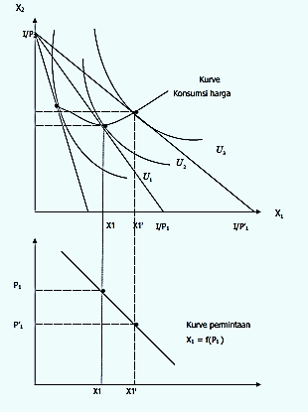

Slide 42
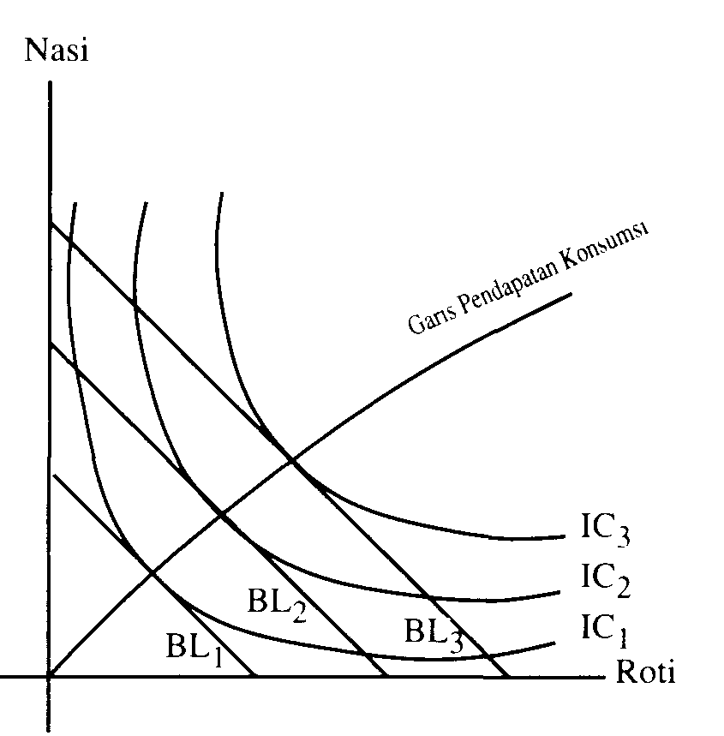
Income-Consumption Curve: the level of the consumption of goods (bread and rice) when income changes

Slide 43
Substitution Effect, Income Effect, Total Effect
The Substitution Effect is the effect due only to the relative price change, controlling for the change in real income.
In order to compute it we ask what is the bundle that would make the consumer just as happy as before the price change, but if they had to make their choice faced with the new prices.
To find this point we consider a budget line characterized by the new prices but with a level of income such that it is tangent to the initial indifference curve.

Slide 44
The Income Effect is the effect due to the change in real income. For example, when the price goes up the consumer is not able to buy as many bundles that she could purchase before. This means that in real terms she has become worse off. The effect is measured as the difference between the “intermediate" consumption” and the final consumption
Unlike the Substitution Effect, the Income Effect can be both positive and negative depending on whether the product is a normal or inferior good.
By the way we constructed them, the Substitution Effect plus the Income Effect equals the Total Effect of the price change.

Slide 45
Substitution effect : An effect caused by a rise in price that induces a consumer (whose income has remained the same) to buy more of a relatively lower-priced good and less of a higher-priced one.
Substitution effect is always negative for the seller : consumers always switch from spending on higher-priced goods to lower-priced ones as they attempt to maintain their living standard in face of rising prices. Substitution effect is not confined only to consumer goods, but manifests in other areas as well such as demand for labor and capital.

Slide 46
Income Effect :A change in the demand of a good or service, induced by a change in the consumers' discretionary income.
Any increase or decrease in price correspondingly decreases or increases consumers' discretionary income which, in turn, cause a lower or higher demand for the same or some other good or service.
For example, if a consumer spends one-half of his or her income on bread alone, a fifty-percent decrease in the price of bread will increase the free money available to him or her by the same amount which he or she can spend in buying more bread or something else

Slide 47
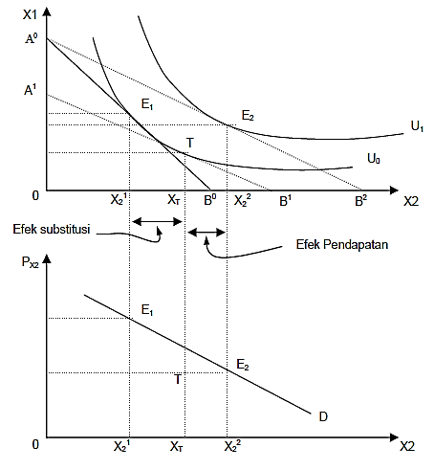
Total Effect, Substitution Effect, and Income Effect Because of The Price Changes (the price of X2 decreases)

Slide 48
Corner Solutions
The utility maximizing bundle lies of one of the endpoints of the budget line and the consumer chooses to consume zero unit of a good: corner solution
Quantity of fried rice
A
●
C
IV
Consumers spend their entire budget and choose to purchase none of X (A) or Y (B)
●
I’
III
II
I
I
B
Let’s say the consumer chooses to purchase none of X (purchase only Y)
●
Quantity of roti cane

Slide 49
This is caused by the price of X is sufficiently high relative to MU_{X} ; MU_{X}/p_{X} is very small.
At point A
a consumer chooses to buy zero X and spend his/her entire budget on Y
The higher utility curve for A is III which has smaller slope than the slope of the budget line (in absolute value); MRS < p_{X}/p_{Y ,} so for the corner solution at A,
MU_{X}/p_{X} < MU_{Y}/p_{Y}
When the consumer spends all of her income on Y, the MU per dollar spent on X delivers less than the last dollar spent on Y

Slide 50
Suppose there is a sufficiently large decrease in the price of X relative to the price of Y, the budget line will be changed (from I to I’) and the combination of consumption is going to be C.
At point C, the new budget line could become tangent to some indifference curve (IV) where both X and Y are bought
In general, a corner solution in which the consumer purchases none of some good X, results when
MU_{X}/p_{X} < MU_{i}/p_{i} = … = MU_{j}/p_{j}

Slide 51
A Mathematical Analysis of the Theory of Consumer Behavior

Slide 52
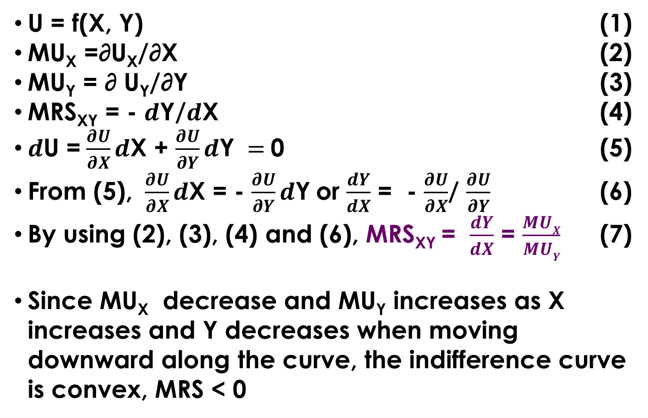
Marginal Rate of Substitution
U = f(X, Y) (1)
MU_{X} =∂U_{X}/∂X (2)
MU_{Y} = ∂ U_{Y}/∂Y (3)
MRS_{XY} = - $d$Y/$d$X (4)
$d$U =$\frac{∂U}{∂X}d$X + $\frac{∂U}{∂Y}d\text{Y} =$0 (5)
From (5), $\frac{∂U}{∂X}d$X = - $\frac{∂U}{∂Y}d\text{Y}$or $\frac{dY}{dX}$ = - $\frac{∂U}{∂X}$/ $\frac{∂U}{∂Y}$ (6)
By using (2), (3), (4) and (6), MRS_{XY} = $\frac{dY}{dX}$ = $\frac{MUX}{MUY}$ (7)
Since MU_{X} decrease and MU_{Y} increases as X increases and Y decreases when moving downward along the curve, the indifference curve is convex, MRS < 0

Slide 53
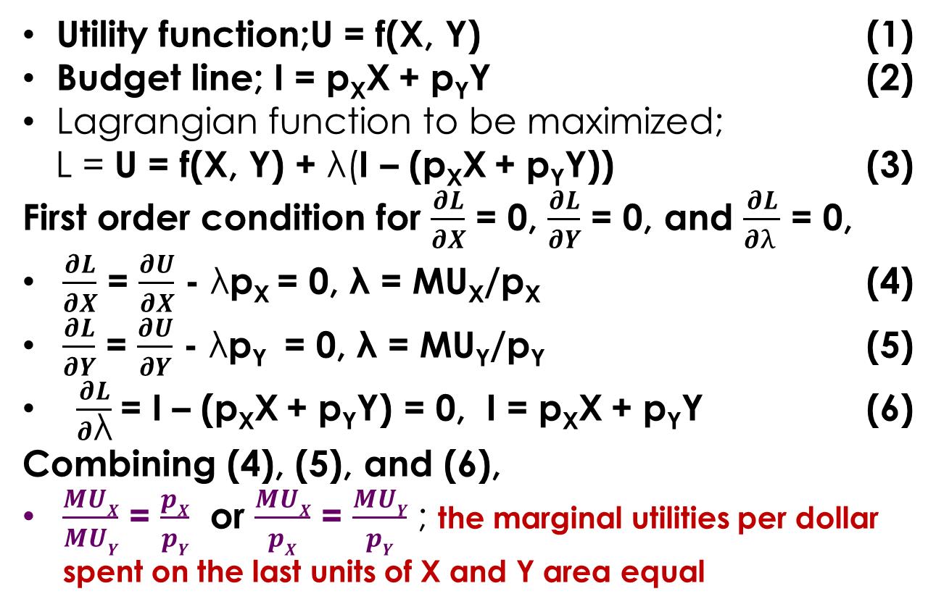
Utility Maximization Subject to Income Constraint
Utility function;U = f(X, Y) (1)
Budget line; I = p_{X}X + p_{Y}Y (2)
Lagrangian function to be maximized;
L = U = f(X, Y) + λ(I – (p_{X}X + p_{Y}Y)) (3)
First order condition for $\frac{∂L}{∂X}$ = 0, $\frac{∂L}{∂Y}$ = 0, and $\frac{∂L}{∂λ }$ = 0,
$\frac{∂L}{∂X}$ = $\frac{∂U}{∂X}$ - λp_{X} = 0, λ = MU_{X}/p_{X} (4)
$\frac{∂L}{∂Y}$ = $\frac{∂U}{∂Y}$ - λp_{Y} = 0, λ = MU_{Y}/p_{Y} (5)
$\frac{∂L}{∂\text{λ}}$= I – (p_{X}X + p_{Y}Y) = 0, I = p_{X}X + p_{Y}Y (6)
Combining (4), (5), and (6),
$\frac{MUX}{MUY}$ = $\frac{pX}{pY}$ or $\frac{MUX}{pX}$ = $\frac{MUY}{pY}$ ; the marginal utilities per dollar spent on the last units of X and Y area equal

Slide 54
Derivation of the Consumer’s Demand Function
Consumer’s demand functions derived from Lagrangian function, equation 3;
L = U = f(X, Y) + λ(I – (p_{X}X + p_{Y}Y))
The demand function from this solutions are:
X* = X*(p_{X} , p_{Y} , I)
and
Y* = Y*(p_{X} , p_{Y} , I)

Slide 55
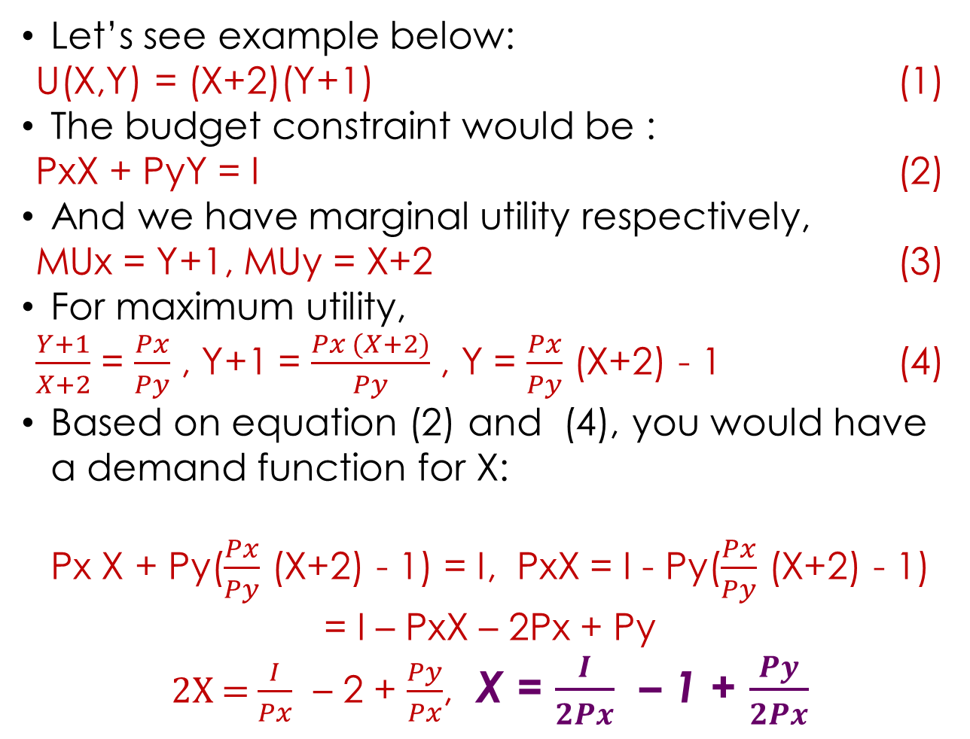
Let’s see example below:
U(X,Y) = (X+2)(Y+1) (1)
The budget constraint would be :
PxX + PyY = I (2)
And we have marginal utility respectively,
MUx = Y+1, MUy = X+2 (3)
For maximum utility,
$\frac{Y+1}{X+2}$ = $\frac{Px}{Py}$ , Y+1 = $\frac{Px (X+2)}{Py}$ , Y = $\frac{Px}{Py}$ (X+2) - 1 (4)
Based on equation (2) and (4), you would have a demand function for X:
Px X + Py($\frac{Px}{Py}$ (X+2) - 1) = I, PxX = I - Py($\frac{Px}{Py}$ (X+2) - 1)
= I – PxX – 2Px + Py
2X = $\frac{I}{Px}$ – 2 + $\frac{Py}{Px}$, X = $\frac{I}{2Px}$ – 1 + $\frac{Py}{2Px}$

Slide 56
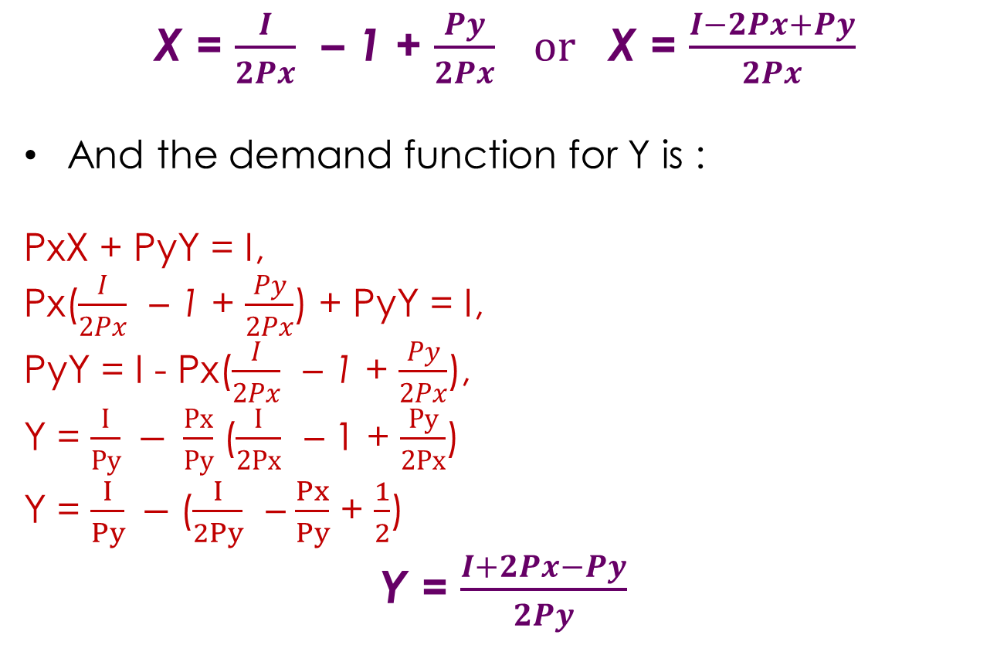
X = $\frac{I}{2Px}$ – 1 + $\frac{Py}{2Px} or$ X = $\frac{I−2Px+Py}{2Px}$
And the demand function for Y is :
PxX + PyY = I,
Px($\frac{I}{2Px}$ – 1 + $\frac{Py}{2Px}$) + PyY = I,
PyY = I - Px($\frac{I}{2Px}$ – 1 + $\frac{Py}{2Px}$),
Y = $\frac{I}{Py} − \frac{Px}{Py}$($\frac{I}{2Px}$ – 1 + $\frac{Py}{2Px}$)
Y = $\frac{I}{Py} −$($\frac{I}{2Py}$ – $\frac{Px}{Py}$ + $\frac{1}{2}$)
Y = $\frac{I+2Px−Py}{2Py}$

Slide 57
Sally purchases only pasta and salad with her income of $160 a month. Each month she buys 10 pasta dinners at $6 each and 20 salads at $5 each. The MU of the last unit of each is 30, what should Sally do? Explain.

Slide 58
Suppose that the MRS is 2, the price of X is $3, and the price of Y is $1
If the consumer obtain 1 more unit of X, how many units of Y must be given up in order to keep utility constant
If the consumer obtain 1 more unit of Y, how many units of X must be given up in order to keep utility constant
Is the consumer making the utility maximizing choice ? Why or why not ? If not, what should the consumer do ? Explain

Slide 59
U = X²Y²
I = PxX + PyY
Set up the constraint maximization problem and derive the first order conditions
Derive the consumer’s demand for X and Y in terms of the problems

