Slide 1
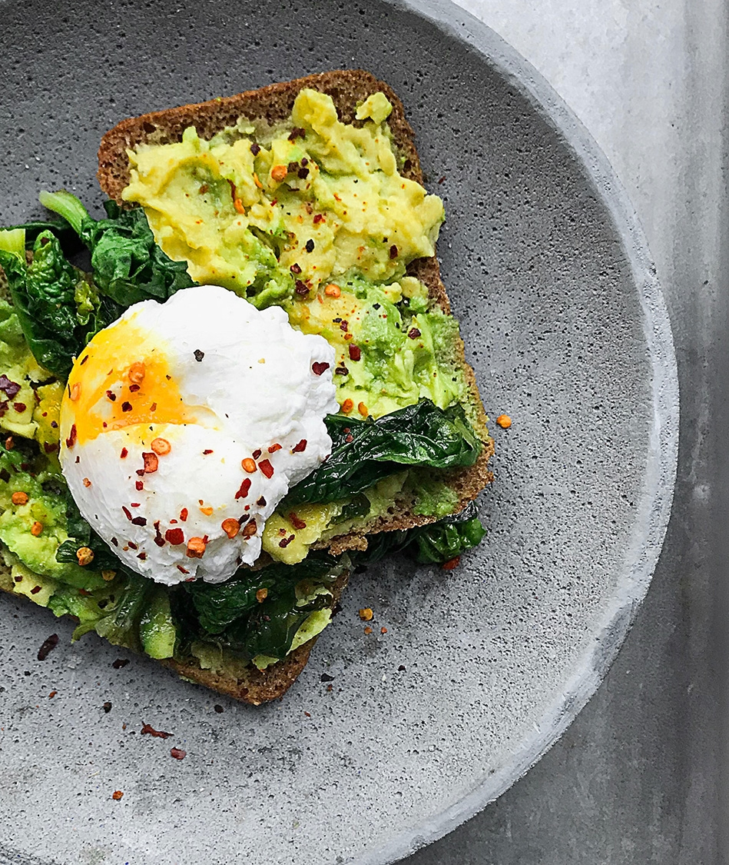
Langkah-Langkah Pelaksanaan Penelitian untuk Thesis Magister Agribisnis
Disampaikan pada Workshop Penelitian Thesis Penulisan Artikel Ilmiah Mahasiswa Magister Agribisnis Angkatan 2022, Pascasarjana UMA, 10-11 Februari 2023
Zulkarnain Lubis
(Dosen Program Magister Agribisnis dan Doktor Ilmu Pertanian UMA)

Slide 2



OVERVIEW OF RESEARCH PROCESS
Preliminary
Data
Gathering
Identifying
Research Problem
Research Questions
&
Research Objectives
Literature
Review
What are the symptoms or
indicators
Analysis
And
findings
Develop
Theoretical/Research
Framework
Research
Design
Hypothesis
development
Method
Sampling
Unit of analysis
Data collection method
Development of hypothesis

Slide 3

IN CONDUCTING RESEARCH :
What to Do
PS, RO, RQ, Scope
Why to Do
Background, Significance
How to Do
Research Design
Theories (concept, construct, preposition), Theoretical Framework

Slide 4
BAB I: What to Do dan Why to Do
BAB II: Landasan Teoritis
Preliminary data gathering
Theory
Theoretical Framework
Hypothesis
Literature Review
RP, RQ, RO
Concept
Construct
Proposition
Variables
BAB III: How to Do
Apa jenis penelitian dan strategi yang digunakan
Apa Jenis data yang dikumpulkan
Apakah data yang dikumpulkan kuantitatif atau kualitatif
Apa unit analisisnya
Bagaimana cara mengumpulkan datanya
Bagaimana pensampelannya
Bagaimana dengan alat ukur yang digunakan: pastikan valid dan reliabel
Apa alat analisis data yang digunakan

Slide 5

Slide 5
Masalah Penelitian
Pertanyaan Penelitian
Tujuan Penelitian
Apa yang melatarbelakangi topik tersebut
Mana data pendukungnya, siapa yang bilang demikian, darimana sumbernya
Apa masalahnya
Merupakan gap yang akan diisi melalui penelitian
Apa pertanyaan yang muncul dari masalah tersebut yang perlu dijawab melalui penelitian
Pertanyaannya bisa saja apa, apakah, apa saja, kenapa, bagaimana, seberapa, seberapa banyak, seberapa besar, sejauh apa dan sebagainya
Pertanyaan inilah yang akan dijawab melalui penelitian
Dalam bentuk kalimat pernyataan
Apa yang ingin dicapai dan dituju
Nanti yang akan menjadi kesimpulan penelitian dan menjadi dasar rekomendasi atau saran
Merupakan kalimat pernyataan

Slide 6

Floral Picture Slide 5
Kata awal untuk tujuan penelitian
  mengidentifikasi (to indentify),
  mengetahui (to find out),
  memastikan (to ensure),
  menentukan (to determine),
  membangun (to establish)
  mengklarifikasi (to clarify),
  melakukan verifikasi (to verify),
  mengkonfirmasi (to confirm),
  menjelaskan (to explain, to describe),
  membandingkan (to compare),
  menentukan (to define), memprediksi (to predict),
  menduga (to estimate),
  menganalisis (to analyze), menilai (to assess),
  menghitung (to calculate),
  mengumpulkan (to collect),
  mengembangkan (to develop),
  mengeksplorasi (to explore),
  menghubungkan (to connect, to relate) dan berbagai perkataan sejenis lainnya.

Slide 7

Literature Review
What is the Literature?
The "literature" should be written by scientists and researchers for scientists and researchers
  They may include: academic, scholarly journal articles, books, conference proceedings, dissertations, patents, standards, technical reports, websites and other internet resources

Slide 8

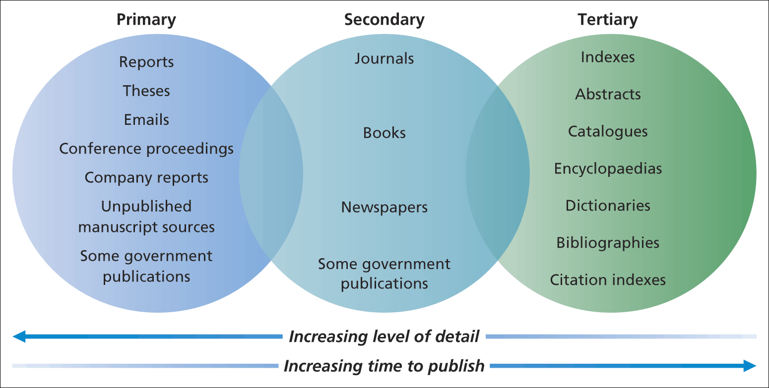
Literature Sources Available

Slide 9

Hipotesis
Hipotesis: dalil atau jawaban sementara yang akan dibuktikan kebenarannya secara empiris
Hipotesis memuat pernyataan singkat yang merupakan jawaban/simpulan sementara terhadap akar masalah penelitian
Penyusunan hipotesis didasarkan atas hasil kajian teori yang telah ada/pengetahuan relevan sehingga bukan sekedar perkiraan/dugaan simpulan penelitian semata yang tidak didasarkan pada pengetahuan yang telah ada.

Slide 10

How Do We Derive Hypotheses?
Therefore :
Ideally you should expect that the hypotheses to be accepted not rejected… aren’t you?
From own dreams?
From own observations?
From other research?
From other hypothesis?
From literature review?
From theoretical framework?
If it is from own observation, supported by other research, supported by other hypothesis, supported by other literature review, and supported by YOUR OWN theoretical framework.

Slide 11

Slide 6
Types of Data
Primary Data vs
Secondary Data
Primary data:
directly collected by
researcher and his/her team
Secondary: data collected
by others
Quantitative vs Qualitative
  Discrete: Nominal
Continuum; Ordinal, Interval,
ratio
The level of mathematical
Operations
Nominal :
= and ≠
Ordinal :
= , ≠, >, <
Interval :
= , ≠ , > , <, + , -
Ratio :
= , ≠, >, <, + , - , × , ÷
cross section vs
time series/
longitudinal
cross section:
the study of a phenomenon
at a particular time
longitudinal:
It has the capacity to study
change and development

Slide 12
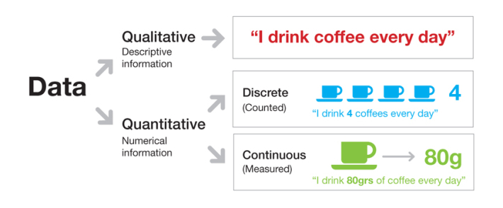
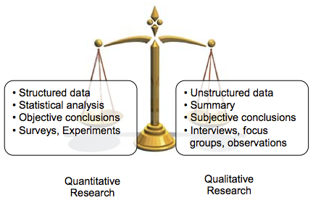
Comparing Qualitative and Quantitative Research

Slide 13

Qualitative and Quantitative Data
Qualitative data
  Data that are not characterized by numbers but rather are textual, visual, or oral.
    Focus is on stories, visual portrayals, meaningful characterizations, interpretations, and other expressive descriptions.
Quantitative data
  Represent phenomena by assigning numbers in an ordered and meaningful way.

Slide 14
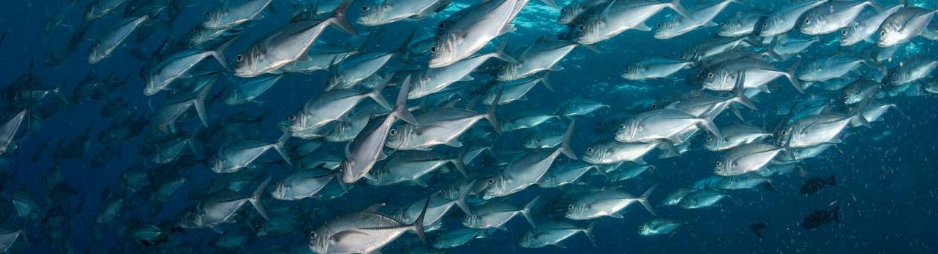
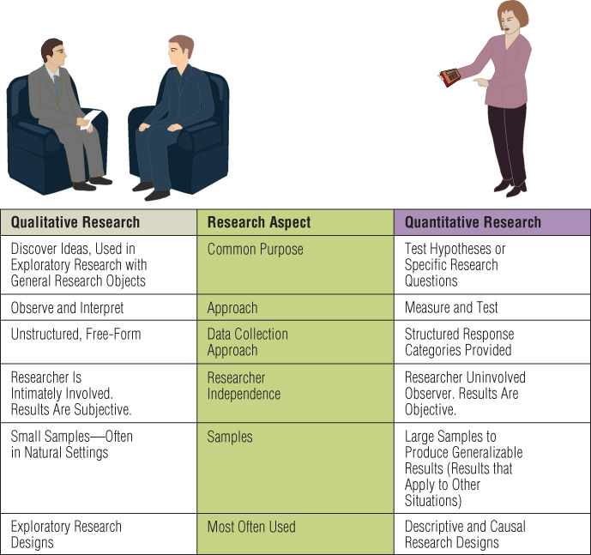
Qualitative vs Quantitative Research:

Slide 15

Uses of Qualitative Research
Qualitative research is useful when:
  It is difficult to develop specific and actionable decision statements or research objectives.
  The research objective is to develop a detailed and in-depth understanding of some phenomena.
  The research objective is to learn how a phenomenon occurs in its natural setting or to learn how to express some concept in colloquial terms.
  The behavior the researcher is studying is particularly context-dependent.
  A fresh approach to studying the problem is needed.

Slide 16
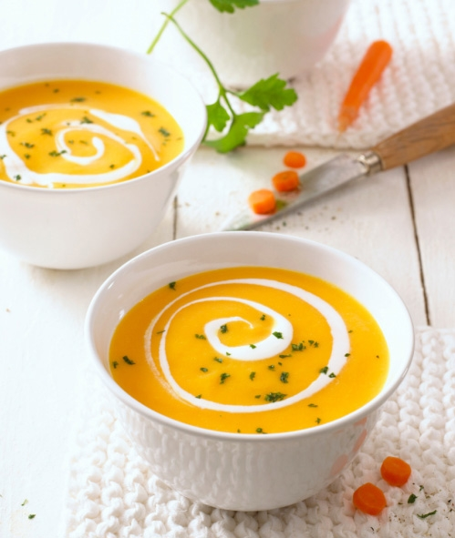
Qualitative Research Orientations
Major Orientations of Qualitative Research
  Phenomenology—originating in philosophy and psychology
  Ethnography—originating in anthropology
  Grounded theory—originating in sociology
  Case studies—originating in psychology and in business research

Slide 17
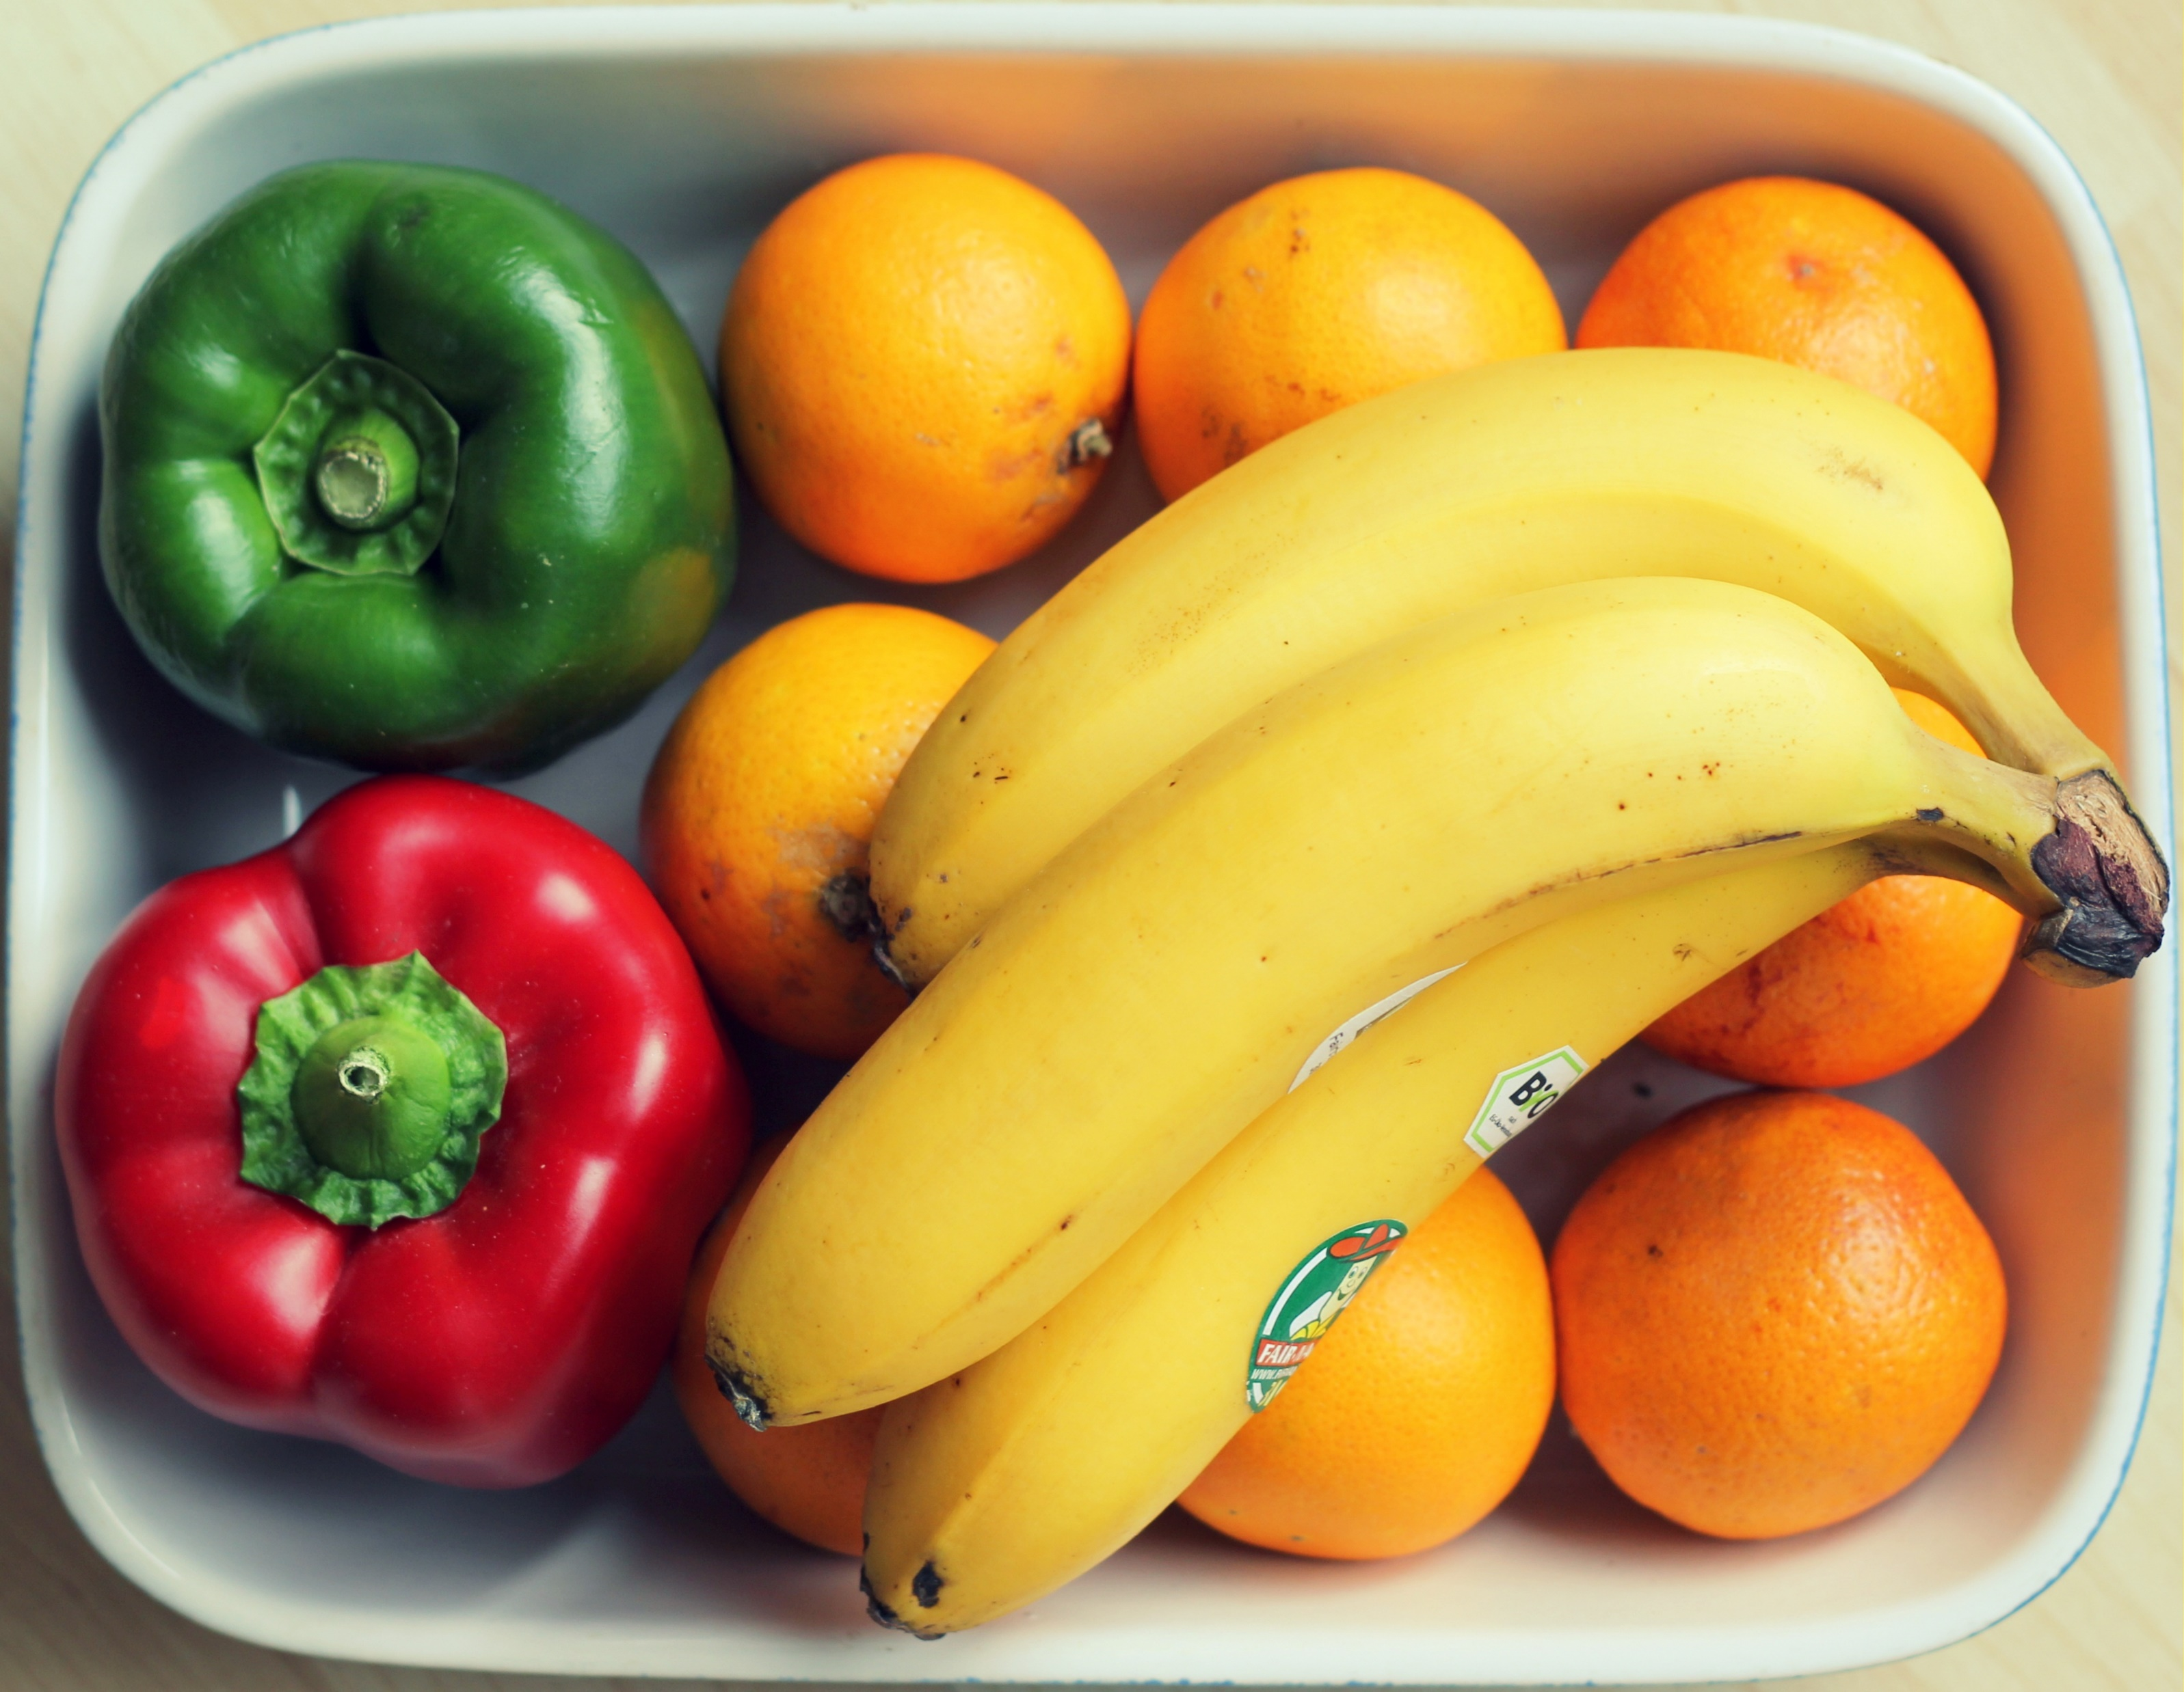
Quantitative data analysis: Key Points
Data must be analyzed to produce information
Computer software analysis is normally used for this process
Data should be carefully prepared for analysis
Researchers need to know how to select and use different charting and statistical techniques

Slide 18

Quantitative data analysis: Key Points
Data must be analyzed to produce information
Computer software analysis is normally used for this process
Data should be carefully prepared for analysis
Researchers need to know how to select and use different charting and statistical techniques

Slide 19

Quantitative data analysis: Main Concerns
Preparing, inputting and checking data
Choosing the most appropriate statistics to describe the data
Choosing the most appropriate statistics to examine data relationships and trends

Slide 20

Data Sources
Data used for analyzing in order to reach the objectives, to answer the questions, to have a solution to the problems
Secondary data
  Documentary, survey, or an amalgam of both
  Times series for longitudinal studies
  Cohort studies (compiling for the same population over time using a series of “snap-shots”)
  Area-based data sets
Primary data
  Experiments and observational study
  Questionnaires/tests
  Interviews
  Focus groups
RP, RQ, RO

Slide 21

Sampling Methods
Probability sampling: selecting sample is based on the consideration of the probability theory
Non probability sampling: the sample is selected based on certain considerations, does not use the probability theory approach, and without random
Probability sampling is better to use in selecting sample, but in reality it is often not possible. If so, then non probability sampling can be used as an alternative

Slide 22

Probability Sampling
Simple random
Systematic
Stratified random
Cluster
Multi-stage

Slide 23

Non Probability Sampling
Accidental Sampling. It is also called as Convenience Sampling, Opportunity Sampling, or Haphazard Sampling
Purposive Sampling
Expert Sampling
Quota sampling: proportionate Quota Sampling, Non-proportionate Quota Sampling, and Snowball Sampling
Self-selection Sampling

Slide 24
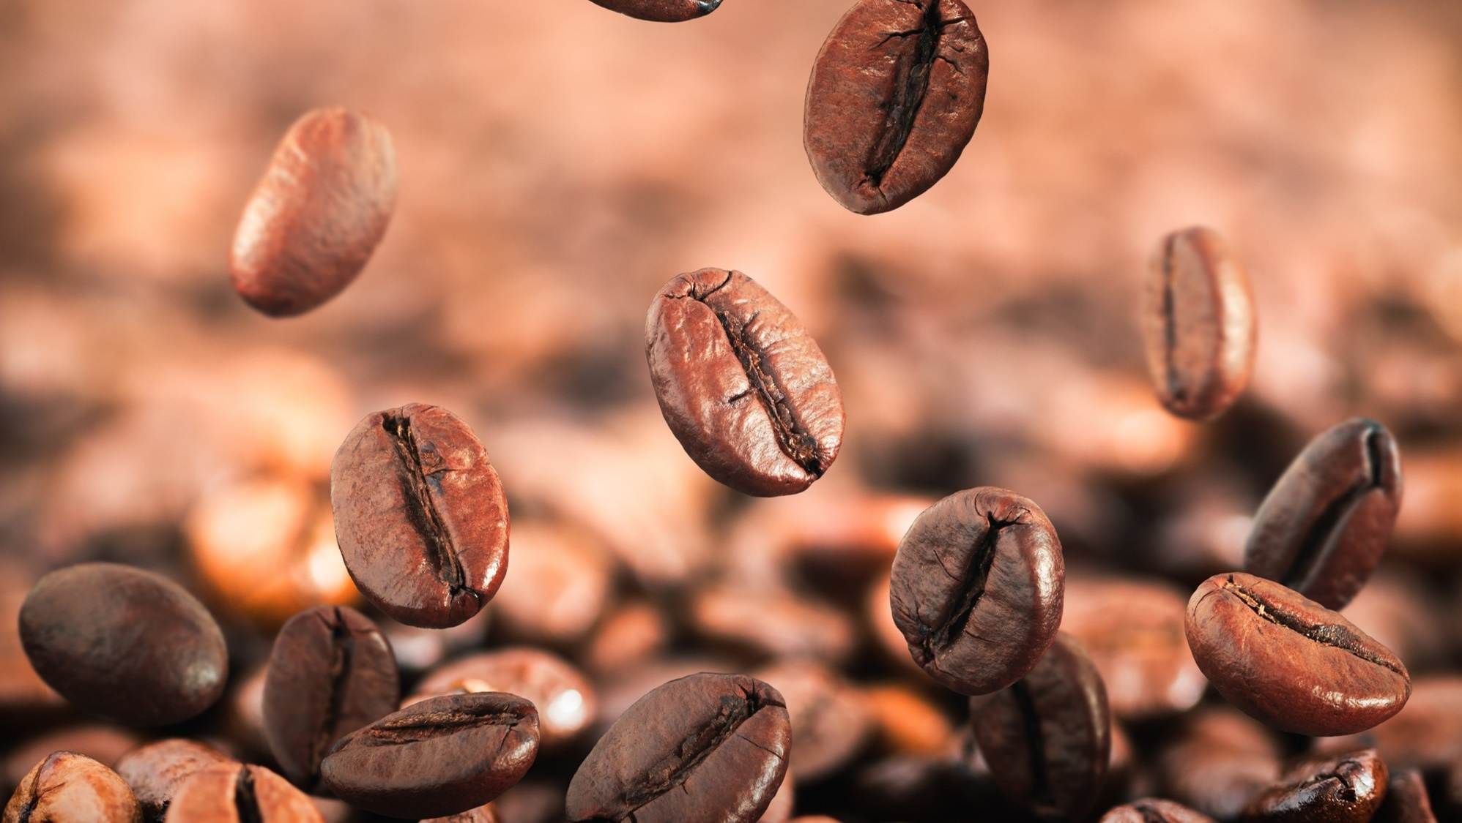
Data Analysis
Qualitative Analysis
Statistical Analysis
Quantitative Analysis Besides Statistics

Slide 25

Qualitative Data Analysis
Qualitative data result from the collection of non-standardised data that require classification and are analysed through use of conceptualisation
Qualitative analysis can involve summarising, categorising and structuring data
The process of data analysis and collection are necessarily interactive

Slide 26

Descriptive Statistics: Part of statistics which is specifically used to describe data; describing visually and measurement
Inductive Statistics: Part of Statistics for taking formal conclusions and generalizing to population based on data sample; classified on Parametric Statistics and Non-Parametric Statistics
STATISTICAL ANALYSIS

Slide 27
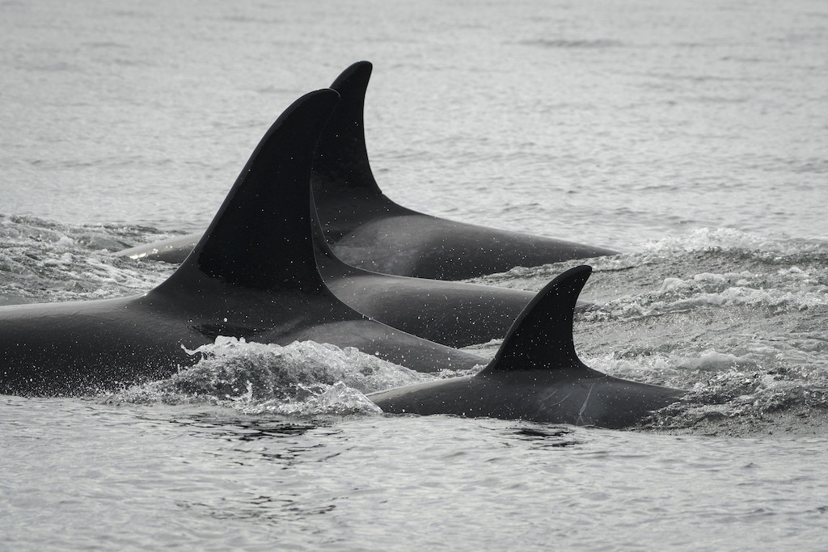
Types of Tests
Test for the measurement
Test for the statistical tools
Test for the hypothesis
Pay attention, which one is related to RP, RQ, RO

Slide 28

POKOK-POKOK PENELITIAN dan LAPORAN
Lima pilar utama metode ilmiah dalam penelitian
What is the Problem?
Jawabannya ada dalam
Bab Pendahuluan
How do you study the Problem?
Jawabannya ada dalam
Bab Metode Penelitian
What do you find ?
Jawabannya ada dalam
Bab Hasil Penelitian
What do these findings mean ?
Jawabannya ada dalam
Bab Pembahasan
How do you communicate these findings?
Jawabannya ada dalam Artikel Jurnal Ilmiah hasil penelitian

Slide 29
KESALAHAN-KESALAHAN YANG SERING MUNCUL

Slide 30
Masalah yang tidak kuat, harus jelas piramidanya, tidak tegas, tidak jelas, terputus dengan tujuan penelitian
Ada masalah penelitian, ada pertanyaan penelitian, ada tujuan penelitian,
PS, RQ, RO harus jelas dan tidak membingungkan
Arti dari hipotesis, perlunya hipotesis, penulisan hipotesis
Kerangka pemikiran, merupakan hasil dari tinjauan Pustaka
Tinjauan Pustaka: teori yang mendukung, konsep dan preposisi, penelitian agribisnis, bukan agroteknologi
Data yang digunakan; data penelitian vs data pendukung
Jenis data primer vs sekunder
Metode pengumpulan data
Defenisi operasional vs defenisi konseptual
Judul terlalu panjang vs tidak menggambarkan PS, RQ, RO

Slide 31
Perbedaan disertasi, thesis dan skripsi; jangan sama saja; kedalaman, keluasan
Lain judul, lain pernyataan masalah, lain tujuan penelitian, lain tinjauan Pustaka, lain analisis data, lain variable
Sistematika penulisan
Lihat penelitian terdahulu, jangan menjadi pengulangan
Komponen, klasifikasi, atau variable
Intrepretasi dari istilah statistik; uji F,ANOVA, uji t, R², r
Uji asumsi klasik
Skala pengukuran

Slide 32

Terima Kasih, Semoga Sukses

