Slide 1
RESEARCH DESIGN
Zulkarnain Lubis
Research Design (Strategy, Purpose)
Data (Qualitative Vs Quantitative, Secondary Vs Primary, Survey, Questioner, Interview, Validity And Reliability)
Sampling Methods (Sample Size, Probability Sampling, Non Probability Sampling)
Statistical Analysis (Descriptive, Inductive, Exploratory, Confirmatory, Parametric, Non Parametric, Assumpsion)
Any Statistical Computer Software (SPSS, MINITAB, Etc)

Slide 2

OVERVIEW OF RESEARCH PROCESS
Preliminary
Data
Gathering
Identifying
Research Problem
Research Questions
&
Research Objectives
Literature
Review
What are the symptoms or
indicators
Analysis
And
findings
Develop
Theoretical/Research
Framework
Research
Design
Hypothesis
development
Method
Sampling
Unit of analysis
Data collection method
Development of hypothesis

Slide 3

design of research
The research design is the master plan specifying the methods and procedures for collecting and analyzing the needed information.
A detailed outline of how an investigation will take place. A research design will typically include how data is to be collected, what instruments will be employed, how the instruments will be used and the intended means for analysing data collected.
A master plan that specifies the methods and procedures for collecting and analyzing the needed information

Slide 4
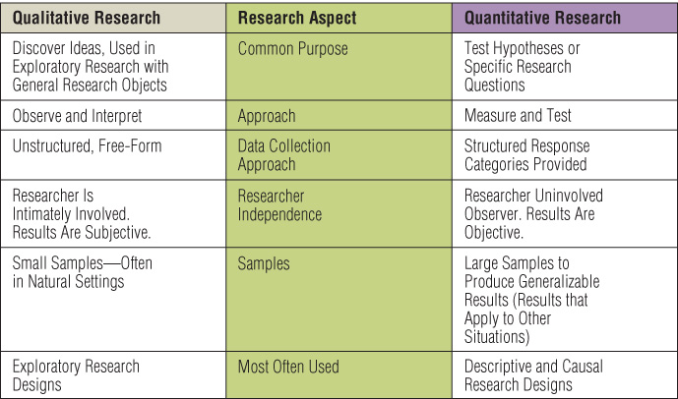
Qualitative vs Quantitative Research:
Type of Research :
Exploratory research
Descriptive studies
Explanatory (causal) studies
Research Strategies :
Experiment
Survey
Case study
Action research
Grounded theory
Ethnography
Archival research
Time Horizons:
Cross-sectional studies
Longitudinal studies
Data Collection and Data Analysis

Slide 5

Research Strategies: Experiment
An experiment will involve:
  Definition of a theoretical hypothesis
  Selection of samples from know populations
  Random allocation of samples
  Introduction of planned intervention
  Measurement on a small number of dependent variables
  Control of all other variables

Slide 6

Research Strategies: Survey
Key Features:
  Popular in social science
  Perceived as authoritative
  Allows collection of quantitative data
  Data can be analysed quantitatively
  Samples need to be representative
  Gives the researcher independence
  Structured observation and interviews can be used
Survey
To collect a large amount of data from a sizeable population and standardize it to allow easy comparison
Types: Questionnaires, Structured Interviews

Slide 7

Research Strategies: Case study
Key features
  Provides a rich understanding of a real life context
  Uses and triangulates multiple sources of data
  A case study can be categorised in four ways and based on two dimensions:
    single case v. multiple case (more ability to generalize)
    holistic case (choose 1 organization as a whole)
    v. embedded case (some departments or activities)
Case Studies:
  The documented history of a particular person, group, organization, or event.

Slide 8

Research Strategies: Action research
Key features
  Research IN action - not ON action focusing on the purpose
  Involvement of practitioners in the research
  The researcher becomes part of the organisation
  Promotes change within the organisation
  Can have two distinct focus (Schein, 1999) – the aim of the research and the needs of the sponsor

Slide 9

Research Strategies; Grounded theory (Inductive deductive approach)
Key features:
Theory is built through induction and deduction
Helps to predict and explain behaviour
Develops theory from data generated by
observations
Is an interpretative process, not a logical-deductive one
  Represents an inductive investigation in which the researcher poses questions about information provided by respondents or taken from historical records.
    The researcher asks the questions to him or herself and repeatedly questions the responses to derive deeper explanations.

Slide 10

Research Strategies: Ethnography (Inductive approach)
Key features
    Aims to describe and explain the social world inhabited by the researcher
    Takes place over an extended time period
    Is naturalistic
    Involves extended participant observation such as studying gorillas in their natural habitat
Ethnography
  Represents ways of studying cultures through methods that involve becoming highly active within that culture.

Slide 11

Research Strategies: Archival research
Key features
  Uses administrative records and documents as the principal sources of data
  Allows research questions focused on the past
  Is constrained by the nature of the records and documents
  Example: historical research

Slide 12

Types of Data
Primary Data vs
Secondary Data
Primary data:
directly collected by
researcher and his/her team
Secondary: data collected
by others
Quantitative vs Qualitative
  Discrete: Nominal
Continuum; Ordinal, Interval,
Ratio
The level of mathematical
Operations
Nominal : = and ≠
Ordinal : = , ≠, >, <
Interval := , ≠ , > , <, + , -
Ratio : = , ≠, >, <, +, - , × , ÷
cross section vs
time series/
longitudinal
cross section:
the study of a phenomenon
at a particular time
longitudinal:
It has the capacity to study
change and development

Slide 13
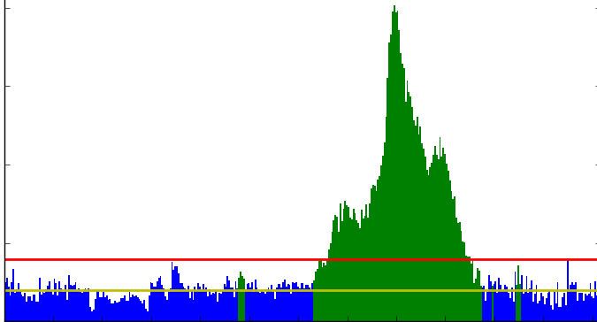
Time Horizons
Cross-sectional studies the study of a phenomenon at a particular time. Because of time restrictions
Longitudinal studies it has the capacity to study change and development

Slide 14
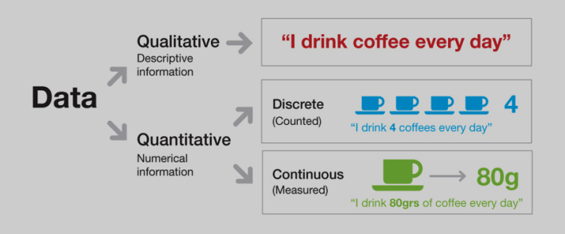
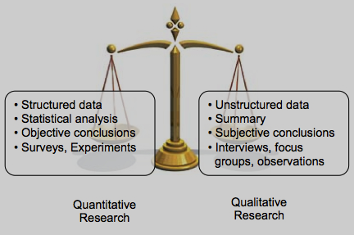
Comparing Qualitative and Quantitative Research

Slide 15

Uses of Qualitative Research
Qualitative research is useful when:
  It is difficult to develop specific and actionable decision statements or research objectives.
  The research objective is to develop a detailed and in-depth understanding of some phenomena.
  The research objective is to learn how a phenomenon occurs in its natural setting or to learn how to express some concept in colloquial terms.
  The behavior the researcher is studying is particularly context-dependent.
  A fresh approach to studying the problem is needed.

Slide 16

Qualitative Research Orientations
Major Orientations of Qualitative Research
  Phenomenology—originating in philosophy and psychology
  Ethnography—originating in anthropology
  Grounded theory—originating in sociology
  Case studies—originating in psychology and in business research

Slide 17

Quantitative data analysis: Key Points
Data must be analyzed to produce information
Computer software analysis is normally used for this process
Data should be carefully prepared for analysis
Researchers need to know how to select and use different charting and statistical techniques

Slide 18

Quantative data analysis: Main Concerns
Preparing, inputting and checking data
Choosing the most appropriate statistics to describe the data
Choosing the most appropriate statistics to examine data relationships and trends

Slide 19

Data Sources
Secondary data
  Documentary, survey, or an amalgam of both
  Times series for longitudinal studies
  Cohort studies (compiling for the same population over time using a series of “snap-shots”)
  Area-based data sets
Primary data
  Experiments and observational study
  Questionnaires/tests
  Interviews
  Focus groups

Slide 20

Secondary Data
Availability of secondary data sources
    References in publications (books, journal articles)
    Within organisations (unpublished sources)
    Tertiary literature ( indexes and catalogues in archives or online)

Slide 21
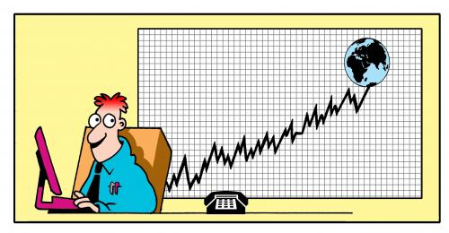
Primary Data
Primary data – data you collect
Primary Data - Examples
  Surveys
  Focus groups
  Questionnaires
  Personal interviews
  Experiments and observational study

Slide 22
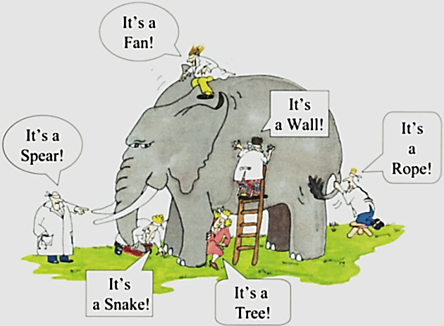
Sampling Methods

Slide 23
Selecting Samples
Population, sample and individual cases
population
sample

Slide 24
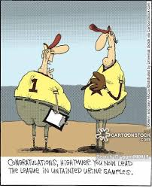
The Need to Sample
Sampling- a valid alternative to a census when
A survey of the entire population is impracticable
Budget constraints restrict data collection
Time constraints restrict data collection
Results from data collection are needed quickly

Slide 25
Sampling Units
Sampling Unit
  A single element or group of elements subject to selection in the sample.
  Primary Sampling Unit (PSU)
    A unit selected in the first stage of sampling.
  Secondary Sampling Unit
    A unit selected in the second stage of sampling.
  Tertiary Sampling Unit
    A unit selected in the third stage of sampling.
Sampling Units = Unit of Analysis ?

Slide 26
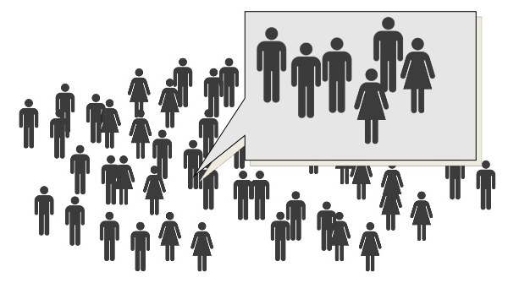
When the sample is representative ?
The size of the sample
The sampling methods

Slide 27

Sample Size
Random Error and Sample Size
  Random sampling error varies with samples of different sizes.
  Increases in sample size reduce sampling error at a decreasing rate.
    Diminishing returns - random sampling error is inversely proportional to the square root of n.

Slide 28
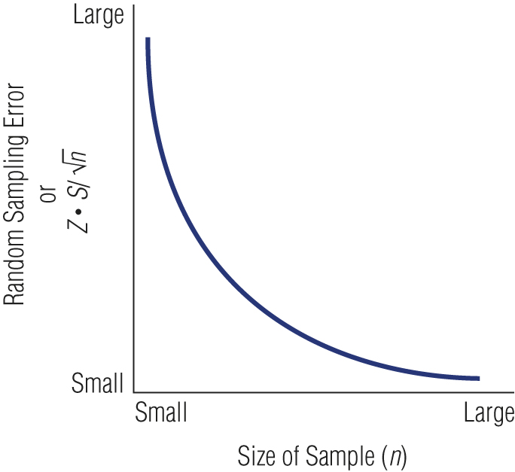
Relationship between Sample Size and Error
mistake

Slide 29
The Sample Size
the sample size is determined based on
  the comparison of sample size to the population size
  the level of homogeneity or uniformity of the population
  the sampling method used
  the level of precision desired
  the purpose of the research
  the availability of budget and time

Slide 30
Factors of Concern in Choosing Sample Size
Variance (or Heterogeneity)
  A heterogeneous population has more variance (a larger standard deviation) which will require a larger sample.
  A homogeneous population has less variance (a smaller standard deviation) which permits a smaller sample.
Magnitude of Error (Confidence Interval)
  How precise must the estimate be?
Confidence Level
  How much error will be tolerated?

Slide 31
Sampling Methods
probability sampling: Selecting sample is based on the consideration of the probability theory
non probability sampling: The sample is selected based on certain considerations, does not use the probability theory approach, and without random
Probability sampling is better to use in selecting sample, but in reality it is often not possible. If so, then non probability sampling can be used as an alternative

Slide 32
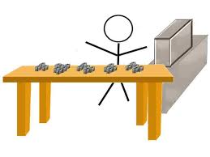
Probability Sampling
Simple random
Systematic
Stratified random
Cluster
Multi-stage

Slide 33
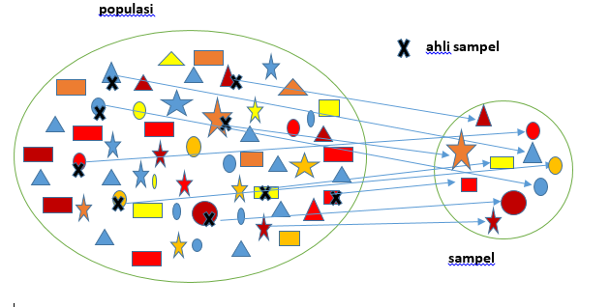
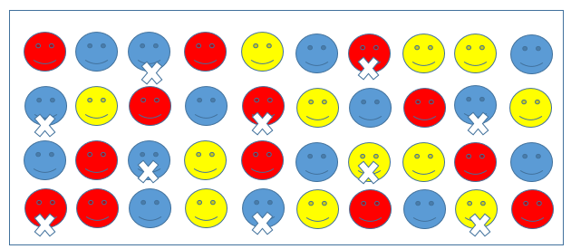
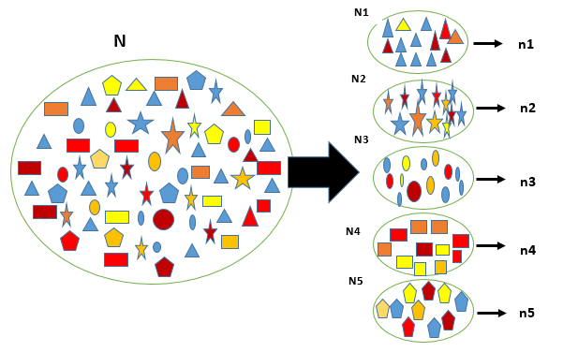
Simple Random Sampling
  Assures each element in the population of an equal chance of being included in the sample.
Systematic Sampling
  A starting point is selected by a random process and then every nth number on the list is selected.
Stratified Sampling
  Simple random subsamples that are more or less equal on some characteristic are drawn from within each stratum of the population.

Slide 34
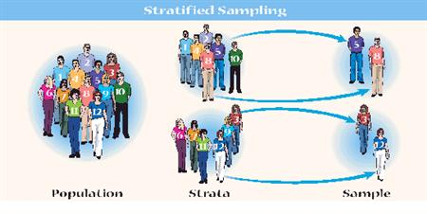
Proportional Stratified Sample
  The number of sampling units drawn from each stratum is in proportion to the population size of that stratum.
Disproportional Stratified Sample
  The sample size for each stratum is allocated according to analytical considerations.

Slide 35
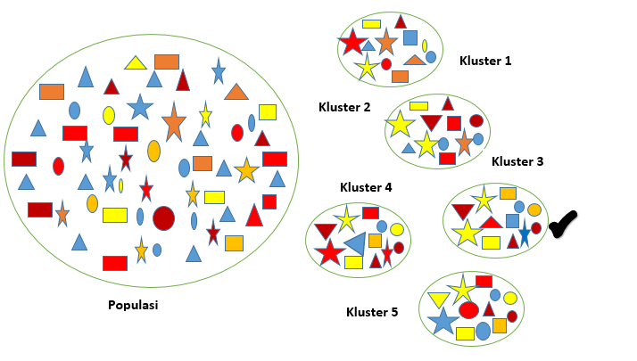
Cluster Sampling
  An economically efficient sampling technique in which the primary sampling unit is not the individual element in the population but a large cluster of elements.
  Clusters are selected randomly.

Slide 36
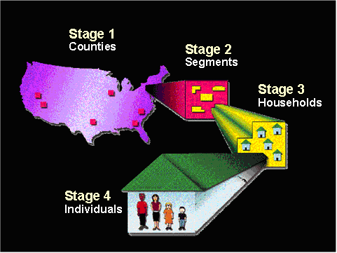
Multistage Area Sampling
  Involves using a combination of two or more probability sampling techniques.
    Typically, geographic areas are randomly selected in progressively smaller (lower-population) units.
    Researchers may take as many steps as necessary to achieve a representative sample.
    Progressively smaller geographic areas are chosen until a single housing unit is selected for interviewing.

Slide 37
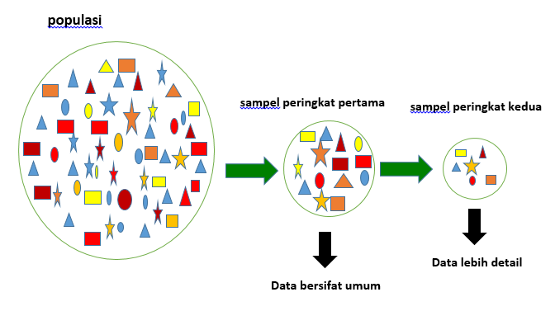
Multiphase Sampling
First phase sampling
Second phase sampling
population
Data in general
Data in detail

Slide 38

Non- Probability Sampling
Accidental Sampling. It is also called as Convenience Sampling, Opportunity Sampling, or Haphazard Sampling
Purposive Sampling
Expert Sampling
Quota sampling: Proportionate Quota Sampling, Non-proportionate Quota Sampling, and Snowball Sampling
Self-selection Sampling

Slide 39
Convenience Sampling
  Obtaining those people or units that are most conveniently available.
Judgment (Purposive) Sampling
  An experienced individual selects the sample based on personal judgment about some appropriate characteristic of the sample member.
Quota Sampling
  Ensures that various subgroups of a population will be represented on pertinent characteristics to the exact extent that the investigator desires.

Slide 40

Snowball Sampling
  A sampling procedure in which initial respondents are selected by probability methods and additional respondents are obtained from information provided by the initial respondents.

Slide 41

Summary of Sampling Methods
Choice of sampling techniques depends upon the research question(s) and their objectives
Factors affecting sample size include:
- confidence needed in the findings
- accuracy required
- likely categories for analysis

Slide 42

Summary of Sampling Methods
Probability sampling requires a sampling frame and can be more time consuming
When a sampling frame is not possible, non- probability sampling is used
Many research projects use a combination of sampling techniques

Slide 43
Data Collecting
Measurement
Validity and Reliability
“how do we know that we are indeed measuring what we want to measure?”
Validity
“can we be sure that if we repeated the measurement we will get the same result?”
Reliability

Slide 44
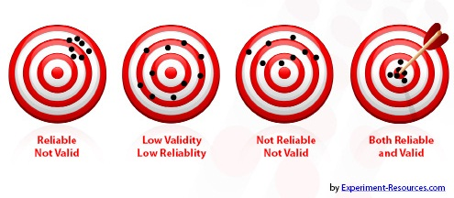
  Reliability
    How consistent it is given the same conditions
    Consistency, stability, or repeatability
  Validity
    If it measures what it is supposed to and how accurate it is
    The correctness or truthfulness of an inference

Slide 45

Validity Test
Validity test is used to determine the level of validity of the instrument (questionnaire) for collecting data
Product Moment Correlation: A statistical tool usually used to test the validity of and instrument (construct validity)
The level of validity is measured by the coefficient of correlation between the scores of each indicator / item questions (Xi) with a total score / factor (X). It can be determined by any computer software; MINITAB, SPSS
Using SPSS: Analyze, Correlate, Bivariate, Variables, Total Variable

Slide 46

What are some ways to improve validity?
Make sure your goals and objectives are clearly defined and operationalized.
Match your assessment measure to your goals and objectives.
Get students involved; have the students look over the assessment for troublesome wording, or other difficulties.
If possible, compare your measure with other measures, or data that may be available.

Slide 47

Types of Reliability
Test-retest reliability (external)
Parallel forms reliability (external)
Inter-rater reliability
Internal consistency reliability
  Average inter-item correlation
  Split-half reliability (external)

Slide 48
Cronbach's alpha
Cronbach's alpha was developed by Cronbach's alpha coefficient (1951) as a general measure of the internal consistency of multi-item scale
Cronbach's alpha is calculated by using the formula :
If cronbach’s alpha > r_{table(α, n-1) ,} considered the instrument reliable
Items which have “corrected item-total correlation” <r_{table(α, n-1)} considered unreliable
Using Cronbach's alpha to test reliability can be performed by SPSS as the following: Analyze, Scale, Reliability Analysis, select items, statistics, descriptive for, item, scale, scale if item deleted, continue, OK

Slide 49

Some Methods To Calculate Internal Reliability Besides Alfa Cronbach
Spearman Brown (split half)
Flanagant
Rulon
KR 20
KR 21
Analyisis of Variance Hyot)

Slide 50

Data Analysis
QUALITATIVE ANALYSIS
STATISTICAL ANALYSIS
QUANTITATIVE ANALYSIS BESIDES STATISTICS

Slide 51
Qualitative Data Analysis
Qualitative data result from the collection of non-standardised data that require classification and are analysed through use of conceptualisation
Qualitative analysis can involve summarising, categorising and structuring data
The process of data analysis and collection are necessarily interactive

Slide 52
Statistical Analysis
Explorative Data Analysis
Confirmative Data Analysis
Searching and disclosure of structure and pattern of existing data,
checking the form and pattern of distribution of data,
revealing the presence of irregularities
Using simple arithmetics and graphs
Finding information about a population based on a sample,
Performing inference or generalization from sample to population
Consideration of strict assumptions
Hypothesis Test

Slide 53
STATISTICAL ANALYSIS
Descriptive Statistics: Part of statistics which is specifically used to describe data; describing visually and measurement
Inductive Statistics: Part of Statistics for taking formal conclusions and generalizing to population based on data sample; classified on Parametric Statistics and Non-Parametric Statistics
Hypothesis Test

Slide 54
Descriptive Statistics
Visually
By measurement
Table: Cross Tabulation, Frequency Tables, etc.
Figure/Picture/ Chart/Graph: Histogram, Bar Chart, Plot Diagram, Box-Plot Diagram, Pie Chart, Run Chart, Control Chart, Time Series graph, Stem and Leaf Diagram
Measures of central tendency or measure of location: mean, median, modus, midrange, midhinge
Measures of dispersion: range, variance, standard deviation, standard deviation, absolute deviation, inter-quartile range
Other measures: proportion, percentages, ratio

Slide 55
Inductive Statistics
Parametric Statistics
Non-Parametric Statistics
Parametric Statistics: based on strict assumptions relating to the characteristics of the population from which data were obtained
Such assumptions: normal distribution, independent, homogenous variance
Usually used interval and ratio scale of measurement
Suitable for natural science
Non-Parametric Statistics: The assumptions are not so strict , the assumption is usually required only symmetry
Can be used for an ordinal, interval, and ratio scale of measurement
Suitable social sciences which are sometimes the data are difficult to be quantified

Slide 56
Hypothesis Test
Testing the magnitude of a population mean using Z –test
Testing the magnitude of a population mean using t-test
Testing the magnitude of the difference of two population mean using Z-test
Testing the magnitude of the difference of two population means using t-test
Testing the magnitude of a population variance using χ2 test
Testing the magnitude of the ratio of two population variances using F-test
Testing the differences of several population means using F-test (Analysis of Variances )

Slide 57
In general, statistical parametric and non-parametric statistics have equivalent analytical tools that can be used for the same purpose
The Pair of Data Analysis Tools of Parametric and Non Parametric Statistics
Hypothesis | Parametric | Non Parametric
One sample or paired samples | Z-test or t-test | Sign test or Wilcoxon sign test
Two independent samples | Z-test or t-test | Mann-Whitney-(Wilcoxon) test
Many independent samples | F-test (ANOVA) | Kruskal Wallis test or Friedmen test
The parameters of location or dispersion of two independent samples | F-test | Siegel Tukey test
Association or Correlation Analysis | Pearson Correlation or χ2 test or F-test | Spearman Correlation or Tau Kendall Correlation

Slide 58
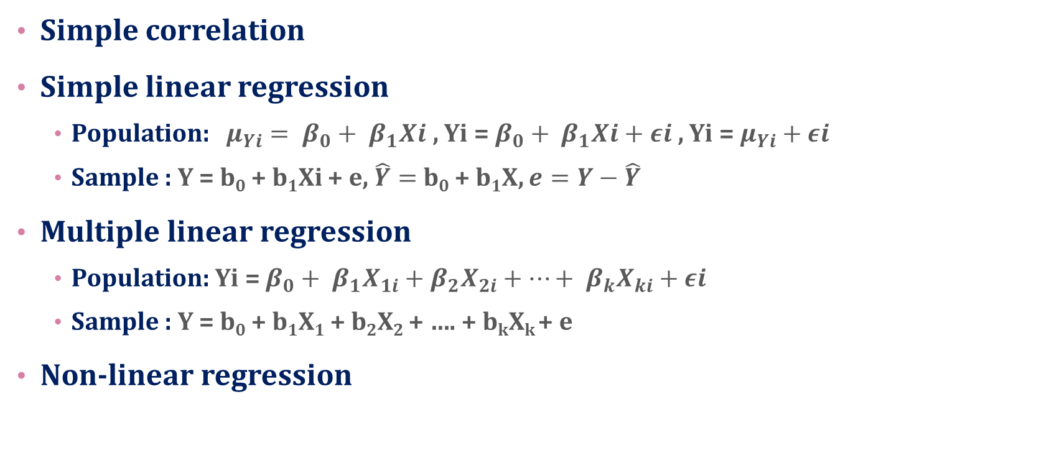
ESTIMATING RELATIONSHIP
AMONG VARIABLES
Simple correlation
Simple linear regression
  Population: $μ_{Yi}= β_{0}+ β_{1}Xi$ , Yi = $β_{0}+ β_{1}Xi+εi$ , Yi = $μ_{Yi}+$ $εi$
  Sample : Y = b₀ + b₁Xi + e, $\hat{Y}=$b₀ + b₁X, $e=Y−\hat{Y}$
Multiple linear regression
  Population: Yi = $β_{0}+ β_{1}X_{1i}+β_{2}X_{2i}+…+ β_{k}X_{ki}+εi$
  Sample : Y = b₀ + b₁X₁ + b₂X₂ + …. + b_{k}X_{k} + e
Non-linear regression

Slide 59
Test for the measurement
Test for the statistical tools
Test for the hypothesis

Slide 60
Classical Assumption For Regression Analysis
Normality
Homoscedasticity
No Multicollinearity
No Autocorrelation

Slide 61
NORMALITY
In general, the normality test is to compare the empirical data (the data we have) to the theoretical data (distributed normally)
Normality test can be done by using:
  histogram
  stem-leaf diagram
  scatter diagram
  box plot diagram
  Lilliefors
  Kolmogorov-Smirnov
  goodness of fit test
  normal P-P Plot (normal Probability Plot)
  Most of the tests can be performed using statistical software such as SPSS, MINITAB, and others

Slide 62
NORMALITY
To test normality by using SPSS:
  ‘Analyze’
  ‘Descriptive Statistics’
  ‘Explore’
  Select the variables to be tested put on ‘dependent variable’
  “Both”
  ‘Histogram’, ‘Stem and Leaf Diagram’,
  ‘Normality plot with test’

Slide 63
Homoscedasticity
The use of regression analysis should be based on BLUE (best linear unbiased estimator)
BLUE means:
  the mean of residuals is equal to 0
  has the least variance among all estimators
  has constant variance at every level of each independent variable
  no correlation among residuals
  Homoscedasticity: the variances are equal at any level of every independent variable

Slide 64
Homoscedasticity
If heteroscedasticity occurs, an estimation would be inefficient and unreliable, the variance of residual will affect the variance of regression and would affect the test results of the regression coefficients both t-test and F-test
There are many methods to test the heteroscedasticity:
  Plot diagram
  Goldfeld-Quandt Test
  Breusch-Pagan Test
  Park Test
  Glejser Testt
  Spearman’s Rank Correlation Test
  Breusch-Pagan-Godfrey Test
  White’s General Heteroscedasticity Test,
  Koenker-Basset Test

Slide 65
Homoscedasticity
  Plot diagram, Park Test, Glejser test, and Spearman Correlations are more frequently used to test the heteroscedasticity and can be done by SPSS
  The simplest way to test heteroscedasticity is by using diagram plot between the standardized predicted value of dependent variable and standardized residual
  By SPSS, the standardized predicted value of dependent variable is written as ZPRED and the standardized residual is written as ZRESID.
  To get the diagram plot between ZPRED and ZRESID by SPSS:
    ‘ ‘regression’, ‘linear’, dependent variable , independet variable(s) ‘plot’, put ZRESID on Y-axis and ZPRED on axis-X

Slide 66
Heteroscedasticity
No heteroscedasticity
Heteroscedasticity

Slide 67
  Spearman’s Rank Correlation Test:
The indicator used to ensure the presence of heteroscedasticity is the magnitude of the correlation coefficient between each independent variable to the absolute value of the residuals.
High correlation coefficients indicate heteroscedasticity
SPSS can be used to test the heteroscedasticity with Spearman correlation as follow:
  ‘regression’
  ‘linear’
  ‘save’ (there will be a new variable saved RES_1)
  ‘Abs(RES_1)’ there RES_1 transformed to an absolute value
  ‘analyze’
  ‘correlate’
  ‘bivariate’

Slide 68
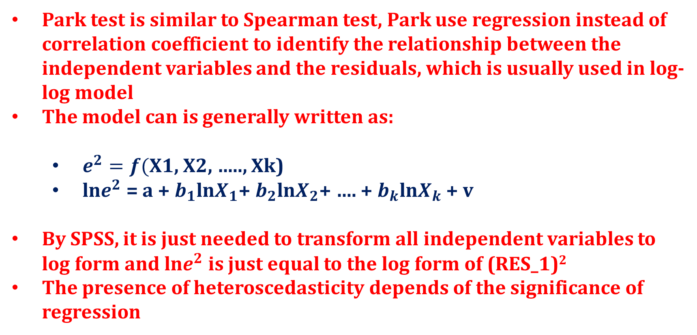
Park test
Park test is similar to Spearman test, Park use regression instead of correlation coefficient to identify the relationship between the independent variables and the residuals, which is usually used in log-log model
The model can is generally written as:
  $e^{2}=f($X1, X2, ….., Xk)
  ln$e^{2}$ = a + $b_{1}$ln$X_{1}$+ $b_{2}$ln$X_{2}$+ …. + $b_{k}$ln$X_{k}$ + v
By SPSS, it is just needed to transform all independent variables to log form and ln$e^{2}$ is just equal to the log form of (RES_1)²
The presence of heteroscedasticity depends of the significance of regression

Slide 69
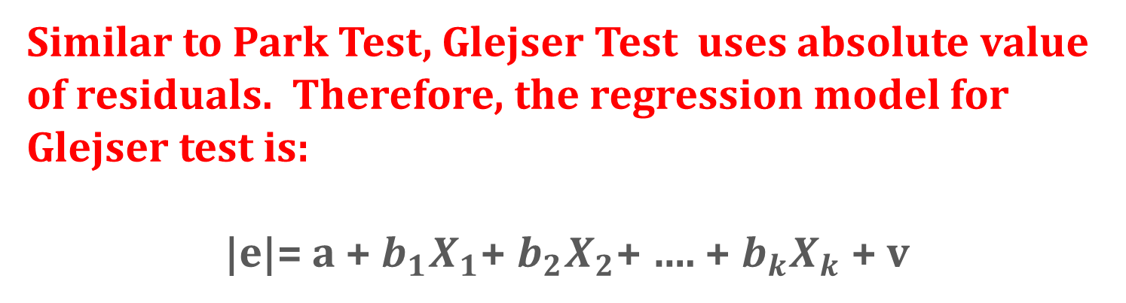
Glejser Test
Similar to Park Test, Glejser Test uses absolute value of residuals. Therefore, the regression model for Glejser test is:
|e|= a + $b_{1}X_{1}$+ $b_{2}X_{2}$+ …. + $b_{k}X_{k}$ + v

Slide 70
Multicollinearity
Multicollinearity is the presence of perfect linear correlation or very high correlation among the independent variables which cause the regression coefficients are no longer shows the real effect of the independent variables in the model, so that the test results will not be accurate beause the variance the regression will be very high
As a result, the tests performed on each of the regression coefficients will tend to be no significant because the standard deviation of the regression coefficient will be very large, the statistical value of t will be small, so it tends to reject the basic hypothesis (H₀)
That is why if the model is not free from multicollinearity, the coefficient of determination (R²) will be very high, the value of the F statistic will also be very high, but the regression coefficient tends to be no significant because the value of t statistic tends to be very small.

Slide 71
Multicollinearity
Various ways are used to detect multicollinearity. It can be identified by :
  Calculating the correlation coefficient among independent variables,
  Comparing the coefficient of determination of each independent variable (r²) to the coefficient of determination for all independent variables (R²),
    Condition Index (CI)
    Tolerance Value (TOL)
    Eigenvalue
    Variance Inflation Factor (VIF)

Slide 72
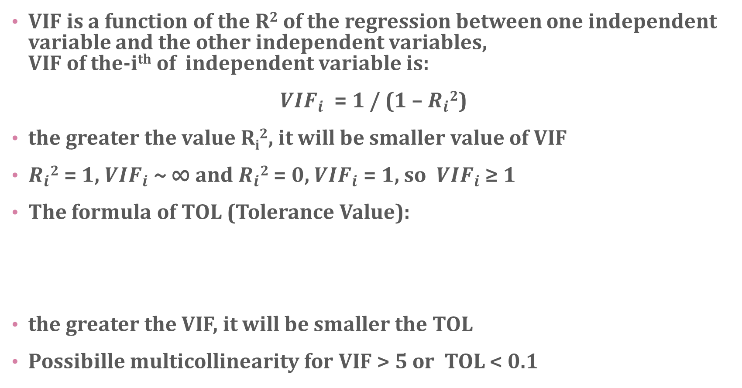
Multicollinearity
VIF is a function of the R² of the regression between one independent variable and the other independent variables,
VIF of the-i^{th} of independent variable is:
${VIF}_{i}$ = 1 / (1 – $R_{i}$²)
the greater the value R_{i}², it will be smaller value of VIF
$R_{i}$² = 1, ${VIF}_{i}$~ ∞ and $R_{i}$² = 0, ${VIF}_{i}$= 1, so ${VIF}_{i}$ ≥ 1
The formula of TOL (Tolerance Value):
the greater the VIF, it will be smaller the TOL
Possibille multicollinearity for VIF > 5 or TOL < 0.1

Slide 73
Multicollinearity
Another way to detect multicollinearity problem is by calculating the characteristic value (eigenvalue) of the X'X matrix, where the matrix X is a data matrix of independent variables
eigenvalue symbolized as λ_{i} where λ_{i} > 0 and i is equal to 1,2, ..., p + 1, p is the number of independent variables
multicollinearity level is determined based on the comparison between the λ maximum and the λ minimum expressed as k.
In general,
  k <100, no multicollinearity problem,
  100 ≤ k ≤ 1000, moderate multicollinearity problem
  k> 1000, serious multicollinearity problem

Slide 74
Multicollinearity
Condition Index (CI) is equal to the square root of k
  CI < 10, no multicollinearity problem
  10<CI< 30, moderate multicollinearity problem
  CI> 30.,serious multicollinearity problem
  VIF, TOL, eigenvalue, and CI can be calculated by using statistical software like SPSS
  For SPSS, can be performed as follow:
    ‘analyze’,
    ‘regression’,
    ‘linear’
    after defining variables then
    ‘statistics’
    ‘collinearity diagnostics’ (if needed ‘covariance matrix’)

Slide 75
Autocorrelation
The presence of highly correlated between one observation value and other observation value. Of course for time series data, it can be said that highly correlated between one observation value for a certain time period and the observation value for previous observation
Usually, autocorrelation problem is rare found for cross section data, but it often occurs for the time series data
One way to test the autocorrelation is the Durbin-Waston Test. This test is based on the consideration that the residuals for a certain period in the regression model is influenced by the residual in the previous period, so it can be expressed as
ε_{t} = ρε_{t-1} + a_{t}
ρ which magnitude is -1 <ρ <1, is an indicator of the level of autocorrelation

Slide 76
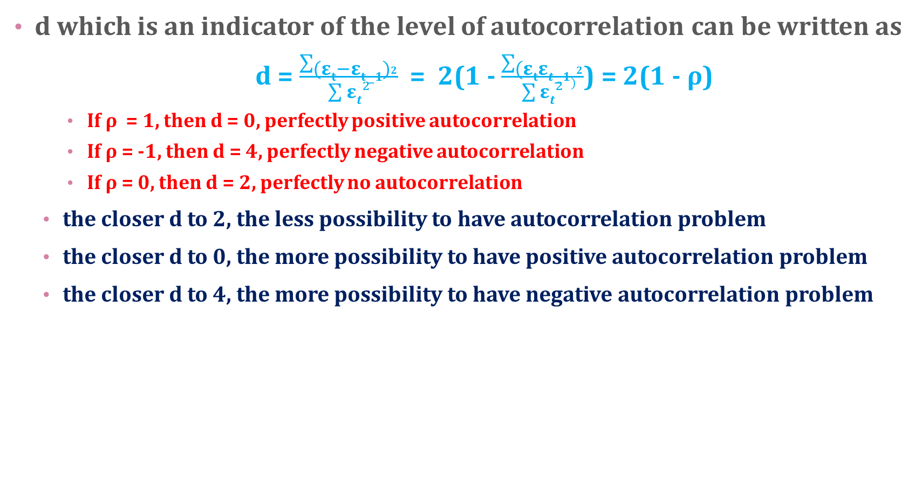
Autocorrelation
d which is an indicator of the level of autocorrelation can be written as
  d = $\frac{\sum{{(εt−εt−1)}^{2}}}{\sum{εt}²}$ = 2(1 - $\frac{\sum{{(εtεt−1)}^{2}}}{\sum{εt}²}$) = 2(1 - ρ)
    If ρ = 1, then d = 0, perfectly positive autocorrelation
    If ρ = -1, then d = 4, perfectly negative autocorrelation
    If ρ = 0, then d = 2, perfectly no autocorrelation
  the closer d to 2, the less possibility to have autocorrelation problem
  the closer d to 0, the more possibility to have positive autocorrelation problem
  the closer d to 4, the more possibility to have negative autocorrelation problem

Slide 77
Autocorrelation
The limit indicating d close to or far from 0, 2, or 4, is determined by using Durbin-Watson table, which shows the value of dL and dU depending of the numbers of variables and observations
  Positive autocorrelation if d <d_{L}
  Can not be concluded if d_{L} <d <d_{U}
  No autocorrelation if d_{U} <d <4 - d_{U}
  Can not be concluded if 4 - d_{U} <d <4 - d_{L}
  Negative autocorrelation if d> 4 – d_{L}
  By using SPSS, it is just needed to click 'Durbin-Watson' on 'statistics' menu after entering the independent variables and the dependent variable

Slide 78
MORE ON ESTIMATING RELATIONSHIP
AMONG VARIABLES
Logistic Regression
Path Analysis
Structural Equation Modeling
Partial Least Square

Slide 79
Logistic Regression
For logistic regression, the data scale dependent variable (Y) is categorical (non-metric), either binary (binary logistic regression) or multinomial (ordinal logistic regression)
In logistic regression, we know namely the concept of odds ratio related to the concept of probability
Logistic regression is part of the regression analysis that is used when the dependent variable (response) is a dichotomous variable (for binary).
Dichotomous variables usually only consists of two values, which represent the appearance or absence of an event that is usually given the number 0 or 1

Slide 80
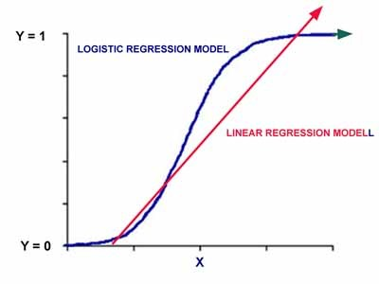
Unlike ordinary linear regression, logistic regression does not assume the relationship between independent and dependent variables is linear. Logistic regression is a non-linear regression models specified which would follow the pattern of the curve as shown below

Slide 81
The model used in the logistic regression is:
Log (p / 1 - p) = β0 + β1X1 + β2X2 + .... + βkXk
Where p is the possibility for Y = 1, and X1, X2, X3 are the independent variables, and βs are regression coefficients.

Slide 82
direct and indirect effect
Direct effect and Indirect effect can be identified by :
  path analysis
  structural equation modeling
  partial least squares

Slide 83

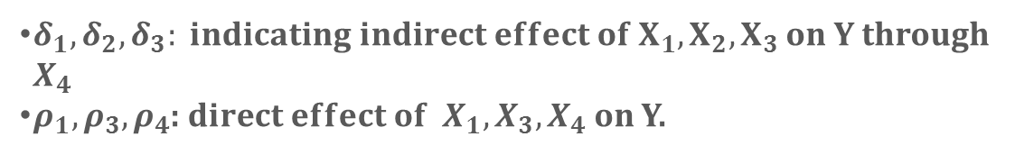




Path Analysis
Path analysis is a technique for analyzing the causal relationship that occurs in multiple regression if the independent variables affect the dependent variable not only directly but also indirectly ". (Robert D. Retherford 1993)
Path analysis is an extension of multiple regression analysis
$$X_{1}$$
$$X_{4}= δ_{0}+δ_{1}X_{1}+ δ_{2}X_{2}+δ_{3}X_{3}+ ∈$$
$$Y= ρ_{0}+ρ_{1}X_{1}+ρ_{3}{ X}_{3}+ρ_{4} X_{4}+ε$$
$$X_{2}$$
$$X_{4}$$
Y
$δ_{1}, δ_{2}, δ_{3}: indicating indirect effect of X_{1}, X_{2}, X_{3}$ on Y through $X_{4}$
$ρ_{1}, ρ_{3}, ρ_{4}$: $direct effect of { X}_{1}, X_{3}, X_{4}$on Y.
$$X_{3}$$

Slide 84
Structural Equation Modeling
Structural equation modeling (SEM)
  A very general, chiefly linear, chiefly cross-sectional statistical modeling technique
    factor analysis
    path analysis and
    regression
SEM is a largely confirmatory rather than exploratory technique
  A researcher are more likely to use SEM to determine whether a certain model is valid rather than using SEM to "find" a suitable model
  Although SEM analyses often involve a certain exploratory element

Slide 85
A structural equation model implies a structure of the covariance matrix of the measures
hence an alternative name for this field, "analysis of covariance structures"

Slide 86
Partial Least Square (PLS)
PLS is an alternative method of settlement of a complex multilevel models that do not require a big size samples
PLS regression is particularly useful when we need to predict a set of dependent variables from a (very) large set of independent variables (predictors)
In addition there are also some advantages, namely PLS which will have implications for the optimal prediction accuracy
PLS method is a powerful method of analysis because it does not assume a scale of measurement data and can also be used to confirm the theory

Slide 87
PLS regression is a recent technique that generalizes and combines features from principal component analysis and multiple regression.
Its goal is to predict or analyze a set of dependent variables from a set of independent variables or predictors.
This prediction is achieved by extracting from the predictors a set of orthogonal factors called latent variables which have the best predictive power.
Some programs are designed to complete the PLS is SmartPLS, PLSGraph, VPLS or PLS-GUI.

