Slide 1
Research Process
Research Problem, Research Questions, Research Objectives
Literature Review, Theory, Variable, Theoretical Framework, Hypothesis
Research Design
Zulkarnain Lubis

Slide 2

Research is….
the application of the scientific method in searching for the truth
a systematized effort to gain new knowledge

Slide 3

The scientific method:
A set of prescribed procedures for establishing and connecting theoretical statements about event, for analyzing empirical evidence, and for predicting events yet unknown; techniques or procedures used to analyze empirical evidence in an attempt to confirm or disprove prior conceptions

Slide 4

The Scientific Method
One of the research keywords
Used for all kinds of research, social sciences, physical sciences, natural sciences, and so on
The way researchers go about using knowledge and evidence to reach objective conclusions about the real world
The characteristics scientific method: rational, empirical, systematic
The scientific criteria: facts, free of prejudice, the principles of analysis, hypothesis, objective measures, quantification technique

Slide 5
RESEARCH PROCESS
Identify and Define Research Problem
Theory / Practice
Hypotheses / Conceptualization
Research Design
Data collection
Data Analysis
Findings

Slide 6
Research Process
Formulate and identify problems
Conducting literature study
Formulate concepts, hypotheses, and variables
Determining the model and hypothesis testing
Preparing for data collection
Collecting the data
Compile, analyze, and interpret data
Making generalizations and conclusions
Making research report

Slide 7

OVERVIEW OF RESEARCH PROCESS
Preliminary
Data
Gathering
Identifying
Research Problem
Research Questions
&
Research Objectives
Literature
Review
What are the symptoms or
indicators
Analysis
And
findings
Develop
Theoretical/Research
Framework
Research
Design
Hypothesis
development
Method
Sampling
Unit of analysis
Data collection method
Development of hypothesis

Slide 8
IN CONDUCTING RESEARCH :
What to Do
PS, RO, RQ, Scope
Why to Do
Background, Significance
How to Do
Research Design
Theories (concept, construct, preposition), Theoretical Framework

Slide 9
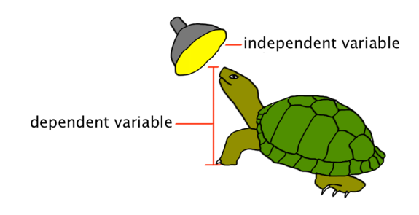
Types of Research
Exploratory: Conducted to clarify ambiguous situations or discover ideas
Descriptive: describe characteristics of objects, people, groups, organizations, or environments, tries to “paint a picture” og a given situation
Causal: Allow causal inferences to be made; seeks to identify cause-and-effect relationships

Slide 10
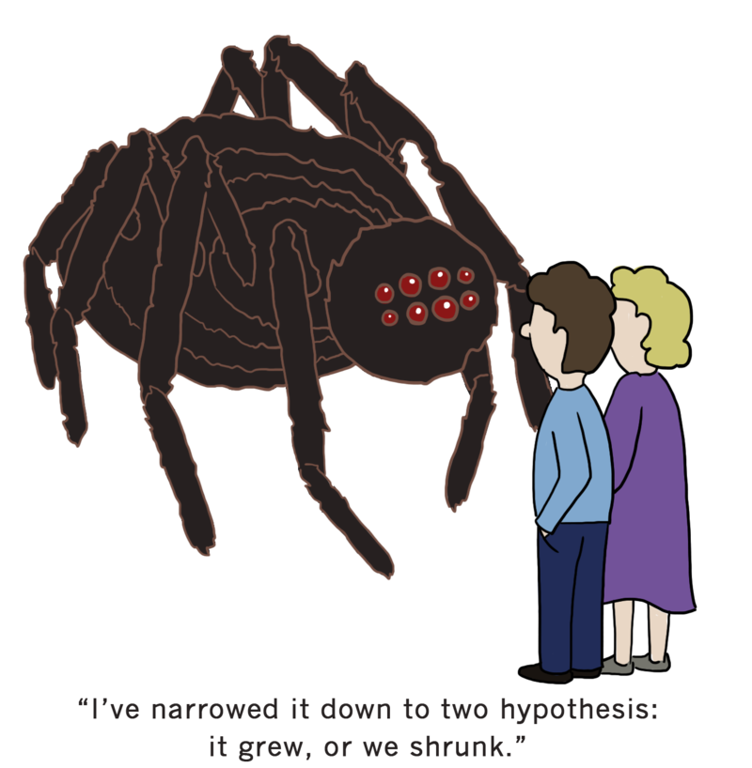
Exploratory Research
Conducted to clarify ambiguous situations or discover ideas that may be potential business opportunities.
Initial research conducted to clarify and define the nature of a problem.
Does not provide conclusive evidence
Subsequent research expected

Slide 11
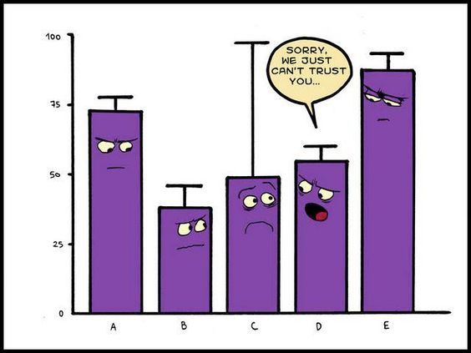
Descriptive Research
Describes characteristics of objects, people, groups, organizations, or environments.
Addresses who, what, when, where, why, and how questions.
Considerable understanding of the nature of the problem exists.
Does not provide direct evidence of causality.
Diagnostic analysis
Seeks to diagnose reasons for market outcomes and focuses specifically on the beliefs and feelings consumers have about and toward competing products.

Slide 12
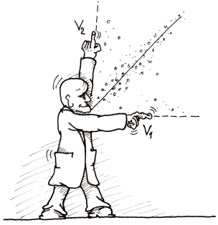
Causality
Causal inference: a conclusion that when one thing happens, another specific thing will follow
Three critical pieces of causal inference:
Temporary sequence: deals with the time order of events; the cause must occur before the effect
Concomitant variance: occurs when two events “covary” or “corelate”, meaning they vary systematically
Nonspurious association: any covariation between a cause and an effect is true and not simply due to some other variables
Causal research should do all the following:
Establish the appropriate causal order or sequence of events
Measure the concomitant variation between the presumed cause and the presumed effect
Examine the possibility of spuriousness by considering the presence of alternative plausible causal factors

Slide 13

Research Problem, Research Question, and Research Objective

Slide 14

(Research) Problem :
The problem is the gap between what should be and what is in reality, or between what is necessary and what is available, or between the expectation and the reality, or between what theoretically should be and what happens in practice,, or between the rule and the reality
A problem requires research to find a solution, although not all problems require research, however, a research conducted due to the problem.
So, someone who will do the research must first determine what the problem is

Slide 15

The research problem should be:
useful to be disclosed
RELEVANT to the ability or expertise of researchers.
ATTRACTING attention to be disclosed
possibly PRODUCING something new
ensured that data could be collected completely and objectively
NOT TOO WIDE, but also not too narrow

Slide 16

Defining a research problem allows for the formulation of a research question to be answered or hypothesis to be tested
Statement of the problem provides the focus and direction of the study
Recall that a problem can be something to be explained, to be further understood or to be addressed.
A good statement of the problem clearly defines the problem, states the concepts to be related in the study and identifies a feasible solution to the problem.
By clearly stating the concepts to be related, a well-written problem statement helps to identify the variables to be investigated in the study.

Slide 17

Research Question
Express the research objectives in terms of questions that can be addressed by research
Help to develop well-formulated, specific hypotheses that can be empirically tested
Help the researcher design a study that will produce useful results
The researcher’s translation of the problem into a specific inquiry
Provide input that can be used as a standard for selecting from among alternative solutions

Slide 18

Research Question
A research Question is clear, focused and arguable question around which you plan to center your research
A research question is associated with the problem statement and can be answered directly through the analysis of data
A research question has not yet been answered satisfactorily (literature review !!)
The answer would contribute to science and/or society

Slide 19

Research Questions : A statement that identifies the phenomenon to be studied
Provide focus for your research
Provides reason for your review to explore a range of answers
In order to ensure that a research question is practical and useful, we need to make sure that it clearly identifies
the people, the group of people to be studied
the options, the choices or options that should be compared
the outcomes from those options.

Slide 20

Research Objectives
Research objectives are the deliverables of the research project
Research Questions and Research Objectives
RQ: Identify the questions whose answers will guide solving the problem.
RO: Identify the goals associated with each of the research questions.
Research Objectives should be clear and achievable

Slide 21

Research Objectives
Research objectives outline the specific goals the study plans to achieve when completed.
The research objectives are usually divided into:
General objective/broad objective or overall objective
Specific objectives
The general (broad) objective or goal and specific objectives are not the same and should be dealt with separately
The general objective is a goal that the project hopes to achieve
The specific objective is a specific result that the project aims to achieve within a given time frame

Slide 22
Turning ideas into research projects: Include SMART Personal objectives
Specific: What precisely do you hope to achieve from undertaking the research?
Measurable: What measures will you use to determine whether you have achieved your objectives?(Secured a career-level first job in software design)
Achievable: Are the targets you have set for yourself achievable given all the possible constraints?
Realistic: Given all other demands upon your time, will you have the time and energy to complete the research on time?
Timely: Will you have time to accomplish all your objectives?

Slide 23



Research objectives are usually classified into general objectives and specific objectives.
General objective:
summarizes what is to be achieved by the study
should be clearly related to the statement of the problem
Specific objectives:
logically connected parts of the general objective
use action verbs such as: determine, verify, identify, describe, assess, compare, calculate, establish, explore
Literature Review

Slide 24

What is the Literature?
The "literature" should be written by scientists and researchers for scientists and researchers
They may include:
Academic, scholarly journal articles
Books
Conference Proceedings
Dissertations
Patents
Standards
Technical Reports
Websites and other Internet Resources

Slide 25
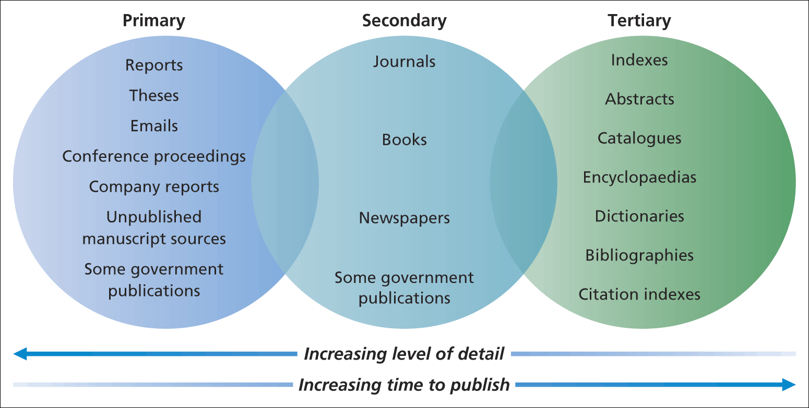
Literature Sources Available

Slide 26

What is a Literature Review?
A critical, analytical summary and synthesis of the current knowledge of a topic
Compare and relate different theories and findings
Should have a focus/theme to organize the review
Does not need to be exhaustive but should cover significant, academic literature

Slide 27

Reasons for reviewing the literature
To conduct a ‘preliminary’ search of existing material
To organise valuable ideas and findings
To identify other research that may be in progress
To generate research ideas
To develop a critical perspective

Slide 28
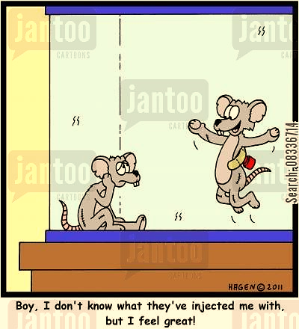
Approaches to critical review
Deductive approach – using literature to identify theories and ideas that you will test using data
Inductive approach – to explore your data and to develop theories from them that you will relate to the literature

Slide 29

Deductive Approaches
Develop Theory
Formulate Hypothesis
Collect & analyze data
Accept/Reject
Hypothesis

Slide 30

Inductive Approaches
Theory
Tentative Hypothesis
Pattern
Observation

Slide 31

Theory

Slide 32
THEORY
A set of interrelated constructs (concepts), definitions, and propositions that presents a systematic view of phenomena by specifying relations among variables, with the purpose of explaining and predicting the phenomena
It is a statement of relationship between two variables, one acting as the independent variable, another as the dependent variable
Theory is developed by which to explain and predict complex events, objects or phenomena. An explanation establishes the substantive meaning of constructs, variables, and their linkages, while a prediction tests that substantive meaning by comparing it to empirical evidence

Slide 33

Theories
Descriptive theories “describe or classify specific dimensions or characteristics of individuals, groups, situations, or events by summarizing the commonalities found in discrete observations
Explanatory theories “specify relations among the dimensions or characteristics of individuals, groups, situations, or events Explanatory theories are tested by using correlational research
Predictive theories are intended to predict “precise relationships between the dimensions or characteristics of a phenomenon or differences between groups

Slide 34
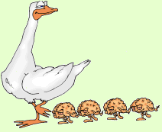
To describe a particular phenomenon
descriptive research studies
To explain relationships between or among phenomena
correlational research
To predict how one phenomenon affects another
Experimental or quasi-experimental research designs

Slide 35
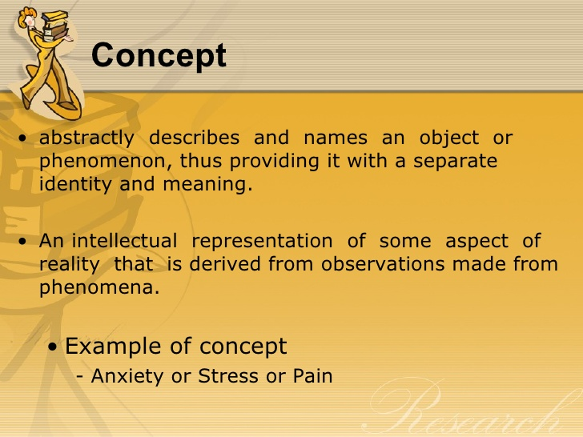


Slide 36
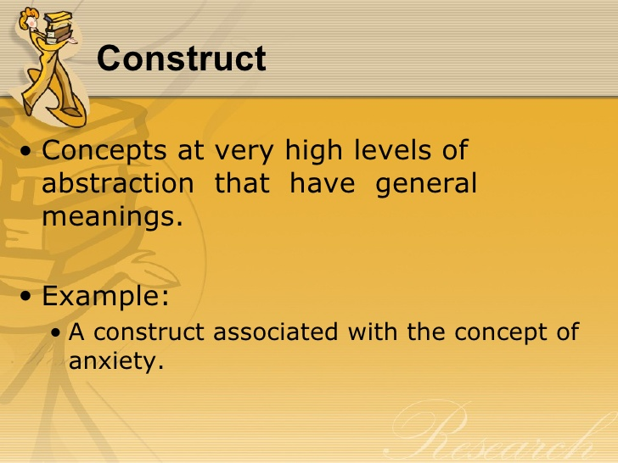


Slide 37
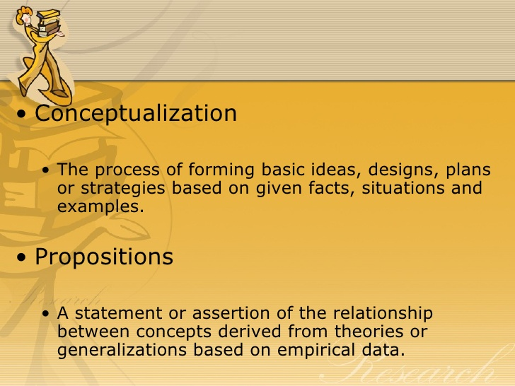


Slide 38
Process of Hypothesis Generation
Theory
Concept
Concept
Concept
Proposition
Proposition
Hypothesis
Hypotheses should express relationships between variables in an unambiguous, precise manner, and they should be based on the propositions that evolved from the theoretical framework

Slide 39

Theoretical Framework

Slide 40
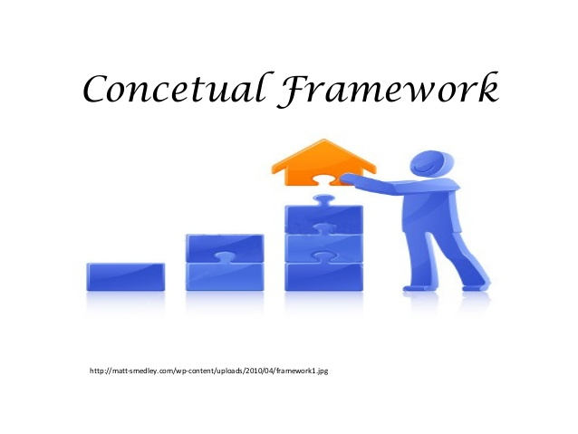
Theoretical Framework
A theoretical framework is a conceptual model of how one theorizes or makes logical sense of the relationships among the several factors that have been identified as important to the problem
Theoretical / conceptual framework – using material from the Literature Review, produce the working definition of the main concepts you will use in your study.
Integrating your logical beliefs with published research, taking into consideration the boundaries and constrains governing the situation
The theoretical framework discusses the interrelationships among the variables that are deemed to be integral to the dynamics of the situation being investigated

Slide 41
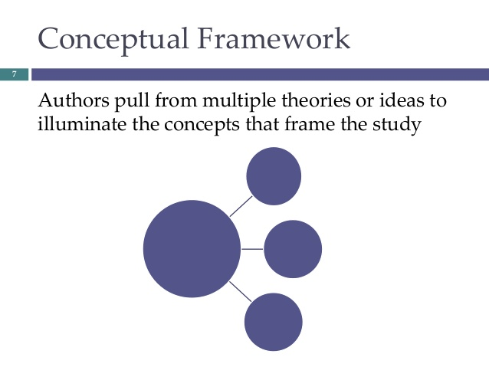
Schematic diagram which able to help in deciding and explaining the route that we are interested to take.
From the theoretical framework,
a conceptual framework can be developed,
variables can be identified, and
hypotheses to be tested can be constructed
The theoretical framework provides a general representation of relationships between things in a given phenomenon, on the other hand, The conceptual framework, embodies the specific direction by which the research will have to be undertaken

Slide 42
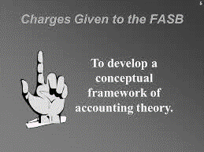
Statistically speaking, the conceptual framework describes the relationship between specific variables identified in the study. It also outlines the input, process and output of the whole investigation.
The conceptual framework is used in research to outline possible courses of action or to present a preferred approach to an idea or thought. The conceptual framework is also called the research paradigm.

Slide 43
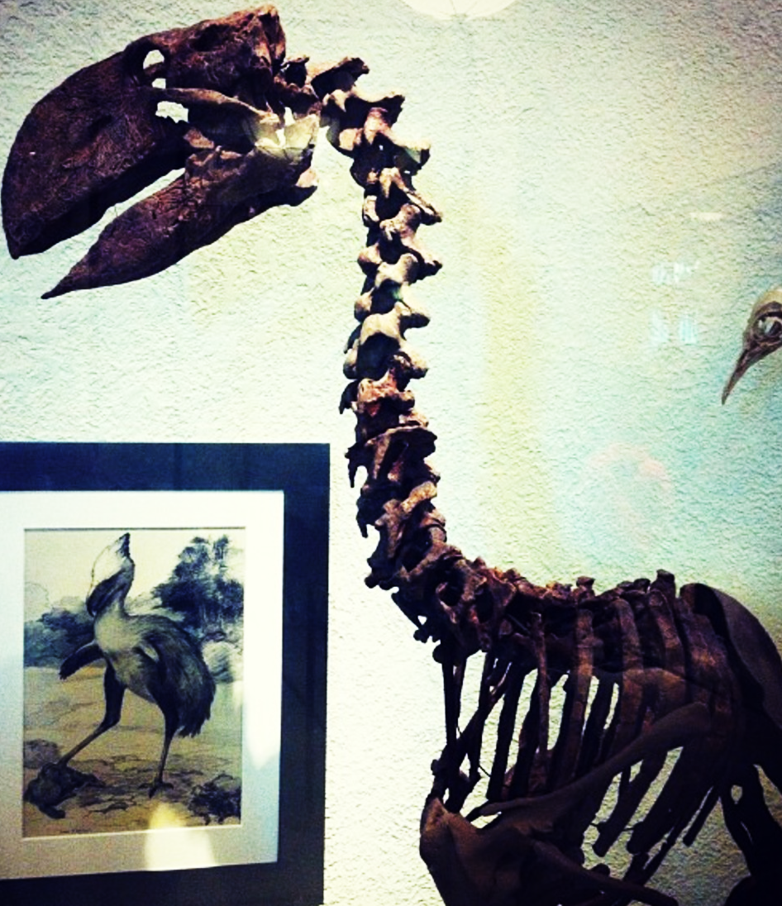
Functions of theoretical framework
It provides the general framework which can guide the data analysis
It identifies the variables to be measured
It explains why one variable can possibly affect another or why the independent variable can possibly influence the dependent variable
It limits the scope of data relevant to the framework by focusing on specific variables
It stipulates…..in analyzing and interpreting data

Slide 44
THEORETICAL FRAMEWORK (Extended)
Usefulness
Ease of use
Playfulness
Compatibility
Attitude Towards Internet Abuse
Organizational Outcomes
Work Inefficiency
Security Threats
Internet Abuse
Peer culture
Supervisor culture
Family culture
Mass media
Subjective Norm
Psychological Outcomes
Depression
Loneliness
Demographics
Age
Gender
Internet Experience
Self efficacy
Facilitating conditions
Workplace privacy
Electronic monitoring
Internet policy
Perceived Behavior Control
Moderating Variables
Antecedents
Independent Variables
Dependent Variable
Outcome
Variables

Slide 45
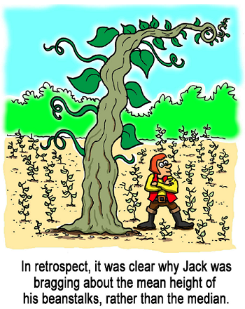
Variable and Hypothesis Development

Slide 46
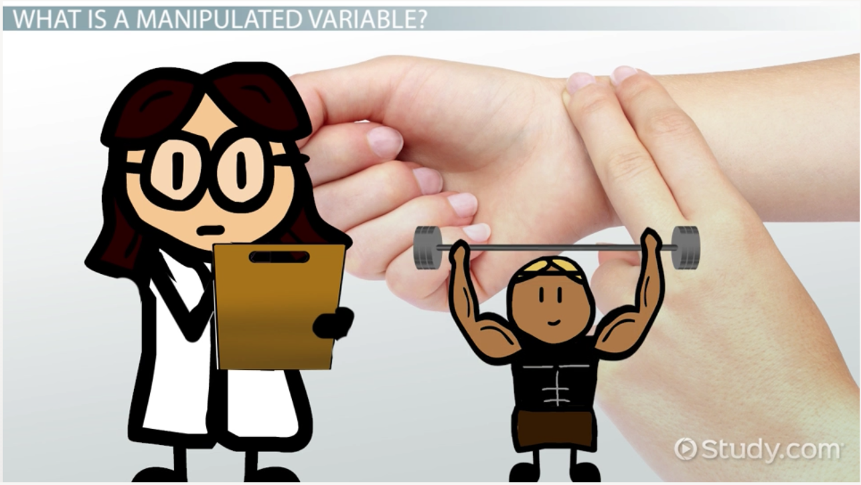
Variable
a characteristic, number, or quantity that increases or decreases over time, or takes different values in different situations.
a measurable characteristic that varies. It may change from group to group, person to person, or even within one person over time.

Slide 47
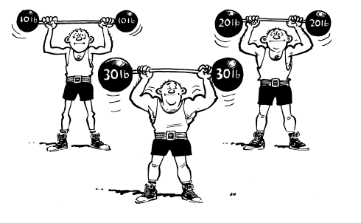
Independent and Dependent Variable
Dependent
Presumed effect
Response
Predicted to..
Consequence
Measured outcome
Independent
Predictor
Presumed cause
Stimulus
Predicted from
Antecedent
Manipulated

Slide 48

Other Types of Variable
Intervening variables
Moderator variables
Control variables
Extraneous variables
Antecedent
Endogenous variable
Exogenous variable
Binary variable
Categorical Variable
Confounding variable
Continuous variable
Control variable
Criterion variable
Dichotomous variable
Discrete variable
Dummy Variables
Interval variable
Latent variable
Manifest variable
Manipulated variable
Mediating variable
Nominal variable
Ordinal variable
Outcome variable
Polychotomous variables
Predictor variable
Treatment variable

Slide 49
Theoretical Framework and Hypothesis
Literature Review
Theory
Theoretical Framework
Hypothesis
Concept
Construct
Proposition
Variables

Slide 50

What Is Hypothesis?
A statement that shows a relationship between two or more variables in testable form.
A proposition formulated for empirical testing
The hypothesis is the foundation of the research
The development of a hypothesis is the first step in designing and conducting research
The hypothesis should be clear, specific, and testable (or researchable)
The hypothesis is the link between the theory and the research, that leads us to new discoveries

Slide 51

How Do We Derive Hypotheses?
From own dreams?
From own observations?
From other research?
From other hypothesis?
From literature review?
From theoretical framework?
If it is from own observation, supported by other research, supported by other hypothesis, supported by other literature review, and supported by YOUR OWN theoretical framework.
Therefore :
Ideally you should expect that the hypotheses to be accepted not rejected… aren’t you?

Slide 52
Hypothesis Development
Hypothesis is :
A statement logically formed an opinion on the basis of relationships between two or more variables.
An opinion is made on the basis of theoretical network.
A statement that shows a relationship between two or more variables in testable form.
A proposition formulated for empirical testing
a prediction for the outcome of an experiment
Explains facts and guides the research to possible outcomes

Slide 53
Hypothesis’ Format
If-then statement
If the employees are more healthy, then they will take sick leave less frequently.
Directional
The greater the stress experienced in the job, the lower the job satisfaction.
Non directional
There is a relationship between age and job satisfaction

Slide 54
Directional and Non-directional Hypotheses
If, in stating the relationship between two variables or comparing two groups, terms such as positive, negative, more than, less than, and the like are used, then these hypotheses are directional because the direction of the relationship between the variables is indicated.
Example:
The greater the stress experienced in the job, the lower the job satisfaction of employee
Women are more motivated than men

Slide 55
Directional and Non-directional Hypotheses
Non-directional hypotheses are formulated either because the relationships or differences have never been previously explored and hence there is no basis for indicating the direction, or because there have been conflicting findings in previous research studies on the variable.
Example:
There is a relationship between age and job satisfaction.
There is a difference between the work ethic values of American and Asian employees.

