Slide 1

Sampling METHODS
Zulkarnain Lubis

Slide 2

Population, Sample And Individual Cases
population
sample

Slide 3
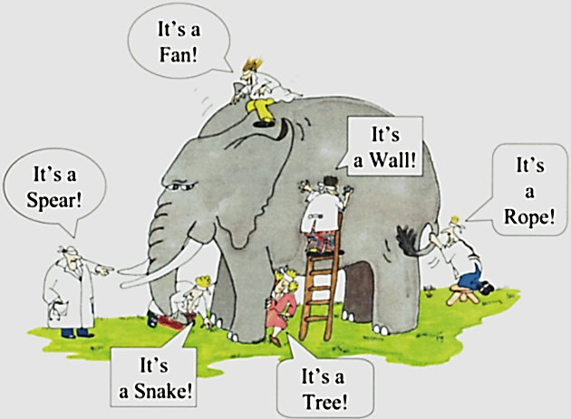
The Need To Sample
Sampling- a valid alternative to a census when
A survey of the entire population is impracticable
Budget constraints restrict data collection
Time constraints restrict data collection
Results from data collection are needed quickly

Slide 4

When the sample is representative ?
The size of the sample
The sampling methods

Slide 5

Sample Size
Random Error and Sample Size
  Random sampling error varies with samples of different sizes.
  Increases in sample size reduce sampling error at a decreasing rate.
    Diminishing returns - random sampling error is inversely proportional to the square root of n.

Slide 6
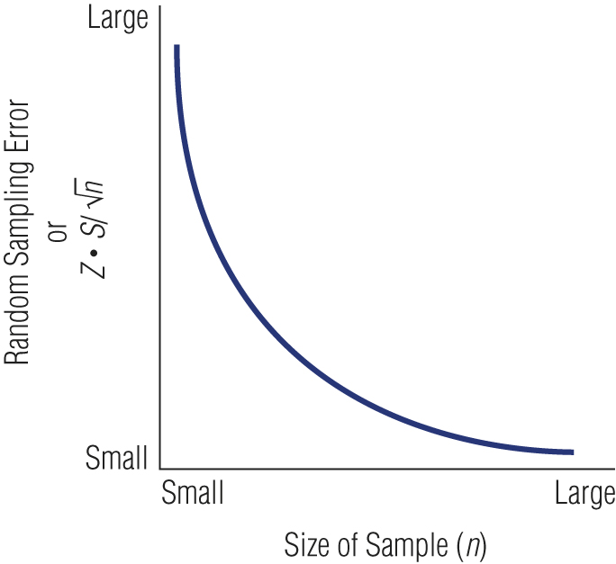
Relationship between Sample Size and Error
mistake

Slide 7


The Sample Size
The Sample Size Is Determined Based On :
  The Comparison Of Sample Size To The Population Size
  The Level Of Homogeneity Or Uniformity Of The Population
  The Sampling Method Used
  The Level Of Precision Desired
  The Purpose Of The Research
  The Availability Of Budget And Time

Slide 8
Factors Of Concern In Choosing Sample Size
Variance (Or Heterogeneity)
  A heterogeneous population has more variance (A larger standard deviation) which will require A larger sample.
  A homogeneous population has less variance (a smaller standard deviation) which permits a smaller sample.
Magnitude Of Error (Confidence Interval)
  How precise must the estimate be?
Confidence Level
  How much error will be tolerated?

Slide 9
Sampling Methods
Probability sampling: selecting sample is based on the consideration of the probability theory
Non probability sampling: the sample is selected based on certain considerations, does not use the probability theory approach, and without random
Probability sampling is better to use in selecting sample, but in reality it is often not possible. If so, then non probability sampling can be used as an alternative

Slide 10

Probability Sampling
Simple random
Systematic
Stratified random
Cluster
Multi-stage

Slide 11
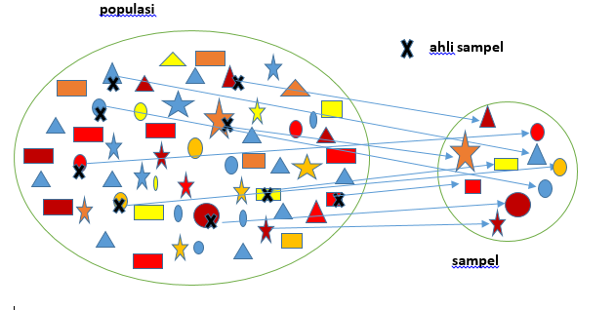
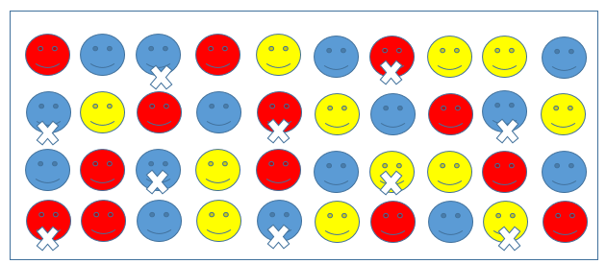
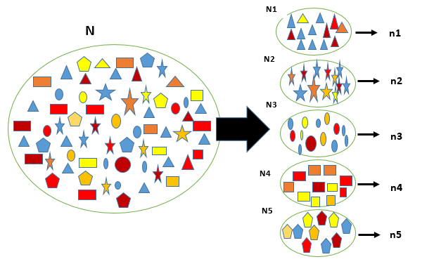
Simple Random Sampling
  Assures each element in the population of an equal chance of being included in the sample.
Systematic Sampling
  A starting point is selected by a random process and then every nth number on the list is selected.
Stratified Sampling
  Simple random subsamples that are more or less equal on some characteristic are drawn from within each stratum of the population.

Slide 12
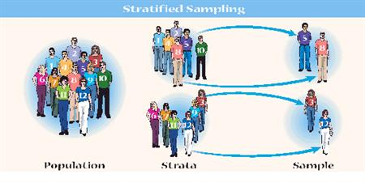




Proportional Stratified Sample
  The number of sampling units drawn from each stratum is in proportion to the population size of that stratum.
Disproportional Stratified Sample
  The sample size for each stratum is allocated according to analytical considerations.

Slide 13
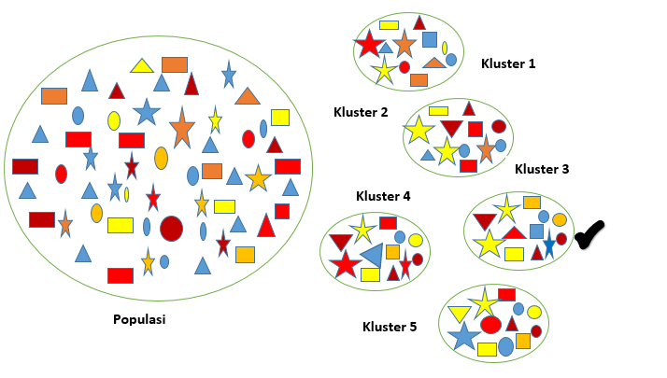
Cluster Sampling
  An economically efficient sampling technique in which the primary sampling unit is not the individual element in the population but a large cluster of elements.
  Clusters are selected randomly.

Slide 14
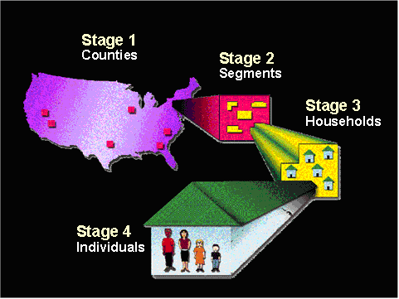
Multistage Area Sampling
  Involves using a combination of two or more probability sampling techniques.
    Typically, geographic areas are randomly selected in progressively smaller (lower-population) units.
    Researchers may take as many steps as necessary to achieve a representative sample.
    Progressively smaller geographic areas are chosen until a single housing unit is selected for interviewing.

Slide 15

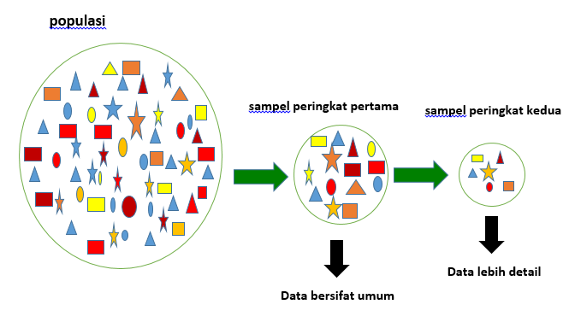
Multiphase Sampling
First phase sampling
Second phase sampling
population
Data in general
Data in detail

Slide 16

Non Probability Sampling
Accidental Sampling. It is also called as Convenience Sampling, Opportunity Sampling, or Haphazard Sampling
Purposive Sampling
Expert Sampling
Quota sampling: proportionate Quota Sampling, Non-proportionate Quota Sampling, and Snowball Sampling
Self-selection Sampling

Slide 17

Convenience Sampling
  Obtaining those people or units that are most conveniently available.
Judgment (Purposive) Sampling
  An experienced individual selects the sample based on personal judgment about some appropriate characteristic of the sample member.
Quota Sampling
  Ensures that various subgroups of a population will be represented on pertinent characteristics to the exact extent that the investigator desires.

Slide 18

Expert Sampling
The data collected are the opinion or point of view of some people related to their knowledge, expertise, and experience in accordance to research topic.
Sometime, used to accomplish the data taken by other sampling methods
Needed to determine the categories of samples as expertise, knowledgeable, and experienced.

Slide 19
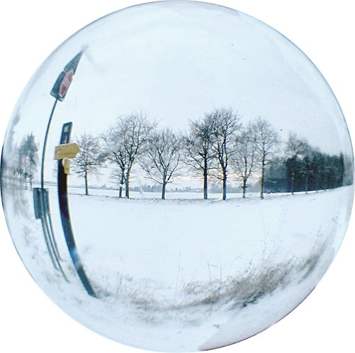
Snowball Sampling
  A sampling procedure in which initial respondents are selected by probability methods and additional respondents are obtained from information provided by the initial respondents.

Slide 20

Thank You
Zulkarnain Lubis

