Slide 1
EKONOMI MANAGERIAL;
Konsep Produksi
Zulkarnain Lubis

Slide 2

Konsep Dasar Analisis Produksi
Dalam ekonomi manajerial, aktivitas berproduksi merupakan sisi penawaran yg menunjukkan perilaku produsen dalam menawarkan produk di pasar
Aktivitas produksi bukan sekedar transformasi input menjadi output, tetapi penciptaan nilai tambah,sehingga setiap aktivitas harus memberikan nilai tambah (value added) untuk menghindari pemborosan (wasting)

Slide 3
Produksi: Suatu aktivitas dalam perusahaan industri berupa penciptaan nilai tambah dari input menjadi output secara efektif dan efisien sehingga produk sbg output dari proses penciptaan nilai tambah itu dapat dijual dengan harga yang kompetitif di pasar global
Sistem produksi

Slide 4

Sistem produksi memiliki karakteristrik :
Komponen2 atau elemen2 yg saling terkait dlm kesatuan yg utuh
Komponen
Tujuan
Aktivitas
Mekanisme
Tujuan untuk menghasilkan barang/jasa bermutu yg dapat dijual dgn harga kompetitif di pasar
Aktivitas, berupa proses transformasi nilai tambah input menjadi output secara efektif dan efisien
Mekanisme yg mengendalikan pengoperasiannya berupa optimalisasi alokasi sumberdaya

Slide 5

Elemen structural dan Elemen fungsional
Elemen struktural : bahan, mesin, peralatan, tenaga kerja, modal, energi, informasi, tanah, dll
Elemen fungsional: suvervisi, perencanaan, pengendalian, koordinasi, kepemimpinan manajemen dan organisasi

Slide 6
Elemen input
Tenaga Kerja
Modal
Material/Bahan
Energi
Tanah
Informasi
Manajerial
Untuk jangka pendek input; input variabel dan input tetap
Input variabel tergantung pada jumlah output
Input tetap penggunaannya tidak terpengaruh dengan jumlah output

Slide 7
Elemen Proses dalam Sistem Produksi
Proses dlm sistem produksi: integrasi sekuensial dari TK, material, info, metode kerja, mesin&peralatan untuk menghasilkan nilai tambah produk agar dapat dijual di pasar
Proses dari setiap sistem produksi memiliki spesifikasi yg berbeda,namun secara umum terdiri dari tiga kategori: tugas-tugas (task), aliran-aliran (flows), dan penyimpanan (storage)
  Tugas merubah karakteristik sedangkan aliran merubah posisi dari barang/jasa
  Aliran terdiri dari aliran material dan aliran info
  Penyimpanan, jika tidak ada tugas dan tidak ada aliran
Aliran material dan penyimpanan sering jadi wasting

Slide 8

Elemen Output dalam Produksi
Pengukuran karakteristik output (barang/jasa) yang biasa disebut sebagai produk seyogianya mengacu mengacu kepada kebutuhan dan keinginan konsumen
Beberapa pengukuran pada tingkat output sistem produksi yg relevan dipertimbangkan adalah :
  kuantitas produksi,
  tingkat efektivitas dari sistem produksi,
  banyaknya produk cacat,
  biaya per satuan produk,
  karakteristik kualitas produk sesuai keinginan konsumen

Slide 9
FAKTOR LINGKUNGAN
Dua hal yang perlu menjadi pertimbangan dalam analisis sistem produksi: kondisi ekonomi dan keadaan teknologi
  Kondisi ekonomi mempengaruhi harga input yng digunakan dan harga output yg dihasilkan, oleh karena itu analisis sistem produksi dilakukan pd kondisi ekonomi tertentu, jika kondisi berubah maka analisispun harus disesuaikan
  Keadaan teknologi akan mempengaruhi perilaku sistem produksi, yaitu meningkatkan produksi rata-rata

Slide 10

Aspek teknologi mencakup :
Yang terkandung pada manusia; pengetahuan, keterampilan, sikap, perilaku, budaya,dll
Yang terkandung dalam barang; mesin, peralatan, produk
Yang terkandung dalam lembaga organisasi dan manajemen
Yang terkandung dalam dokumen berupa info yang dihasilkan manusia; paten, rumus, gambar, buku, majalah, disket, mikrofilm

Slide 11
Company’s Behavior as A Producer
A company is established for the purpose of producing goods and services for sale on the market
A company as a producer:
  Buying resources and organizing them to produce goods and services
  Marketing production
  Taking risks
  Individuals involved in the activities of the company :
    Owners or employers
    Employees
    The company's goal is assumed to maximize profits

Slide 12

Large Image Slide
Konsep Dasar Teori Produksi
Maksimumkan output dengan tingkat penggunaan input tetap tertentu
Memproduksi output pada level tertentu dengan biaya produksi yang paling minimum
JIT: output pada tingkat tertentu sesuai permintaan pasar dengan biaya produksi seminimal mungkin

Slide 13

Jit = just in time
Memproduksi produk yg diperlukan pd tempat dan waktu yg dibutuhkan dlm jumlah sesuai kebutuhan, pd setiap tahap proses dlm sistem produksi, dgn cara yg paling efisien.
Tujuan JIT adalah untuk mengurangi biaya produksi dan meningkatkan produktivitas total industri dgn menghilangkan pemborosan (waste)
Pemborosan:segala aktivitas yg tdk mempunyai/tdk memberikan nilai tambah

Slide 14
7 sumber pemborosan
Kelebihan produksi dari permintaan pasar
Waktu menunggu
Transportasi dalam pabrik/proses produksi
Inventori/penyimpanan
Pergerakan (motion)
Pembuatan produk cacat
Proses produksi yg tdk efektif&efisien

Slide 15
Technical and Economical Efficiency
Technical efficiency: producing the maximum output for any given combination of inputs and existing technology
When the firm is technically efficient, every input is being utilized to the fullest extend possible, and there is no way to get more output without using more of at least one input or reducing the usage of any input will necessarily cause output to fall
Economic efficiency: producing a given level of output at the lowest possible total cost (producing a highest possible level of output at a given total cost ?)
Engineers at most firms focus on ensuring that production takes place in a technically efficient manner, while business managers are not only interested in technical efficiency but also plan to achieve economic efficiency

Slide 16
The reason of managers focus on economic efficiency: profit cannot be maximized unless the firm’s output is produced at the lowest possible total cost
An economically efficient firm must also be technically efficient, however, it is possible to produce in a technically efficient way without achieving economic efficiency
The combination of inputs used that make a firm into technically efficient or economically efficient depend on input prices

Slide 17
Production
In terms of managerial economics, production activity is the supply side which shows the behavior of producers in offering products on the market
Production : the creation of goods and services from inputs
Production activity is not just a transformation of inputs into outputs, but this is the activity in order to create value-added, so that every activity should provide added value to avoid wasting

Slide 18
Production involves services as well as making goods people buy, it is also undertaken by non-profit organizations and governments; education, health care, entertainment, an so on
Inputs or resources or factors of production consisting of raw materials, factories, machineries and other capital equipment, lands, and labors
For the purpose of analysis, the inputs are grouped into material, labor, and capital
Goods and services should be processed effectively and efficiently so that the product as the output of the process of creation of added value can be sold at competitive prices in the global market

Slide 19

Production Function
Production function: a schedule (or table or mathematical equation) showing the maximum amount of output that can be produced from any specified set of inputs, given the existing technology or state of knowledge concerning available production methods
In mathematical terms, the production function can be expressed as
Q = f($X_{1 },X_{2 },$ …….. $X_{n }$)
but for analytical purposes only grouped into material (M). Labor (L), and Capital (K), the production function is usually written as
Q = f(M, L, K)
However, in a simpler case of production function, normally, we will use only two inputs, L and K. Hence, the production function becomes :
Q = f(L, K)

Slide 20
Variable Proportions Production and Fixed Proportions Production
For more production functions, the same output can be produced using different combinations of capital and labor
When input substitution is possible, we call this kind of production, variable proportions production. Variable proportions production can be defined as production in which a given level of output can be produced with more than one combination of inputs
When there is one, and only one, ratio or mix of inputs that can be used to produce a good, it is called as fixed proportions production. Fixed proportions production is production in which one and only one ratio of inputs can be used to produced a good

Slide 21
Short Run and Long Run Production Function
Short run production function:
  The maximum quantity of a good or service that can be produced by a set of inputs, assuming of at least one of the inputs used remains unchanged
  Refers to the current time span during which one or more inputs are fixed inputs and must be paid whether or not any output is produced
  Long run production function:
    The maximum quantity of a good or service that can be produced by a set of inputs, assuming the firm is free to vary the amount of all the inputs being used
    Refers to the time period far enough in the future to allow all fixed inputs to become variable inputs

Slide 22
In the short run at least one input is a fixed input, and in the long run all fixed inputs become variable inputs
The long run planning horizon is the set of all possible short run situations from which the firm may choose to operate in the long run

Slide 23
Inputs In Production
Variable input: input for which the level of usage may be readily varied in order to change (to increase or decrease) the level of output; payments of variable inputs are called variable costs; producing more output is accomplished by using greater amounts of the variable inputs, variable costs are directly related to the level of output, the higher the level of output, the greater the payment of variable costs
  Fixed input: an input for which the level of usage cannot be changed and which must be paid even if no output is produced; payments of fixed inputs are called fixed costs
    Quasi-fixed input : a lumpy or indivisible input for which a fixed amount must be used for any positive level of output, and none is purchased when output is zero; payments of quasi-fixed inputs used is called quasi-fixed costs

Slide 24
Sunk Cost and Avoidable Cost
Sunk cost in production: payment for an input that, once made, cannot be recovered should the firm no longer wish to employ that input; fixed costs are sunk costs
Avoidable cost in productions: payment for an input that a firm can recover or avoid paying should the firm no longer wish to use that input; variable costs and quasi-fixed cost are avoidable costs

Slide 25
Input in Production
Types of inputs | Payment | Relation to output | Avoidable or sunk | Employed in SR or LR
Variable input | Variable cost | Direct | Avoidable | Both SR and LR
Fixed input | Fixed cost | Constant | Sunk | Only SR
Quasi-fixed input | Quasi-fixed cost | Constant | Avoidable | If required: SR and LR

Slide 26

Production Function in the Short Run
Total Product, Average Product, and Marginal Product
The Three Stages of Production in the Short Run
The Law of Diminishing Marginal Product/The Law of Diminishing Return
Production elasticity or output elasticity

Slide 27
Total Product, Average Product, and Marginal Product
Total Product (TP) : The maximum amount of output for various levels of the input in a question (i.e. labor) while other input(s) (i.e. capital) held constant
Average Product (AP): The total output divided by the number of the input used, in other words, the AP is the amount of output for one unit of the input used
Marginal Product (MP): A change in output (ΔQ) divided by a change in the input in a question (ΔL or ΔK), so MP can be regarded as the magnitude of the change in output when an input in a question change one unit; the additional output attributable to using one additional the input with the use of all other inputs fixed

Slide 28
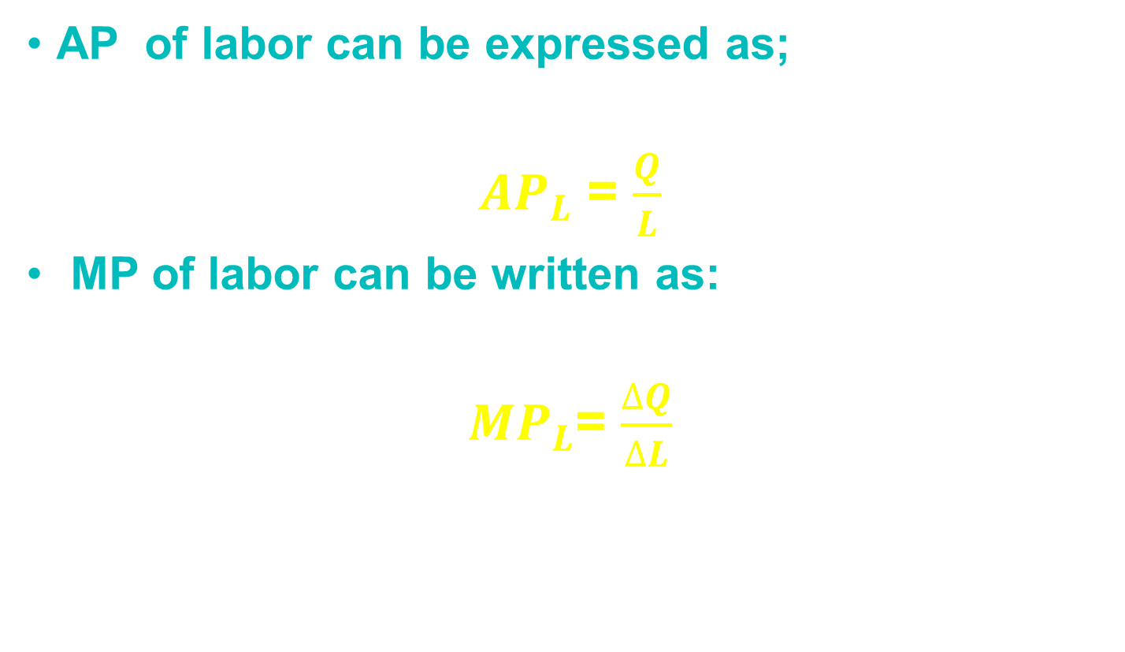
AP of labor can be expressed as;
${AP}_{L}$ = $\frac{Q}{L}$
MP of labor can be written as:
${MP}_{L}$= $\frac{∆Q}{∆L}$

Slide 29
The relation between the usage of L and the level of Q for K = 2, MP and AP for any level of L used
L | K | TP ( Q ) | MP | AP
1 | 2 | 15 | 15 | 15,0
2 | 2 | 31 | 16 | 15,5
3 | 2 | 48 | 17 | 16,0
4 | 2 | 59 | 11 | 14,8
5 | 2 | 68 | 9 | 13,6
6 | 2 | 72 | 4 | 12,0
7 | 2 | 73 | 1 | 10,4
8 | 2 | 72 | -1 | 9,0
9 | 2 | 70 | -2 | 7,8
10 | 2 | 67 | -3 | 6,7

Slide 30
A graph illustrates the relation among TP, AP, and MP

Slide 31
Q
C
A typical graph illustrates TP, AP, and MP
B
TP
A
0
L_{A}
L_{B}
L_{C}
L
MP,AP
Stage I
Stage II
Stage III
AP
0
L_{A}
L_{B}
L_{C}
L
MP

Slide 32
The Three Stages of Production in the Short Run
Stage I : Fixed input grossly underutilized, specialization and teamwork cause AP to increase when additional variable input is used
Stage II : Specialization and teamwork continue to result in greater output when additional variable input is being properly used
Stage III : Fixed input capacity is reached, additional variable input causes output to fall

Slide 33
Suppose the input variable is labor and capital is fixed input, at stage I, the labor used is relatively small compared to the use of capital, so at this stage, TP and AP increase, while MP initially increases and then decrease after reach the maximum point
At stage II, TP continued to incline until it reaches a maximum point, while AP and MP decline, MP will be equal to 0 when TP reaches a maximum, while the AP continues to decline, but the magnitude remains greater than 0
At stage III, TP decreased as indicated by the negative value of MP, while the AP continues to decline

Slide 34
Q
TP
irrational
rational
irrational
0
L
MP,AP
AP
0
MP
L

Slide 35
Stage II is “rational” while stage I and stage III is “irrational”
At stage III, the use of more L produce less Q, so the firm would reduce the amount of L in order to gain more Q
At stage I, the firm would have so much fixed capacity relative to its usage of variable input, that it could increase the output per unit of variable input (average product) simply by adding more variable inputs to its capacity
Q
L = X’ and L = X” result in the same AP, but L = X” producing more Q than L = X’
MP
AP
X’
X”
L

Slide 36
Because stage II is rational, then a firm will be operating in this area, the area which indicates diminishing marginal product, so-called the law of diminishing marginal product or the law of diminishing marginal return
The law of diminishing marginal product: the principle that as the number of units of the variable input increases, other inputs held constant, a point will be reached beyond which the marginal product decrease

Slide 37
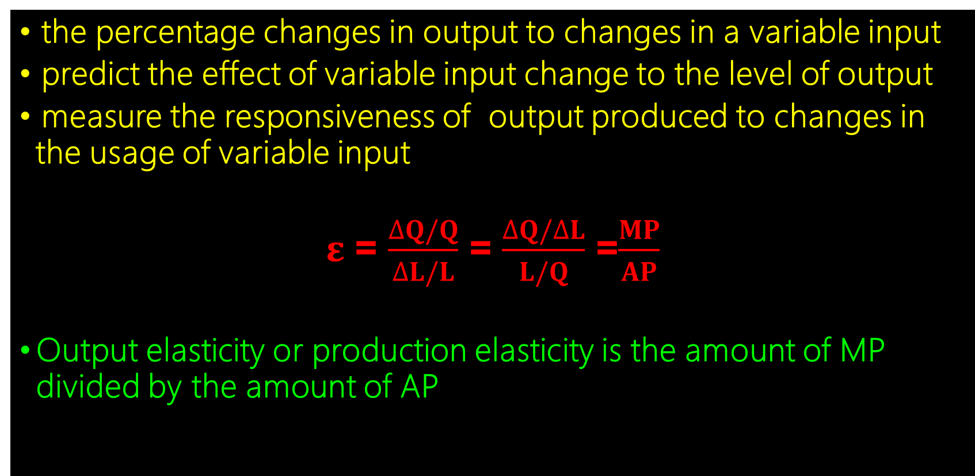
Production Elasticity or Output Elasticity ($ε)$
the percentage changes in output to changes in a variable input
  predict the effect of variable input change to the level of output
  measure the responsiveness of output produced to changes in the usage of variable input
  $ε$ = $\frac{∆Q/Q}{∆L/L}$ = $\frac{∆Q/∆L}{L/Q}$ =$\frac{MP}{AP}$
  Output elasticity or production elasticity is the amount of MP divided by the amount of AP

Slide 38






Q
TP
$$ε>1$$
$$0<ε<1$$
$$ε<0$$
0
$$ε=1$$
$$ε=0$$
L
MP,AP
At the rational area;
$$0<ε<1$$
AP
0
MP
L

Slide 39



Summary of Different Stages of Production
Stages of Producti-on | Total Product (TP) | Marginal Product (MP) | Average Product (AP) | Rational vs Irrational | Production Elasticity
Stage I | TP starts rising at an increasing rate and then at a decreasing rate | MP reaches its maximum and starts declining | AP starts rising and attains its maximum | irrational
Stage II*) | TP continues to rise at a decreasing rate and reaches its maximum | MP continues to decline till reaches zero | AP begins to decline | rational
Stage III | TP starts declining | MP is negative | AP continues to decline but remains positive | Irrational
$$ε>1$$
$$0<ε<1$$
$ε<$0
*) fit to the law of diminishing marginal product

Slide 40
Changes in Fixed Inputs
A change in the level of capital usage causes :
A change TP for each level of labor usage
A different short run production function
A shift in the short run production curve
A change in AP and MP of labor at every level of labor usage

Slide 41
A Typical TP, AP, and MP when fixed input changes
TP1
Q
TP
0
L
MP,AP
AP1
AP
MP1
0
MP
L

Slide 42
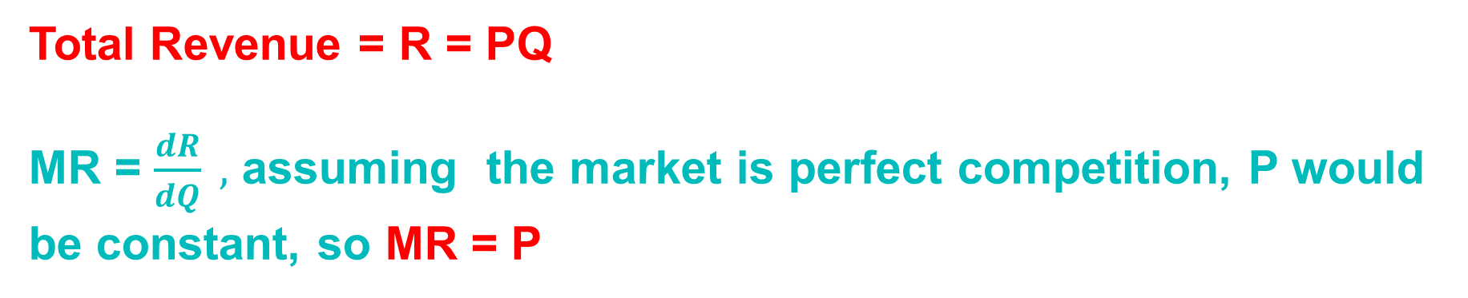
Total Revenue (R), Marginal Revenue (MR)
Total Revenue = R = PQ
MR = $\frac{dR}{dQ} ,$ assuming the market is perfect competition, P would be constant, so MR = P

Slide 43
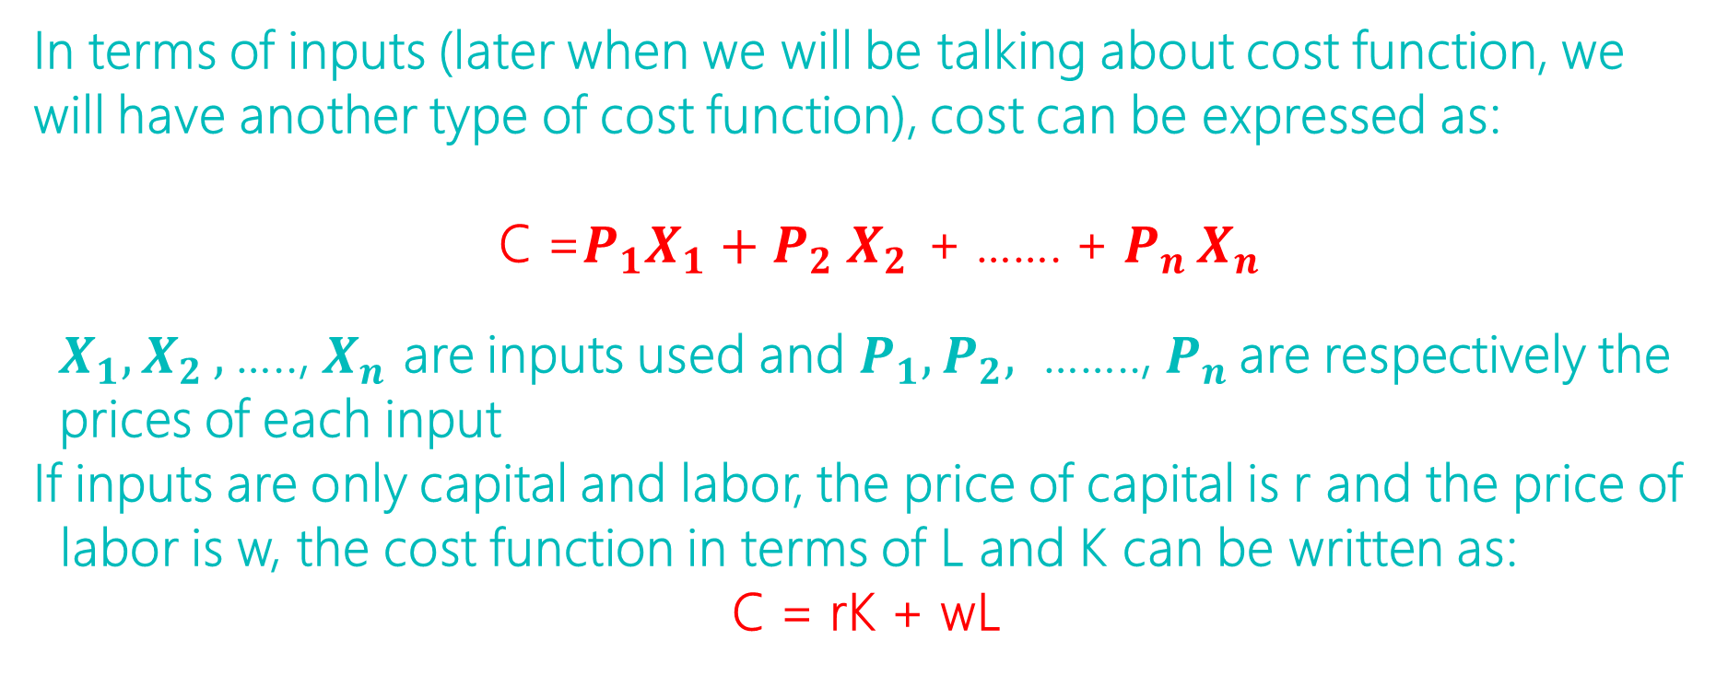
Cost function (In terms of inputs), Total Cost
In terms of inputs (later when we will be talking about cost function, we will have another type of cost function), cost can be expressed as:
  C =$P_{1}X_{1}{+ P}_{2}X_{2 }$+ ……. + $P_{n }X_{n}$
  $X_{1}, X_{2 },$….., $X_{n}$ are inputs used and $P_{1}{, P}_{2},$ …….., $P_{n }$are respectively the prices of each input
  If inputs are only capital and labor, the price of capital is r and the price of labor is w, the cost function in terms of L and K can be written as:
  C = rK + wL

Slide 44
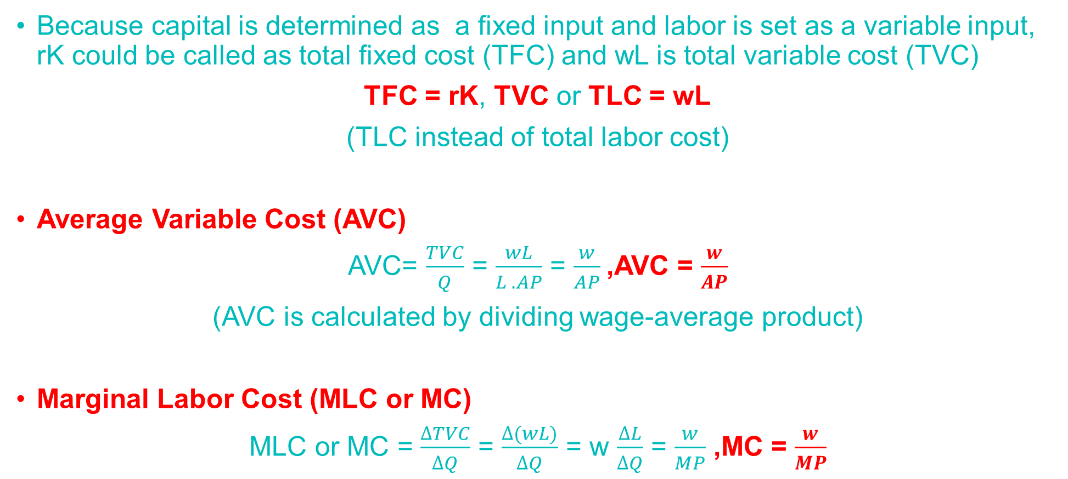
Variable Cost, Fixed Cost, Average Variable Cost, Marginal (Labor) Cost (MLC) or MC, Marginal Revenue Product (MRP)
Because capital is determined as a fixed input and labor is set as a variable input, rK could be called as total fixed cost (TFC) and wL is total variable cost (TVC)
TFC = rK, TVC or TLC = wL
(TLC instead of total labor cost)
Average Variable Cost (AVC)
AVC= $\frac{TVC}{Q}$ = $\frac{wL}{L . AP}$ = $\frac{w}{AP}$,AVC = $\frac{w}{AP}$
(AVC is calculated by dividing wage-average product)
Marginal Labor Cost (MLC or MC)
MLC or MC = $\frac{∆TVC}{∆Q}$ = $\frac{∆(wL)}{∆Q}$ = w $\frac{∆L}{∆Q}$ = $\frac{w}{MP}$ ,MC = $\frac{w}{MP}$

Slide 45
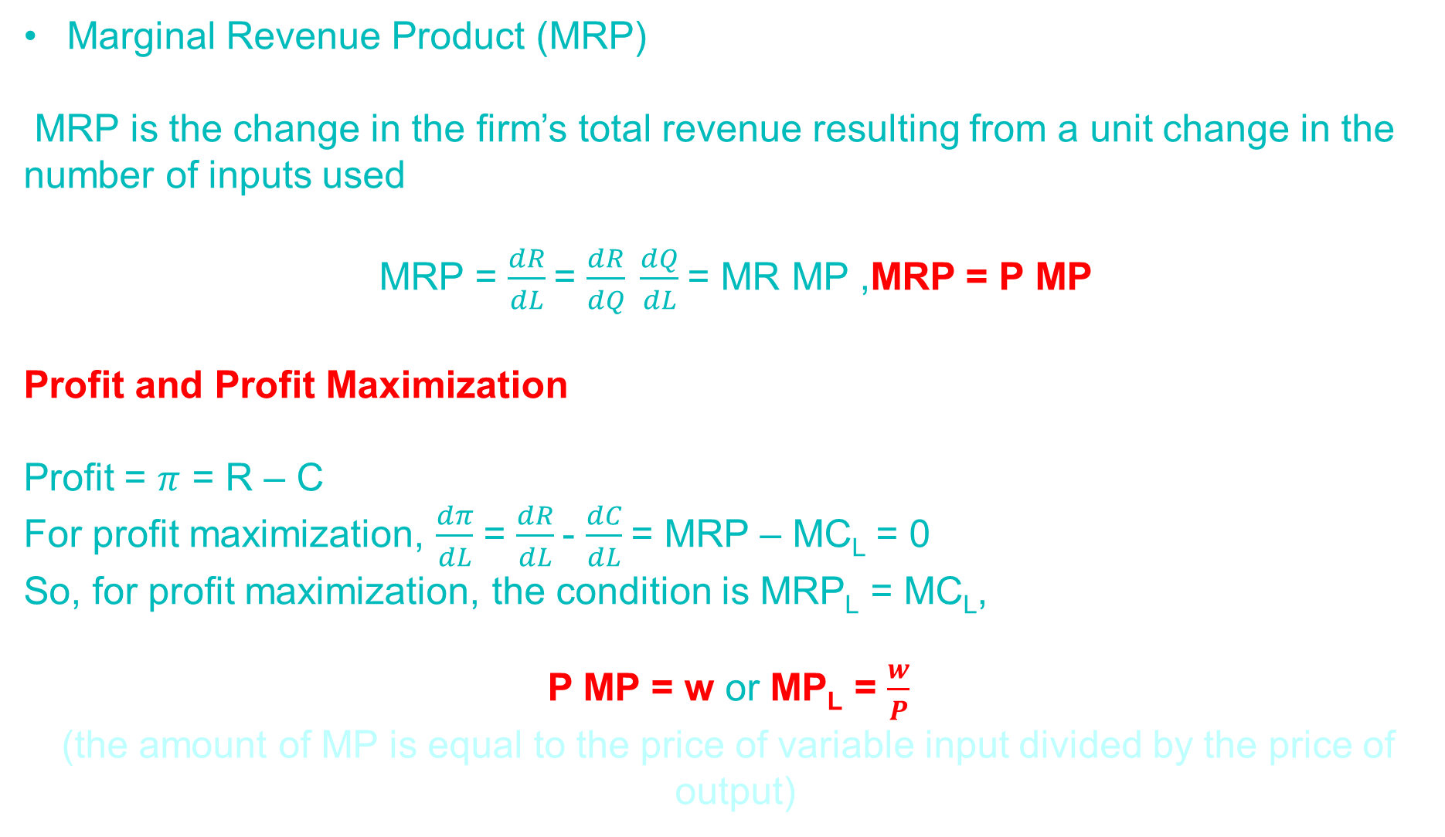
Marginal Revenue Product (MRP)
MRP is the change in the firm’s total revenue resulting from a unit change in the number of inputs used
MRP = $\frac{dR}{dL}$= $\frac{dR}{dQ} \frac{dQ}{dL}$= MR MP ,MRP = P MP
Profit and Profit Maximization
Profit = $π$ = R – C
For profit maximization, $\frac{dπ}{dL}$ = $\frac{dR}{dL}$- $\frac{dC}{dL}$= MRP – MC_{L} = 0
So, for profit maximization, the condition is MRP_{L} = MC_{L},
P MP = w or MP_{L} = $\frac{w}{P}$
(the amount of MP is equal to the price of variable input divided by the price of output)

Slide 46

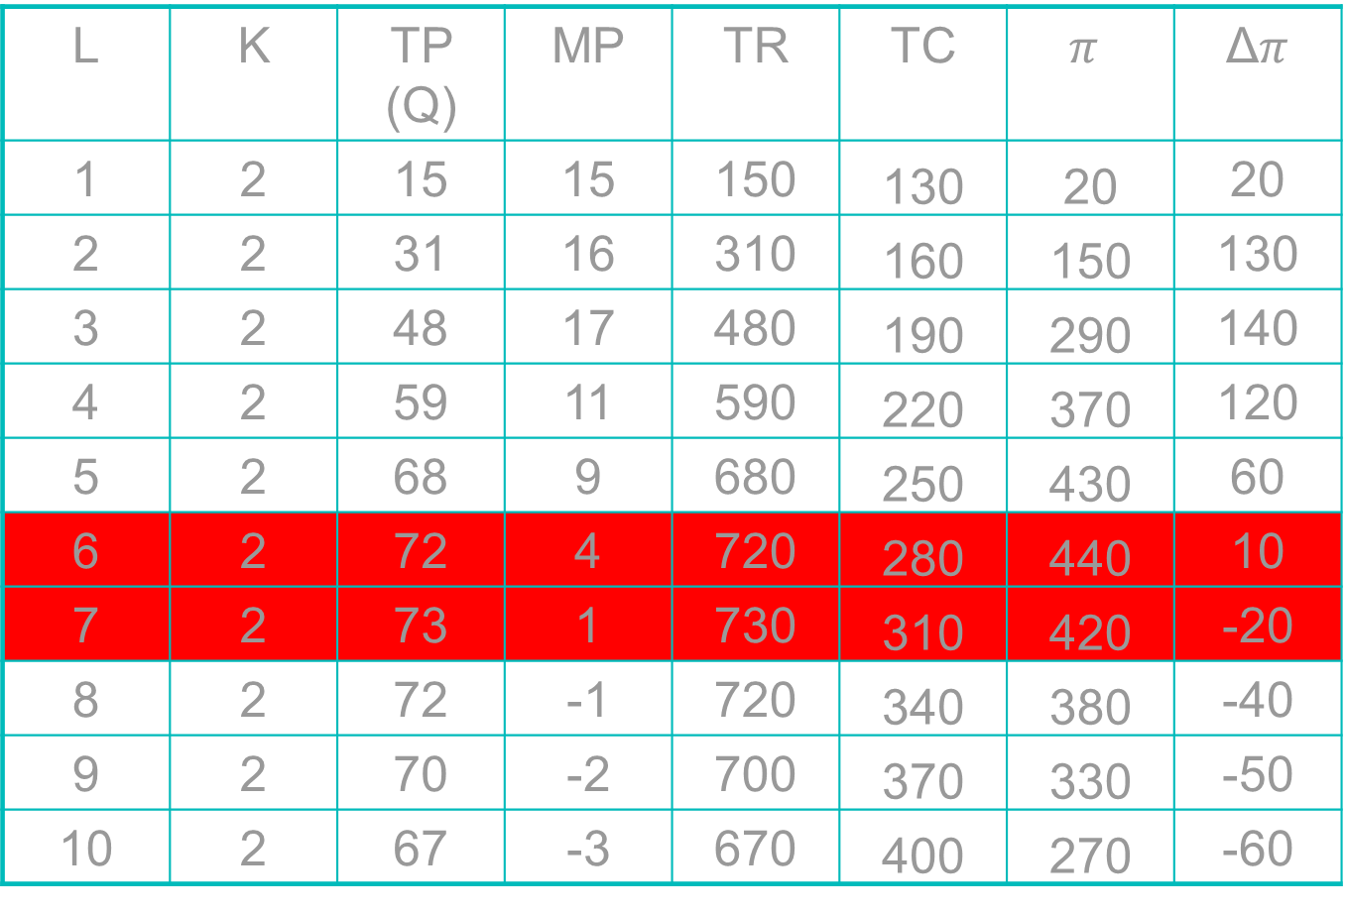
The usage of L, the level of Q, $π$
When w = 30, r = 50 and P = 10 (w/P = 3)
L | K | TP (Q) | MP | TR | TC | $$π$$ | Δ$π$
1 | 2 | 15 | 15 | 150 | 130 | 20 | 20
2 | 2 | 31 | 16 | 310 | 160 | 150 | 130
3 | 2 | 48 | 17 | 480 | 190 | 290 | 140
4 | 2 | 59 | 11 | 590 | 220 | 370 | 120
5 | 2 | 68 | 9 | 680 | 250 | 430 | 60
6 | 2 | 72 | 4 | 720 | 280 | 440 | 10
7 | 2 | 73 | 1 | 730 | 310 | 420 | -20
8 | 2 | 72 | -1 | 720 | 340 | 380 | -40
9 | 2 | 70 | -2 | 700 | 370 | 330 | -50
10 | 2 | 67 | -3 | 670 | 400 | 270 | -60

Slide 47
L | TP (Q) | MP | AP | TC | TVC | AVC (w/AP) | MC (w/MP)
1 | 15 | 15 | 15 | 130 | 30 | 2 | 2
2 | 31 | 16 | 15.5 | 160 | 60 | 1.935 | 1.875
3 | 48 | 17 | 16 | 190 | 90 | 1.875 | 1.765
4 | 59 | 11 | 14.25 | 220 | 120 | 2.105 | 2.727
5 | 68 | 9 | 13.6 | 250 | 150 | 2.206 | 3.333
6 | 72 | 4 | 12 | 280 | 180 | 2.5 | 7.5
7 | 73 | 1 | 10.43 | 310 | 210 | 2.876 | 30
8 | 72 | -1 | 9 | 340 | 240 | 3.333 | *
9 | 70 | -2 | 7.77 | 370 | 270 | 3.861 | *
10 | 67 | -3 | 6.7 | 400 | 300 | 4.478 | *

Slide 48
An Example of Using Mathematical Formula
Suppose the production function is:
Q = f(K,L) = 600K² L² - K³ L³
Let’s determine K as an fixed input, K = 10, so that the equation become
Q = TP = 60 000L² - 1 000 L³
Marginal Product MP_{L} = ∂Q/∂L ,
MP_{L} = 120 000L – 3 000 L²
MP_{L} = 0, is the condition to find a maximum output,
120 000L – 3 000 L² = 0
L = 40
TP would be reached a maximum output when the usage of L = 40 and the maximum output is Q = 32 000 000

Slide 49
Average Product of Labor, AP_{L} = Q/L;
AP_{L} = 60 000 L - 1 000 L²
AP_{L} reachs the maximum point when the first order condition, ∂AP_{L}/∂L = 0,
∂AP_{L}/∂L= 60 000 – 2 000 L = 0
L = 30, AP_{L} = 900 000
When AP_{L} reachs the maximum point , AP_{L} = MP_{L} ,
MP_{L} = 120 000L – 3 000L²
MP_{L} = 900 000 = AP_{L}

Slide 50
The condition for maximum profit MRP_{L} = MR MP_{L} = MC_{L} since MR = P = the price of output dan MC_{L} = w = the price of L,
MP_{L} = w/P
If wage, w = 2 700 000 and the price of output, P = 3, the condition for profit maximization is :
MP_{L} = 120 000L – 3 000L² = 900 000
Using mathematics, the equation becomes:
L² - 40L + 300 = 0
then the result is L = 10 and L = 30 (between the two L, L = 30 is fit to the profit maximization (∂MRP_{L} /∂L < 0)

Slide 51
If the wage remains equal to 2 700 000 but the price of output increase to 9, the condition for maximizing profit would become :
MP_{L} = 120 000L – 3 000L² = 300 000
then
L² - 40L + 100 = 0
So, you will get L = 2.7 and L = 37.3 (L = 37.3 would be chosen because it is fitted to ∂MRP_{L} /∂L < 0
It can be seen that the usage of labor increased and, of course, the level of output increased

Slide 52


The Various Forms of Production Function
Linear Production Function : Q = aL + bK + c
Fixed Proportions Production Function
Polynomial Production Function :
  Q = aLK - bL²K²
  Q = aLK + bL²K + cLK²- dL³K - eLK³
Power Production Function: Q = cL^{α}K^{β}
Cobb-Douglas Production Function:
Q = c$L^{α}K^{(1−α)}$

Slide 53



Production Function in the Long Run
Isoquant, isoquant curve (isoquant map), characteristics of isoquants
marginal rate technical substitution (MRTS), relation of MRTS to MP
Isocost, isocost curve, characteristics of isocost curves, shifts in isocost curve
Finding the Optimal Combination of Inputs
Expansion Path
Return to Scale
Changes in Technology
z

Slide 54
A Typical example of the maximum amount of output (Q) that can be produced from various combination of labor (L) and capital (K)
Units of K | Units of L
 |  | 1 | 2 | 3 | 4 | 5 | 6
 | 10 | 52 | 71 | 87 | 101 | 113 | 122
 | 9 | 56 | 74 | 89 | 102 | 111 | 120
 | 8 | 59 | 75 | 91 | 99 | 108 | 117
 | 7 | 61 | 77 | 87 | 96 | 104 | 112
 | 6 | 62 | 72 | 82 | 91 | 99 | 107
 | 5 | 55 | 66 | 75 | 84 | 92 | 99
 | 4 | 47 | 58 | 68 | 77 | 85 | 91
 | 3 | 35 | 49 | 59 | 68 | 76 | 83
 | 2 | 15 | 31 | 48 | 59 | 68 | 72
 | 1 | 5 | 12 | 35 | 48 | 56 | 55

Slide 55
Isoquant (curve), isoquant map, characteristics of isoquants
Isoquant:
  a curve showing all possible combinations of inputs physically capable of producing a given fixed level of output; each point on an isoquant is technically efficient
  The concept of isoquant implies that it is possible to substitute some amount of one input for some of the other, there are an invite number of input combinations capable of producing each level of output
  Characteristics of isoquants :
    when labor, capital (two inputs used), and output are continuously divisible
    Each L and K combination can be on only one isoquant, isoquants cannot be intersect
    A graph showing a group of isoquants (Isoquant map), all isoquants lying above and to the right of a given isoquant indicate higher level of output

Slide 56
Isoquant for Q = 52 in various combinations of the usage of L and K
K
6
4
3
Q = 52
2
0
2
3
4
6
8
L

Slide 57
A Typical Isoquant Curve for Continuous Production Function; generally convex to the O, the farther the isoquant curve from O, the higher the level of Q
K
50
40
Q₃=300
A
20
Q₂=200
T
10
Q₁=100
L
0
15
20
40
75

Slide 58
Unit of K Employed | Output Quantity (Q)
8 | 57 | 60 | 83 | 96 | 107 | 117 | 127 | 128
7 | 42 | 64 | 78 | 90 | 101 | 110 | 119 | 120
6 | 37 | 52 | 64 | 73 | 82 | 90 | 97 | 104
5 | 31 | 47 | 58 | 67 | 75 | 82 | 89 | 95
4 | 24 | 39 | 52 | 60 | 67 | 73 | 79 | 85
3 | 17 | 29 | 41 | 52 | 58 | 64 | 69 | 73
2 | 8 | 18 | 29 | 39 | 47 | 52 | 56 | 52
1 | 4 | 8 | 14 | 20 | 27 | 24 | 21 | 17
 | 1 | 2 | 3 | 4 | 5 | 6 | 7 | 8
 | Unit of L Employed

Slide 59

Marginal Rate Technical Substitution (MRTS), relation of MRTS to MP
MRTS :
  the rate of which one input is substituted for another along an isoquant
  MRTS = -∆K/∆L; the minus sign is added to make MRTS a positive number, since ∆K/∆L, the slope of the isoquant, is negative
  Over the relevant range of production, MRTS diminishes; the more and more L is substituted for K, the absolute value of ∆K/∆L decreases
  Because the level of output along the isoquant curve is equal, it can be expressed that :
    $∆Q= {MP}_{L }$($∆L)$+ ${MP}_{K }$($∆K$) = 0
    MRTS = -(∆K/∆L) = $\frac{\text{MP}\text{L}}{\text{MP}\text{K}}$
z

Slide 60
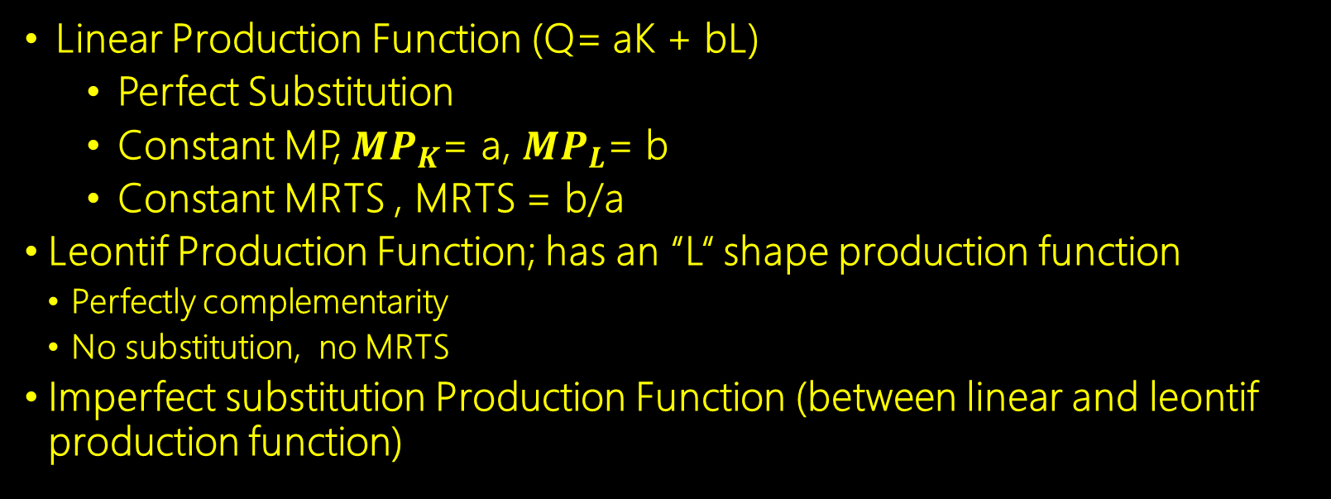
Substitutability of Two Inputs in A production Function
Linear Production Function (Q= aK + bL)
  Perfect Substitution
  Constant MP, ${MP}_{K}$= a, ${MP}_{L}$= b
  Constant MRTS , MRTS = b/a
  Leontif Production Function; has an “L“ shape production function
    Perfectly complementarity
    No substitution, no MRTS
    Imperfect substitution Production Function (between linear and leontif production function)
Perfectly complementarity
Imperfect substitution
Perfect substitution

Slide 61
Isocost Curve
Isocost curve: line that shows the various combinations of inputs that may be purchased for a given level of expenditure at a given input prices
The isocost curve is linear because the prices of the inputs are constant
The prices of the inputs in relation to each other are represented by the slope of the isocost line.
If we denote the quantity of capital and labor by K and L, and denote their respective prices by r and w, total cost, C, is simply the number of units of K multiplied by its price (r) plus the number of unit of L multiplied by its price (w). The equation for the total cost can be written as:
C = rK + wL

Slide 62
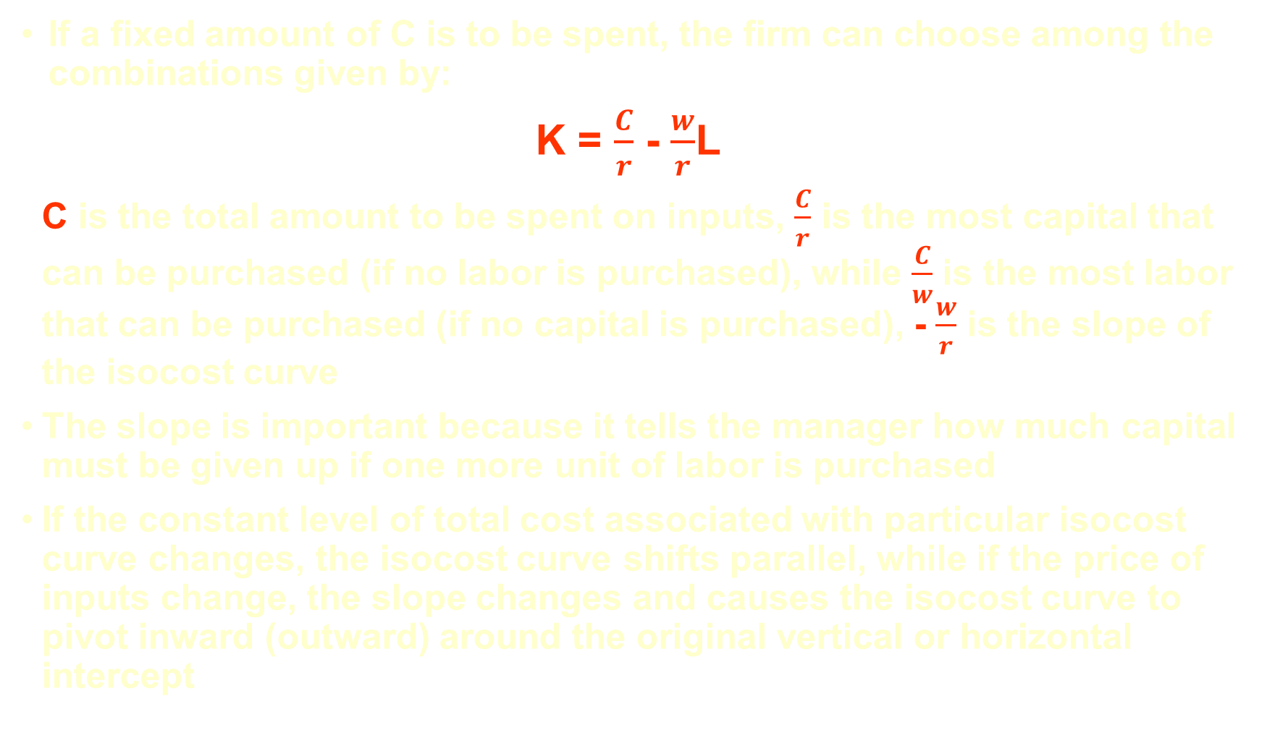
If a fixed amount of C is to be spent, the firm can choose among the combinations given by:
K = $\frac{C}{r}$ - $\frac{w}{r}$L
C is the total amount to be spent on inputs, $\frac{C}{r}$ is the most capital that can be purchased (if no labor is purchased), while $\frac{C}{w}$ is the most labor that can be purchased (if no capital is purchased), - $\frac{w}{r}$ is the slope of the isocost curve
The slope is important because it tells the manager how much capital must be given up if one more unit of labor is purchased
If the constant level of total cost associated with particular isocost curve changes, the isocost curve shifts parallel, while if the price of inputs change, the slope changes and causes the isocost curve to pivot inward (outward) around the original vertical or horizontal intercept

Slide 63
Isocost curve for C = 400, w = 25, and r = 50
10
A
8
B
6
25L + 50K = 400; K=8-0.5 L
K (Unit)
C
4
K=10-0.5 L
K=10 - L
D
2
E
0
2
4
6
8
10
12
14
16
18
20
L (Unit)

Slide 64
Finding the Optimal Combination of Inputs
A manager wishes to produce a given level of output at a lowest possible total cost, the manager chooses the combination on the desired isoquant that cost the least; production of a given output at minimum cost. This is constrained minimization problem
Some time n level of managers (i.e. managers of nonprofit organizations) have a budget or fixed amount of money available for production and wish to maximize the amount of output that can be produced, the manager wishes to maximize output for a given level of total cost, the manager must chooses the input combination on the isocost curve that lies on the highest isoquant; production of maximum output at a given cost. This is constrained maximization problem

Slide 65

Production of A Given Output at Minimum Cost
The tangency condition for cost minimization is:
The slope of isoquant = the slope of isocost
    MRTS = -(∆K/∆L) = $\frac{\text{PM}\text{L}}{\text{PM}\text{K}}$ = $\frac{w}{r}$
    Or it can be expressed as :
    $\frac{\text{PM}\text{L}}{w}$ = $\frac{\text{PM}\text{K}}{r}$
K
140
C₃
133,3
120
100
A
C₂
60
B
40
C
Q₁=10,000
C₁
L
60
90
140
160
200
210

Slide 66
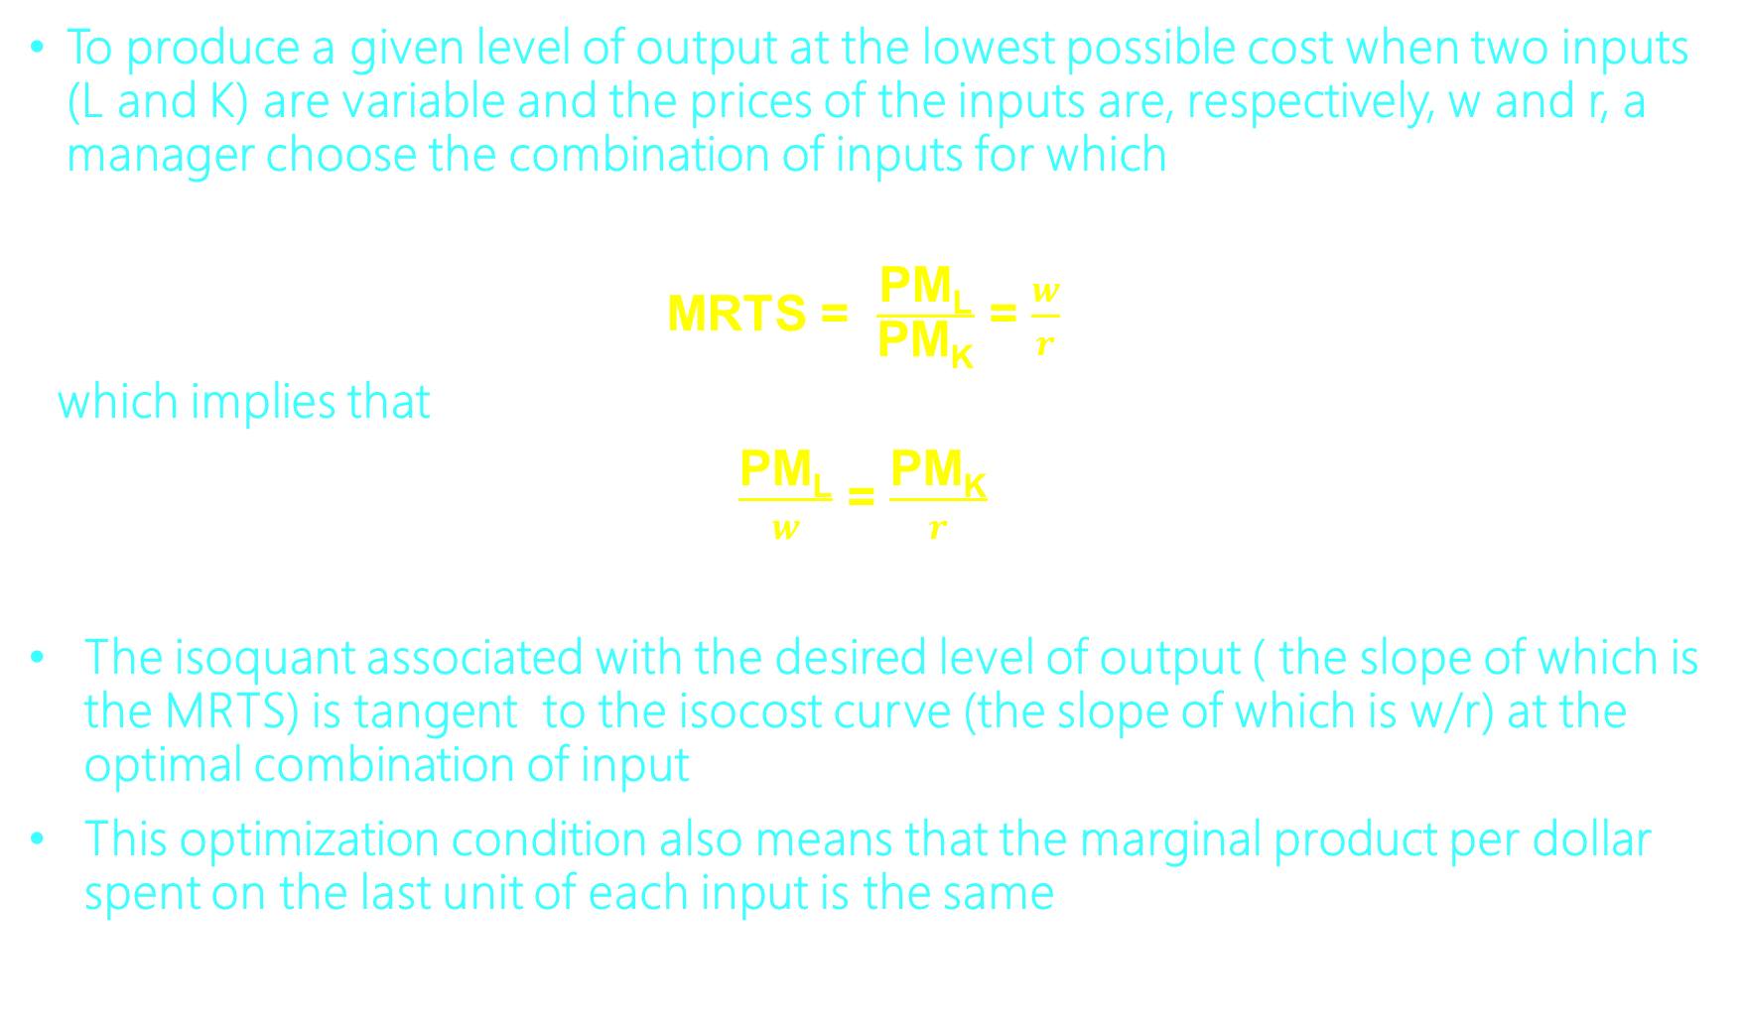
To produce a given level of output at the lowest possible cost when two inputs (L and K) are variable and the prices of the inputs are, respectively, w and r, a manager choose the combination of inputs for which
    MRTS = $\frac{\text{PM}\text{L}}{\text{PM}\text{K}}$ = $\frac{w}{r}$
which implies that
$\frac{\text{PM}\text{L}}{w}$ = $\frac{\text{PM}\text{K}}{r}$
The isoquant associated with the desired level of output ( the slope of which is the MRTS) is tangent to the isocost curve (the slope of which is w/r) at the optimal combination of input
This optimization condition also means that the marginal product per dollar spent on the last unit of each input is the same

Slide 67
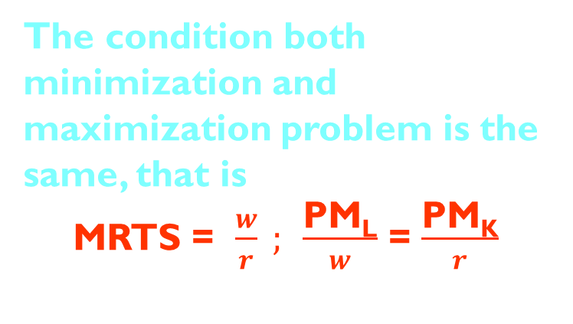
Production of Maximum Output at a Given Cost
K
The condition both minimization and maximization problem is the same, that is
    MRTS = $\frac{w}{r} ;$ $\frac{\text{PM}\text{L}}{w}$ = $\frac{\text{PM}\text{K}}{r}$
A
C
B
Q₁=10,000
D
Q₁=8,000
Q₁=6,000
L

Slide 68
Expansion Path
The curve along which a firm expands or contracts output when input prices remain constant. Each point on the expansion path represents an efficient input combination (least cost)
K
Along the expansion path, the MRTS equals the constant input price ratio
250
The expansion path indicates how input usage changes when output or cost changes
200
Expansion Path
C
150
Q₃=900
B
126
A
Q₃=700
91
Q₃=500
C₃
C₁
C₂
L
0
118
148
200
300
400
500

Slide 69
The level of Total which will be produced Q = 10000
Production Function, Q = 500K^{0.5}L^{0.5}
The combinations of the usage of inputs for Q = 10000 based on the production function is:
10000= 500K^{0.5}L ^{0.5} 20 = K^{0.5}L ^{0.5},
KL = 400
Several combinations of the usage of inputs for Q= 10000, (L,K) = (50,8), (40,10) (25,16), (10,40), etc.
If the price of inputs is respectively wages (P1) = $40, interest rate (P2) = $60
Calculate the amount of each input employed and the minimum cost?

Slide 70
  Isocost : C = 40L + 60K
The condition of cost minimizing,
MRTS = -∆K/∆L = PM_{L}/PM_{K} = P_{L}/P_{K}
PM_{L} = 250 K^{0.5}/L^{0.5} = 250(K/L)^{0.5}
PM_{K} = 250 L^{0.5}/K^{0.5} = 250(L/K)^{0.5}
PM_{L}/PM_{K} = K/L = P_{L/}P_{K} = 40/60 = 2/3, K = 2/3 L
2/3 L L = 400 , then L = 24.50 and K = 16.33
Minimum cost: 40(24.50) + 60(16.33) = 1959.8
Compare to other combinations of the usage of inputs,
40(50) + 60(8) = 2480
40(40) + 60(10) = 2200
40(25) + 60(16) = 1960
40(10) + 60(40) = 2800

Slide 71
Return to Scale
Increasing Return to Scale (IRS), decreasing Return to Scale (DRS), Constant Return to Scale (CRS)
Q = f(K,L); zQ = f(cK,cL)
z > c; IRS, z < c; DRS, z = c; CRS
z

Slide 72
Changes in Technology
Isoquant curve Q2 and Q1 have the same level of output, but Q2 employing less inputs than Q1. that is caused by technology change
K (Unit)
Q₁=10.00
Q₂=10.00
L (Unit)

Slide 73
Summary
Technical efficiency occurs when a firm produces maximum output for a given input combination and technology; economic efficiency is achieved when the firm produces a given output at the lowest total cost
  Production inputs can be variable, fixed, or quasi-fixed inputs
Short run refers to the current time span during which one or more inputs are fixed; Long run refers to the period far enough in the future that all fixed inputs become variable inputs
Sunk costs are irrelevant for future decisions and are not part of economic cost of production in future time periods; avoidable costs are payments a firm can recover or avoid, thus they do matter in decisions

Slide 74
Summary
The total product curve gives the economically efficient amount of labor for any output level when capital is fixed in the short run
Average product of labor is the total product divided by the number of workers: AP = Q/L
Marginal product of labor is the additional output attributable to using one additional worker with the use of capital fixed: MP = ∆Q/∆L
The law of diminishing marginal product states that as the number of units of the variable input increases, other inputs held constant, a point will be reached beyond which the marginal product of the variable input declines

Slide 75
Summary
In the long run, all fixed inputs become variable inputs
  An isoquant is a curve showing all possible input combinations capable of producing a given level of output
  The marginal rate of technical substitution, MRTS, is the slope of an isoquant and measures the rate at which the two inputs can be substituted for one another while maintaining a constant level of output
Isocost curves show the various combinations of inputs that may be purchased for a given level of expenditure at given input prices
  The isocost curve’s slope is the negative of the input price ratio

Slide 76

Good Luck

