Slide 1

ANALISIS DATA KUANTITATIF
Zulkarnain Lubis

Slide 2
ANALISIS DATA
Dalam kaitan proses pelaksanaan penelitian, untuk analisis data penelitian
Dalam kaitan pengambilan keputusan, data base decision making

Slide 3
ANALISIS DATA
ANALISIS KUALITATIF
ANALISIS KUANTITATIF
    ANALISIS STATISTIKA
    ANALISIS KUANTITATIF SELAIN STATISTIKA

Slide 4
Diagram/
Grafik
VISUAL
Tabel
    STATISTIKA DESKRIPTIF
Pemusatan
UKURAN
Penyebaran
Ukuran Lain
    ANALISIS STATISTIKA
STAT. PARAMETRIK
    STATISTIKA INDUKTIF
STAT. NONPARAMETRIK

Slide 5
Analisis Statistik Deskriptif; Mendeskripsi Secara Visual
Mengidentifikasi Pola Penyebaran Data
  histogram
  diagram dahan dan daun (stem and leaf diagram)
  diagram kotak garis (box-plot diagram)
Mengidentifikasi Hubungan Antar Variabel dengan Gambar dan Tabel
  tabulasi silang (cross tabulation); untuk data kategorikal
  diagram plot (plot diagram): untuk data kontiniu (continuous data).

Slide 6
Analisis Statistik Deskriptif; Mendeskripsi Secara Visual
Peramalan, Identifikasi Masalah, dan Pengamatan Proses
  run chart,
  control chart,
  grafik deret waktu (time series graph)
  Mendeskripsi Penyebaran Data Untuk Skala Nominal
  bagan melingkar (pie chart)
  diagram batang (bar chart)

Slide 7
Analisis Statistik Deskriptif; Mendeskripsikan Menggunakan Ukuran
ukuran pemusatan atau ukuran kecenderungan memusat (measures of central tendency) atau disebut juga sebagai ukuran lokasi (measure of location):
  rata-rata (mean), median, modus, midrange, midhinge
ukuran penyebaran (measures of dispersion):
  ragam atau variansi (variance), standar deviasi (standard of deviation), jangkauan atau kisaran (range), jarak antar kuartil (inter quartile distance)
ukuran-ukuran lain:
  proporsi (proportion), nisbah (ratio), persentase (percentage), peragam (covariance).

Slide 8
Frequencies; Histogram Frequency, Descriptive Statistics; Deskripsi Data, Explore, Crosstab
Histogram
rata-rata (mean),
median,
modus,
midrange,
Midhinge
Quartile
Stem And Leaf Diagram
Plot Diagram
Box-plot Diagram
Skewness
Curtosis
Variance
standard of deviation
Range
inter quartile distance

Slide 9
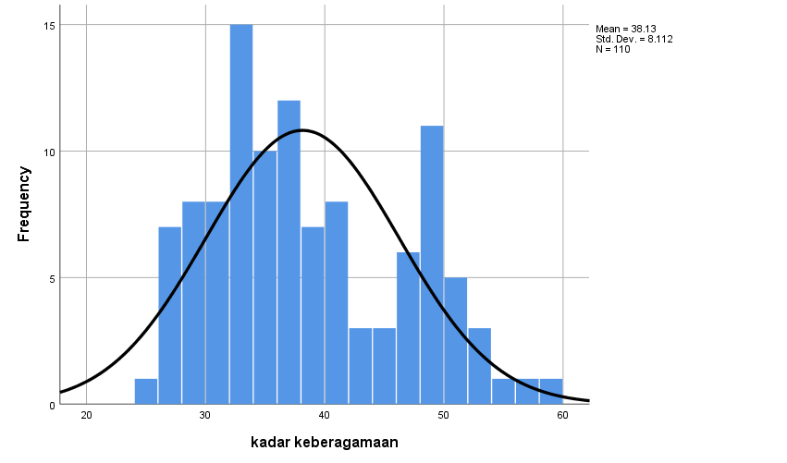

Slide 10
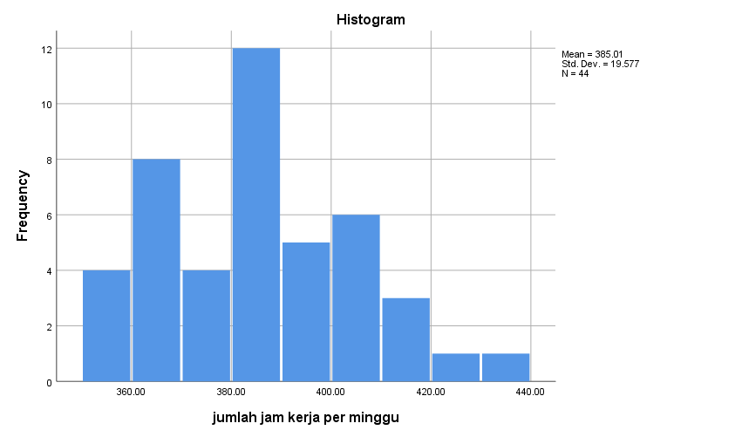

Slide 13
Stem-and-leaf of laman1 N = 33
Leaf Unit = 1.0
8 1 01122334
(12) 1 556778899999
13 2 0111223334
3 2 66
1 3
1 3
1 4
1 4 5
Stem-and-leaf of laman2 N = 33
Leaf Unit = 1.0
1 1 5
4 1 777
14 1 8888999999
(3) 2 011
16 2 2333333
9 2 44455
4 2 667
1 2
1 3
1 3
1 3 5

Slide 14
Stem-and-leaf of prodviti N = 40
Leaf Unit = 10
4 0 9999
16 1 111122233334
19 1 559
(7) 2 2333444
14 2 569
11 3 124
8 3
8 4 333
5 4 5
4 5 4
3 5 56
1 6
1 6 7

Slide 15
Stem-and-leaf of MANSKLH N = 347
Leaf Unit = 1.0
3 1 233
22 1 5555666678889999999
64 2 000000111111112222222222222333344444444444
107 2 5555555556666666666677777777788888889999999
157 3 00000000001111111111111222222222233333333333344444
(59) 3 55555555555555666666666666667777777777888888888888899999999
131 4 00000000001111111111111112222222333344444
90 4 555555666666677778888888888888999999999
51 5 0011111222223344
35 5 55555666777777788899
15 6 0001134
8 6 558
5 7 1
4 7 577
1 8
1 8 5

Slide 18
religiusitas dalam kategori * lingkungan pekerjaan Crosstabulation
Count
 |  | lingkungan pekerjaan |  |  |  |  | Total
 |  | tidak baik | kurang baik | sedang | menyenangkan | sangat baik
religiusitas dalam kategori | reigiusitas rendah | 14 | 1 | 1 | 0 | 0 | 16
 | religiusitas biasa | 7 | 15 | 9 | 1 | 0 | 32
 | religiusitas lumayan | 1 | 8 | 12 | 1 | 2 | 24
 | religiusitas tinggi | 0 | 1 | 2 | 5 | 1 | 9
 | religiusitas sangat tinggi | 1 | 2 | 1 | 12 | 13 | 29
Total |  | 23 | 27 | 25 | 19 | 16 | 110

Slide 19
Rows: didik Columns: rokok
1 2 3 4 All
1 3 3 3 4 13
2 7 8 10 4 29
3 8 9 9 11 37
4 1 4 4 2 11
All 19 24 26 21 90
Chi-Square = 4.602, DF = 9, P-Value = 0.868

Slide 20
Intensitas lalu lintas
Klasifikasi jln | A | B | C | D | E | Total
1 | 8 | 3 | 1 | 0 | 0 | 12
2 | 2 | 9 | 2 | 1 | 0 | 14
3 | 0 | 4 | 6 | 8 | 1 | 19
4 | 0 | 0 | 1 | 4 | 5 | 10
Total | 10 | 16 | 10 | 13 | 6 | 86

Slide 22
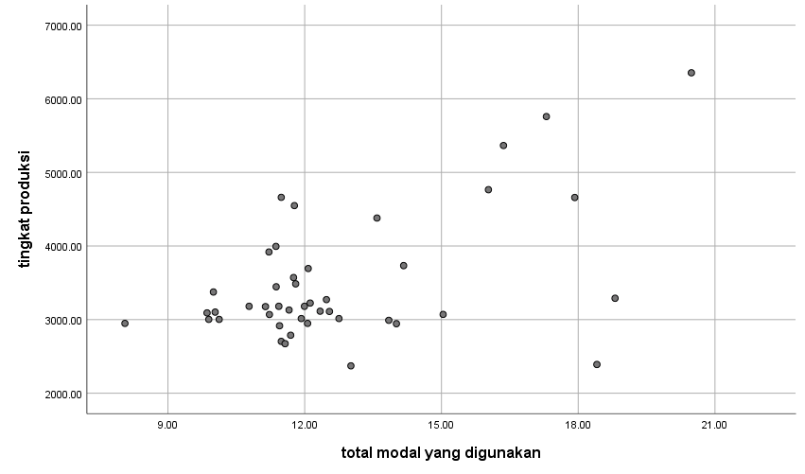

Slide 25
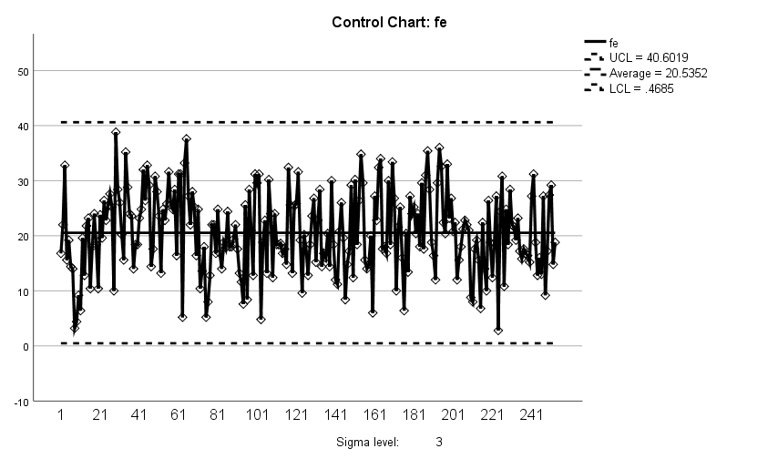

Slide 30
Statistics
 |  | tingkat produksi | kepatuhan terhadap peraturan | kadar keberagamaan | age
N | Valid | 44 | 44 | 44 | 44
 | Missing | 76 | 76 | 76 | 76
Mean |  | 3491.1747 | 52.23 | 39.85 | 48.05
Median |  | 3178.9763 | 48.00 | 38.40 | 47.00
Mode |  | 3180.96 | 34 | 32 | 42ª
Std. Deviation |  | 861.87655 | 14.812 | 8.102 | 12.068
Variance |  | 742831.182 | 219.389 | 65.641 | 145.626
Skewness |  | 1.639 | .409 | .354 | .254
Std. Error of Skewness |  | .357 | .357 | .357 | .357
Kurtosis |  | 2.551 | -.818 | -.753 | -.230
Std. Error of Kurtosis |  | .702 | .702 | .702 | .702
Range |  | 3980.80 | 56 | 33 | 51
Minimum |  | 2371.83 | 26 | 25 | 24
Maximum |  | 6352.63 | 82 | 58 | 75
Sum |  | 153611.69 | 2298 | 1753 | 2114
Percentiles | 25 | 3003.0400 | 40.50 | 33.20 | 39.25
 | 50 | 3178.9763 | 48.00 | 38.40 | 47.00
 | 75 | 3723.7138 | 63.50 | 46.60 | 56.75
a. Multiple modes exist. The smallest value is shown

Slide 31
Descriptive Statistics
Variable N Mean Median Tr Mean StDev SE Mean
tahanja 23 3.152 3.200 3.157 1.035 0.216
miliksah 23 43.65 42.00 43.57 11.12 2.32
usia 23 34.87 34.00 34.86 7.60 1.58
lingtnan 23 69.48 73.00 69.81 13.52 2.82
fisik 23 33.65 35.00 34.33 5.56 1.16
Variable Min Max Q1 Q3
tahanja 1.500 4.700 2.300 4.200
miliksah 22.00 67.00 35.00 54.00
usia 23.00 47.00 28.00 42.00
lingtnan 45.00 87.00 58.00 80.00
fisik 14.00 39.00 33.00 37.00
 | Midrange | Midhinge
DTAHAN | 3.2 | 1.9
MILIK | 45.00 | 19.00
USIA | 24.00 | 14.00
LINGKUNG | 42.00 | 22.00
FISIK | 25.00 | 4.00

Slide 32
Covariances
matik bing bindo ipa
matik 243.2322
bing 111.4640 233.7681
bindo 54.9642 66.3851 89.5594
ipa 101.7170 97.2421 48.6800 108.4268

Slide 33
Berbagai Jenis Analisis Statistik dan Uji hipotesis
analisis statistik univariat (univariate statistical analysis) yang merupakan uji hipotesis terhadap hanya satu variabel
analisis statistik bivariate (bivariate statistical analysis) yang merupakan uji hipotesis untuk dua variabel
analisis statistik multivariat (multivariate statistical analysis) yang merupakan uji hipotesis untuk banyak variabel

Slide 34
Uji Hipotesis
hipotesis relasional (relational hypothesis) berupa uji hipotesis pengaruh perubahan satu variabel kepada perubahan variabel lainnya
hipotesis untuk mengidentifikasi perbedaan antar group untuk melakukan pengujian apakah nilai satu variabel berbeda antara satu group dengan group lainnya
hipotesis untuk melakukan pengujian apakah nilai variable tertentu sama besar atau berbeda dengan satu ukuran yang telah ditentukan.

Slide 35

Test for population mean
One sample t test for population mean
T test for comparing two population means
ANOVA for testing population means of k independent

Slide 36
Prosedur Uji Hipotesis
membuat hipotesis dua bentuk hipotesis yaitu hipotesis nari dasar dan hipotesis tandingan
dari sampel yang dipilih didapatkan data variabel dan data ini dibandingkan dengan hipotesis yang sudah dibuat
Jika data yang diperoleh sesuai dengan hipotesis dasar, maka dikatakan bahwa hipotesis dasar diterima
apabila data yang diperoleh tidak sesuai dengan hipotesis dasar, maka hipotesis dasar ditolak (hipotesis tandingannya diterima)
Keputusan menerima atau menolak hipotesis dasar (tandingan) ditentukan berdasarkan teori peluang yaitu membandingkan tingkat signifikansi (significance level) dan nilai-p (p-value)

Slide 37
Prosedur Uji Hipotesis
Tingkat signifikansi adalah tingkat risiko kesalahan dalam mengambil keputusan yang disebut sebagai kesalahan jenis pertama (type-1 error) yang disimbolkan sebagai α
Nilai-p adalah nilai peluang yang berkaitan dengan ukuran variabel sesuai dengan data empiris yang dikumpulkan
nilai-p > α hipotesis dasar diterima,
nilai-p < α hipotesis dasar ditolak (hipotesis tandingan diterima)

Slide 38
Uji Hipotesis Relasional
sekadar keeratan hubungan, digunakan koefisien korelasi
mengetahui pengaruh satu atau lebih variabel terhadap variabel lain, digunakan analisis regresi
analisis regresi, dua jenis variabel:
  variabel yang mempengaruhi (variabel bebas)
  variabel yang dipengaruhi (variabel tak bebas)
  uji hipotesis untuk analisis regresi, apakah perubahan variabel bebas signifikan memberi perubahan pada variabel tak bebas
  untuk analisis korelasi, hanya sekedar ingin mengidentifikasi keeratan hubungan dua variabel tanpa memerlukan yang mana yang mempengaruhi dan yang mana yang dipengaruhi.

Slide 39
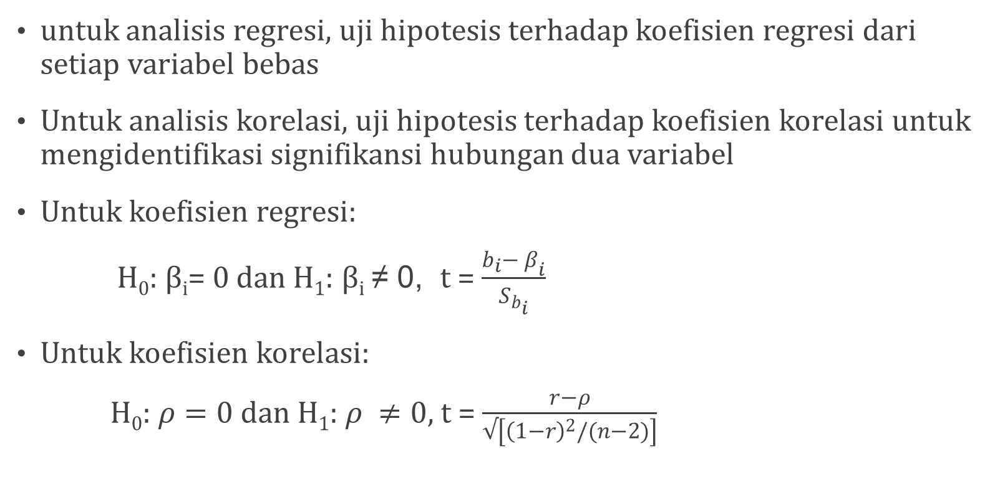
Uji Hipotesis Relasional
untuk analisis regresi, uji hipotesis terhadap koefisien regresi dari setiap variabel bebas
Untuk analisis korelasi, uji hipotesis terhadap koefisien korelasi untuk mengidentifikasi signifikansi hubungan dua variabel
Untuk koefisien regresi:
H₀: β_{i}= 0 dan H₁: β_{i} ≠ 0, t = $\frac{b_{i}− β_{i}}{S_{b_{i}}}$
Untuk koefisien korelasi:
H₀: $ρ=0$ dan H₁: $ρ ≠0$, t = $\frac{r−ρ}{√\left[{\left(1−r\right)}^{2}/(n−2)\right]}$

Slide 40

Estimating Relationship
Among Variables
Correlation
Regression
Classical Assumption For Regression Analysis
Normality
Homoscedasticity
No Multicollinearity
No Autocorrelation

Slide 41
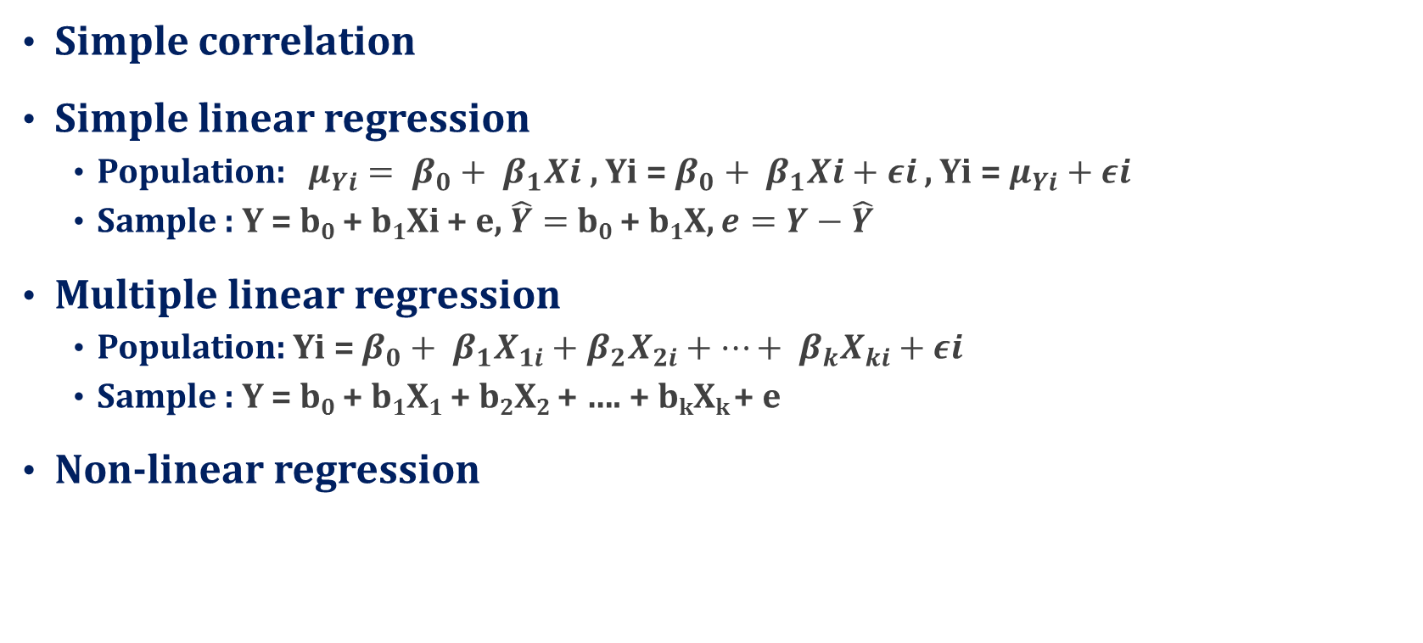
ESTIMATING RELATIONSHIP
AMONG VARIABLES
Simple correlation
Simple linear regression
  Population: $μ_{Yi}= β_{0}+ β_{1}Xi$ , Yi = $β_{0}+ β_{1}Xi+εi$ , Yi = $μ_{Yi}+$ $εi$
  Sample : Y = b₀ + b₁Xi + e, $\hat{Y}=$b₀ + b₁X, $e=Y−\hat{Y}$
Multiple linear regression
  Population: Yi = $β_{0}+ β_{1}X_{1i}+β_{2}X_{2i}+…+ β_{k}X_{ki}+εi$
  Sample : Y = b₀ + b₁X₁ + b₂X₂ + …. + b_{k}X_{k} + e
Non-linear regression

Slide 42
Uji Hipotesis
uji hipotesis relasional untuk menguji ukuran dan siginifikansi (significance)
  koefisien korelasi
  koefisien regresi
  pengaruh langsung (direct effect)
  pengaruh tak langsung (indirect effect)

Slide 43
Correlations
 |  | total modal yang digunakan | tingkat produksi
total modal yang digunakan | Pearson Correlation | 1 | .527**
 | Sig. (2-tailed) |  | .000
 | Sum of Squares and Cross-products | 301.980 | 51796.724
 | Covariance | 7.023 | 1204.575
 | N | 44 | 44
tingkat produksi | Pearson Correlation | .527** | 1
 | Sig. (2-tailed) | .000
 | Sum of Squares and Cross-products | 51796.724 | 31941740.827
 | Covariance | 1204.575 | 742831.182
 | N | 44 | 44
**. Correlation is significant at the 0.01 level (2-tailed).

Slide 44
Jadual 11.9. Hasil Analisis Regresi antara Kos Iklan dan Perolehan Jualan
The regression equation is
omset = - 64.3 + 17.8 iklan
Predictor Coef StDev T P
Constant -64.30 42.37 -1.52 0.139
iklan 17.796 1.819 9.78 0.000
S = 67.03 R-Sq = 75.5% R-Sq(adj) = 74.7%
Analysis of Variance
Source DF SS MS F P
Regression 1 429881 429881 95.68 0.000
Error 31 139284 4493
Total 32 569164

Slide 45
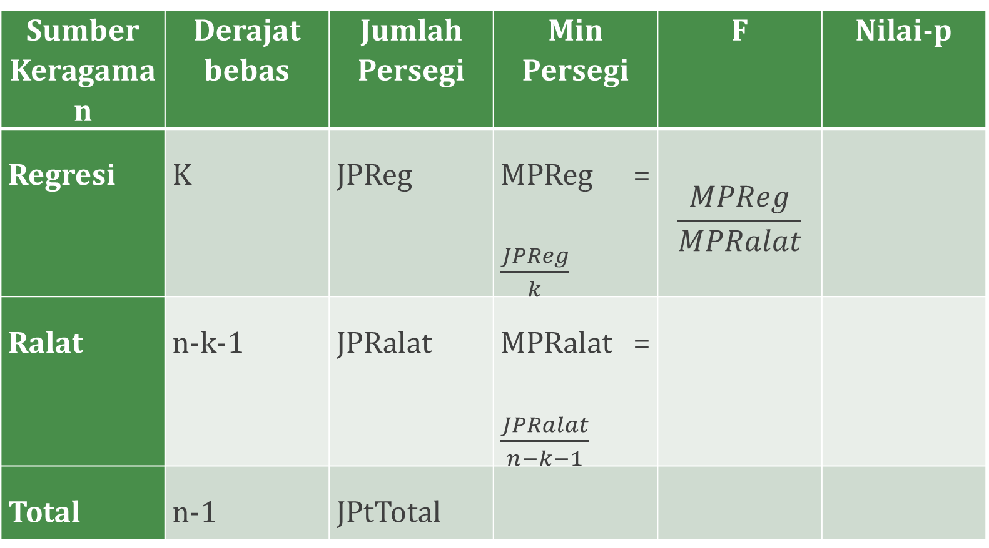
Sumber Keragaman | Derajat bebas | Jumlah Persegi | Min Persegi | F | Nilai-p
Regresi | K | JPReg | MPReg = $\frac{JPReg}{k}$ | $$\frac{MPReg}{MPRalat}$$
Ralat | n-k-1 | JPRalat | MPRalat = $\frac{JPRalat}{n−k−1}$
Total | n-1 | JPtTotal

Slide 46
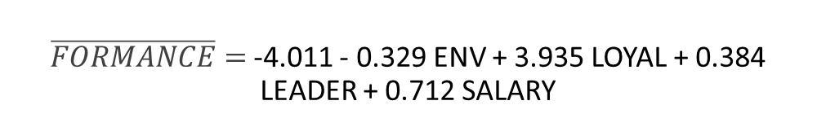
$\overline{FORMANCE}=$-4.011 - 0.329 ENV + 3.935 LOYAL + 0.384 LEADER + 0.712 SALARY
ANOVAª
Model |  | Sum of Squares | Df | Mean Square | F | Sig.
1 | Regression | 10114,229 | 4 | 2528,557 | 57,462 | ,000^{b}
 | Residual | 4136,398 | 94 | 44,004
 | Total | 14250,626 | 98
a. Dependent Variable: employee performance
b. Predictors: (Constant), salary system , manager leadership, work environment, emplyee loyality

Slide 47
Coefficientsª
Model |  | Unstandardized Coefficients |  | Standardized Coefficients | T | Sig. | Collinearity Statistics
 |  | B | Std. Error | Beta |  |  | Tolerance | VIF
1 | (Constant) | -4,011 | 7,317 |  | -,548 | ,585
 | work environment | -,329 | ,494 | -,040 | -,666 | ,507 | ,856 | 1,169
 | emplyee loyality | 3,935 | ,310 | ,794 | 12,701 | ,000 | ,790 | 1,265
 | manager leadership | ,384 | ,459 | ,048 | ,837 | ,405 | ,935 | 1,069
 | salary system | ,712 | ,350 | ,131 | 2,038 | ,044 | ,744 | 1,344
a. Dependent Variable: employee performance

Slide 48
Classical Assumption For Regression Analysis
Normality
Homoscedasticity
No Multicollinearity
No Autocorrelation

Slide 49
NORMALITY
In general, the normality test is to compare the empirical data (the data we have) to the theoretical data (distributed normally)
Normality test can be done by using:
  histogram
  stem-leaf diagram
  scatter diagram
  box plot diagram
  Lilliefors
  Kolmogorov-Smirnov
  goodness of fit test
  normal P-P Plot (normal Probability Plot)
  Most of the tests can be performed using statistical software such as SPSS, MINITAB, and others

Slide 50
NORMALITY
To test normality by using SPSS:
  ‘Analyze’
  ‘Descriptive Statistics’
  ‘Explore’
  Select the variables to be tested put on ‘dependent variable’
  “Both”
  ‘Histogram’, ‘Stem and Leaf Diagram’,
  ‘Normality plot with test’

Slide 51
Homoscedasticity
The use of regression analysis should be based on BLUE (best linear unbiased estimator)
BLUE means:
  the mean of residuals is equal to 0
  has the least variance among all estimators
  has constant variance at every level of each independent variable
  no correlation among residuals
  Homoscedasticity: the variances are equal at any level of every independent variable

Slide 52
Homoscedasticity
If heteroscedasticity occurs, an estimation would be inefficient and unreliable, the variance of residual will affect the variance of regression and would affect the test results of the regression coefficients both t-test and F-test
There are many methods to test the heteroscedasticity:
  Plot diagram
  Goldfeld-Quandt Test
  Breusch-Pagan Test
  Park Test
  Glejser Testt
  Spearman’s Rank Correlation Test
  Breusch-Pagan-Godfrey Test
  White’s General Heteroscedasticity Test,
  Koenker-Basset Test

Slide 53
Homoscedasticity
  Plot diagram, Park Test, Glejser test, and Spearman Correlations are more frequently used to test the heteroscedasticity and can be done by SPSS
  The simplest way to test heteroscedasticity is by using diagram plot between the standardized predicted value of dependent variable and standardized residual
  By SPSS, the standardized predicted value of dependent variable is written as ZPRED and the standardized residual is written as ZRESID.
  To get the diagram plot between ZPRED and ZRESID by SPSS:
    ‘ ‘regression’, ‘linear’, dependent variable , independet variable(s) ‘plot’, put ZRESID on Y-axis and ZPRED on axis-X

Slide 54
Heteroscedasticity
No heteroscedasticity
Heteroscedasticity

Slide 55
  Spearman’s Rank Correlation Test:
The indicator used to ensure the presence of heteroscedasticity is the magnitude of the correlation coefficient between each independent variable to the absolute value of the residuals.
High correlation coefficients indicate heteroscedasticity
SPSS can be used to test the heteroscedasticity with Spearman correlation as follow:
  ‘regression’
  ‘linear’
  ‘save’ (there will be a new variable saved RES_1)
  ‘Abs(RES_1)’ there RES_1 transformed to an absolute value
  ‘analyze’
  ‘correlate’
  ‘bivariate’

Slide 56
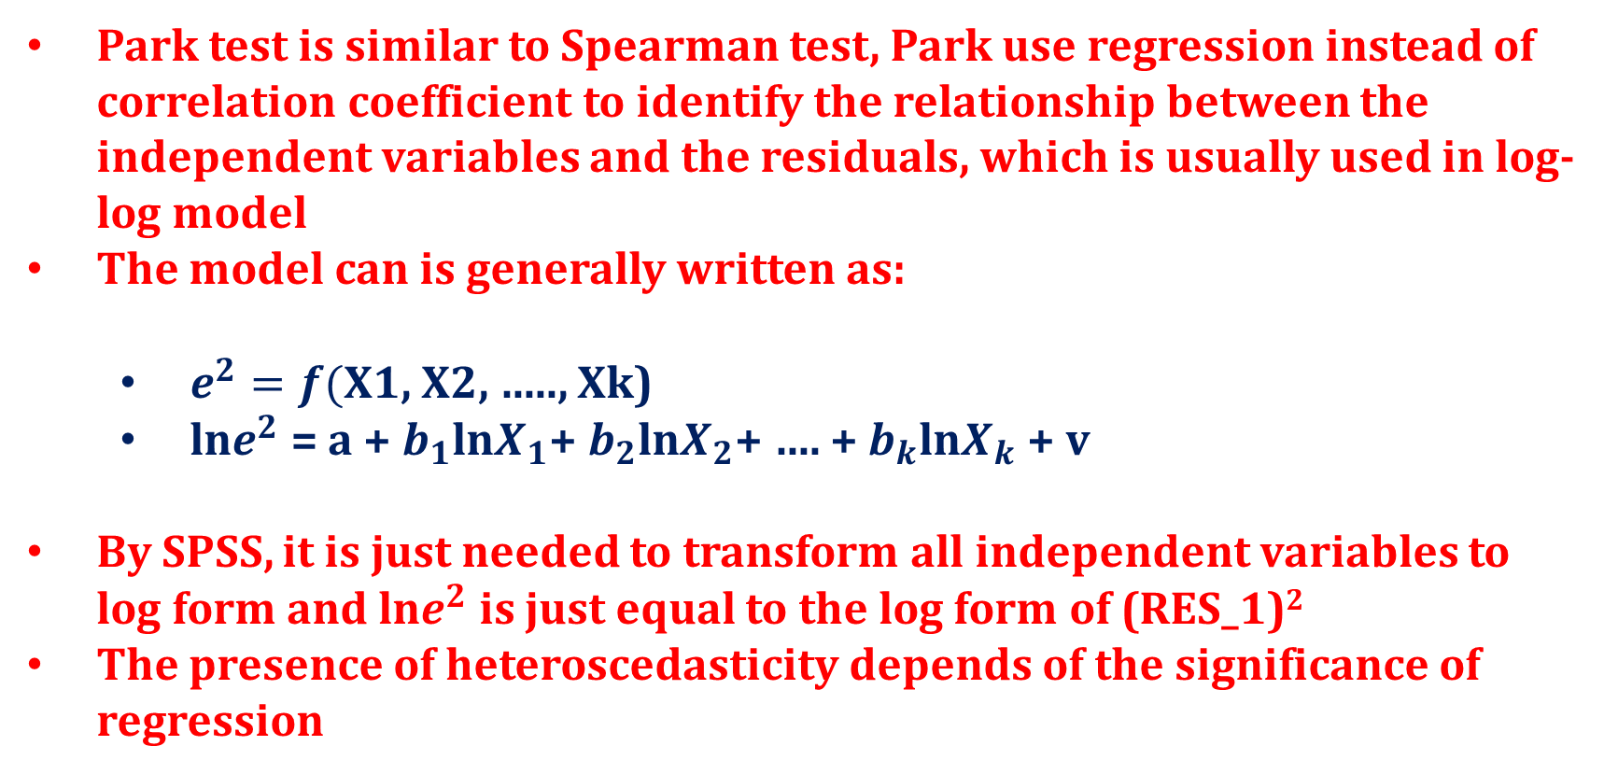
Park test
Park test is similar to Spearman test, Park use regression instead of correlation coefficient to identify the relationship between the independent variables and the residuals, which is usually used in log-log model
The model can is generally written as:
  $e^{2}=f($X1, X2, ….., Xk)
  ln$e^{2}$ = a + $b_{1}$ln$X_{1}$+ $b_{2}$ln$X_{2}$+ …. + $b_{k}$ln$X_{k}$ + v
By SPSS, it is just needed to transform all independent variables to log form and ln$e^{2}$ is just equal to the log form of (RES_1)²
The presence of heteroscedasticity depends of the significance of regression

Slide 57
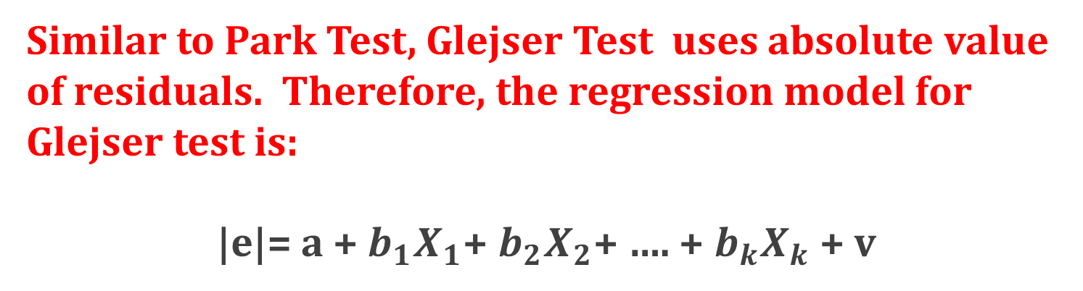
Glejser Test
Similar to Park Test, Glejser Test uses absolute value of residuals. Therefore, the regression model for Glejser test is:
|e|= a + $b_{1}X_{1}$+ $b_{2}X_{2}$+ …. + $b_{k}X_{k}$ + v

Slide 58
Multicollinearity
Multicollinearity is the presence of perfect linear correlation or very high correlation among the independent variables which cause the regression coefficients are no longer shows the real effect of the independent variables in the model, so that the test results will not be accurate beause the variance the regression will be very high
As a result, the tests performed on each of the regression coefficients will tend to be no significant because the standard deviation of the regression coefficient will be very large, the statistical value of t will be small, so it tends to reject the basic hypothesis (H₀)
That is why if the model is not free from multicollinearity, the coefficient of determination (R²) will be very high, the value of the F statistic will also be very high, but the regression coefficient tends to be no significant because the value of t statistic tends to be very small.

Slide 59
Multicollinearity
Various ways are used to detect multicollinearity. It can be identified by :
  Calculating the correlation coefficient among independent variables,
  Comparing the coefficient of determination of each independent variable (r²) to the coefficient of determination for all independent variables (R²),
    Condition Index (CI)
    Tolerance Value (TOL)
    Eigenvalue
    Variance Inflation Factor (VIF)

Slide 60
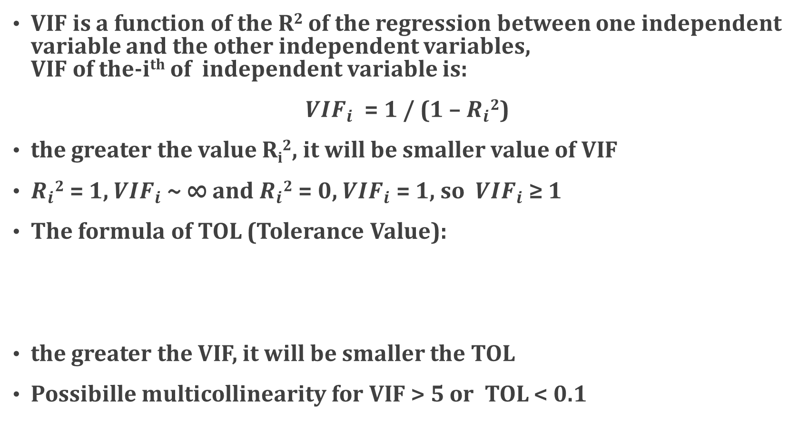
Multicollinearity
VIF is a function of the R² of the regression between one independent variable and the other independent variables,
VIF of the-i^{th} of independent variable is:
${VIF}_{i}$ = 1 / (1 – $R_{i}$²)
the greater the value R_{i}², it will be smaller value of VIF
$R_{i}$² = 1, ${VIF}_{i}$~ ∞ and $R_{i}$² = 0, ${VIF}_{i}$= 1, so ${VIF}_{i}$ ≥ 1
The formula of TOL (Tolerance Value):
the greater the VIF, it will be smaller the TOL
Possibille multicollinearity for VIF > 5 or TOL < 0.1

Slide 61
Multicollinearity
Another way to detect multicollinearity problem is by calculating the characteristic value (eigenvalue) of the X'X matrix, where the matrix X is a data matrix of independent variables
eigenvalue symbolized as λ_{i} where λ_{i} > 0 and i is equal to 1,2, ..., p + 1, p is the number of independent variables
multicollinearity level is determined based on the comparison between the λ maximum and the λ minimum expressed as k.
In general,
  k <100, no multicollinearity problem,
  100 ≤ k ≤ 1000, moderate multicollinearity problem
  k> 1000, serious multicollinearity problem

Slide 62
Multicollinearity
Condition Index (CI) is equal to the square root of k
  CI < 10, no multicollinearity problem
  10<CI< 30, moderate multicollinearity problem
  CI> 30.,serious multicollinearity problem
  VIF, TOL, eigenvalue, and CI can be calculated by using statistical software like SPSS
  For SPSS, can be performed as follow:
    ‘analyze’,
    ‘regression’,
    ‘linear’
    after defining variables then
    ‘statistics’
    ‘collinearity diagnostics’ (if needed ‘covariance matrix’)

Slide 63
Autocorrelation
The presence of highly correlated between one observation value and other observation value. Of course for time series data, it can be said that highly correlated between one observation value for a certain time period and the observation value for previous observation
Usually, autocorrelation problem is rare found for cross section data, but it often occurs for the time series data
One way to test the autocorrelation is the Durbin-Waston Test. This test is based on the consideration that the residuals for a certain period in the regression model is influenced by the residual in the previous period, so it can be expressed as
ε_{t} = ρε_{t-1} + a_{t}
ρ which magnitude is -1 <ρ <1, is an indicator of the level of autocorrelation

Slide 64
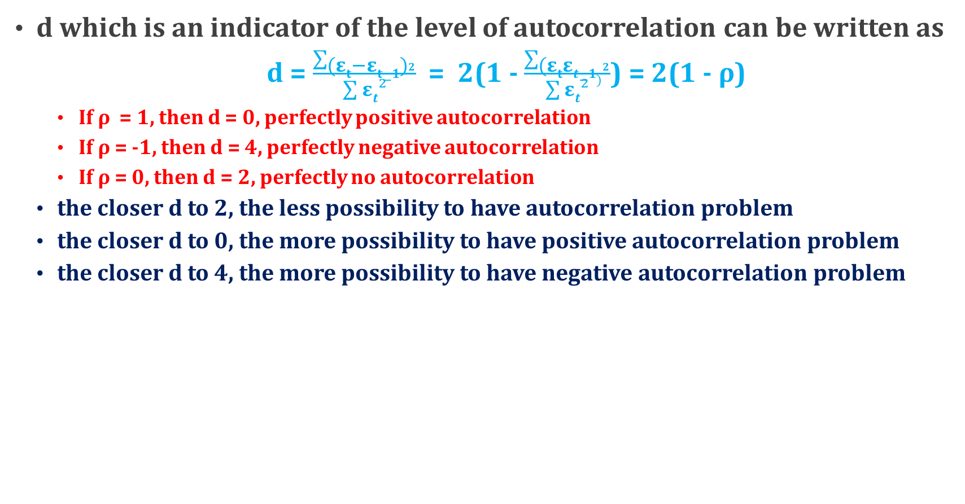
Autocorrelation
d which is an indicator of the level of autocorrelation can be written as
  d = $\frac{\sum{{(εt−εt−1)}^{2}}}{\sum{εt}²}$ = 2(1 - $\frac{\sum{{(εtεt−1)}^{2}}}{\sum{εt}²}$) = 2(1 - ρ)
    If ρ = 1, then d = 0, perfectly positive autocorrelation
    If ρ = -1, then d = 4, perfectly negative autocorrelation
    If ρ = 0, then d = 2, perfectly no autocorrelation
  the closer d to 2, the less possibility to have autocorrelation problem
  the closer d to 0, the more possibility to have positive autocorrelation problem
  the closer d to 4, the more possibility to have negative autocorrelation problem

Slide 65
Autocorrelation
The limit indicating d close to or far from 0, 2, or 4, is determined by using Durbin-Watson table, which shows the value of dL and dU depending of the numbers of variables and observations
  Positive autocorrelation if d <d_{L}
  Can not be concluded if d_{L} <d <d_{U}
  No autocorrelation if d_{U} <d <4 - d_{U}
  Can not be concluded if 4 - d_{U} <d <4 - d_{L}
  Negative autocorrelation if d> 4 – d_{L}
  By using SPSS, it is just needed to click 'Durbin-Watson' on 'statistics' menu after entering the independent variables and the dependent variable

Slide 66
MORE ON ESTIMATING RELATIONSHIP
AMONG VARIABLES
Logistic Regression
Path Analysis
Structural Equation Modeling
Partial Least Square

Slide 67
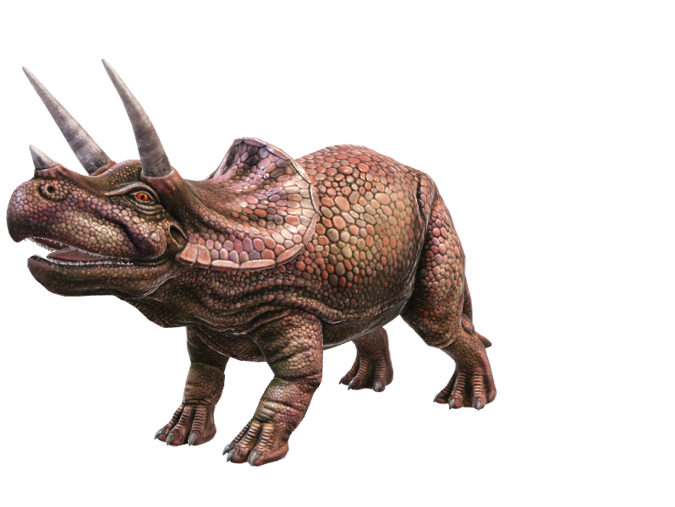
Statistika Nonparametrik
Ketika asumsi statistika parametrik tak dapat dipenuhi
Test yang dilakukan kekuatannya lebih rendah daaripada statistika parametrik

Slide 68

Statistika Non Parametric Statistics
  Goodness-of-fit Test
  Test For Homogeneity
  Test For Independency
  Sign Test
  Mann-Whitney Test (Wilcoxon)
  Wilcoxon Signed Ranks Test
  Uji Kruskal Wallis
  Spearman’s Correlation

Slide 69
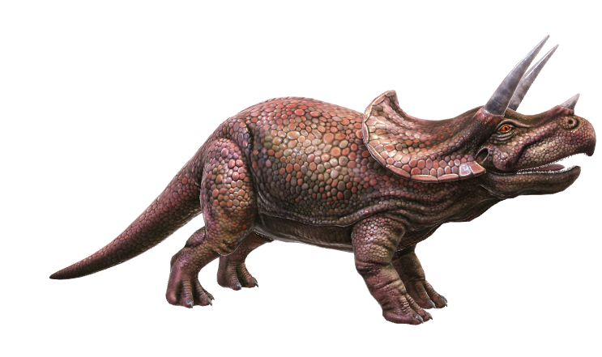
Ada dua jenis untuk pengujian χ²:
  Goodness-of-fit Test (Uji Kesesuaian)
  Test For Homogeneity and Independence (Test Homogenitas dan Independensi)
Tiga asumsi yang mesti dipenuhi untuk χ²:
  Random sampling
  Independence of observations
  Size of expected frequencies- jumlah frekuensi ekpektasi tidak kurang dari 10, untuk sampel kecil minimal jumlah data per sel 5, tapi untuk frekuensi observasi bisa berapapun

