Slide 1
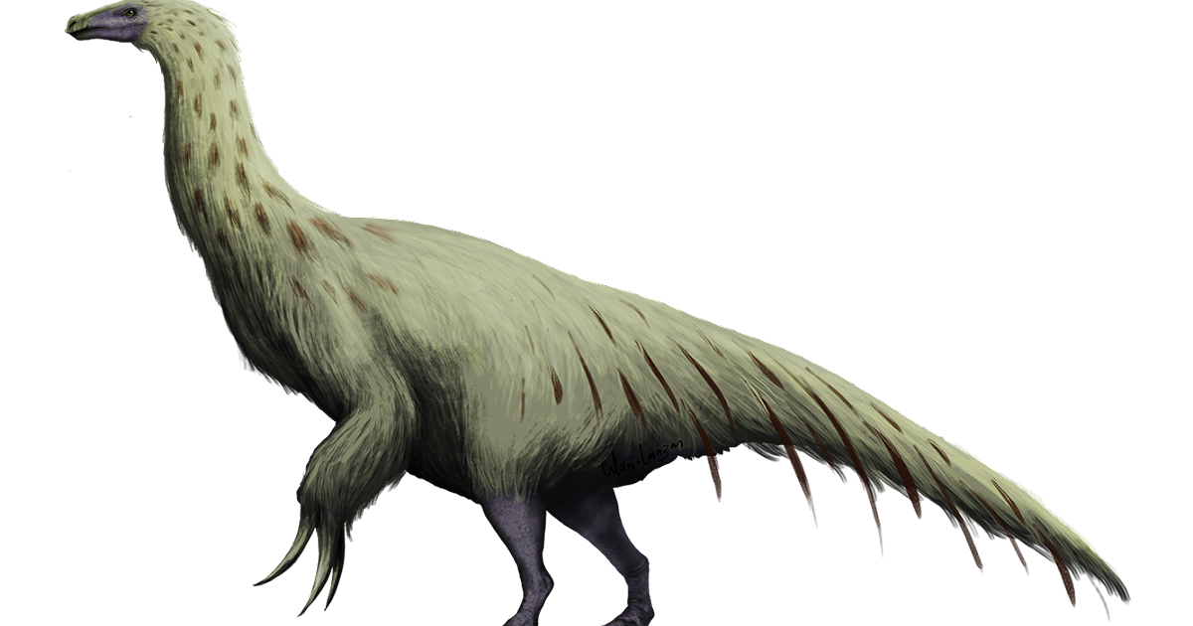
Tambahan Contoh Analisis Data untuk Uji Hipotesis
Zulkarnain Lubis

Slide 2
One-Sample t Test
One-Sample Statistics
 | N | Mean | Std. Deviation | Std. Error Mean
capital in RM millions | 99 | 23.722 | 20.9164 | 2.1022
One-Sample Test
 | Test Value = 25
 | t | df | Sig. (2-tailed) | Mean Difference | 95% Confidence Interval of the Difference
 |  |  |  |  | Lower | Upper
capital in RM millions | -.608 | 98 | .545 | -1.2783 | -5.450 | 2.893

Slide 3
Two Independent Samples t Test
Group Statistics
 | jenis usaha | N | Mean | Std. Deviation | Std. Error Mean
business performance | makanan | 47 | 46.596 | 12.9877 | 1.8945
 | anyaman | 52 | 44.231 | 11.1612 | 1.5478
Independent Samples Test
 |  | Levene's Test for Equality of Variances |  | t-test for Equality of Means
 |  | F | Sig. | t | df | Sig. (2-tailed) | Mean Difference | Std. Error Difference | 95% Confidence Interval of the Difference
 |  |  |  |  |  |  |  |  | Lower | Upper
business performance | Equal variances assumed | 1.592 | .210 | .974 | 97 | .332 | 2.3650 | 2.4276 | -2.4532 | 7.1832
 | Equal variances not assumed |  |  | .967 | 91.239 | .336 | 2.3650 | 2.4463 | -2.4942 | 7.2242

Slide 4
Analysis of Variance ; F test for k independent samples
ANOVA
EXP
 | Sum of Squares | df | Mean Square | F | Sig.
Between Groups | 220.973 | 4 | 55.243 | 1.561 | .195
Within Groups | 2299.718 | 65 | 35.380
Total | 2520.691 | 69

Slide 5
ANOVA for Polynomial Test
ANOVA
omset
 |  |  | Sum of Squares | df | Mean Square | F | Sig.
Between Groups | (Combined) |  | 803.325 | 3 | 267.775 | 18.768 | .000
 | Linear Term | Unweighted | 130.010 | 1 | 130.010 | 9.112 | .003
 |  | Weighted | 144.262 | 1 | 144.262 | 10.111 | .002
 |  | Deviation | 659.063 | 2 | 329.532 | 23.097 | .000
 | Quadratic Term | Unweighted | 625.173 | 1 | 625.173 | 43.818 | .000
 |  | Weighted | 616.370 | 1 | 616.370 | 43.201 | .000
 |  | Deviation | 42.694 | 1 | 42.694 | 2.992 | .086
Within Groups |  |  | 1683.560 | 118 | 14.267
Total |  |  | 2486.885 | 121

Slide 6
Paired Samples Statistics
 |  | Mean | N | Std. Deviation | Std. Error Mean
Pair 1 | economicsuccess after supervision | 40.8407 | 41 | 8.19792 | 1.28030
 | economicsuccess before supervision | 30.0293 | 41 | 5.15270 | .80472
Pair Samples t Test
Paired Samples Correlations
 |  | N | Correlation | Sig.
Pair 1 | economicsuccess after supervision & economicsuccess before supervision | 41 | .617 | .000
Paired Samples Test
 |  | Paired Differences |  |  |  |  | t | df | Sig. (2-tailed)
 |  | Mean | Std. Deviation | Std. Error Mean | 95% Confidence Interval of the Difference
 |  |  |  |  | Lower | Upper
Pair 1 | economicsuccess after supervision - economicsuccess before supervision | 10.81146 | 6.45160 | 1.00757 | 8.77509 | 12.84784 | 10.730 | 40 | .000

Slide 7
Model Summary^{b}
Model | R | R Square | Adjusted R Square | Std. Error of the Estimate | Change Statistics
 |  |  |  |  | R Square Change | F Change | df1 | df2 | Sig. F Change
1 | .709ª | .502 | .486 | 525.2224 | .502 | 30.260 | 1 | 30 | .000
a. Predictors: (Constant), kemandirian belajar
b. Dependent Variable: keberhasialan di tempat kerja
ANOVAª
Model |  | Sum of Squares | df | Mean Square | F | Sig.
1 | Regression | 8347596.388 | 1 | 8347596.388 | 30.260 | .000^{b}
 | Residual | 8275756.465 | 30 | 275858.549
 | Total | 16623352.853 | 31
a. Dependent Variable: keberhasialan di tempat kerja
b. Predictors: (Constant), kemandirian belajar
Simple Linear Regression
Coefficientsª
Model |  | Unstandardized Coefficients |  | Standardized Coefficients | t | Sig. | 95.0% Confidence Interval for B
 |  | B | Std. Error | Beta |  |  | Lower Bound | Upper Bound
1 | (Constant) | -153.853 | 571.320 |  | -.269 | .790 | -1320.644 | 1012.939
 | kemandirian belajar | 10.433 | 1.897 | .709 | 5.501 | .000 | 6.560 | 14.306
a. Dependent Variable: keberhasialan di tempat kerja

Slide 8
Model Summary^{b}
Model | R | R Square | Adjusted R Square | Std. Error of the Estimate | Durbin-Watson
1 | .697ª | .485 | .436 | .9267 | 2.140
a. Predictors: (Constant), kehadiran saat pelatihan, tingkat religiusitas, jumlah kredit yang diterima, kepemilikan lahan, kecukupan kredit yang diterima
b. Dependent Variable: pendapatan petani
Multiple Linear Regression
ANOVAª
Model |  | Sum of Squares | df | Mean Square | F | Sig.
1 | Regression | 42.092 | 5 | 8.418 | 9.803 | .000^{b}
 | Residual | 44.656 | 52 | .859
 | Total | 86.748 | 57
a. Dependent Variable: pendapatan petani
b. Predictors: (Constant), kehadiran saat pelatihan, tingkat religiusitas, jumlah kredit yang diterima, kepemilikan lahan, kecukupan kredit yang diterima

Slide 9
Coefficientsª
Model |  | Unstandardized Coefficients |  | Standardized Coefficients | t | Sig. | Collinearity Statistics
 |  | B | Std. Error | Beta |  |  | Tolerance | VIF
1 | (Constant) | 5.520 | 1.138 |  | 4.850 | .000
 | tingkat religiusitas | .025 | .010 | .269 | 2.605 | .012 | .927 | 1.079
 | jumlah kredit yang diterima | .004 | .022 | .019 | .178 | .860 | .902 | 1.108
 | kecukupan kredit yang diterima | .134 | .133 | .119 | 1.003 | .320 | .706 | 1.416
 | kepemilikan lahan | .591 | .131 | .490 | 4.520 | .000 | .841 | 1.189
 | kehadiran saat pelatihan | .078 | .100 | .091 | .785 | .436 | .738 | 1.355
a. Dependent Variable: pendapatan petani

