Slide 1




Pengolahan dan Analisis Data-2
Zulkarnain Lubis

Slide 2

Inductive Statistics
Parametric Statistics
Non-Parametric Statistics
Parametric Statistics: based on strict assumptions relating to the characteristics of the population from which data were obtained
Such assumptions: normal distribution, independent, homogenous variance
Usually used interval and ratio scale of measurement
Suitable for natural science
Non-Parametric Statistics: The assumptions are not so strict , the assumption is usually required only symmetry
Can be used for an ordinal, interval, and ratio scale of measurement
Suitable social sciences which are sometimes the data are difficult to be quantified

Slide 3

Berbagai Jenis Analisis Statistik dan Uji hipotesis
analisis statistik univariat (univariate statistical analysis) yang merupakan uji hipotesis terhadap hanya satu variabel
analisis statistik bivariate (bivariate statistical analysis) yang merupakan uji hipotesis untuk dua variabel
analisis statistik multivariat (multivariate statistical analysis) yang merupakan uji hipotesis untuk banyak variabel

Slide 4

Uji Hipotesis
hipotesis relasional (relational hypothesis) berupa uji hipotesis pengaruh perubahan satu variabel kepada perubahan variabel lainnya
hipotesis untuk mengidentifikasi perbedaan antar group untuk melakukan pengujian apakah nilai satu variabel berbeda antara satu group dengan group lainnya
hipotesis untuk melakukan pengujian apakah nilai variable tertentu sama besar atau berbeda dengan satu ukuran yang telah ditentukan

Slide 5




Test for population mean
One sample t test for population mean
T test for comparing two population means
ANOVA for testing population means of k independent

Slide 6
Uji Hipotesis Relasional
sekadar keeratan hubungan, digunakan koefisien korelasi
mengetahui pengaruh satu atau lebih variabel terhadap variabel lain, digunakan analisis regresi
analisis regresi, dua jenis variabel:
  variabel yang mempengaruhi (variabel bebas)
  variabel yang dipengaruhi (variabel tak bebas)
  uji hipotesis untuk analisis regresi, apakah perubahan variabel bebas signifikan memberi perubahan pada variabel tak bebas
  untuk analisis korelasi, hanya sekedar ingin mengidentifikasi keeratan hubungan dua variabel tanpa memerlukan yang mana yang mempengaruhi dan yang mana yang dipengaruhi.

Slide 7
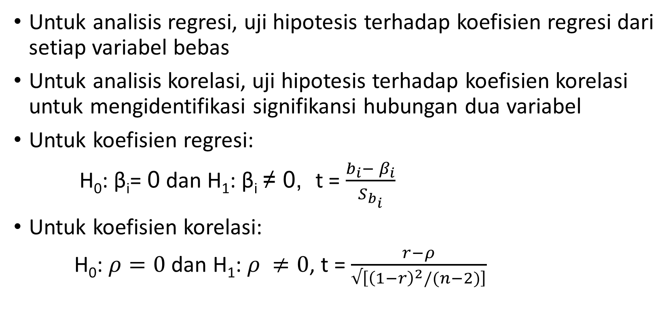
Uji Hipotesis Relasional
Untuk analisis regresi, uji hipotesis terhadap koefisien regresi dari setiap variabel bebas
Untuk analisis korelasi, uji hipotesis terhadap koefisien korelasi untuk mengidentifikasi signifikansi hubungan dua variabel
Untuk koefisien regresi:
H₀: β_{i}= 0 dan H₁: β_{i} ≠ 0, t = $\frac{b_{i}− β_{i}}{S_{b_{i}}}$
Untuk koefisien korelasi:
H₀: $ρ=0$ dan H₁: $ρ ≠0$, t = $\frac{r−ρ}{√\left[{\left(1−r\right)}^{2}/(n−2)\right]}$

Slide 8

Estimating Relationship
Among Variables
Correlation
Regression
Classical Assumption For Regression Analysis
Normality
Homoscedasticity
No Multicollinearity
No Autocorrelation

Slide 9
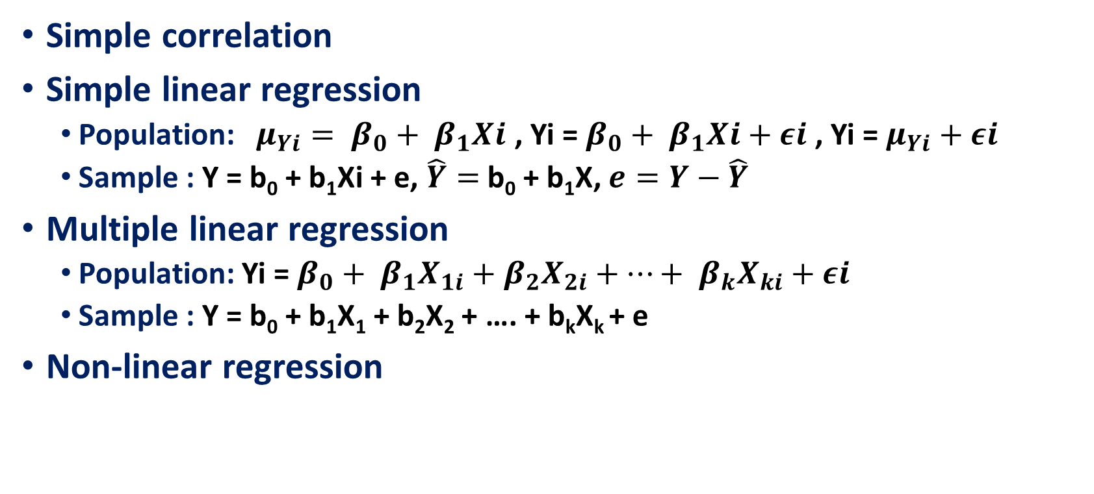
ESTIMATING RELATIONSHIP
AMONG VARIABLES
Simple correlation
Simple linear regression
  Population: $μ_{Yi}= β_{0}+ β_{1}Xi$ , Yi = $β_{0}+ β_{1}Xi+εi$ , Yi = $μ_{Yi}+$ $εi$
  Sample : Y = b₀ + b₁Xi + e, $\hat{Y}=$b₀ + b₁X, $e=Y−\hat{Y}$
Multiple linear regression
  Population: Yi = $β_{0}+ β_{1}X_{1i}+β_{2}X_{2i}+…+ β_{k}X_{ki}+εi$
  Sample : Y = b₀ + b₁X₁ + b₂X₂ + …. + b_{k}X_{k} + e
Non-linear regression

Slide 10

Uji Hipotesis
uji hipotesis relasional untuk menguji ukuran dan siginifikansi (significance)
koefisien korelasi
koefisien regresi
pengaruh langsung (direct effect)
pengaruh tak langsung (indirect effect)

Slide 11

Statistika Nonparametrik
Ketika asumsi statistika parametrik tak dapat dipenuhi
Test yang dilakukan kekuatannya lebih rendah daaripada statistika parametrik

Slide 12
In general, statistical parametric and non-parametric statistics have equivalent analytical tools that can be used for the same purpose
The Pair of Data Analysis Tools of Parametric and Non Parametric Statistics
Hypothesis | Parametric | Non Parametric
One sample or paired samples | Z-test or t-test | Sign test or Wilcoxon sign test
Two independent samples | Z-test or t-test | Mann-Whitney-(Wilcoxon) test
Many independent samples | F-test (ANOVA) | Kruskal Wallis test or Friedmen test
The parameters of location or dispersion of two independent samples | F-test | Siegel Tukey test
Association or Correlation Analysis | Pearson Correlation or χ2 test or F-test | Spearman Correlation or Tau Kendall Correlation

Slide 13

More On Estimating Relationship
Among Variables
Logistic Regression
Path Analysis
Structural Equation Modeling
Partial Least Square

Slide 14
Logistic Regression
For logistic regression, the data scale dependent variable (Y) is categorical (non-metric), either binary (binary logistic regression) or multinomial (ordinal logistic regression)
In logistic regression, we know namely the concept of odds ratio related to the concept of probability
Logistic regression is part of the regression analysis that is used when the dependent variable (response) is a dichotomous variable (for binary).
Dichotomous variables usually only consists of two values, which represent the appearance or absence of an event that is usually given the number 0 or 1

Slide 15
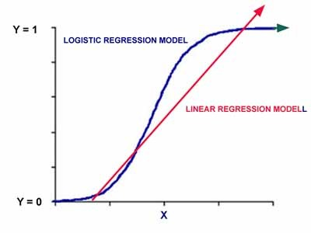
Unlike ordinary linear regression, logistic regression does not assume the relationship between independent and dependent variables is linear. Logistic regression is a non-linear regression models specified which would follow the pattern of the curve as shown below

Slide 16
The model used in the logistic regression is:
Log (p / 1 - p) = β0 + β1X1 + β2X2 + .... + βkXk
Where p is the possibility for Y = 1, and X1, X2, X3 are the independent variables, and βs are regression coefficients.

Slide 17

direct and indirect effect
Direct effect and Indirect effect can be identified by :
  path analysis
  structural equation modeling
  partial least squares

Slide 18
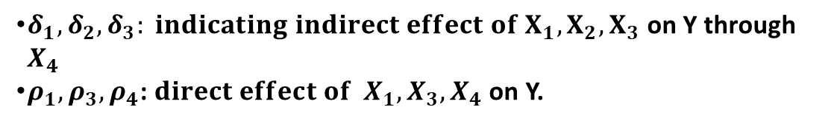

Path Analysis
Path analysis is a technique for analyzing the causal relationship that occurs in multiple regression if the independent variables affect the dependent variable not only directly but also indirectly ". (Robert D. Retherford 1993)
Path analysis is an extension of multiple regression analysis
$$X_{1}$$
$$X_{4}= δ_{0}+δ_{1}X_{1}+ δ_{2}X_{2}+δ_{3}X_{3}+ ∈$$
$$Y= ρ_{0}+ρ_{1}X_{1}+ρ_{3}{ X}_{3}+ρ_{4} X_{4}+ε$$
$$X_{2}$$
$$X_{4}$$
Y
$δ_{1}, δ_{2}, δ_{3}: indicating indirect effect of X_{1}, X_{2}, X_{3}$ on Y through $X_{4}$
$ρ_{1}, ρ_{3}, ρ_{4}$: $direct effect of { X}_{1}, X_{3}, X_{4}$on Y.
$$X_{3}$$

Slide 19
Structural Equation Modeling
Structural equation modeling (SEM)
  A very general, chiefly linear, chiefly cross-sectional statistical modeling technique
    factor analysis
    path analysis and
    regression
SEM is a largely confirmatory rather than exploratory technique
  A researcher are more likely to use SEM to determine whether a certain model is valid rather than using SEM to "find" a suitable model
  Although SEM analyses often involve a certain exploratory element

Slide 20
A structural equation model implies a structure of the covariance matrix of the measures
hence an alternative name for this field, "analysis of covariance structures"

Slide 21
Partial Least Square (PLS)
PLS is an alternative method of settlement of a complex multilevel models that do not require a big size samples
PLS regression is particularly useful when we need to predict a set of dependent variables from a (very) large set of independent variables (predictors)
In addition there are also some advantages, namely PLS which will have implications for the optimal prediction accuracy
PLS method is a powerful method of analysis because it does not assume a scale of measurement data and can also be used to confirm the theory

Slide 22
PLS regression is a recent technique that generalizes and combines features from principal component analysis and multiple regression.
Its goal is to predict or analyze a set of dependent variables from a set of independent variables or predictors.
This prediction is achieved by extracting from the predictors a set of orthogonal factors called latent variables which have the best predictive power.
Some programs are designed to complete the PLS is SmartPLS, PLSGraph, VPLS or PLS-GUI.

Slide 23

Salah Kaprah Tentang Statistika
Cenderung hanya selesai dengan persamaan-persamaan matematika
Cenderung cukup pada kesimpulan nyata dan tidak nyata dalam pengujian hipotesis
Banyak yang menggunakan alat analisis statistika tanpa mempertimbangkan apakah tepat atau tidak.
Menganggap jika sudah menggunakan statistika, sudah pasti valid kesimpulan yang diambil.
Salah dalam menginterpretasi hasil analisis

Slide 24

Sekian dan Terima Kasih
Zulkarnain Lubis

