Slide 1

PANDUAN PENGGUNAAN SPSS UNTUK ANALISIS DATA
Zulkarnain Lubis

Slide 2
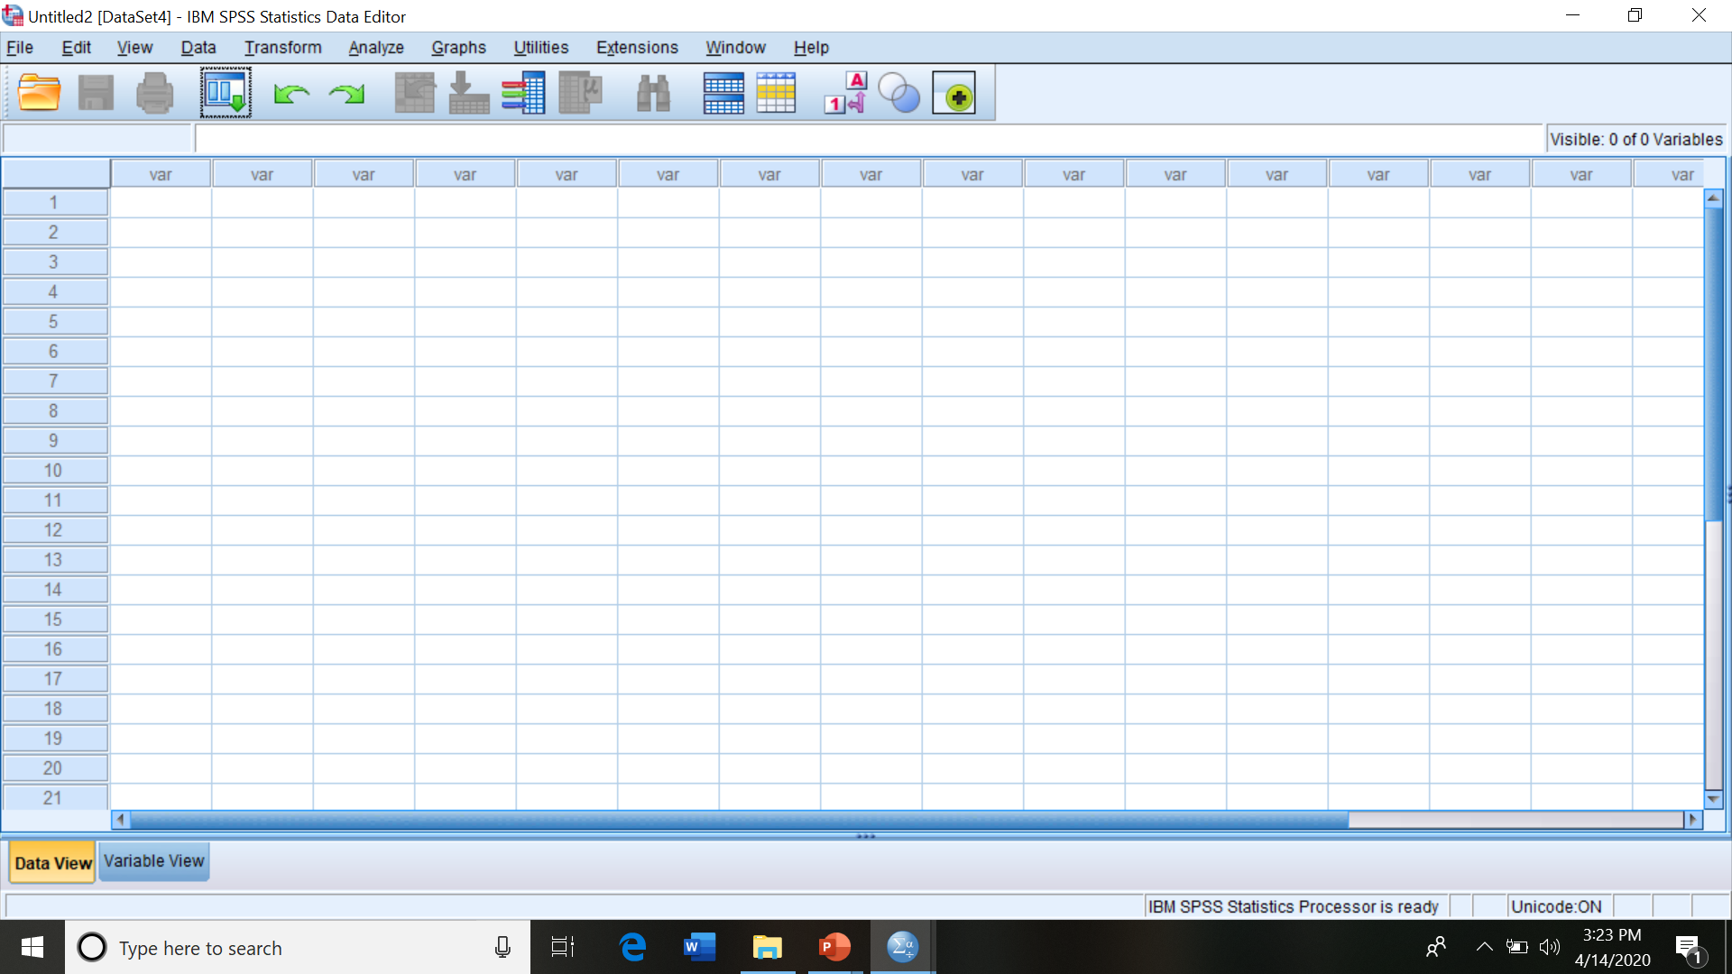
Memulai membuka SPSS
Dimulai dengan Data Editor

Slide 3
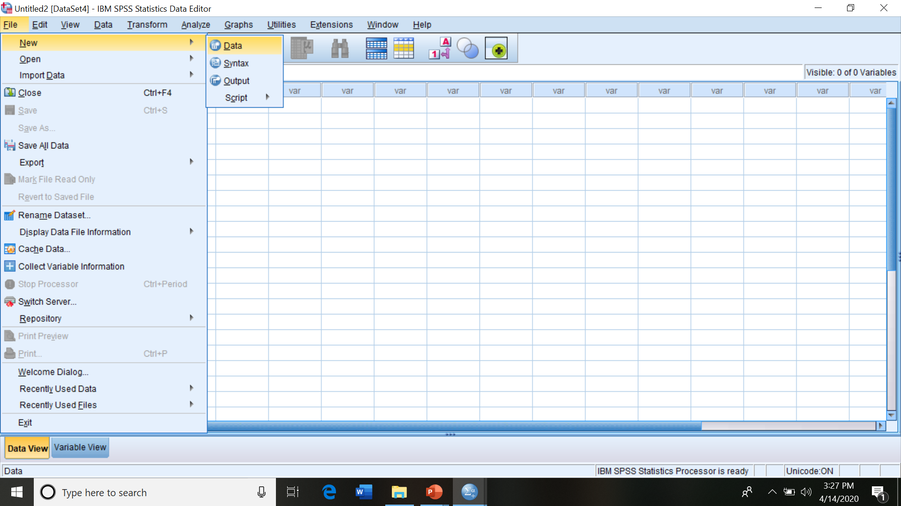
Data Editor akan ditunjukkan dengan perintah “file”, “new”, “data”, dan ENTER
OPEN FILE

Slide 4
Katakan data yang akan diolah terdiri dari 99 industry rumah tangga dengan 7 variabel berikut akan dilakukan entry data dengan SPSS
Modal | Tenagakerja | produksi | manajemen | Usia | Kepatuhan | reigiusitas
11.43 | 394.80 | 3180.96 | 2 | 39 | 80 | 36
11.45 | 378.00 | 2916.00 | 1 | 44 | 58 | 28
11.49 | 364.00 | 2704.00 | 1 | 32 | 82 | 25
11.37 | 410.90 | 3445.69 | 2 | 70 | 62 | 28
….. | ….. | ….. | ….. | ….. | ….. | …..
….. | ….. | ….. | ….. | ….. | ….. | …..
….. | ….. | ….. | ….. | ….. | ….. | …..
11.14 | 365.61 | 3176.99 | 2 | 70 | 26 | 32
13.84 | 373.45 | 2990.62 | 2 | 38 | 36 | 35

Slide 5
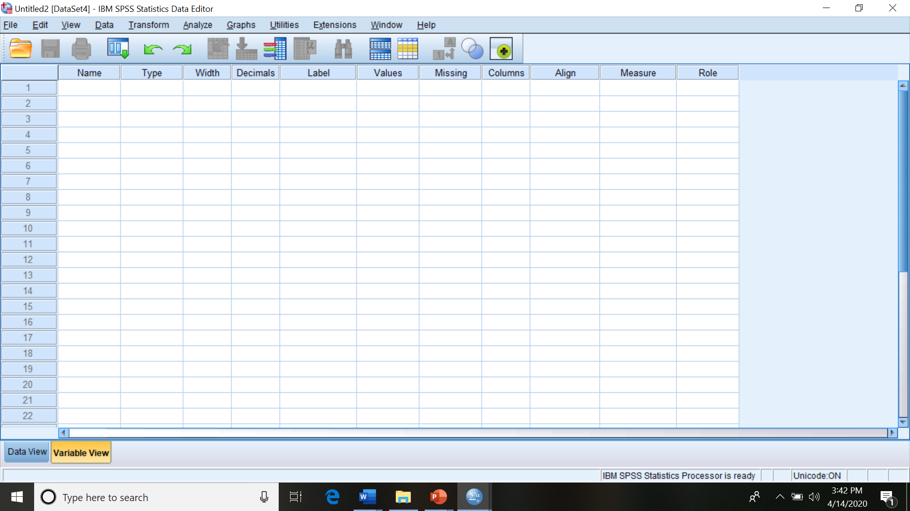
Untuk memberi nama variabel: Pilih Variable View dan lakukan seperti berikut:
Variable View:
name, type, width, decimal, label, values, align, measure

Slide 6
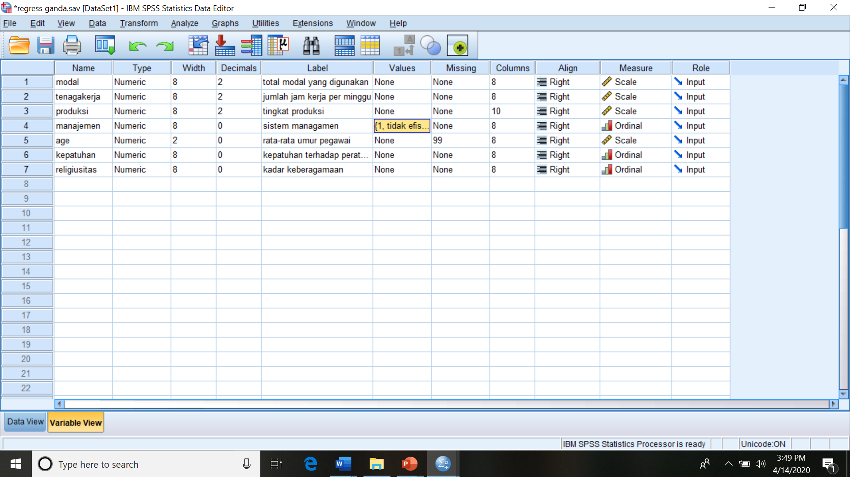
Ketikkan nama dan identitas variabel lainnya sesuai variabel masing-masing, sehingga diperoleh seperti berikut
Arti nilai yang diperoleh
Digit data
Skala pengukuran
Nama file
Banyaknya desimal

Slide 7
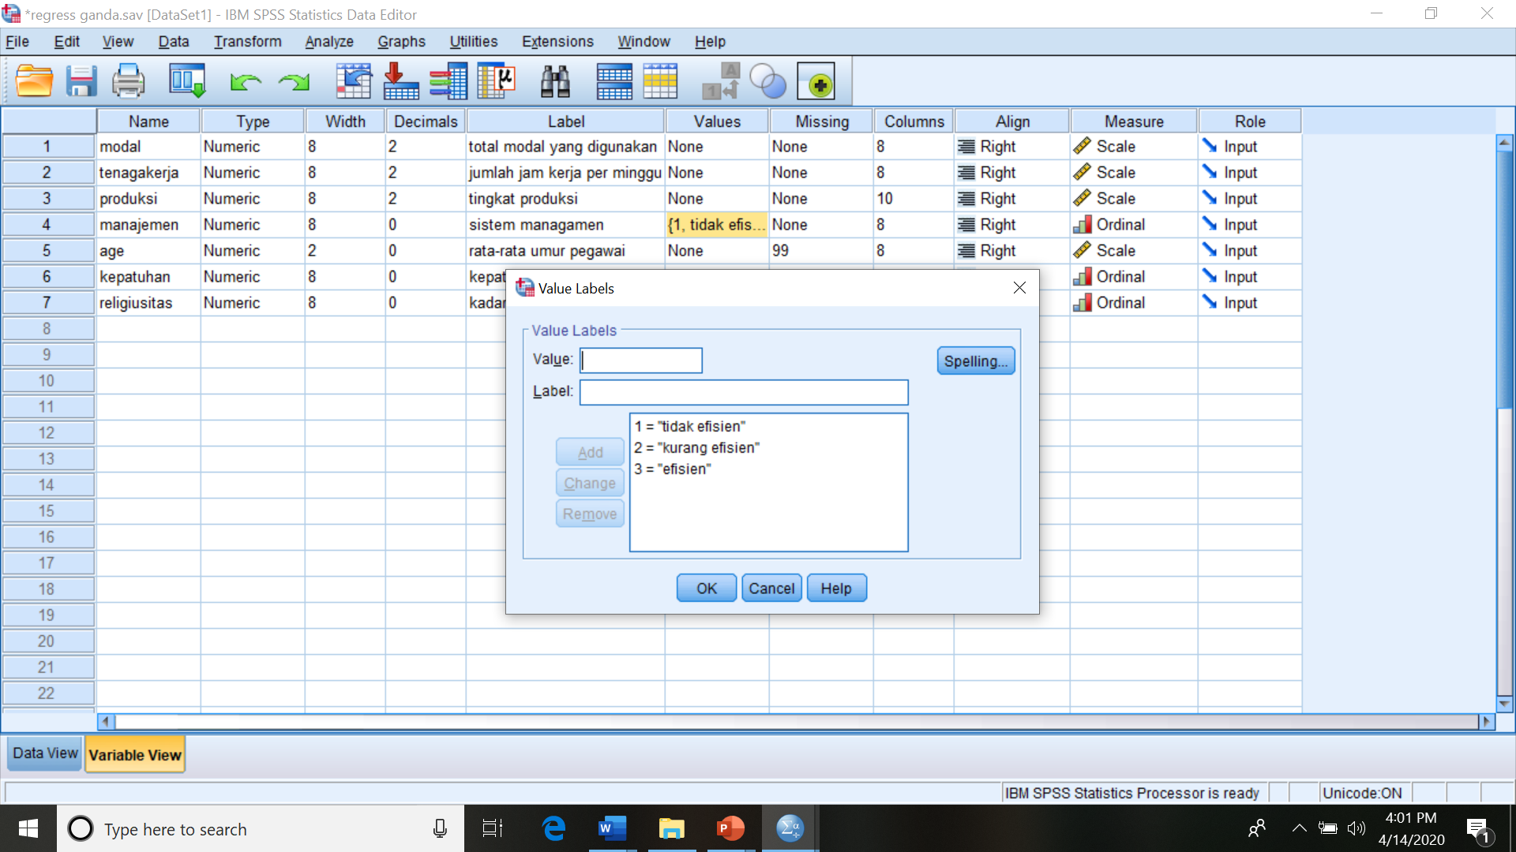
Cara membuat “value” dari variable kategorikal
Dituliskan sesuai defenisi yang dibuat

Slide 8
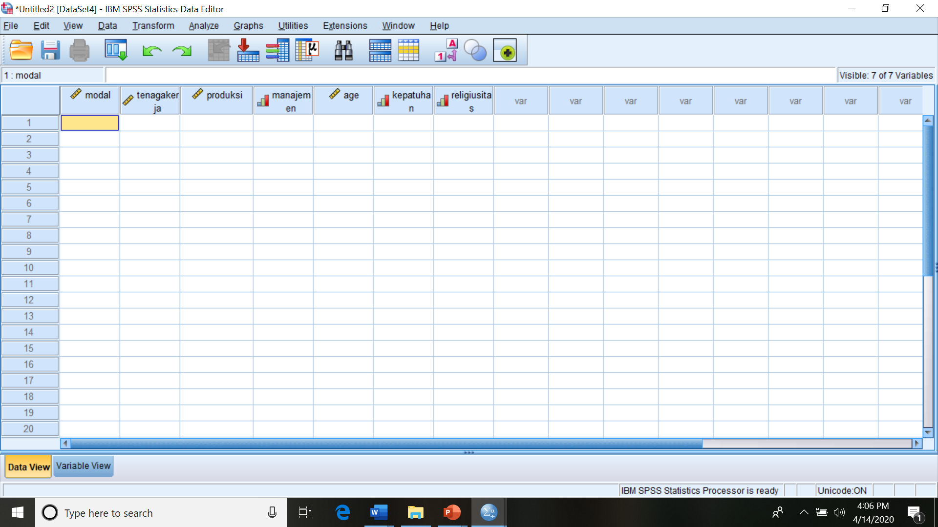
Entry Data; Click Data View dan masukkan data sesuai pengamatan dan variabel
Masukkan setiap nilai pengamatan untuk setiap variabel sampai selesai, sehingga diperoleh seperti slide berikut

Slide 9
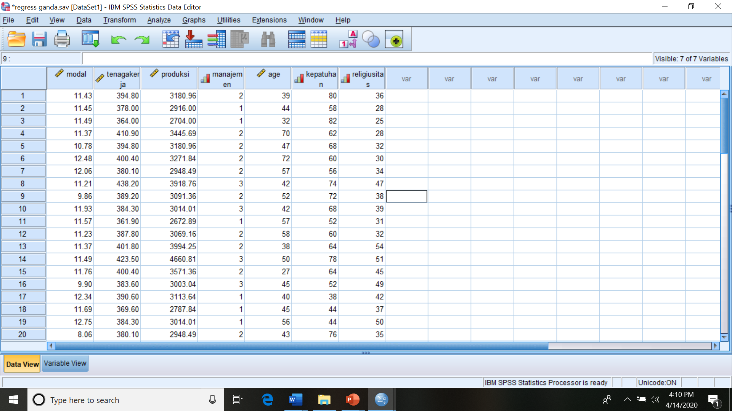
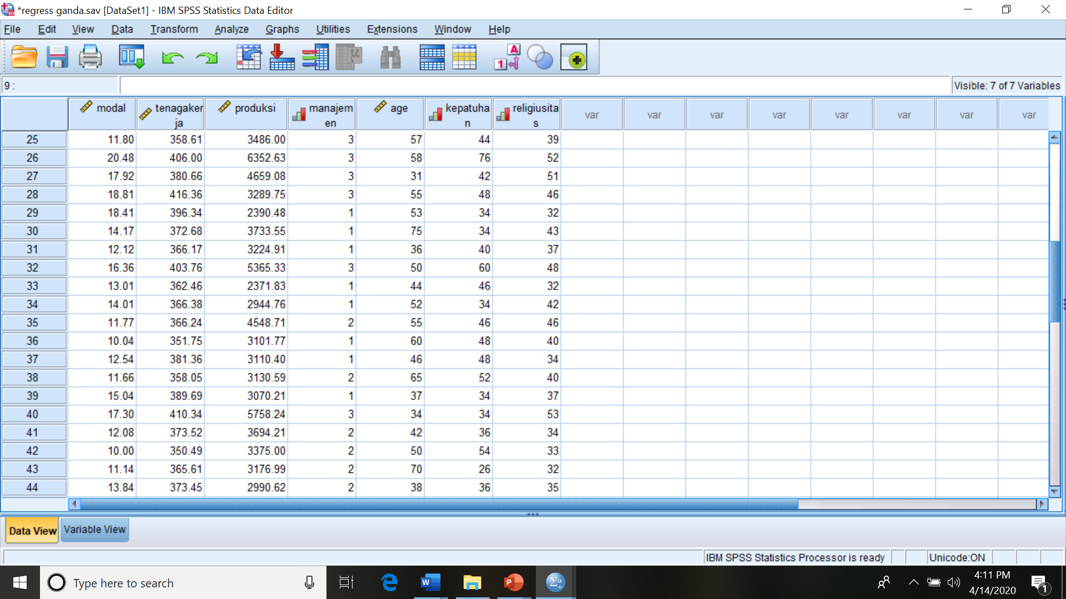
Penampakan sesudah data semua selesai di entry

Slide 10
Untuk mendapatkan deskripsi statistik, tersedia menu
“Frequencies,” “Descriptive Statistics”, dan “Explore”

Slide 11
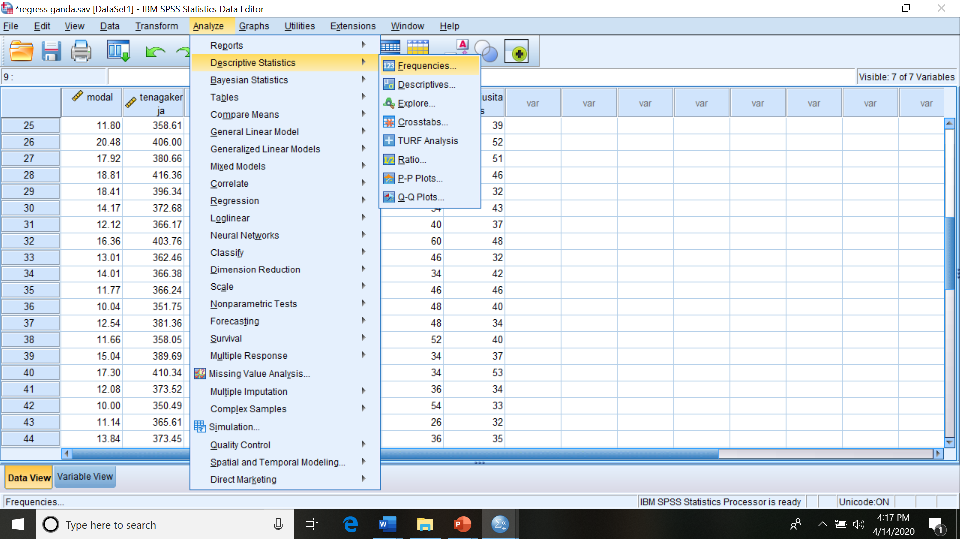
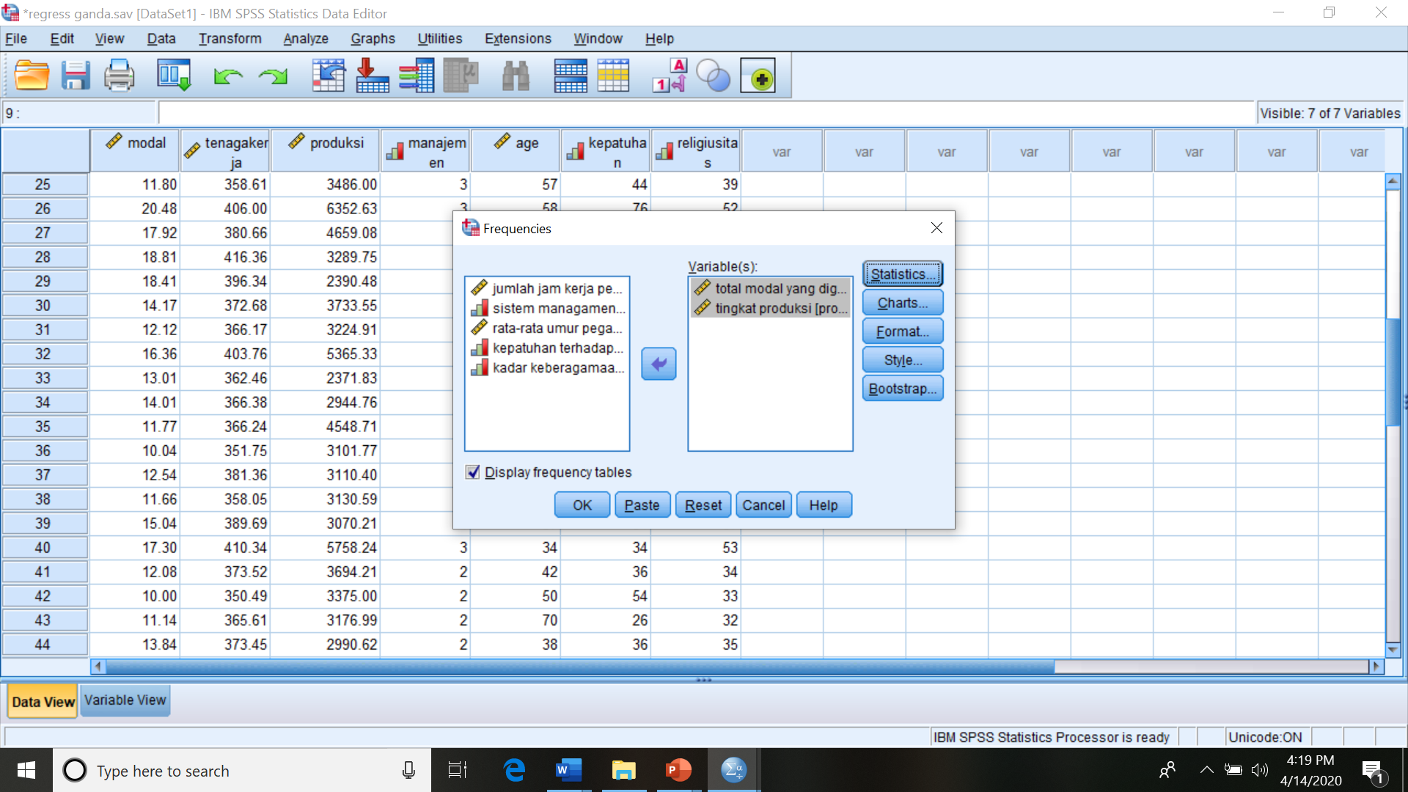
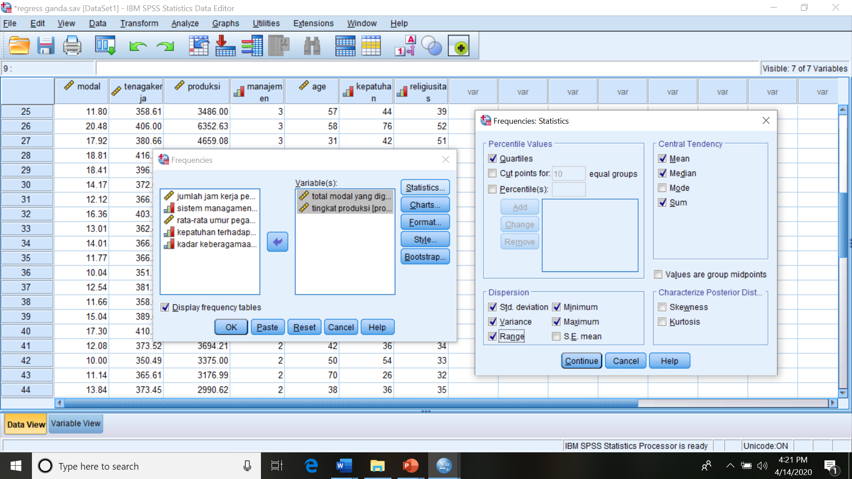
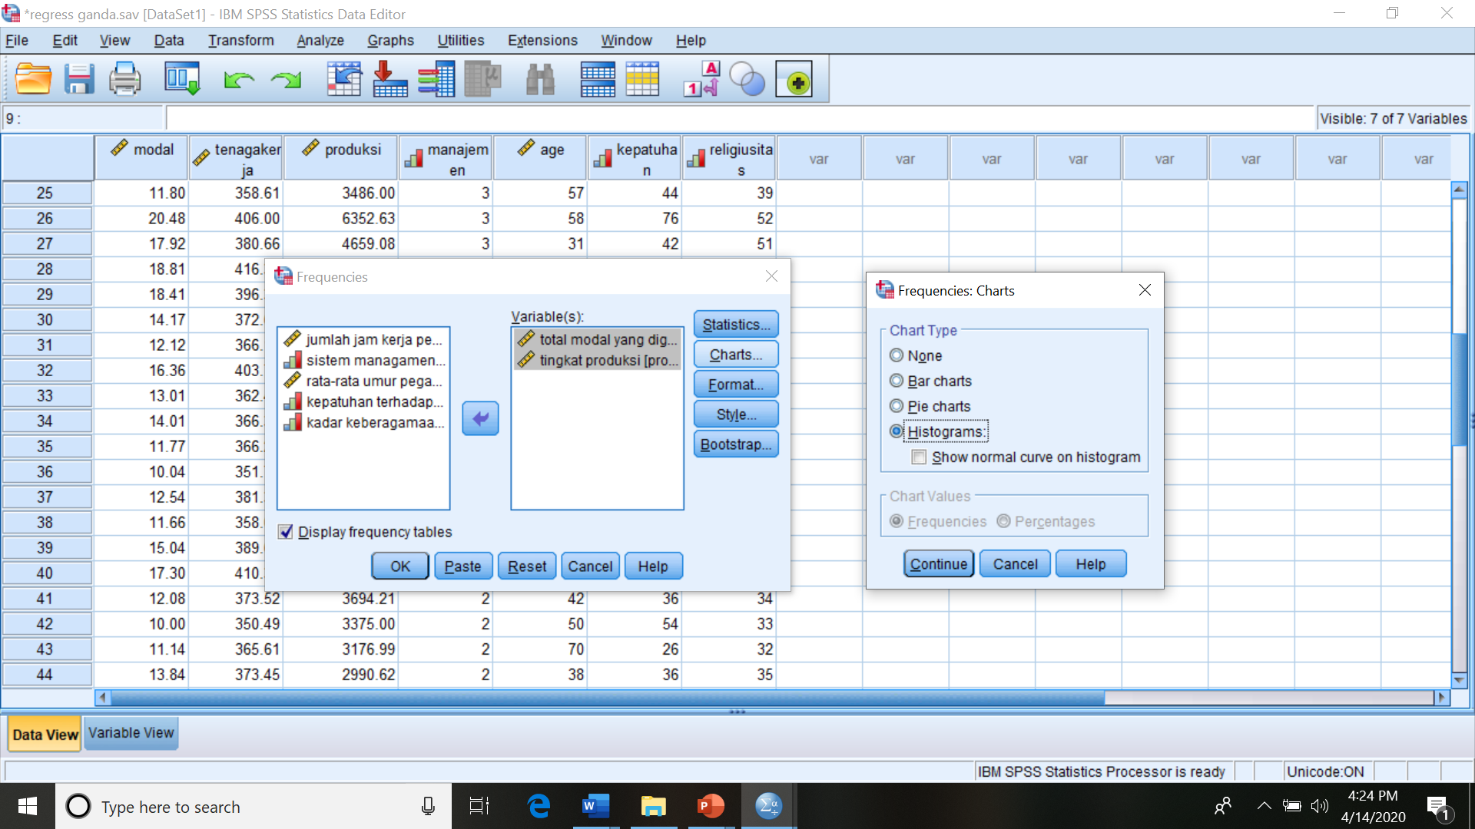
FREQUENCIES: Analyze, Descriptive Statistics, Frequencies, Variable(s)

Slide 12
The Output for Frequencies
Statistics
 |  | total modal yang digunakan | tingkat produksi
N | Valid | 44 | 44
 | Missing | 0 | 0
Mean |  | 12.7370 | 3491.1747
Median |  | 11.8630 | 3178.9763
Std. Deviation |  | 2.65005 | 861.87655
Variance |  | 7.023 | 742831.182
Range |  | 12.43 | 3980.80
Minimum |  | 8.06 | 2371.83
Maximum |  | 20.48 | 6352.63
Sum |  | 560.43 | 153611.69
Percentiles | 25 | 11.3698 | 3003.0400
 | 50 | 11.8630 | 3178.9763
 | 75 | 13.7793 | 3723.7138

Slide 13
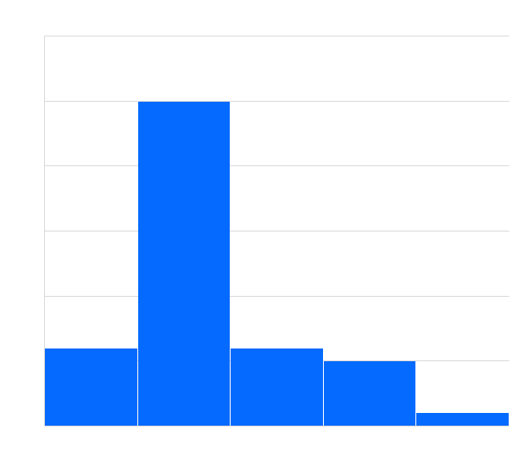
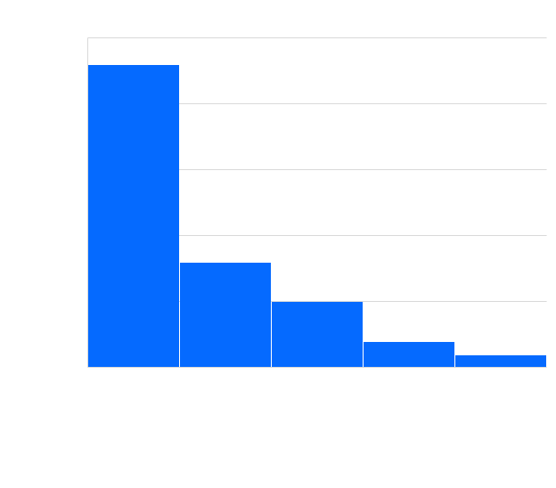

Slide 14

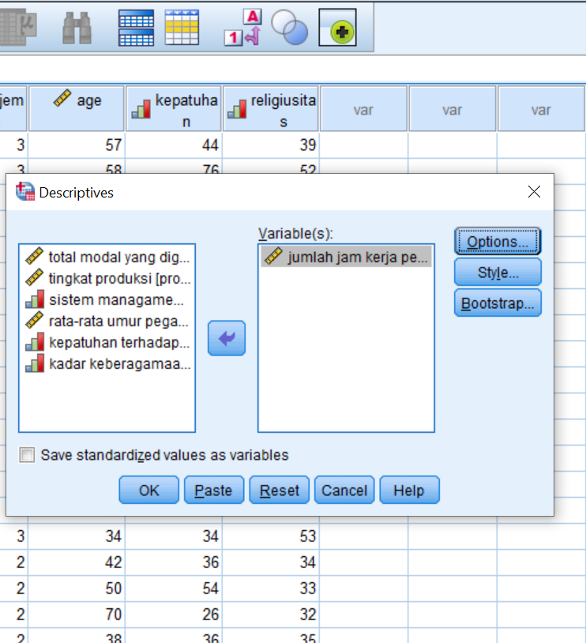
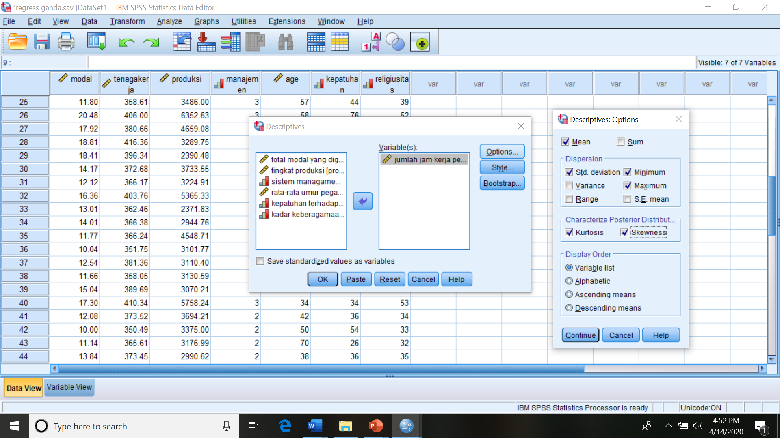
DESCRIPTIVE STATISTICS: Analyze, Descriptive Statistics, Descriptive, Variable(s)

Slide 15
The output of Descriptive Statistics
Descriptive Statistics
 | N | Minimum | Maximum | Mean | Std. Deviation | Skewness |  | Kurtosis
 | Statistic | Statistic | Statistic | Statistic | Statistic | Statistic | Std. Error | Statistic | Std. Error
jumlah jam kerja per minggu | 44 | 350.49 | 438.20 | 385.0064 | 19.57715 | .412 | .357 | .013 | .702
Valid N (listwise) | 44

Slide 16
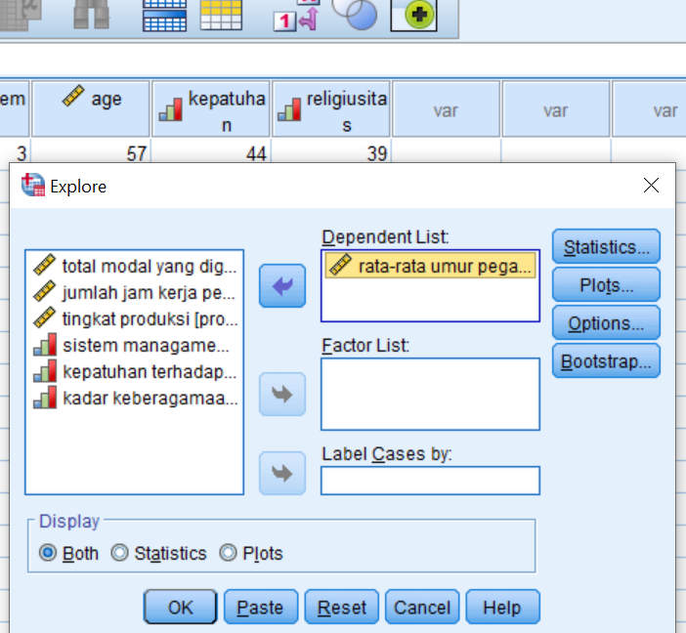
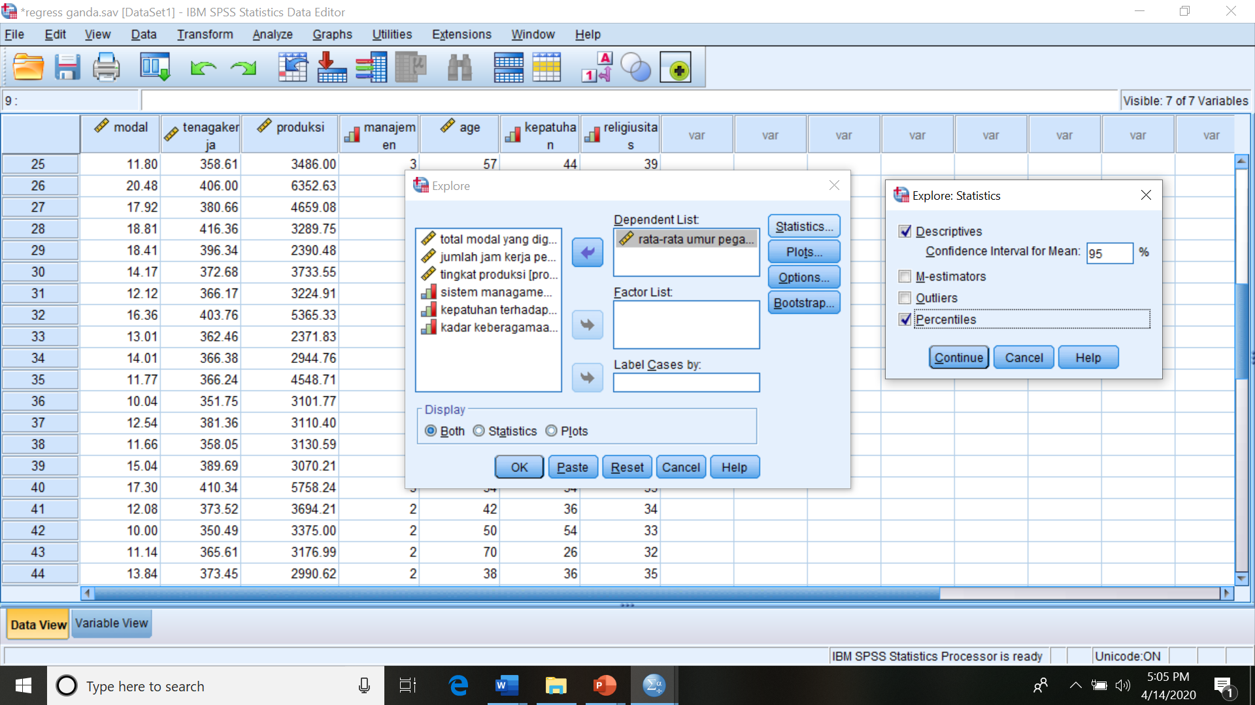

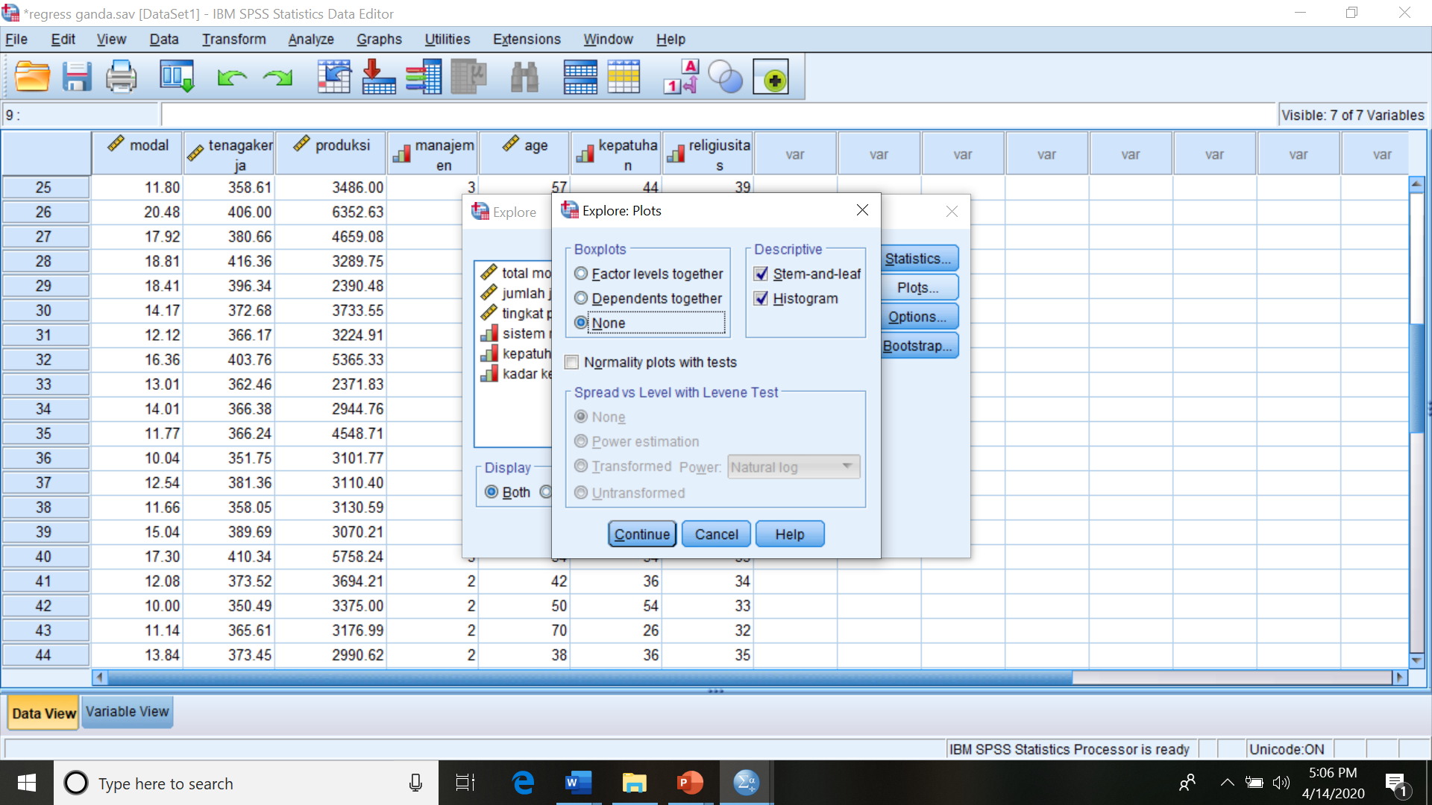
Explore: “Analyze”, “Descriptives”, “Explore”, Variable(s), Statistics, Plots

Slide 17
The Output of Explore
Case Processing Summary
 | Cases
 | Valid |  | Missing |  | Total
 | N | Percent | N | Percent | N | Percent
rata-rata umur pegawai | 44 | 100.0% | 0 | 0.0% | 44 | 100.0%
Percentiles
 |  | Percentiles
 |  | 5 | 10 | 25 | 50 | 75 | 90 | 95
Weighted Average(Definition 1) | rata-rata umur pegawai | 27.75 | 31.50 | 39.25 | 47.00 | 56.75 | 67.50 | 71.50
Tukey's Hinges | rata-rata umur pegawai |  |  | 39.50 | 47.00 | 56.50

Slide 18
The Output of Explore
Descriptives
 |  |  | Statistic | Std. Error
rata-rata umur pegawai | Mean |  | 48.05 | 1.819
 | 95% Confidence Interval for Mean | Lower Bound | 44.38
 |  | Upper Bound | 51.71
 | 5% Trimmed Mean |  | 47.88
 | Median |  | 47.00
 | Variance |  | 145.626
 | Std. Deviation |  | 12.068
 | Minimum |  | 24
 | Maximum |  | 75
 | Range |  | 51
 | Interquartile Range |  | 18
 | Skewness |  | .2 54 | .357
 | Kurtosis |  | -.230 | .702

Slide 19
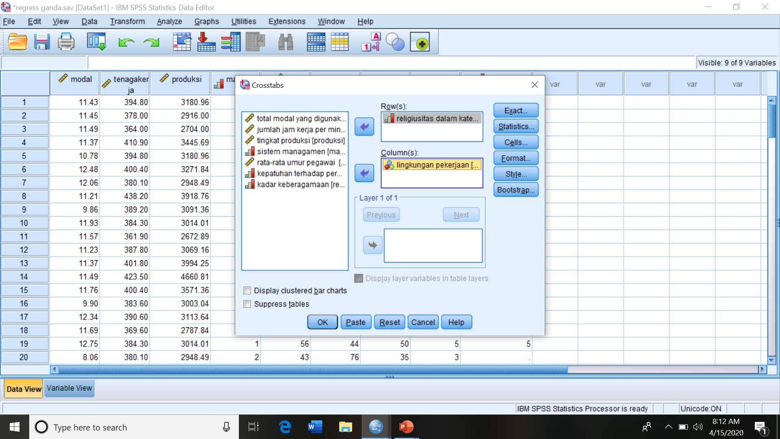
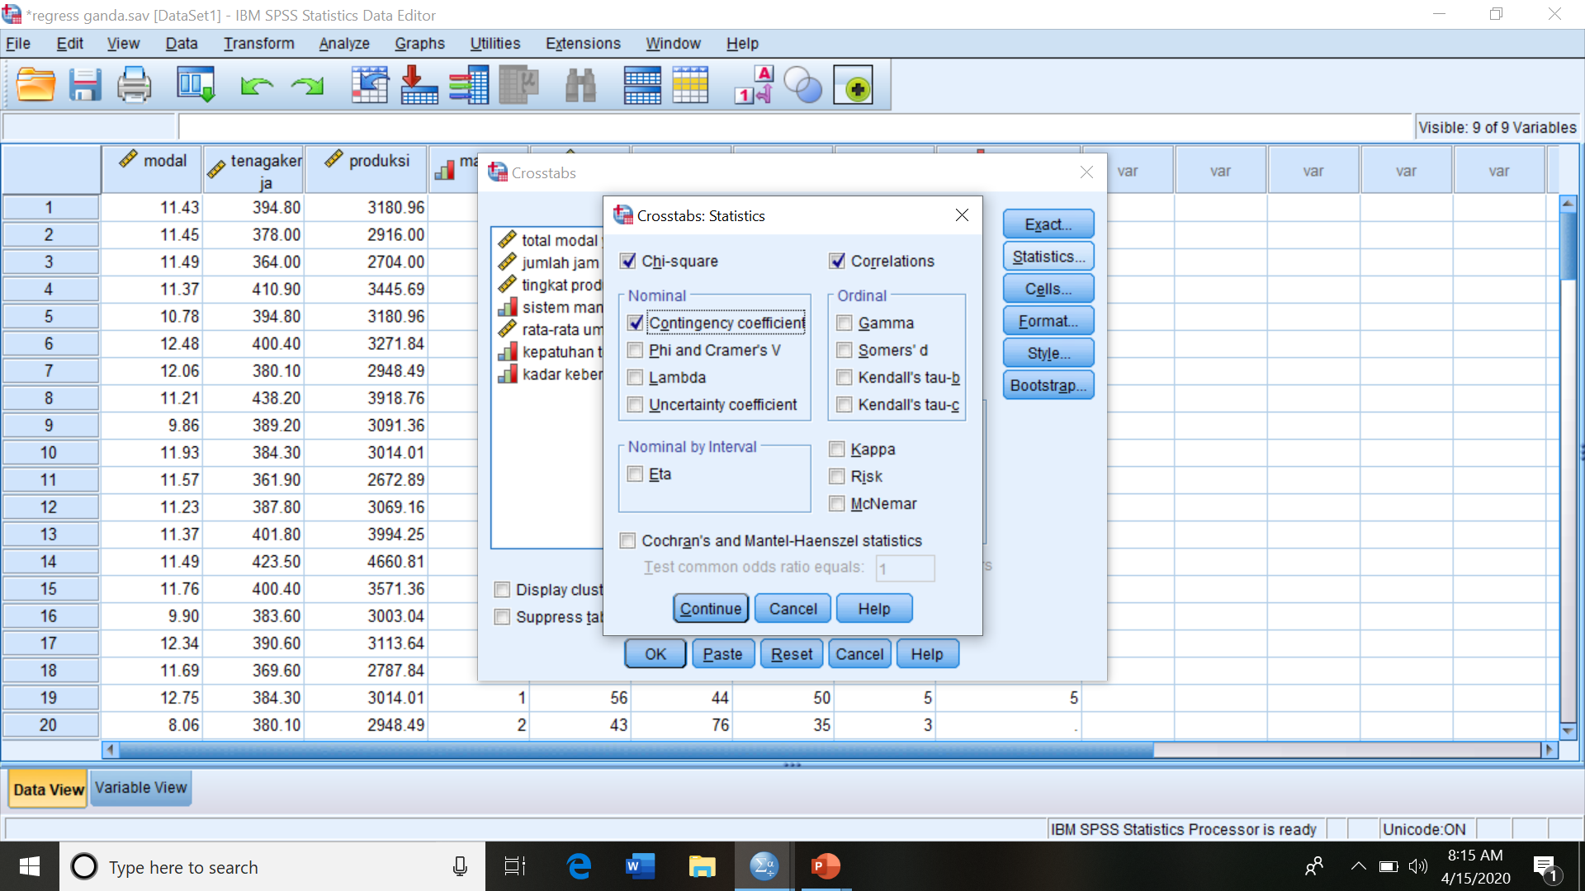
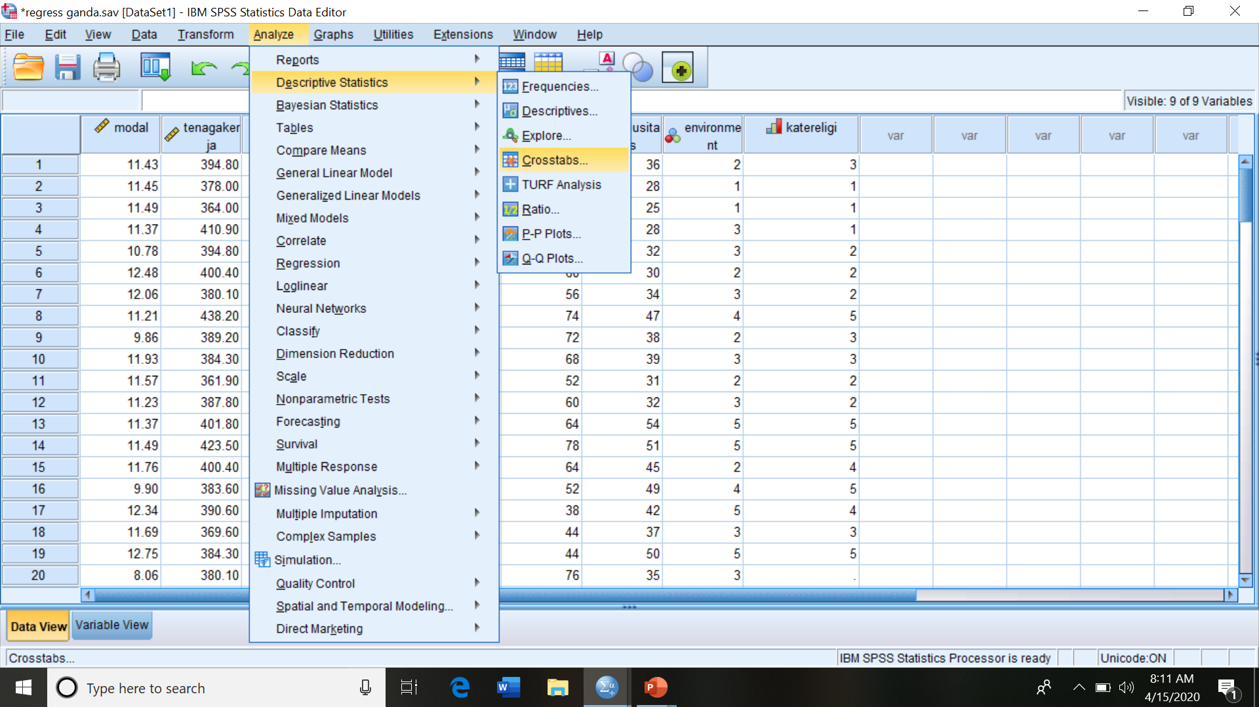
Crosstabulation: “Descriptive Statistics”, “Crosstab”, select Variables, “Statistics”

Slide 20
The Output of Crosstab
Chi-Square Tests
 | Value | df | Asymptotic Significance (2-sided)
Pearson Chi-Square | 124.200ª | 16 | .000
Likelihood Ratio | 117.988 | 16 | .000
Linear-by-Linear Association | 64.402 | 1 | .000
N of Valid Cases | 110
a. 14 cells (56.0%) have expected count less than 5. The minimum expected count is 1.31.
Case Processing Summary
 | Cases
 | Valid |  | Missing |  | Total
 | N | Percent | N | Percent | N | Percent
religiusitas dalam kategori * lingkungan pekerjaan | 110 | 100.0% | 0 | 0.0% | 110 | 100.0%
religiusitas dalam kategori * lingkungan pekerjaan Crosstabulation
Count
 |  | lingkungan pekerjaan |  |  |  |  | Total
 |  | tidak baik | kurang baik | sedang | menyenangkan | sangat baik
religiusitas dalam kategori | reigiusitas rendah | 14 | 1 | 1 | 0 | 0 | 16
 | religiusitas biasa | 7 | 15 | 9 | 1 | 0 | 32
 | religiusitas lumayan | 1 | 8 | 12 | 1 | 2 | 24
 | religiusitas tinggi | 0 | 1 | 2 | 5 | 1 | 9
 | religiusitas sangat tinggi | 1 | 2 | 1 | 12 | 13 | 29
Total |  | 23 | 27 | 25 | 19 | 16 | 110

Slide 21
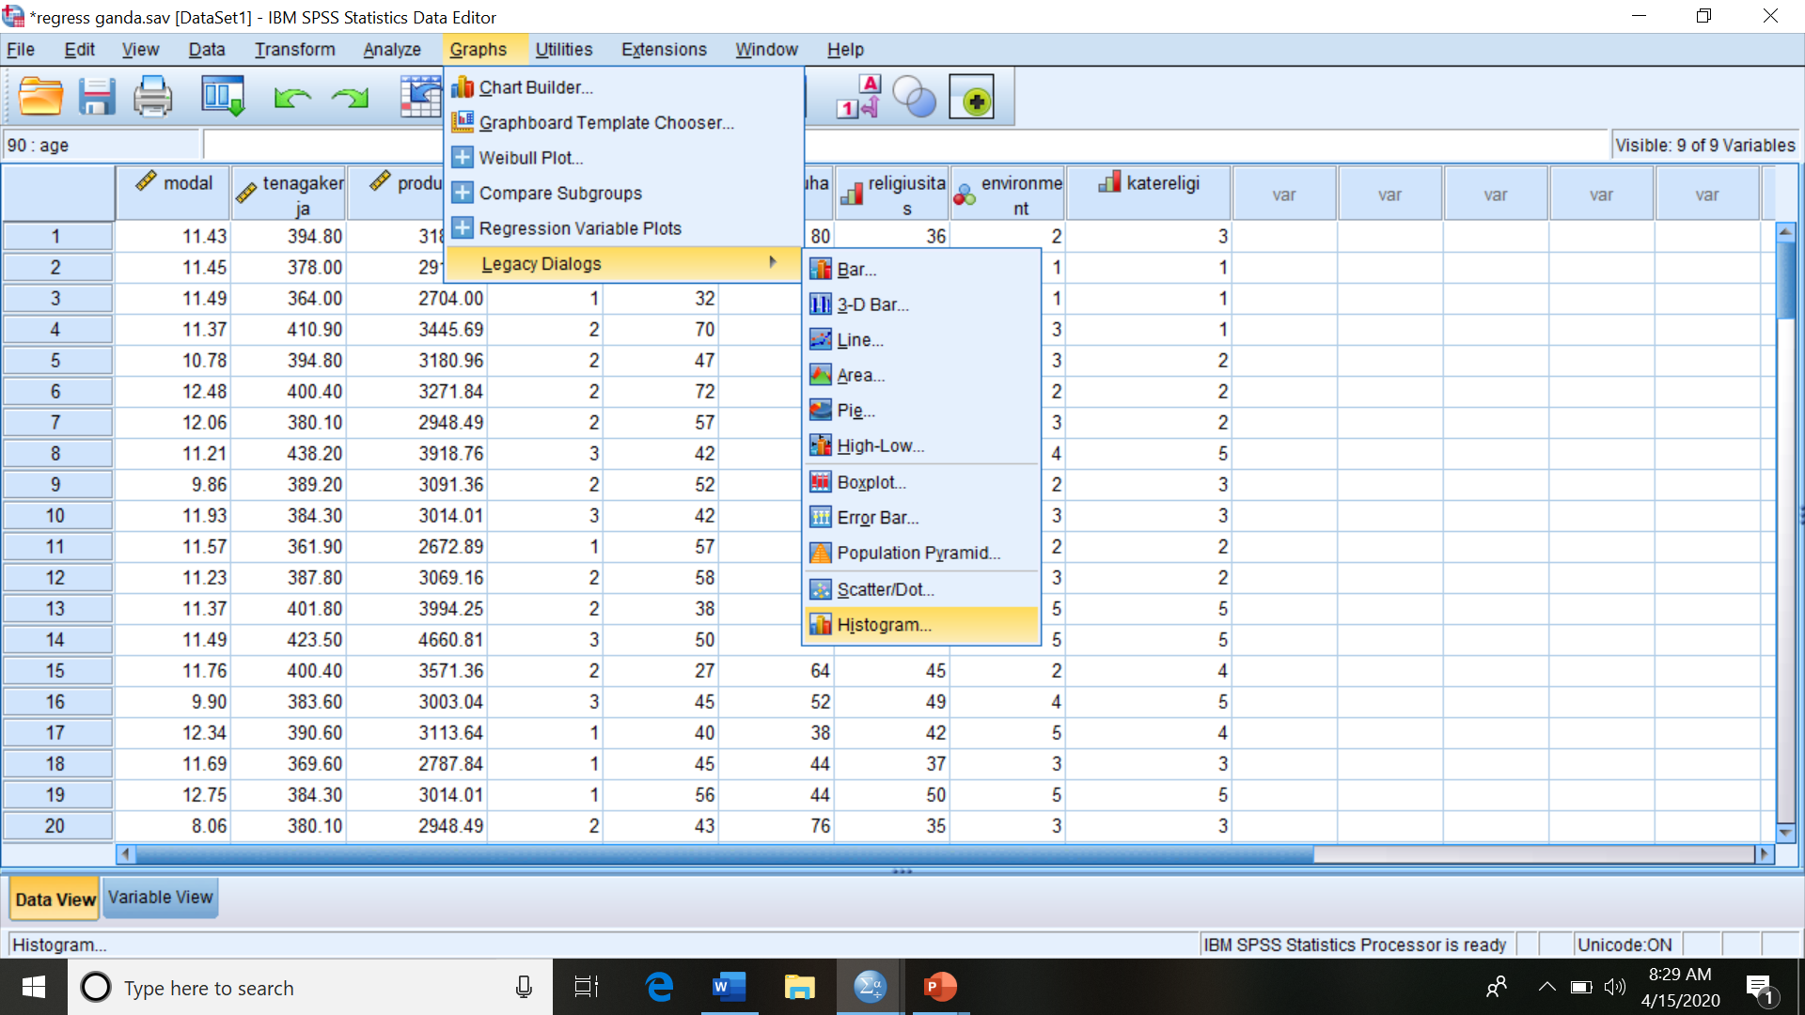
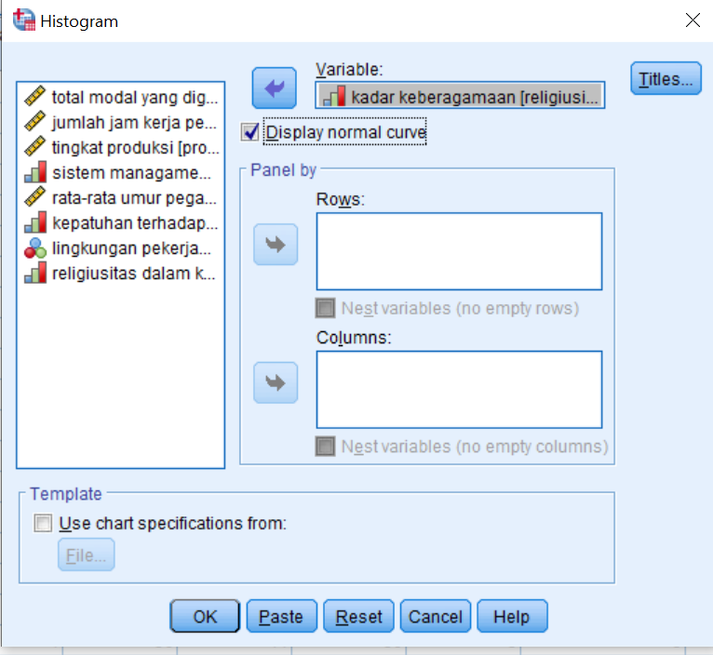
Graphs, Legacy, Histograms, Variable(s)

Slide 22
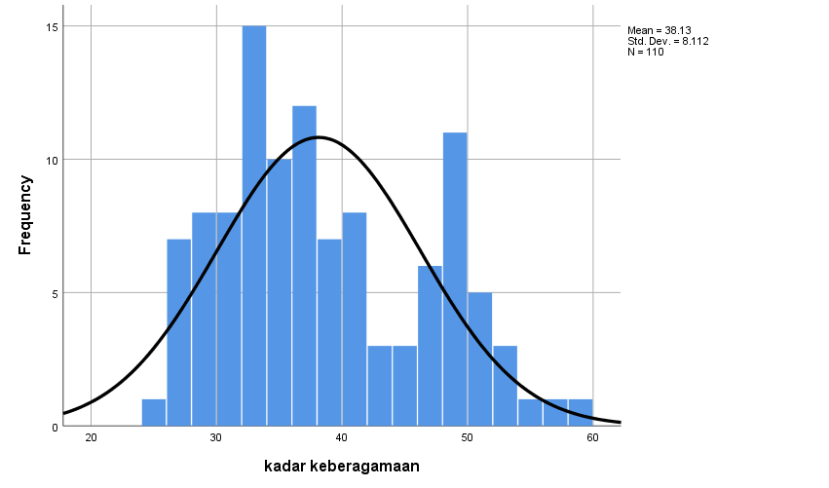
The output of Histogram

Slide 23
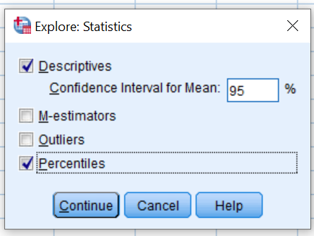

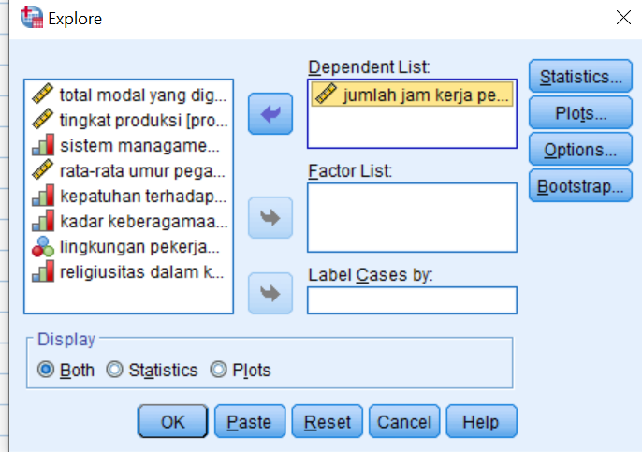
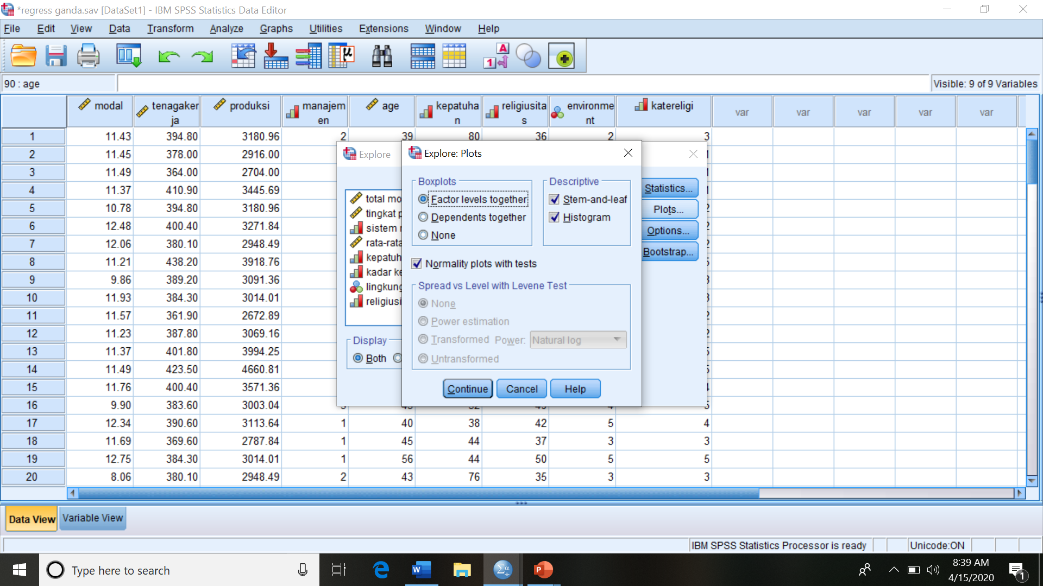
STEM AND LEAF DIAGRAM; analyze, descriptive statistics, explore, dependent lists, statistics, plot

Slide 24
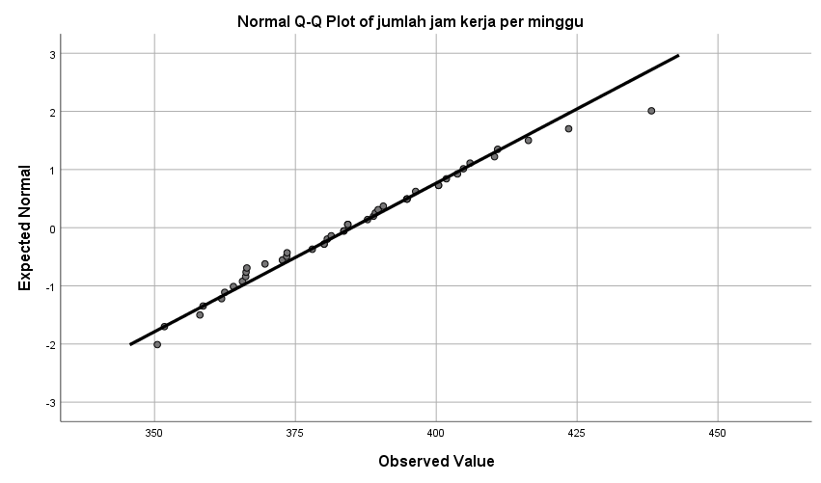
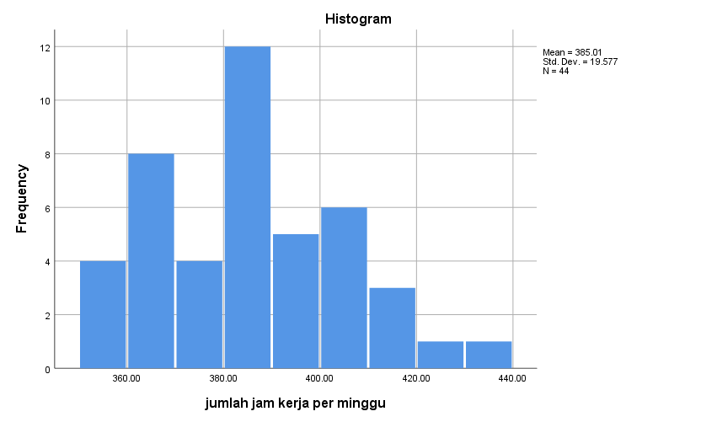
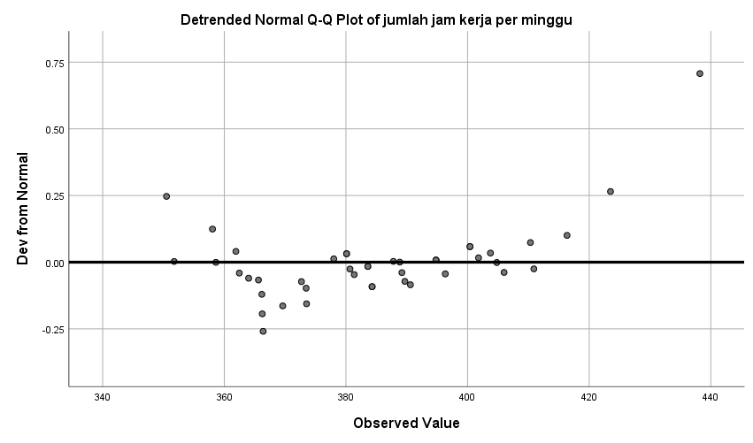
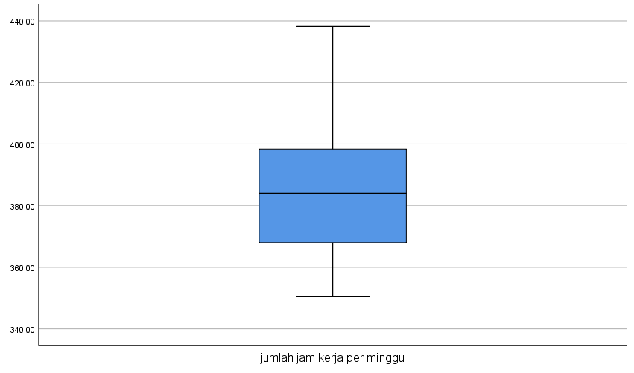
jumlah jam kerja per minggu Stem-and-Leaf Plot
Frequency Stem & Leaf
2.00 35 . 01
2.00 35 . 88
3.00 36 . 124
5.00 36 . 56669
3.00 37 . 233
1.00 37 . 8
8.00 38 . 00013344
4.00 38 . 7899
4.00 39 . 0444
1.00 39 . 6
5.00 40 . 00134
1.00 40 . 6
2.00 41 . 00
1.00 41 . 6
1.00 42 . 3
.00 42 .
.00 43 .
1.00 43 . 8
Stem width: 10.00
Each leaf: 1 case(s)

Slide 25
Descriptives
 |  |  | Statistic | Std. Error
jumlah jam kerja per minggu | Mean |  | 385.0064 | 2.95137
 | 95% Confidence Interval for Mean | Lower Bound | 379.0544
 |  | Upper Bound | 390.9584
 | 5% Trimmed Mean |  | 384.3803
 | Median |  | 383.9500
 | Variance |  | 383.265
 | Std. Deviation |  | 19.57715
 | Minimum |  | 350.49
 | Maximum |  | 438.20
 | Range |  | 87.71
 | Interquartile Range |  | 32.20
 | Skewness |  | .412 | .357
 | Kurtosis |  | .013 | .702
Percentiles
 |  | Percentiles
 |  | 5 | 10 | 25 | 50 | 75 | 90 | 95
Weighted Average(Definition 1) | jumlah jam kerja per minggu | 353.3250 | 360.2550 | 367.1850 | 383.9500 | 399.3850 | 410.6200 | 421.7150
Tukey's Hinges | jumlah jam kerja per minggu |  |  | 367.9900 | 383.9500 | 398.3700
Tests of Normality
 | Kolmogorov-Smirnovª |  |  | Shapiro-Wilk
 | Statistic | df | Sig. | Statistic | df | Sig.
jumlah jam kerja per minggu | .079 | 44 | .200* | .981 | 44 | .667
*. This is a lower bound of the true significance.
a. Lilliefors Significance Correction

Slide 26

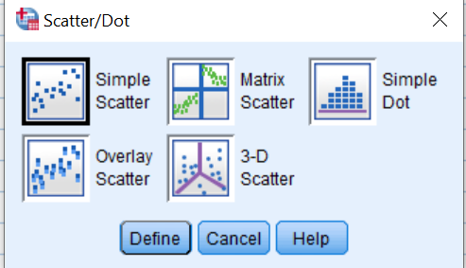
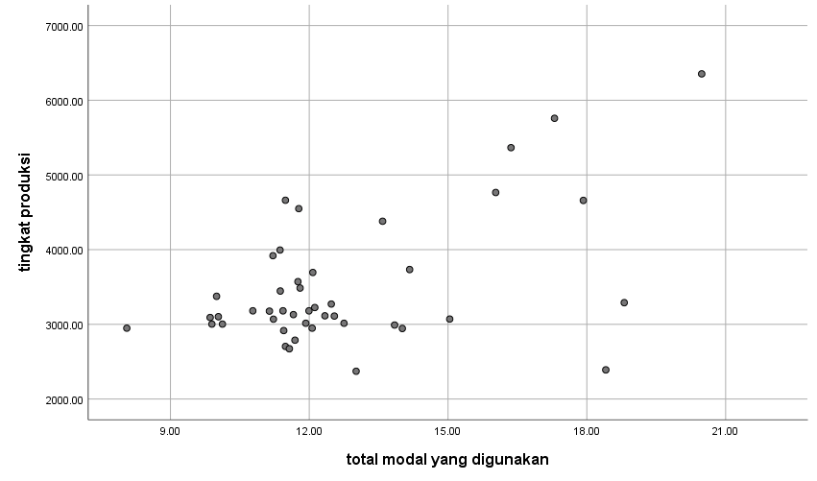
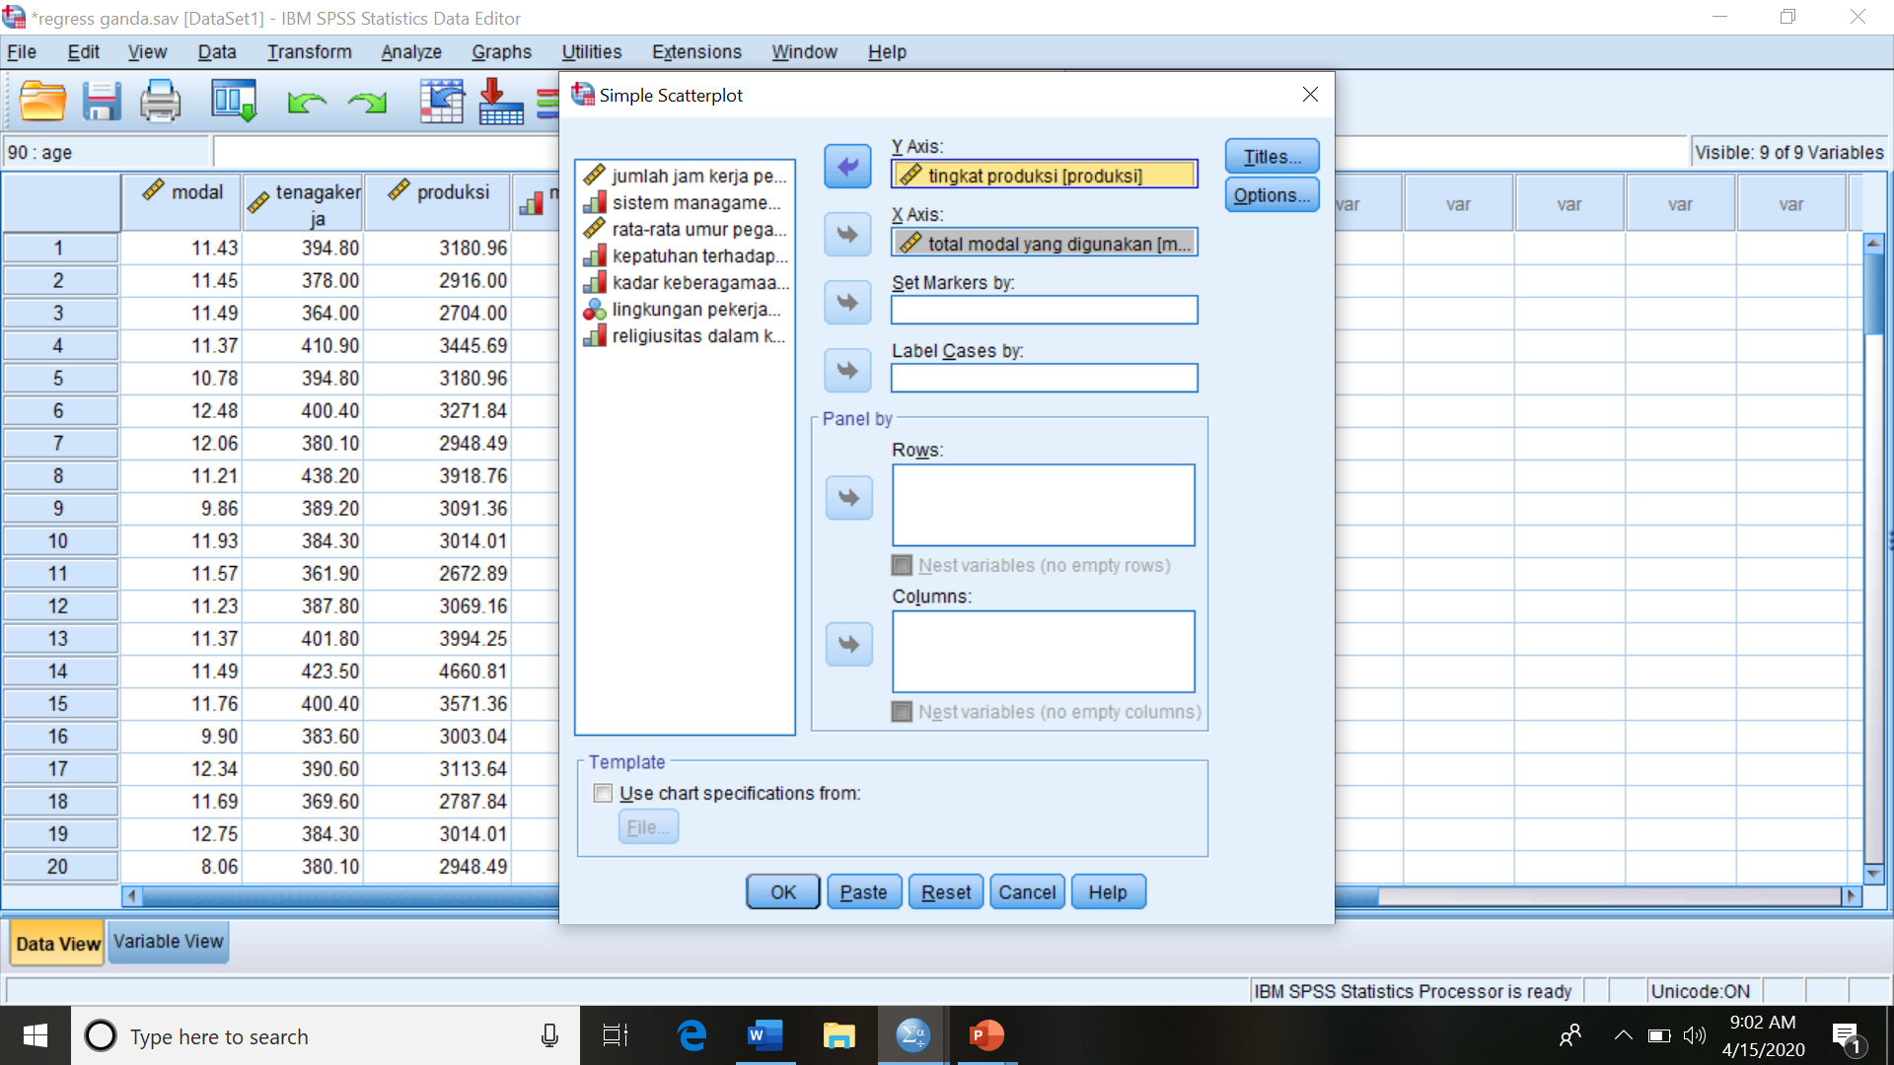
PLOT DIAGRAM: Graphs, Legacy, Scatter/Dot, Simple Scatter, Define, Y-Axis, X-Axis

Slide 27
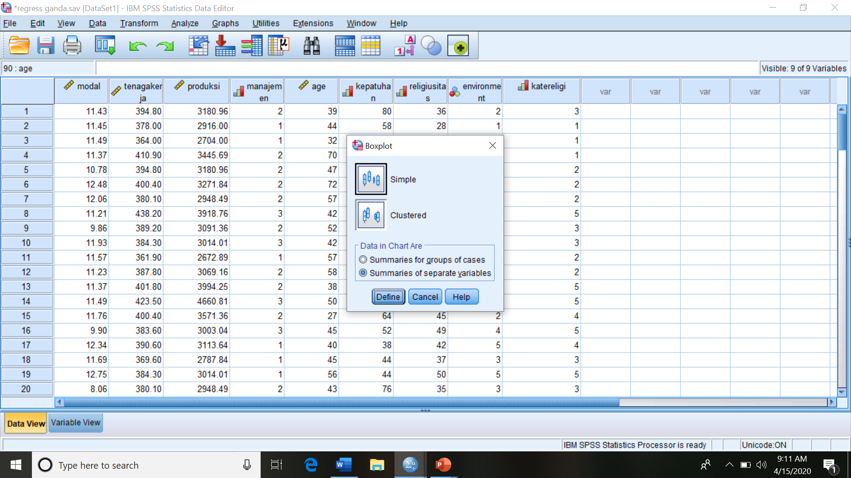
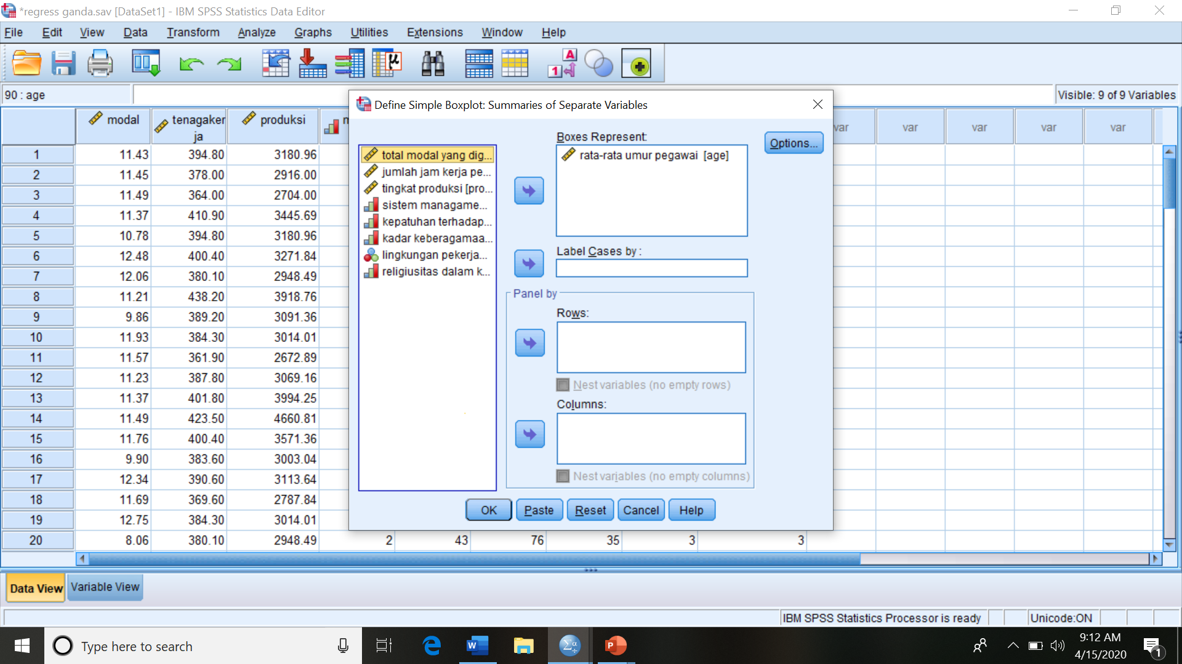
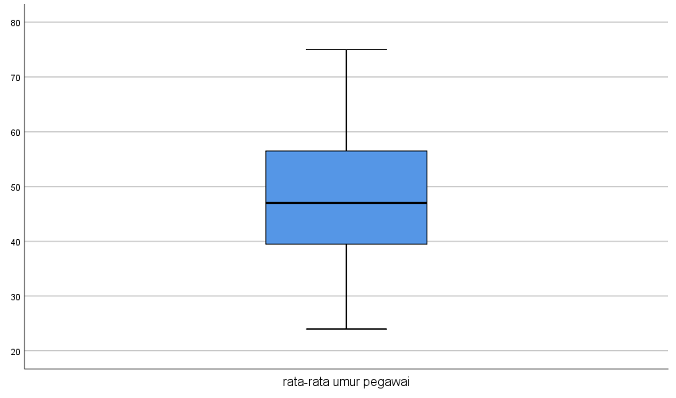
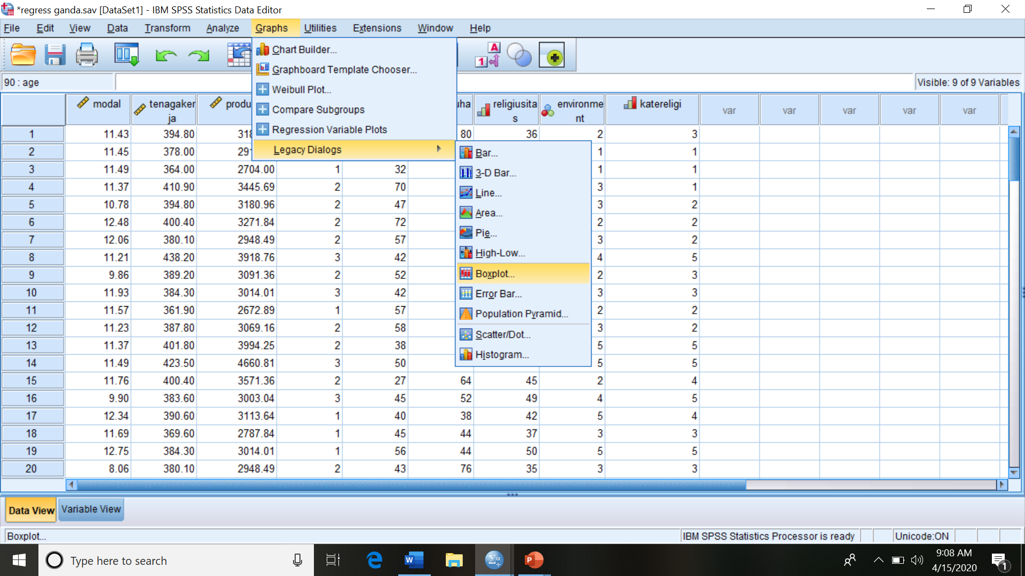
BOX-PLOT DIAGRAM: Graphs, Legacy, Boxplot, Simple Boxplot, Define, Variable

Slide 28
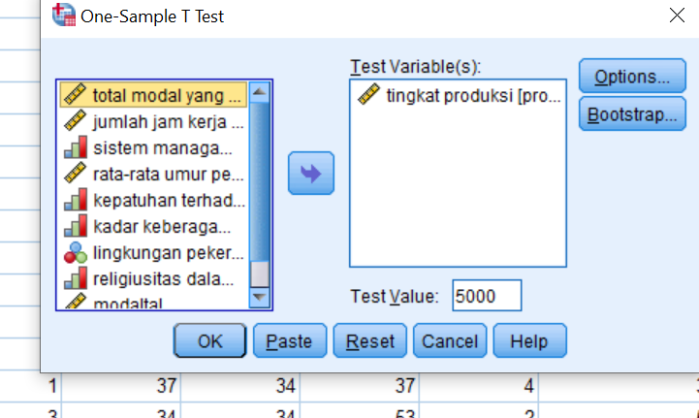
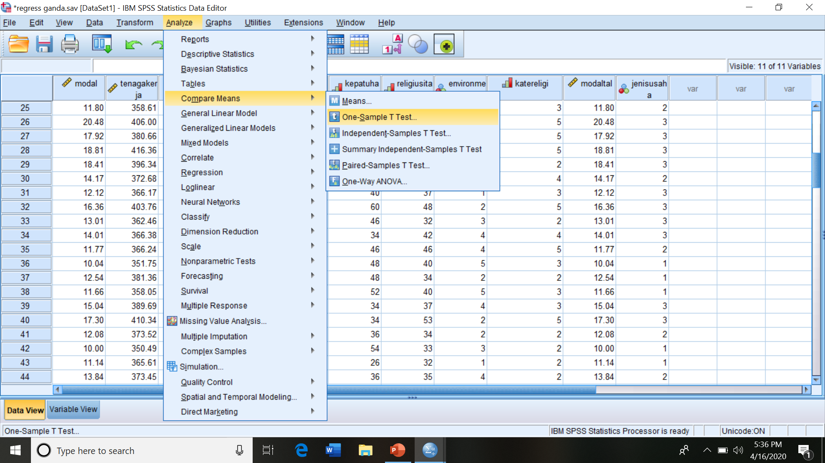
One sample t test for population mean
“analyze”, “compare mean”, “one sample t test”, variable(s), “test value” (if necessary),
One-Sample Statistics
 | N | Mean | Std. Deviation | Std. Error Mean
tingkat produksi | 44 | 3491.1747 | 861.87655 | 129.93278
One-Sample Test
 | Test Value = 5000
 | t | df | Sig. (2-tailed) | Mean Difference | 95% Confidence Interval of the Difference
 |  |  |  |  | Lower | Upper
tingkat produksi | -11.612 | 43 | .000 | -1508.82528 | -1770.8597 | -1246.7909

Slide 29
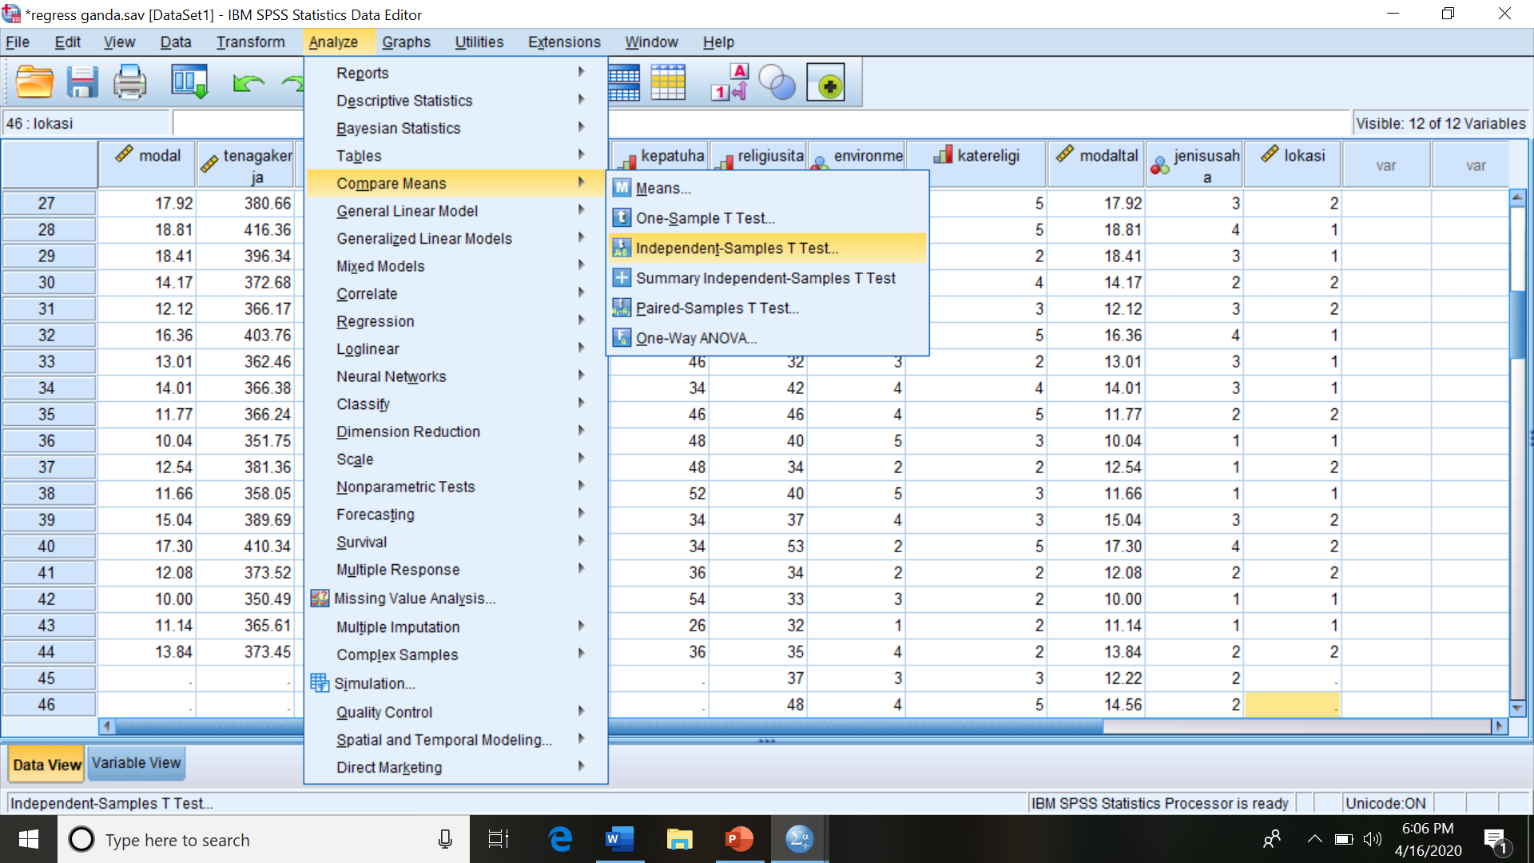
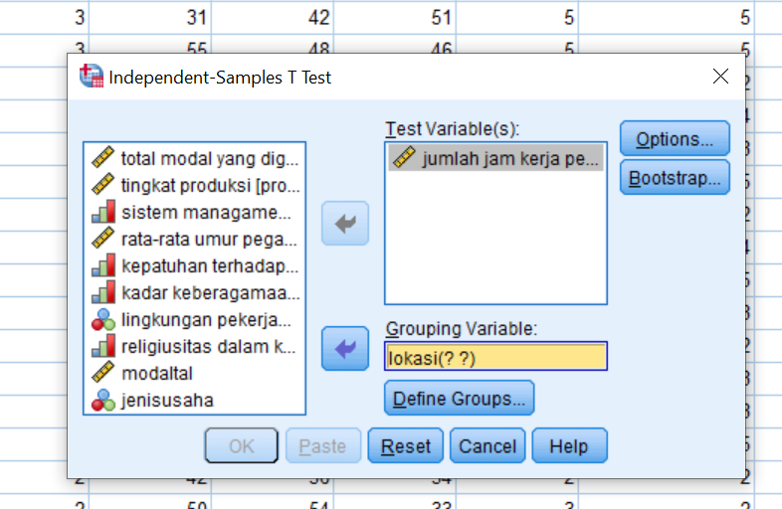
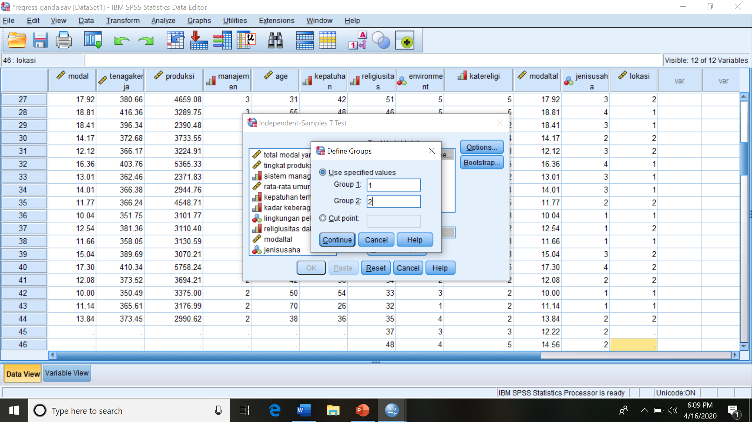
T test for comparing two population means: “analyze”, “compare means”, “independent samples t test”, “test variable(s), “grouping variable”, “define groups’

Slide 30
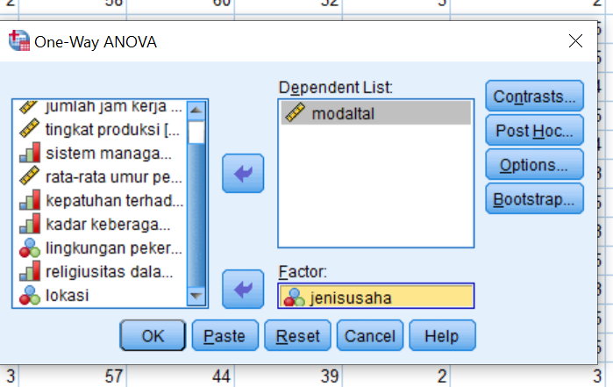

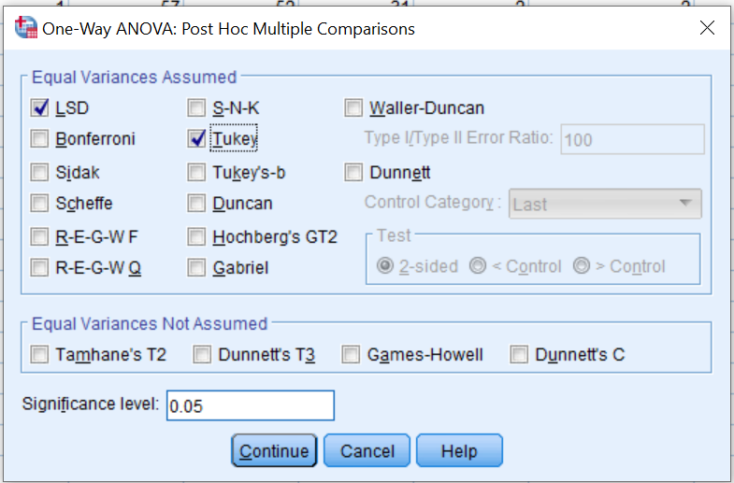
ANOVA for testing population means of k independent samples
“Analyze”, “compare means”, “One-Way ANOVA”, Variables (dependent and factor), “Post Hoc”

Slide 31
ANOVA
modaltal
 | Sum of Squares | df | Mean Square | F | Sig.
Between Groups | 320.777 | 3 | 106.926 | 48.424 | .000
Within Groups | 119.237 | 54 | 2.208
Total | 440.014 | 57
Multiple Comparisons
Dependent Variable: modaltal
 | (I) jenisusaha | (J) jenisusaha | Mean Difference (I-J) | Std. Error | Sig. | 95% Confidence Interval
 |  |  |  |  |  | Lower Bound | Upper Bound
Tukey HSD | makanan | sehari2 | -1.90319* | .46539 | .001 | -3.1369 | -.6695
 |  | kerajinan tangan | -4.32767* | .58797 | .000 | -5.8863 | -2.7690
 |  | furniture | -6.83632* | .61350 | .000 | -8.4626 | -5.2100
 | sehari2 | makanan | 1.90319* | .46539 | .001 | .6695 | 3.1369
 |  | kerajinan tangan | -2.42448* | .60130 | .001 | -4.0184 | -.8305
 |  | furniture | -4.93313* | .62628 | .000 | -6.5933 | -3.2729
 | kerajinan tangan | makanan | 4.32767* | .58797 | .000 | 2.7690 | 5.8863
 |  | sehari2 | 2.42448* | .60130 | .001 | .8305 | 4.0184
 |  | furniture | -2.50865* | .72205 | .005 | -4.4227 | -.5946
 | furniture | makanan | 6.83632* | .61350 | .000 | 5.2100 | 8.4626
 |  | sehari2 | 4.93313* | .62628 | .000 | 3.2729 | 6.5933
 |  | kerajinan tangan | 2.50865* | .72205 | .005 | .5946 | 4.4227
LSD | makanan | sehari2 | -1.90319* | .46539 | .000 | -2.8362 | -.9701
 |  | kerajinan tangan | -4.32767* | .58797 | .000 | -5.5065 | -3.1489
 |  | furniture | -6.83632* | .61350 | .000 | -8.0663 | -5.6063
 | sehari2 | makanan | 1.90319* | .46539 | .000 | .9701 | 2.8362
 |  | kerajinan tangan | -2.42448* | .60130 | .000 | -3.6300 | -1.2189
 |  | furniture | -4.93313* | .62628 | .000 | -6.1887 | -3.6775
 | kerajinan tangan | makanan | 4.32767* | .58797 | .000 | 3.1489 | 5.5065
 |  | sehari2 | 2.42448* | .60130 | .000 | 1.2189 | 3.6300
 |  | furniture | -2.50865* | .72205 | .001 | -3.9563 | -1.0610
 | furniture | makanan | 6.83632* | .61350 | .000 | 5.6063 | 8.0663
 |  | sehari2 | 4.93313* | .62628 | .000 | 3.6775 | 6.1887
 |  | kerajinan tangan | 2.50865* | .72205 | .001 | 1.0610 | 3.9563
*. The mean difference is significant at the 0.05 level.

Slide 32
Group Statistics
 | lokasi | N | Mean | Std. Deviation | Std. Error Mean
jumlah jam kerja per minggu | rumah | 21 | 379.1000 | 18.53054 | 4.04369
 | tempat khusus | 23 | 390.3991 | 19.31945 | 4.02838
Independent Samples Test
 |  | Levene's Test for Equality of Variances |  | t-test for Equality of Means
 |  | F | Sig. | t | df | Sig. (2-tailed) | Mean Difference | Std. Error Difference | 95% Confidence Interval of the Difference
 |  |  |  |  |  |  |  |  | Lower | Upper
jumlah jam kerja per minggu | Equal variances assumed | .004 | .950 | -1.976 | 42 | .055 | -11.29913 | 5.71891 | -22.84036 | .24210
 | Equal variances not assumed |  |  | -1.980 | 41.889 | .054 | -11.29913 | 5.70783 | -22.81891 | .22064

Slide 33
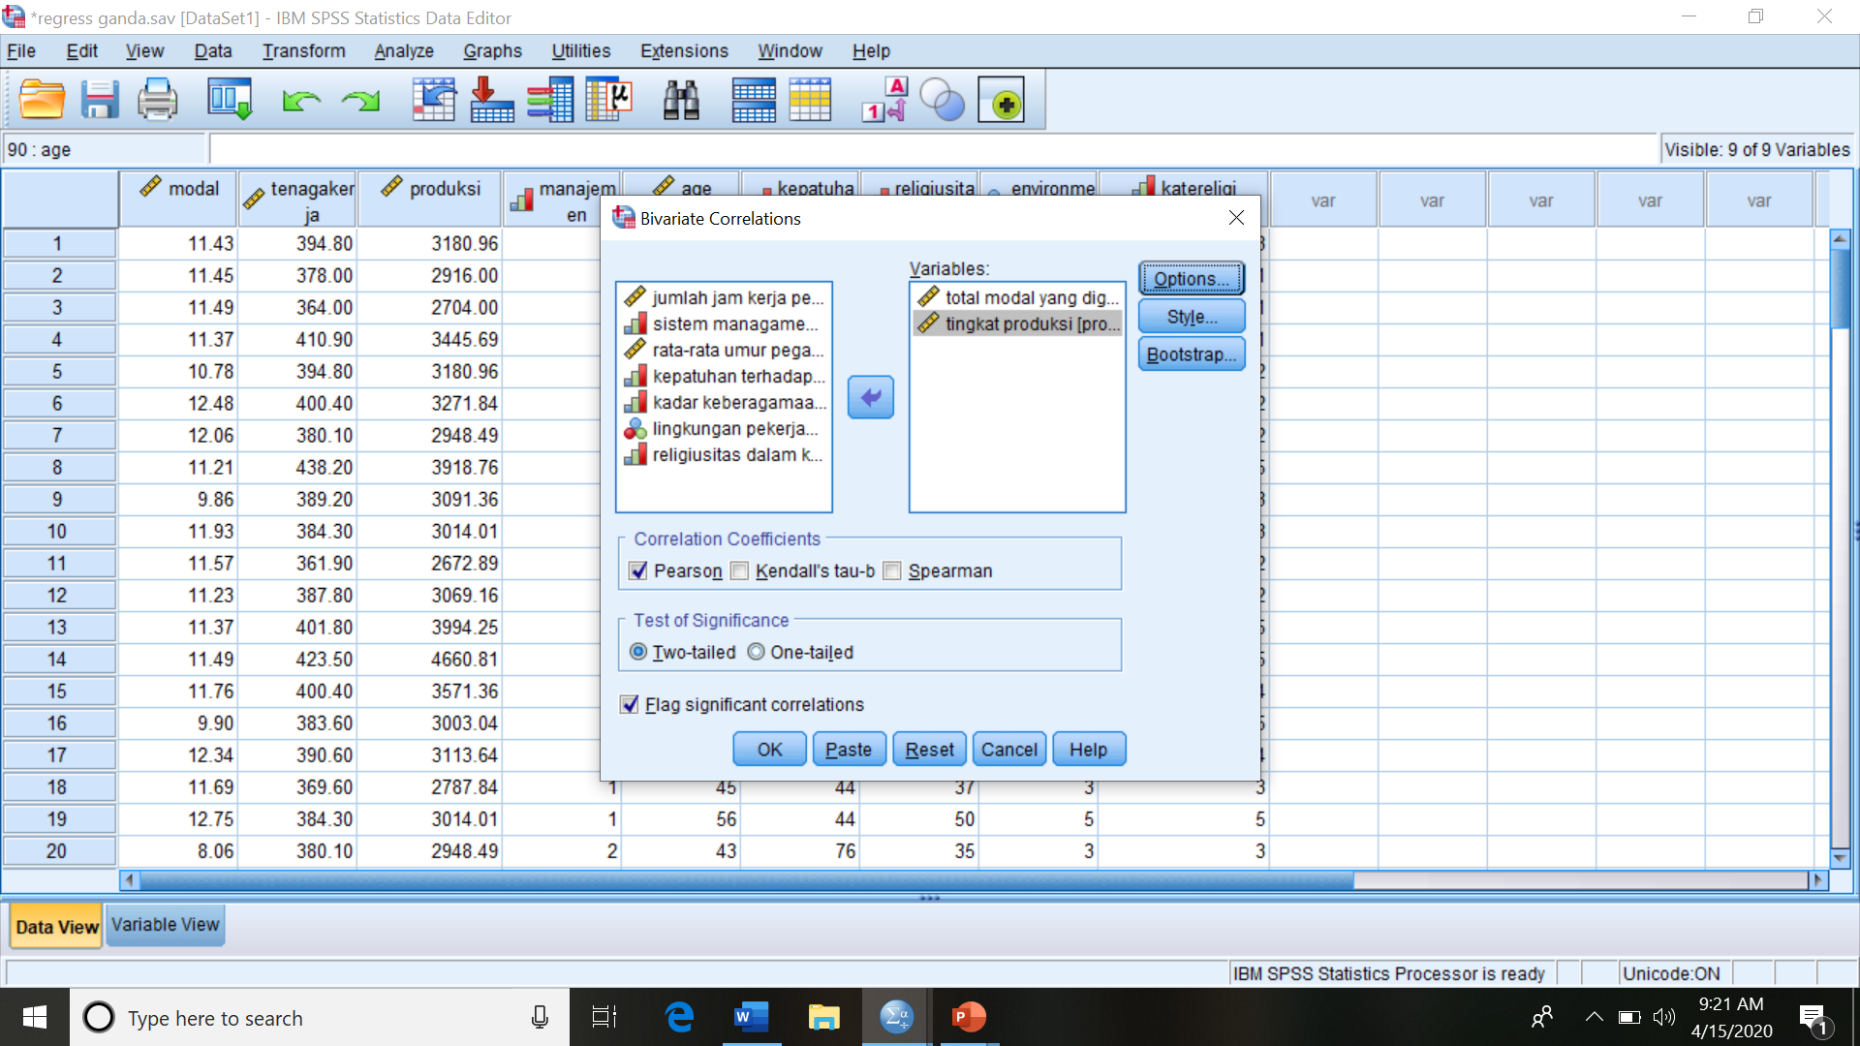
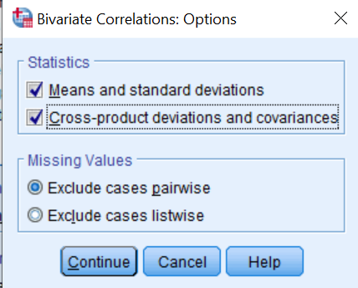
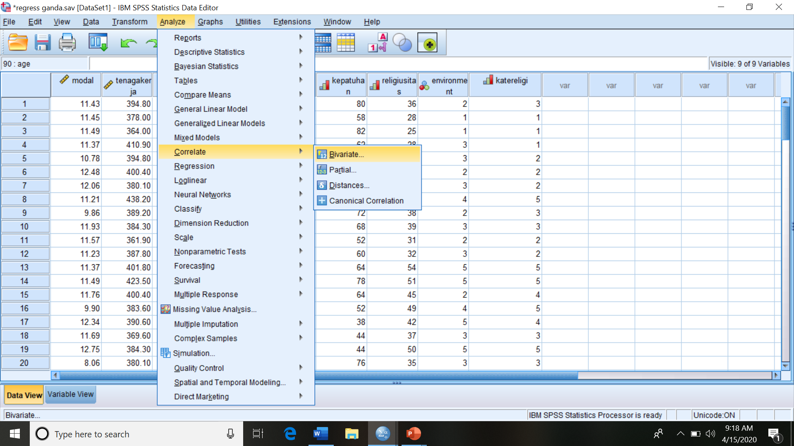
Correlation: “Analyze”, “Correlate”, “Bivariate”, Variables, “Pearson”, Options
Correlations
 |  | total modal yang digunakan | tingkat produksi
total modal yang digunakan | Pearson Correlation | 1 | .527**
 | Sig. (2-tailed) |  | .000
 | Sum of Squares and Cross-products | 301.980 | 51796.724
 | Covariance | 7.023 | 1204.575
 | N | 44 | 44
tingkat produksi | Pearson Correlation | .527** | 1
 | Sig. (2-tailed) | .000
 | Sum of Squares and Cross-products | 51796.724 | 31941740.827
 | Covariance | 1204.575 | 742831.182
 | N | 44 | 44
**. Correlation is significant at the 0.01 level (2-tailed).

Slide 34
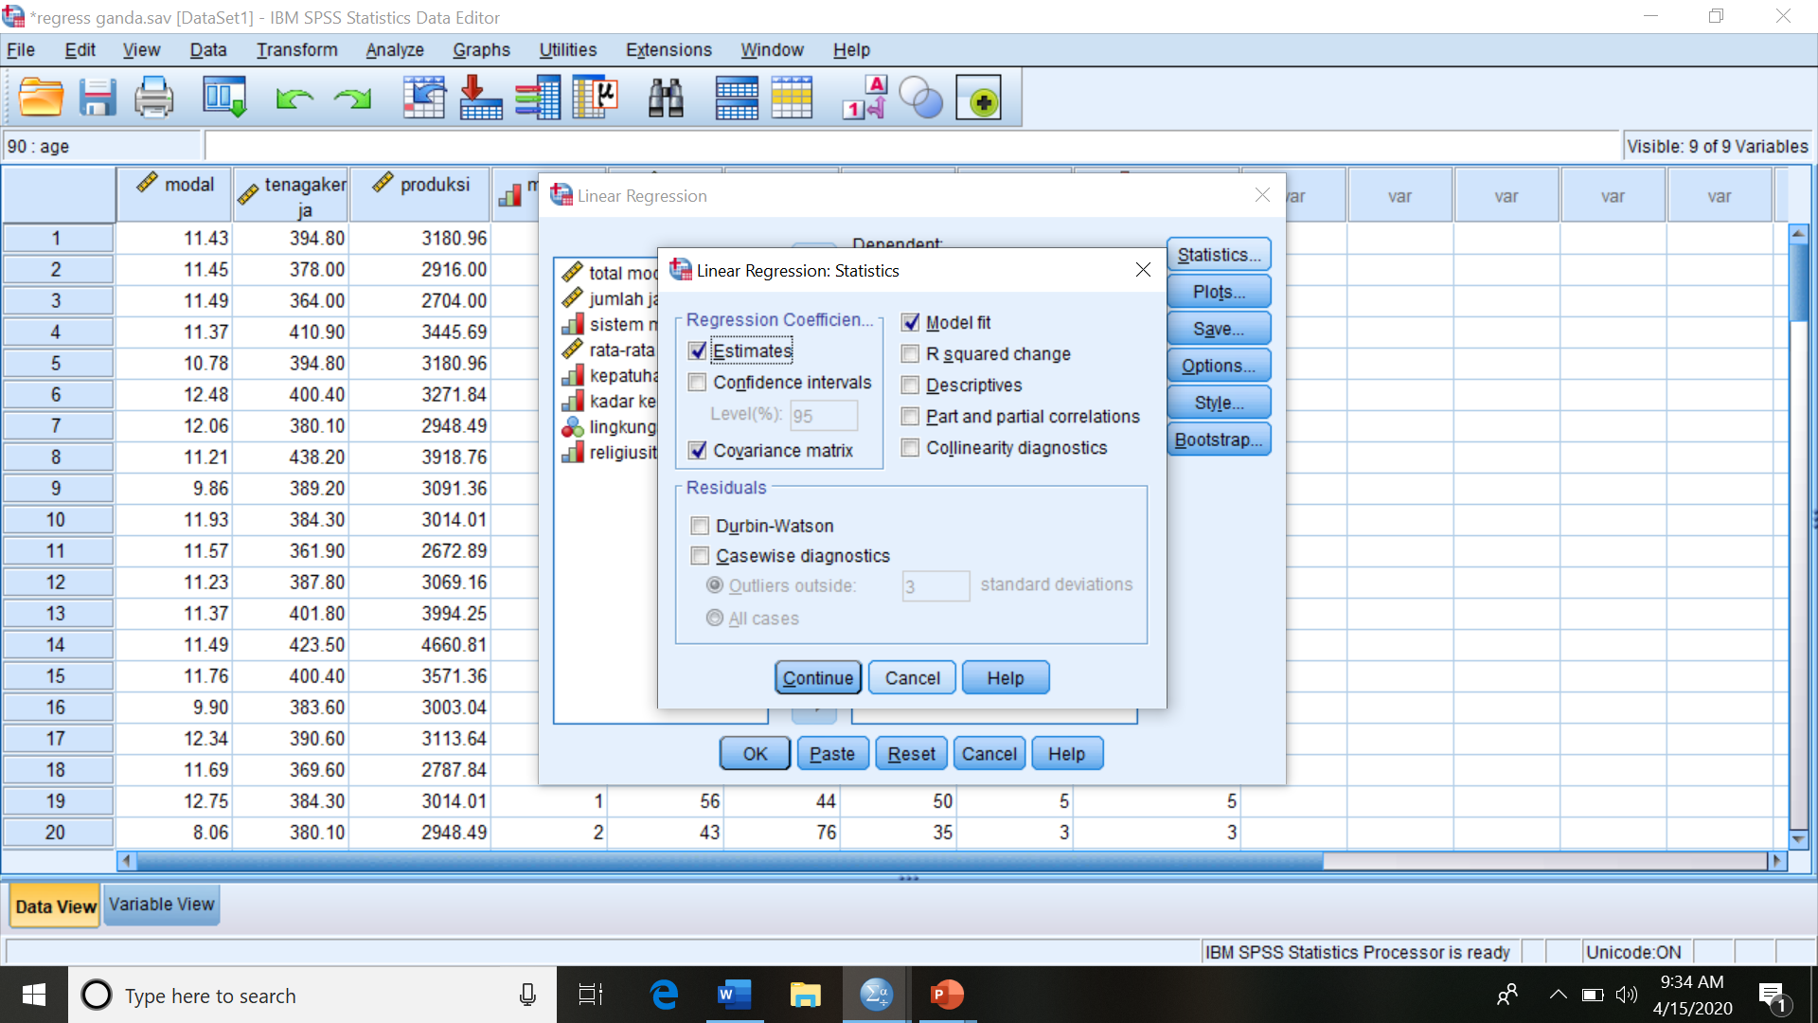



Regression ; Analyze, Regression, Linear, Dependent Variable, Independent Variable(s)

Slide 35
Model Summary^{b}
Model | R | R Square | Adjusted R Square | Std. Error of the Estimate
1 | .844ª | .712 | .666 | 498.28999
a. Predictors: (Constant), lingkungan pekerjaan, kepatuhan terhadap peraturan, sistem managamen, total modal yang digunakan, jumlah jam kerja per minggu, kadar keberagamaan
b. Dependent Variable: tingkat produksi
ANOVAª
Model |  | Sum of Squares | df | Mean Square | F | Sig.
1 | Regression | 22754902.823 | 6 | 3792483.804 | 15.274 | .000^{b}
 | Residual | 9186838.004 | 37 | 248292.919
 | Total | 31941740.827 | 43
a. Dependent Variable: tingkat produksi
b. Predictors: (Constant), lingkungan pekerjaan, kepatuhan terhadap peraturan, sistem managamen, total modal yang digunakan, jumlah jam kerja per minggu, kadar keberagamaan
Coefficientsª
Model |  | Unstandardized Coefficients |  | Standardized Coefficients | t | Sig.
 |  | B | Std. Error | Beta
1 | (Constant) | 154.046 | 1668.836 |  | .092 | .927
 | total modal yang digunakan | 111.091 | 35.269 | .342 | 3.150 | .003
 | jumlah jam kerja per minggu | -2.972 | 5.227 | -.068 | -.569 | .573
 | sistem managamen | 259.356 | 135.260 | .234 | 1.917 | .063
 | kepatuhan terhadap peraturan | 10.843 | 6.446 | .186 | 1.682 | .101
 | kadar keberagamaan | 62.318 | 14.343 | .586 | 4.345 | .000
 | lingkungan pekerjaan | -158.558 | 69.422 | -.237 | -2.284 | .028
a. Dependent Variable: tingkat produksi

Slide 36
Coefficient Correlationsª
Model |  |  | lingkungan pekerjaan | kepatuhan terhadap peraturan | sistem managamen | total modal yang digunakan | jumlah jam kerja per minggu | kadar keberagamaan
1 | Correlations | lingkungan pekerjaan | 1.000 | -.035 | .256 | .027 | -.016 | -.499
 |  | kepatuhan terhadap peraturan | -.035 | 1.000 | -.248 | .410 | -.434 | .210
 |  | sistem managamen | .256 | -.248 | 1.000 | -.044 | -.208 | -.515
 |  | total modal yang digunakan | .027 | .410 | -.044 | 1.000 | -.345 | -.171
 |  | jumlah jam kerja per minggu | -.016 | -.434 | -.208 | -.345 | 1.000 | -.172
 |  | kadar keberagamaan | -.499 | .210 | -.515 | -.171 | -.172 | 1.000
 | Covariances | lingkungan pekerjaan | 4819.374 | -15.794 | 2400.111 | 66.713 | -5.791 | -497.065
 |  | kepatuhan terhadap peraturan | -15.794 | 41.553 | -216.431 | 93.202 | -14.614 | 19.440
 |  | sistem managamen | 2400.111 | -216.431 | 18295.335 | -211.143 | -147.391 | -998.608
 |  | total modal yang digunakan | 66.713 | 93.202 | -211.143 | 1243.903 | -63.565 | -86.286
 |  | jumlah jam kerja per minggu | -5.791 | -14.614 | -147.391 | -63.565 | 27.318 | -12.866
 |  | kadar keberagamaan | -497.065 | 19.440 | -998.608 | -86.286 | -12.866 | 205.735
a. Dependent Variable: tingkat produksi
Residuals Statisticsª
 | Minimum | Maximum | Mean | Std. Deviation | N
Predicted Value | 2656.4807 | 5431.0850 | 3491.1747 | 727.45020 | 44
Residual | -1088.54846 | 925.42505 | .00000 | 462.22007 | 44
Std. Predicted Value | -1.147 | 2.667 | .000 | 1.000 | 44
Std. Residual | -2.185 | 1.857 | .000 | .928 | 44
a. Dependent Variable: tingkat produksi

Slide 37




Slide 38




Select ‘Analyze’, ‘Descriptive Statistics’, ‘Explore’
Select the variables to be tested put on ‘dependent variable’
Select ‘Both’ , ‘Histogram’, ‘Stem and Leaf Diagram’, and ‘Normality plot with test’
Test of normality by using SPSS :
tingkat produksi Stem-and-Leaf Plot
Frequency Stem & Leaf
2.00 2 . 33
.00 2 .
3.00 2 . 677
5.00 2 . 99999
15.00 3 . 000000011111111
4.00 3 . 2223
3.00 3 . 445
2.00 3 . 67
2.00 3 . 99
.00 4 .
1.00 4 . 3
1.00 4 . 5
3.00 4 . 667
3.00 Extremes (>=5365)
Stem width: 1000.00
Each leaf: 1 case(s)
Mestinya titik-titik berpencar acak disekitar garis
Mestinya titik-titik berpencar tak berpola disekitar garis
Mestinya garis di dalam kotak persis membagi dua kotak
Pola penyebaran data tidak normal, miring ke kanan

Slide 39

  Heteroscedasticity
The simplest way to test heteroscedasticity is using diagram plot between the standardized predicted value of dependent variable and standardized residual:
Select ‘ ‘regression’, ‘linear’, Choose desired dependent variable and independet variable(s), Select ‘plot’, put ZRESID on Y-axis and ZPRED on axis-X

Slide 40
The Output
Karena titik-titiknya menyebar tanpa pola, dianggap tidak ada masalah heteroskedastisitas serius

Slide 41

  Multicollinearity:
Various ways to detect multicollinearity: VIF, TOL, eigenvalue, and CI that can be calculated by using SPSS as follow:
Select ‘analyze’, ‘regression’, ‘linear’, after defining variables then select ‘statistics’ and ‘collinearity diagnostics’ (if needed ‘covariance matrix’)

Slide 42


FIV tidak ada yang > 5
TOL tidak ada yang < 0.1
K < 100
Tidak ada persoalan multikolinearitas

Slide 43


Autocorrelation
One way to test the autocorrelation is the Durbin-Waston
By using SPSS, click 'Durbin-Watson' on 'statistics' menu after entering the independent variables and the dependent variable
D-W Stasitic = 1.611, di antara dL = 1.276, dU = 1.777, tak dapat dipastikan adanya autokorelasi

Slide 44



